Slide 1
Efficient Weight Learning for Markov Logic Networks
Daniel Lowd
University of Washington
(Joint work with Pedro Domingos)

Slide 2
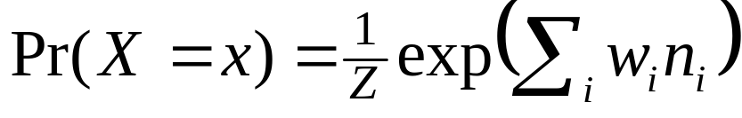
Markov Logic Networks
Complex relationships: first-order logic
Uncertainty: probabilistic models
Markov Logic Network (MLN) =
weighted set of first-order formulas
Applications: link prediction [Richardson & Domingos, 2006], entity resolution [Singla & Domingos, 2006], information extraction [Poon & Domingos, 2007], and more…

Slide 3
Example: WebKB
Collective classification of university web pages
  Class predicted by words on page
  Class also influenced by classes of linked pages
As an MLN:
  Has(page,”homework”) ⇒ Class(page,Course)
  ¬Has(page,”sabbatical”) ⇒ Class(page,Student)
  Class(page1,Student) ∧ LinksTo(page1,page2) ⇒ Class(page2,Professor)

Slide 4
Example: WebKB
Collective classification of university web pages
  Class predicted by words on page
  Class also influenced by classes of linked pages
As an MLN:
  Has(page,+word) ⇒ Class(page,+class)
  ¬Has(page,+word) ⇒ Class(page,+class)
  Class(page1,+class1) ∧ LinksTo(page1,page2) ⇒ Class(page2,+class2)

Slide 5
Overview
Weight learning is a convex optimization problem
Problem: discriminative weight learning in MLNs was prohibitively slow.
Solution: second-order optimization methods
Problem: for MLNs, line search and
function evaluations are intractable
Solution: this talk!

Slide 6
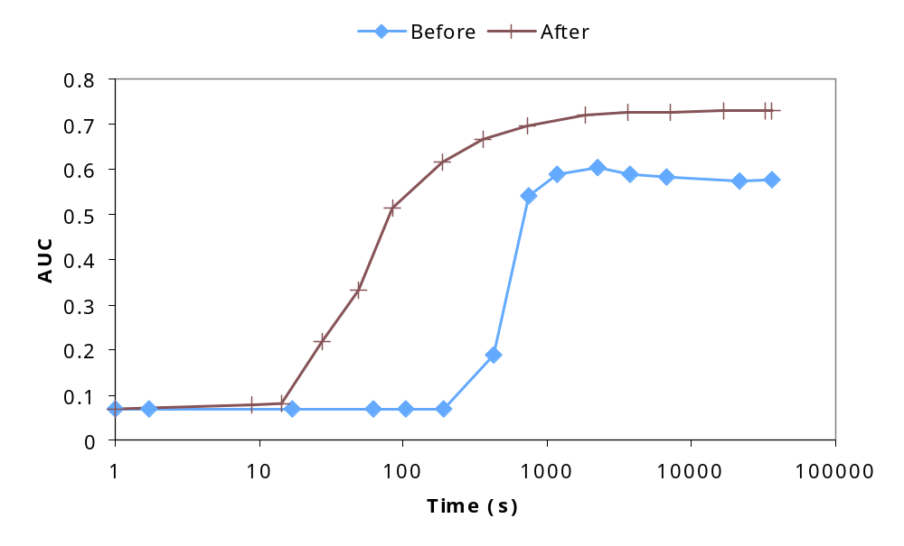
Sneak Preview!

Slide 7
Outline
Background
Algorithms
  Gradient descent
  Newton’s method
  Conjugate gradient
Experiments
  Cora – entity resolution
  WebKB – collective classification
Conclusion

Slide 8
Gradient descent
Move in direction of steepest descent,
scaled by learning rate:
w_{t+1} = w_{t} + η g_{t}

Slide 9
Gradient descent in MLNs
Gradient of conditional log likelihood is:
∂ P(Y=y|X=x)/∂ w_{i} = n_{i} - E[n_{i}]
Problem: Computing expected counts is hard
Solution: Voted perceptron [Collins, 2002; Singla & Domingos, 2005]
  Approximate counts use MAP state
  MAP state approximated using MaxWalkSAT
  The only algorithm ever used for MLN discriminative learning
Solution: Contrastive divergence [Hinton, 2002]
  Approximate counts from a few MCMC samples
  MC-SAT gives less correlated samples [Poon & Domingos, 2006]
  Never before applied to Markov logic

Slide 10
Ill-Conditioning
Condition number: (λ_{max}/λ_{min}) of Hessian
Skewed surface → slow convergence
Solution: utilize second-derivatives
MLNs: Hessian is neg. covariance matrix

Slide 11
Per-weight learning Rates
Some clauses have vastly more groundings than others
  Smokes(X) ⇒ Cancer(X)
  Friends(A,B) ∧ Friends(B,C) ⇒ Friends(A,C)
Need different learning rate in each dimension
Impractical to tune rate to each weight
New
Idea
Learning rate in each dimension is:
η /(# of true clause groundings).

Slide 12
Newton’s Method
Weight update: w = w + H⁻¹ g
We can converge in one step…
If error surface is quadratic
Requires inverting the Hessian matrix

Slide 13
Diagonalized Newton’s Method
Weight update: w = w + D⁻¹ g
We can converge in one step…
If error surface is quadratic
AND the features are uncorrelated

Slide 14
Conjugate gradient
Include previous direction in new
search direction
Avoid “undoing” any work
If quadratic, finds n optimal weights in n steps
Depends heavily on line searches

Slide 15
Scaled conjugate gradient
[Møller, 1993]
Include previous direction in new search direction
Avoid “undoing” any work
If quadratic, finds n optimal weights in n steps
Uses Hessian matrix in place of line search

Slide 16
Step Sizes and Trust Regions
[Møller, 1993; Nocedal & Wright, 2007]
Compute step length
  Approximate function as quadratic
  Compute optimal step length
  Limit step size to “trust region”
  Key idea: within trust region, quadratic approximation is good
Updating trust region
  Check quality of approximation
  (predicted and actual change in function value)
  If good, grow trust region
  If bad, shrink trust region
New
Idea
Use a lower bound on the function change instead.
(Can be derived from gradient, step size, and function convexity.)

Slide 17
Preconditioning
Initial direction of SCG is the gradient
  Very bad for ill-conditioned problems
Well-known fix: preconditioning
  Multiple by matrix to lower condition number
  Ideally, approximate inverse Hessian
Our preconditioner: D⁻¹
[Sha & Pereira, 2003]

Slide 18
Outline
Background
Algorithms
  Gradient descent
  Newton’s method
  Conjugate gradient
Experiments
  Cora – entity resolution
  WebKB – collective classification
Conclusion

Slide 19
Experiments: Algorithms
Voted perceptron (VP, VP-PW)
Contrastive divergence (CD, CD-PW)
Diagonal Newton (DN)
Scaled conjugate gradient (SCG, PSCG)
Baseline: VP
New algorithms: VP-PW, CD, CD-PW, DN, SCG, PSCG

Slide 20
Experiments: Datasets
Cora
  Task: Deduplicate 1295 citations to 132 papers
  Weights: 6141 [Singla & Domingos, 2006]
  Ground clauses: > 3 million
  Condition number: > 600,000
WebKB
  Task: Predict categories of 4165 web pages
  Weights: 10,891
  Ground clauses: > 300,000
  Condition number: ~7000

Slide 21
Experiments: Method
Gaussian prior on each weight
Tuned learning rates on held-out data
Trained for 10 hours
Evaluated on test data
  AUC: Area under precision-recall curve
  CLL: Average conditional log-likelihood of all query predicates

Slide 22
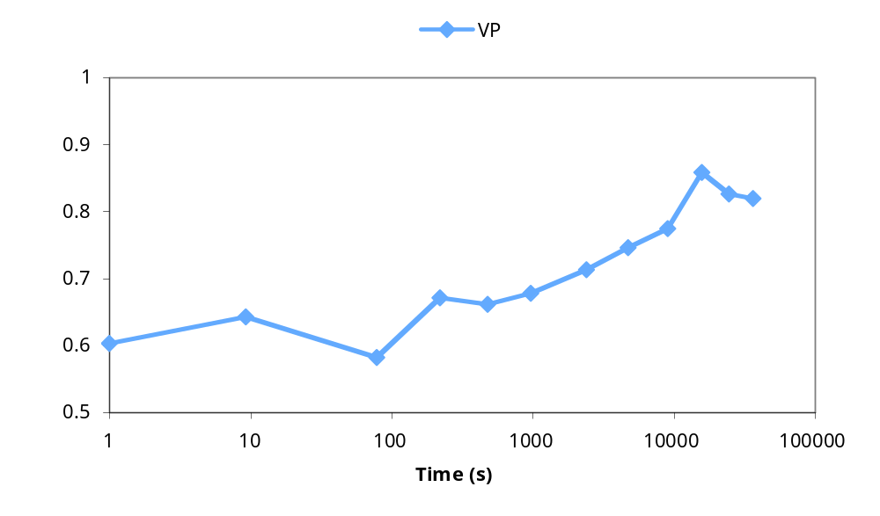
Results: Cora AUC

Slide 23
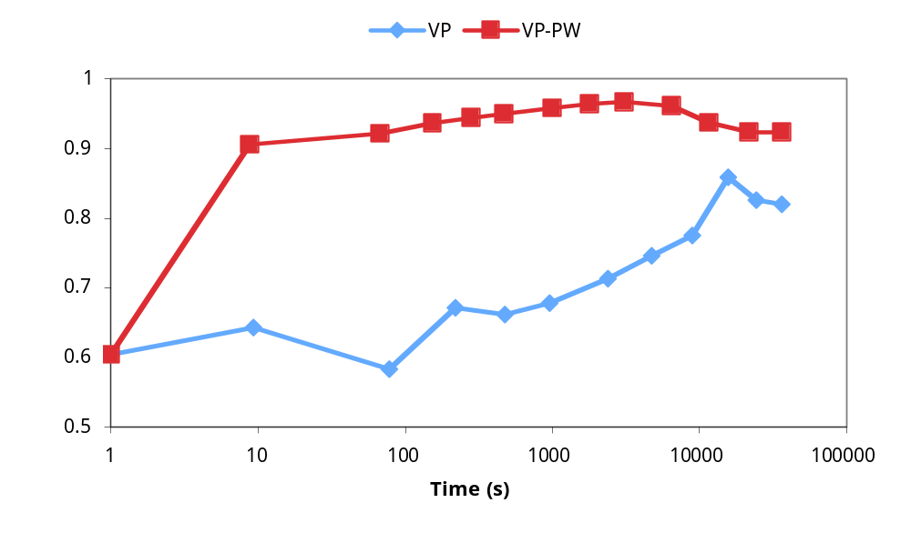
Results: Cora AUC

Slide 24
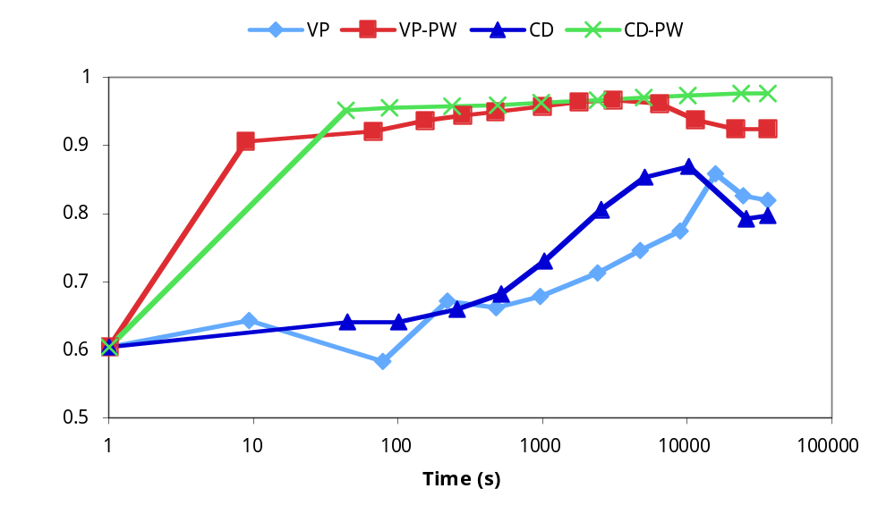
Results: Cora AUC

Slide 25
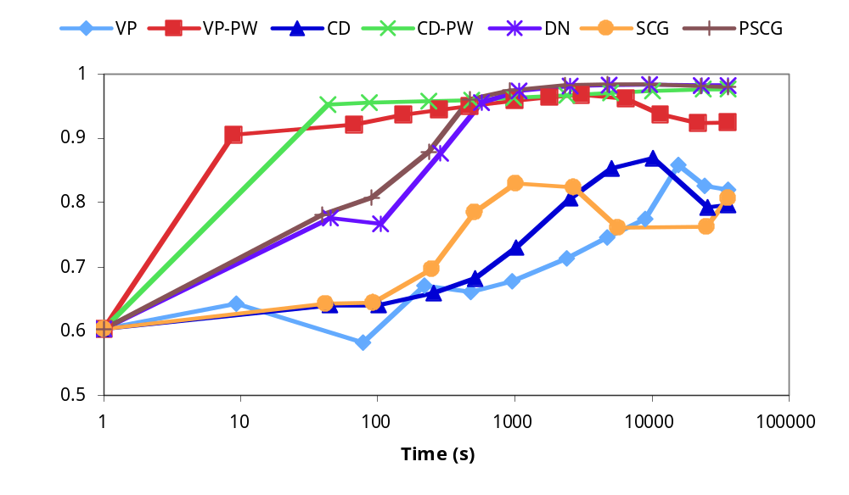
Results: Cora AUC

Slide 26
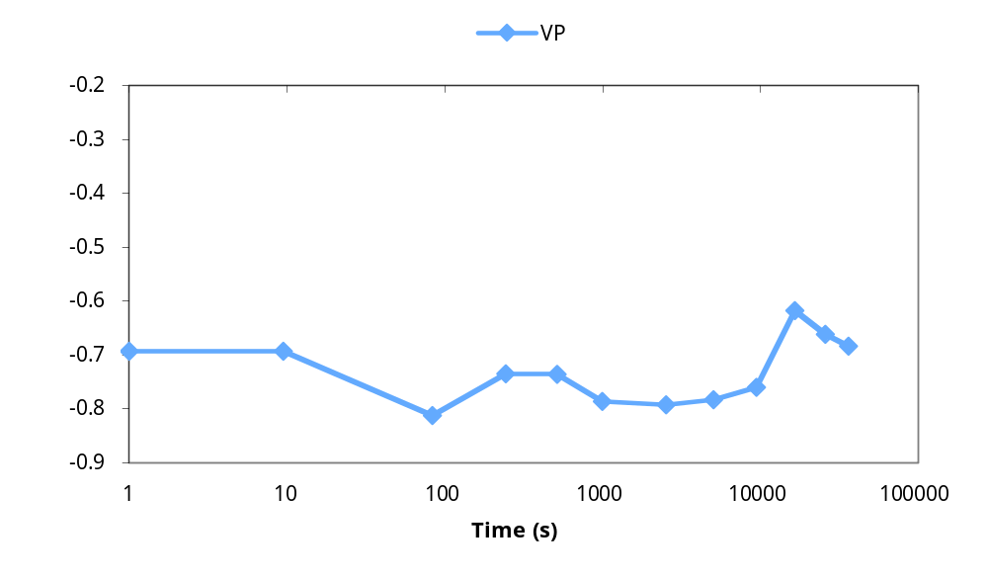
Results: Cora CLL

Slide 27
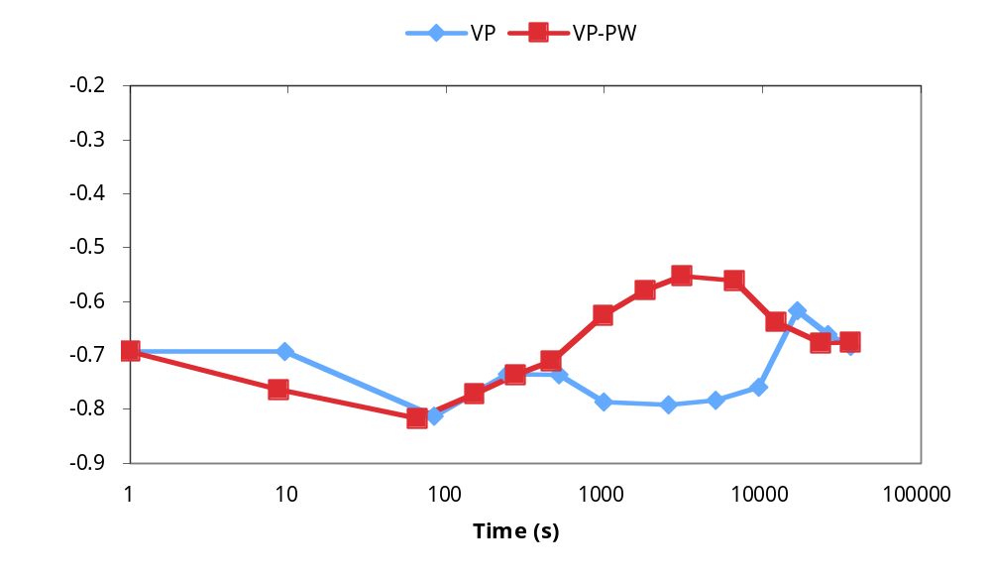
Results: Cora CLL

Slide 28
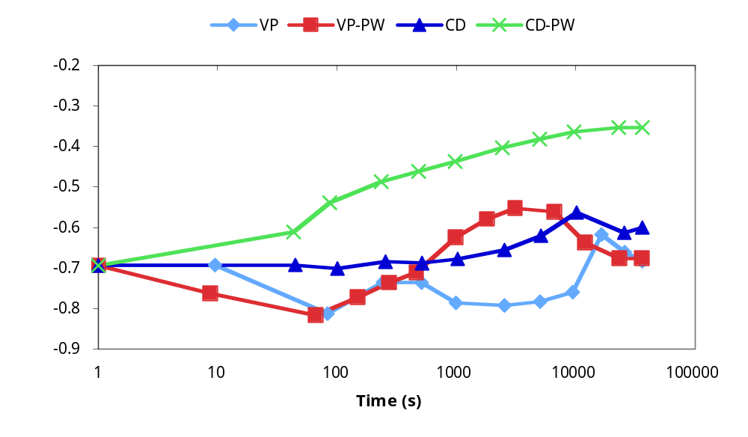
Results: Cora CLL

Slide 29
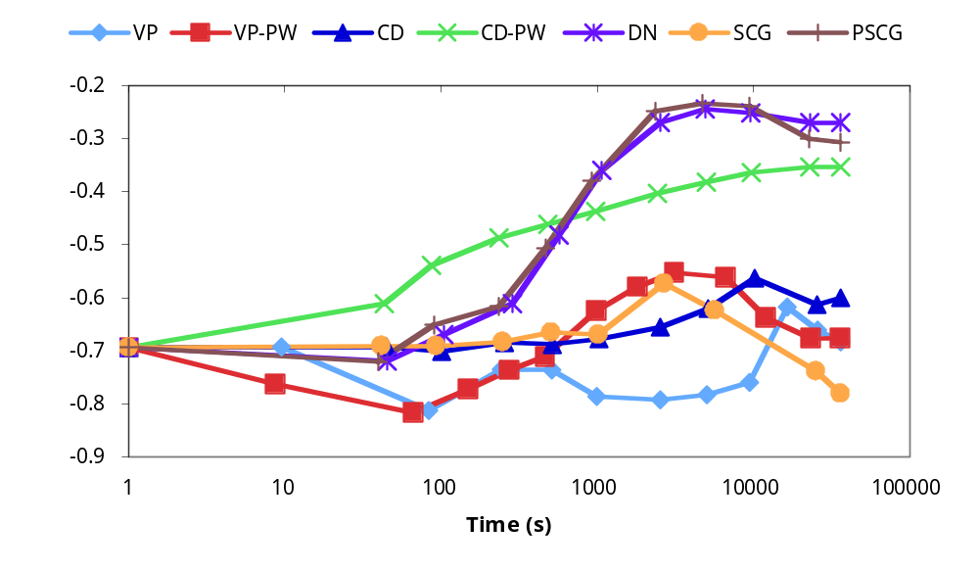
Results: Cora CLL

Slide 30
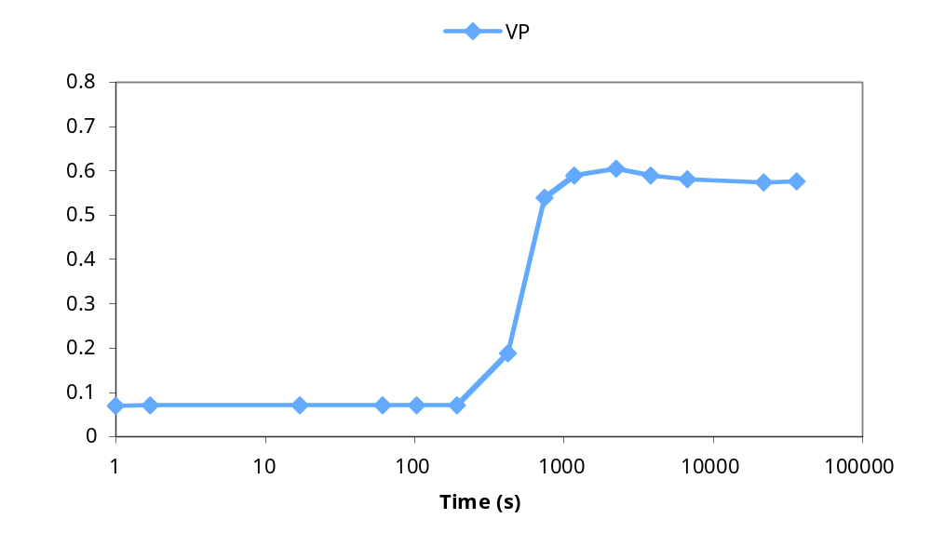
Results: WebKB AUC

Slide 31
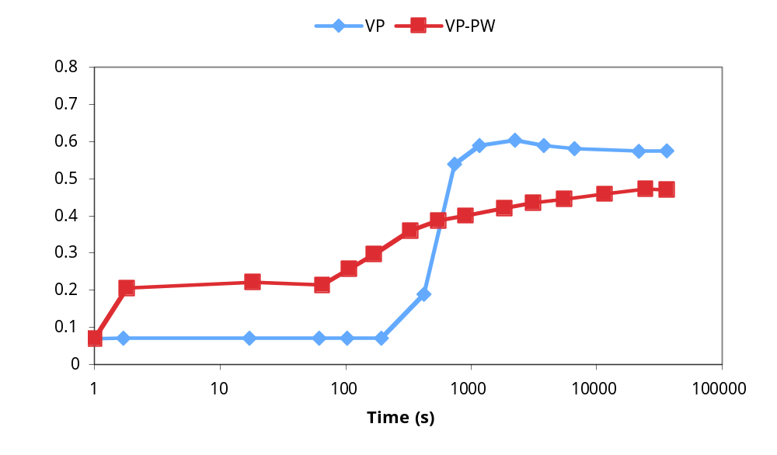
Results: WebKB AUC

Slide 32
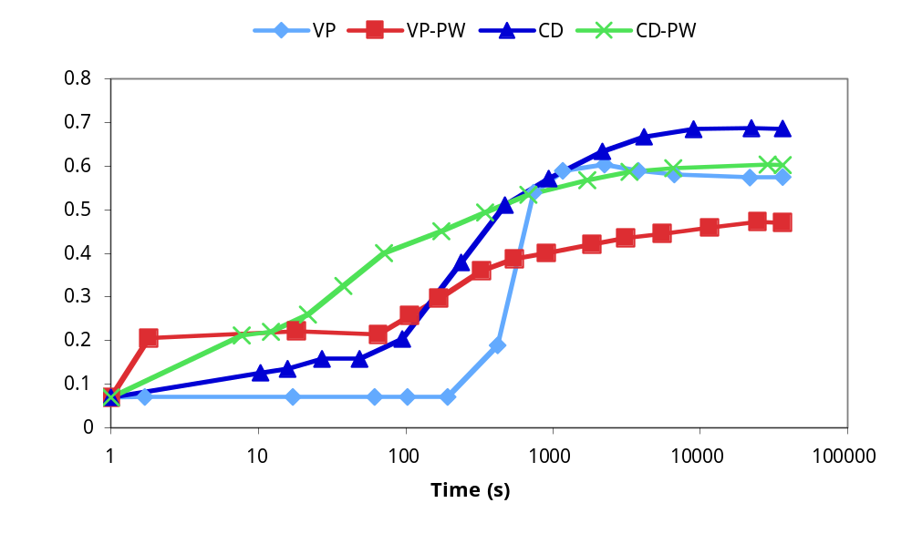
Results: WebKB AUC

Slide 33
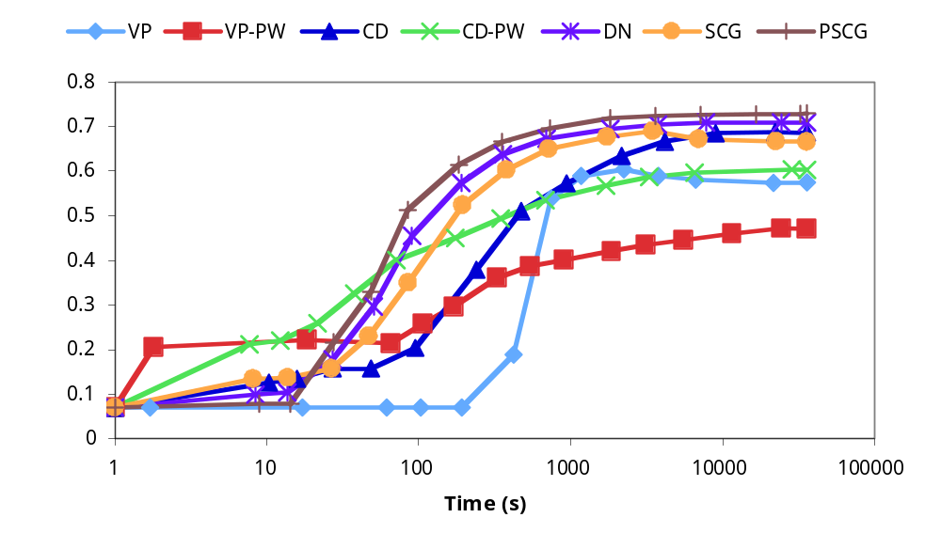
Results: WebKB AUC

Slide 34
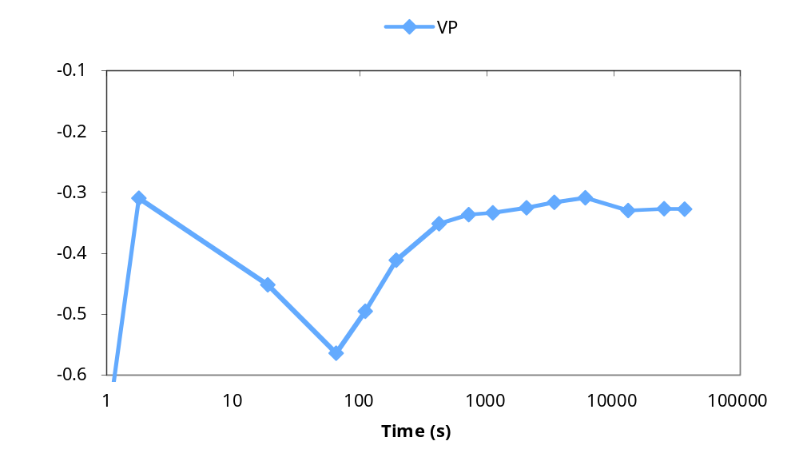
Results: WebKB CLL

Slide 35
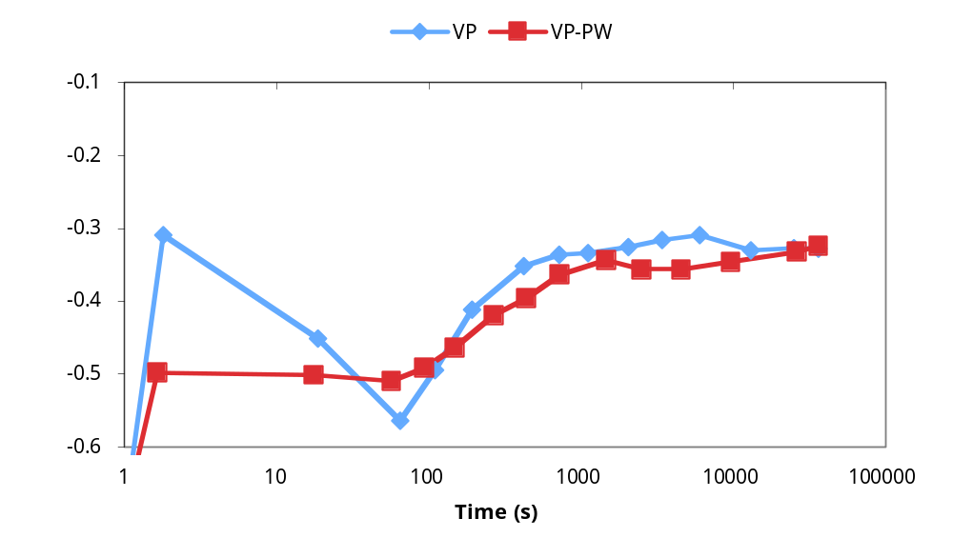
Results: WebKB CLL

Slide 36
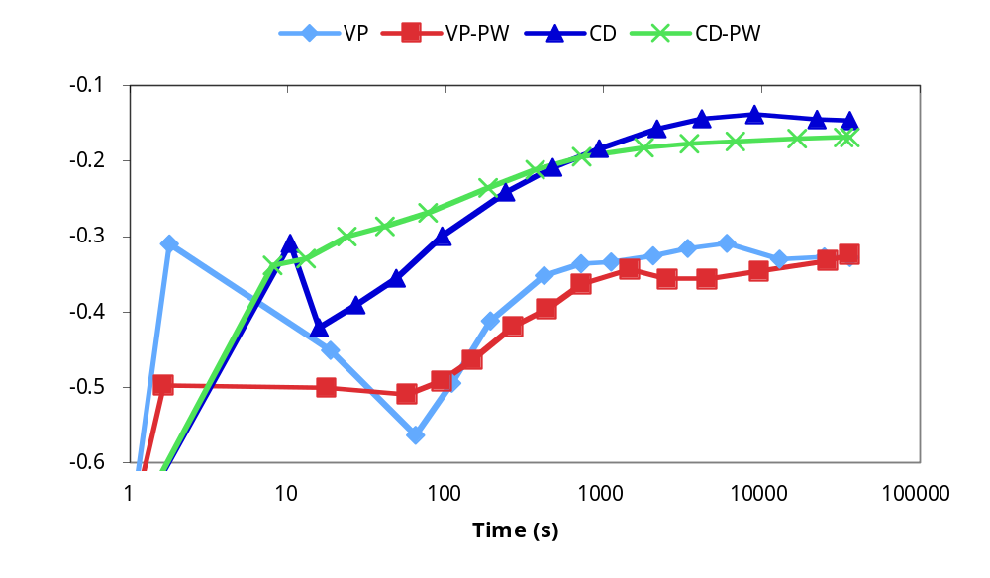
Results: WebKB CLL

Slide 37
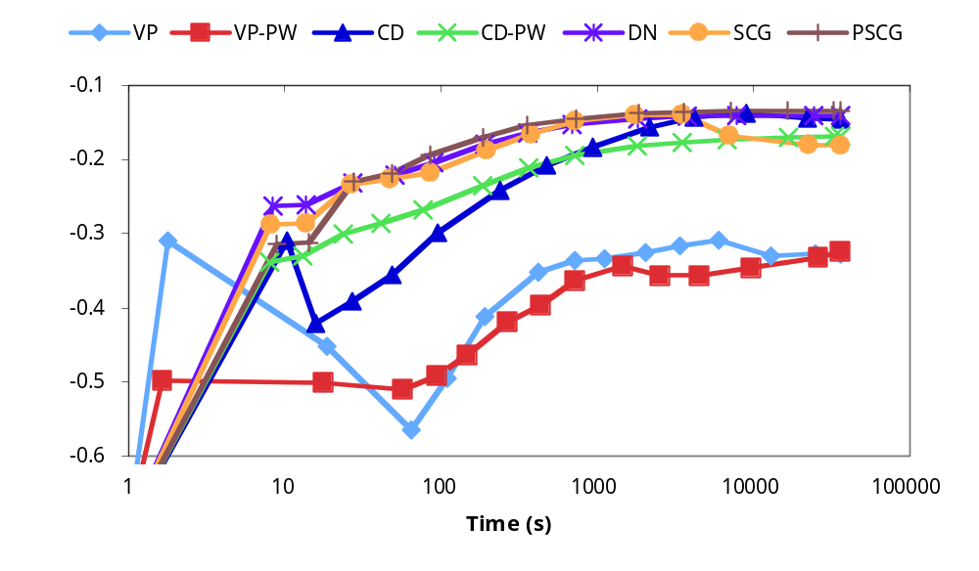
Results: WebKB CLL

Slide 38
Conclusion
Ill-conditioning is a real problem in
statistical relational learning
PSCG and DN are an effective solution
  Efficiently converge to good models
  No learning rate to tune
Details remaining
  Detecting convergence
  Preventing overfitting
Try it out in Alchemy:
http://alchemy.cs.washington.edu/

