Slide 1
Naïve Bayes Models for Probability Estimation
Daniel Lowd
University of Washington
(Joint work with Pedro Domingos)

Slide 2
One-Slide Summary
Using a simple naïve Bayes model:
One can do general purpose probability estimation and inference…
With excellent accuracy…
In linear time.
In contrast, Bayesian network inference is worst-case exponential time.

Slide 3
Outline
Background
  General probability estimation
  Naïve Bayes and Bayesian networks
Naïve Bayes Estimation (NBE)
Experiments
  Methodology
  Results
Conclusion

Slide 4
Outline
Background
  General probability estimation
  Naïve Bayes and Bayesian networks
Naïve Bayes Estimation (NBE)
Experiments
  Methodology
  Results
Conclusion

Slide 5
General purpose probability estimation
Want to efficiently:
  Learn joint probability distribution from data:
  Infer marginal and conditional distributions:
Many applications
Notes:
Applications: collaborative filtering, web usage modeling, robotics -- real time inference is important in these domains!
Only one sentence or two.

Slide 6
State of the Art
Learn a Bayesian network from data
  Structure learning, parameter estimation
Answer conditional queries
  Exact inference: #P complete
  Gibbs sampling: slow
  Belief propagation: approx. may be bad

Slide 7
Naïve Bayes
Bayesian network with structure that allows linear time exact inference
All variables independent given C.
  In our application, C is hidden
Classification
  C represents the instance’s class
Clustering
  C represents the instance’s cluster

Slide 8
Naïve Bayes clustering
C
Shrek
Toy Story
Batman
Star Wars 3
Etc…
Model can be learned from data using expectation maximization (EM)

Slide 9
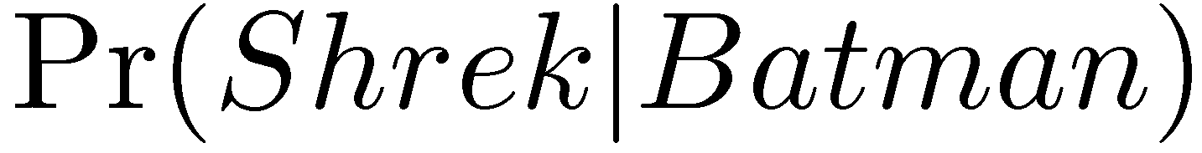
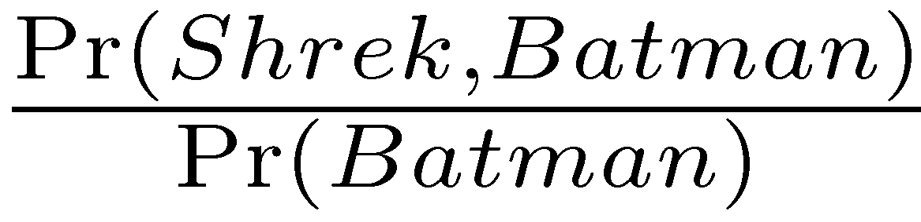
Inference example
C
Shrek
Toy Story
Batman
Star Wars 3
Etc…
Want to determine:
Equivalent to:
Problem reduces to computing marginal probabilities.

Slide 10
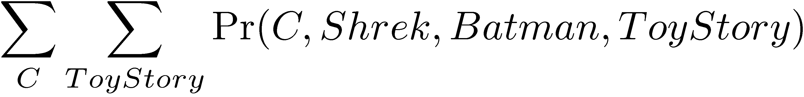
How to find Pr(Shrek,Batman)
(Assuming only one other variable in model: ToyStory)
1. Sum out C and ToyStory.
(In general, sum out all variables not in query.)

Slide 11
How to find Pr(Shrek,Batman)
(Assuming only one other variable in model: ToyStory)
2. Expand, conditioning on C.

Slide 12
How to find Pr(Shrek,Batman)
(Assuming only one other variable in model: ToyStory)
3. Apply naïve Bayes assumption.

Slide 13
How to find Pr(Shrek,Batman)
(Assuming only one other variable in model: ToyStory)
4. Push probabilities in front of summation.

Slide 14
How to find Pr(Shrek,Batman)
(Assuming only one other variable in model: ToyStory)
5. Simplify -- ToyStory can be ignored
(as can any other variable not in the query!)

Slide 15
Related Work
AutoClass – naïve Bayes clustering
(Cheeseman et al., 1988)
Naïve Bayes clustering applied to collaborative filtering
(Breese et al., 1998)
Mixture of Trees – efficient alternative to Bayesian networks
(Meila and Jordan, 2000)

Slide 16
Outline
Background
  General probability estimation
  Naïve Bayes and Bayesian networks
Naïve Bayes Estimation (NBE)
Experiments
  Methodology
  Results
Conclusion

Slide 17
Naïve Bayes Estimation (NBE)
If cluster variable C was observed, learning parameters would be easy.
Since it is hidden, we iterate two steps:
  Use current model to “fill in” C for each example
  Use filled-in values to adjust model parameters
This is the Expectation Maximization (EM) algorithm (Dempster et al, 1977).
Notes:
NBE, at its core, is EM. Describe problem that we solve using EM, don’t describe EM separately.

Slide 18
Naïve Bayes Estimation (NBE)
repeat
Add k clusters, initialized with training examples
repeat
E-step: Assign examples to clusters
M-step: Re-estimate model parameters
Every 5 iterations, prune low-weight clusters
until convergence (according to validation set)
k = 2k
until convergence (according to validation set)
Execute E-step and M-step twice more, including validation set
Running time:
O(#EMiters x #clusters x #examples x #variables)
Notes:
NBE, at its core, is EM. Describe problem that we solve using EM, don’t describe EM separately.
Similar to generic clustering algorithm
Improvements:
Use training examples to initialize clusters
Keep adding clusters as we go
Prune low-weight clusters

Slide 19
Outline
Background
  General probability estimation
  Naïve Bayes and Bayesian networks
Naïve Bayes Estimation (NBE)
Experiments
  Methodology
  Results
Conclusion

Slide 20
Experiments
Compare NBE to Bayesian networks (WinMine Toolkit by Max Chickering)
Metrics
  Learning time
  Accuracy (log likelihood)
  Query speed/accuracy
Query types
  Marginal queries:
  Conditional queries:
Notes:
Add Max Chickering and David Heckerman name, reference to WinMine.

Slide 21
Datasets
47 from UCI machine learning repository
3 other real-world datasets: EachMovie, Jester, and KDDCup 2000
Statistics
  5 to 1,648 variables
  57 to 67,507 examples
  2 to 41 states per variable
Processing
  Discretized continuous variables
  Created train/test/validation sets
  Cross-validated small datasets

Slide 22
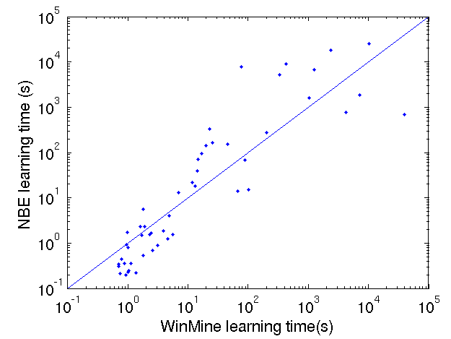
Learning time

Slide 23
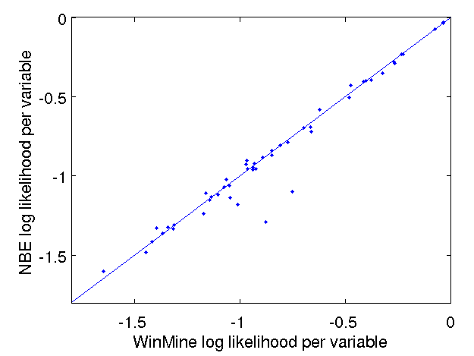
Overall accuracy

Slide 24
Query scenarios
 | Marginal queries | Conditional queries
Example | Pr(Coughing, Sneezing, RunningNose) | Pr(Sneezing | -Coughing, -LungCancer)
Query vars | 1-5 variables | 1 variable*
Hidden vars | All the rest | 0-4 variables
Evidence vars | None | All the rest
* -- See paper for multiple-variable conditional results

Slide 25
Inference Details
NBE: Exact inference
Bayesian networks
  Gibbs sampling: 3 configurations
    1 chain, 1,000 sampling iterations
    10 chains, 1,000 sampling iterations per chain
    10 chains, 10,000 sampling iterations per chain
  Belief propagation, when possible

Slide 26
Marginal query accuracy
# of query variables | 1 | 2 | 3 | 4 | 5
1 chain, 1k samples | 38 | 40 | 41 | 47 | 47
10 chains, 1k samples | 28 | 36 | 39 | 39 | 41
10 chains, 10k samples | 23 | 29 | 31 | 30 | 29
Number of datasets (out of 50) on which NBE wins.

Slide 27
Conditional query accuracy
# of hidden variables | 0 | 1 | 2 | 3 | 4
1 chain, 1k samples | 18 | 17 | 20 | 18 | 23
10 chains, 1k samples | 18 | 15 | 20 | 16 | 21
10 chains, 10k samples | 18 | 15 | 20 | 15 | 20
Belief propagation | 31 | 36 | 30 | 34 | 30
Number of datasets (out of 50) on which NBE wins.

Slide 28
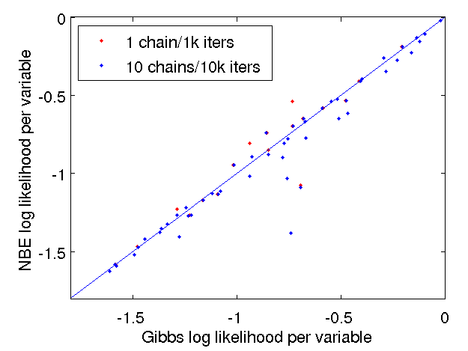
Detailed accuracy comparison

Slide 29
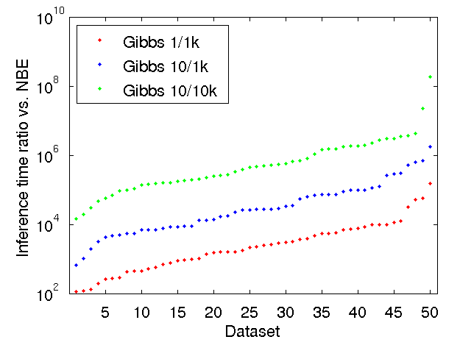
Marginal query speed
188,000,000
580,000
26,000
2,200
(Each set of ratios is independently ordered by magnitude)
Notes:
Y axis is log scale!

Slide 30
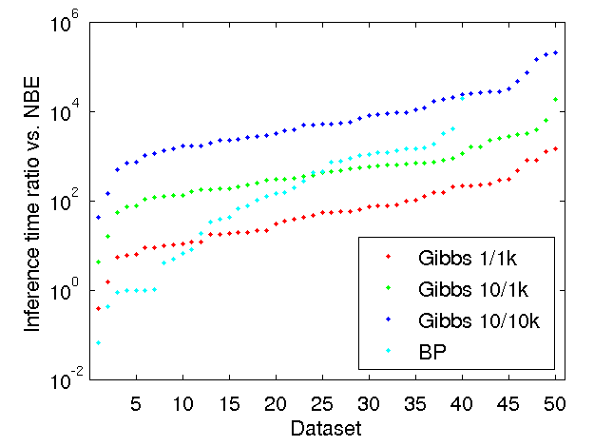
Conditional query speed
200,000
5,200
420
55
(Each set of ratios is independently ordered by magnitude)

Slide 31
Summary of results
Marginal queries
  NBE at least as accurate as Gibbs sampling
  NBE thousands, even millions of times faster
Conditional queries
  Easy for Gibbs: few hidden variables
  NBE almost as accurate as Gibbs
  NBE still several orders of magnitude faster
  Belief propagation often failed or ran slowly

Slide 32
Outline
Background
  General probability estimation
  Naïve Bayes and Bayesian networks
Naïve Bayes Estimation (NBE)
Experiments
  Methodology
  Results
Conclusion

Slide 33
Conclusion
Compared to Bayesian networks, NBE offers:
  Similar learning time
  Similar accuracy
  Exponentially faster inference
Try it yourself:
  Download an open-source reference implementation from:
  http://www.cs.washington.edu/ai/nbe

