Slide 1
Naïve Bayes Models for Probability Estimation
Daniel Lowd
January 20th, 2005
(Joint work with Pedro Domingos)

Slide 2
Outline
Contributions
Background
  General probability estimation
  Naïve Bayes and Bayesian networks
Naïve Bayes Estimation (NBE)
Experiments
  Methodology
  Results
Conclusion and Future Work

Slide 3
Contributions
Reminder that naïve Bayes can solve more general probabilistic problems.
NBE algorithm for training naïve Bayes models.
Extensive empirical evaluation on 50 datasets.

Slide 4
Outline
Contributions
Background
  General probability estimation
  Naïve Bayes and Bayesian networks
Naïve Bayes Estimation (NBE)
Experiments
  Methodology
  Results
Conclusion and Future Work

Slide 5
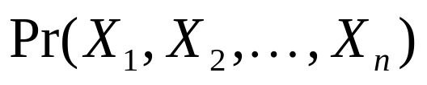
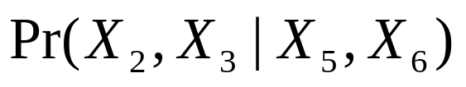
General purpose probability estimation
Want to efficiently:
  Learn joint probability distribution from data:
  Infer marginal and conditional distributions:
Applications:
  Collaborative filtering
  Medical diagnosis
  Demographic analysis

Slide 6
Bayesian networks
Smoking
Family history
Season
Lung cancer
Cold
Coughing
Sneezing
Runny nose

Slide 7
Bayesian network inference
Exact inference
  Good: correct, deterministic
  Bad: #P complete
Gibbs sampling
  Good: simple, converges to true probabilities
  Bad: slow, hard to detect convergence
Belief propagation
  Good: faster than Gibbs
  Bad: no guarantees

Slide 8
Naïve Bayes
All other variables are independent, given class/cluster variable.
Typically applied to classification:
Spam?
Vi@gra
m0rtgage
quals
Bayes
Pedro

Slide 9
Naïve Bayes clustering
C
Shrek
Toy Story
Kill Bill
Pulp Fiction
Etc…
Model can be learned from data using expectation maximization (EM)

Slide 10
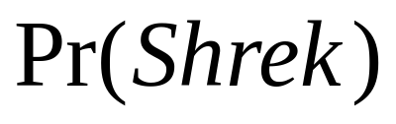
Inference example
C
Shrek
Toy Story
Kill Bill
Pulp Fiction
Etc…
Want to determine:

Slide 11
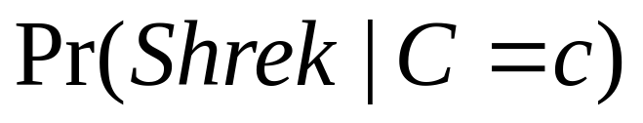
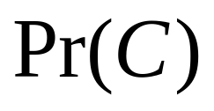
Inference example
C
Shrek
Toy Story
Kill Bill
Pulp Fiction
Etc…
Want to determine:
We know:

Slide 12
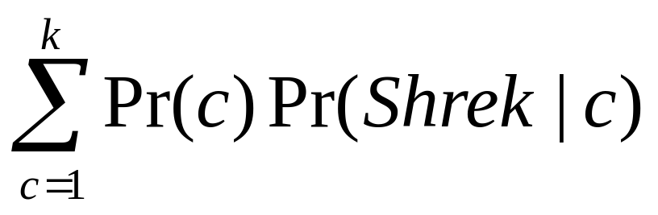
Inference example
C
Shrek
Toy Story
Kill Bill
Pulp Fiction
Etc…
Want to determine:
We know:
Sum out C:

Slide 13
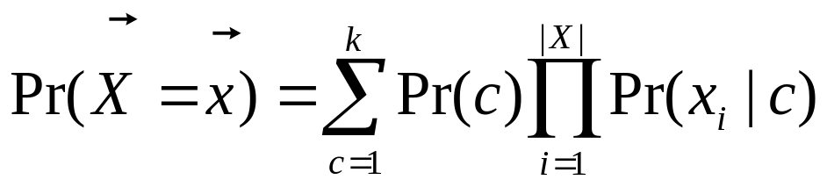
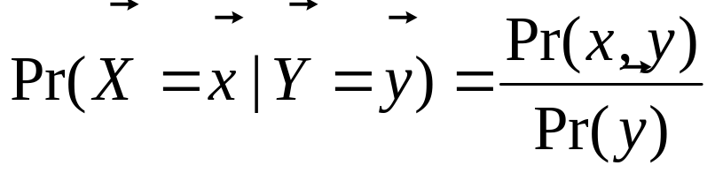
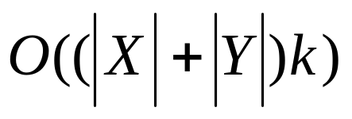
Naïve Bayes inference
Marginal queries:
Conditional queries:
Running time:

Slide 14
Naïve Bayes for general probabilistic modeling
C
Smoking
Fam.History
Cancer
Coughing
Etc…

Slide 15
Related Work
AutoClass – naïve Bayes clustering
(Cheeseman et al., 1988)
Naïve Bayes clustering applied to collaborative filtering
(Breese et al. 1998)
Mixture of Trees – efficient alternative to Bayesian networks
(Meila and Jordan, 2000)

Slide 16
Outline
Contributions
Background
  General probability estimation
  Naïve Bayes and Bayesian networks
Naïve Bayes Estimation (NBE)
Experiments
  Methodology
  Results
Conclusion and Future Work

Slide 17
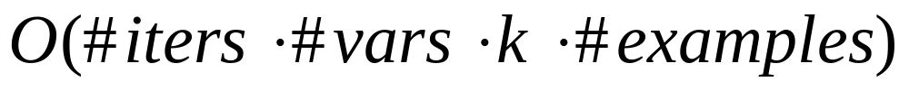
Generic clustering algorithm
Start with k randomly initialized clusters
Iterate the EM algorithm
Stop when hold-out data decreases in likelihood
Running time:

Slide 18
The Expectation Maximization (EM) algorithm
Method for learning with missing data
Consists of two alternating steps:
  E-step: predict missing data, given model
  M-step: adjust model, given complete data
In clustering, the missing data is the cluster variable, C
Analogous to k-means algorithm

Slide 19
Naïve Bayes Estimation (NBE)
Similar to generic clustering algorithm
Improvements:
  Use training examples to initialize clusters
  Keep adding clusters as we go
  Prune low-weight clusters

Slide 20
Outline
Contributions
Background
  General probability estimation
  Naïve Bayes and Bayesian networks
Naïve Bayes Estimation (NBE)
Experiments
  Methodology
  Results
Conclusion and Future Work

Slide 21
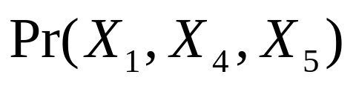
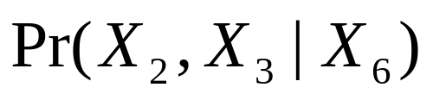
Experiments
Compare NBE to Bayesian networks (WinMine Toolkit)
Metrics
  Learning time
  Accuracy (log likelihood)
  Query speed/accuracy
Query types
  Marginal queries:
  Conditional queries:

Slide 22
Datasets
47 from UCI machine learning repository
3 other real-world datasets: EachMovie, Jester, and KDDCup 2000
Statistics
  5 to 1,648 variables
  57 to 67,507 examples
  2 to 41 states per variable
Processing
  Discretized continuous variables
  Created train/test/hold-out sets
  Cross-validated small datasets

Slide 23
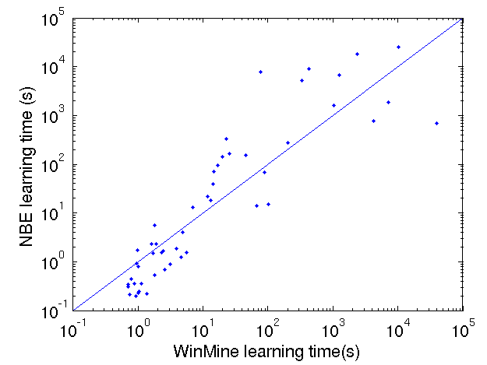
Learning time

Slide 24
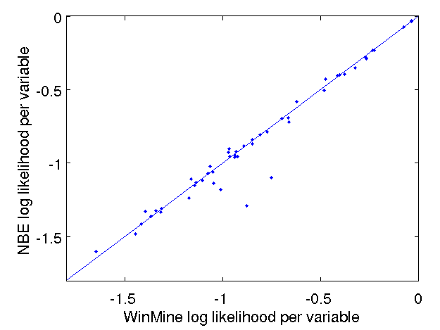
Overall accuracy

Slide 25
Inference Details
NBE: Exact inference
Bayesian networks
  Gibbs sampling: 3 configurations
    1 chain, 1,000 sampling iterations
    10 chains, 1,000 sampling iterations per chain
    10 chains, 10,000 sampling iterations per chain
  Belief propagation, when possible

Slide 26
Marginal queries of up to 5 variables
Examples
  Pr(Toy Story, Kill Bill)
  Pr(Coughing, Sneezing, RunnyNose)
1-5 query variables (e.g., Coughing)
No evidence
NBE exact inference vs. Gibbs

Slide 27
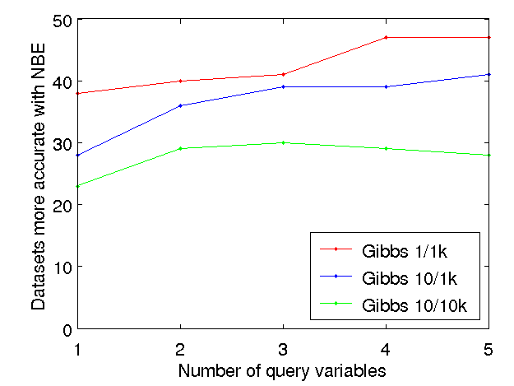
Marginal query accuracy

Slide 28
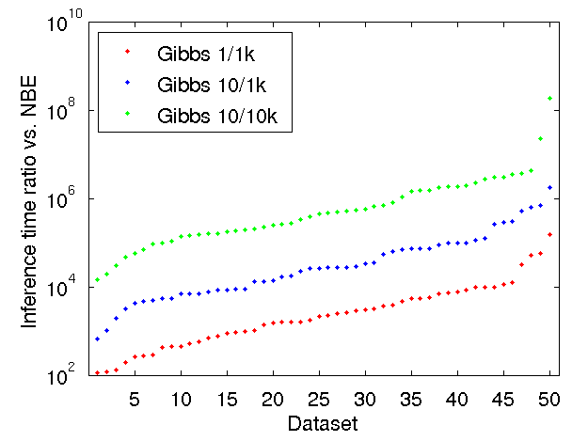
Marginal query speed

Slide 29
Marginal query speed
2,200

Slide 30
Marginal query speed
26,000
2,200

Slide 31
Marginal query speed
580,000
26,000
2,200

Slide 32
Marginal query speed
188,000,000
580,000
26,000
2,200

Slide 33
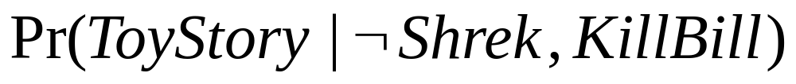
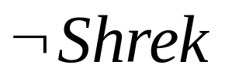
Conditional queries of 1 variable
Examples
1 query variable (e.g., Sneezing)
0-4 hidden variables
All other variables are evidence (e.g., )
NBE exact inference vs. Gibbs sampling and belief propagation

Slide 34
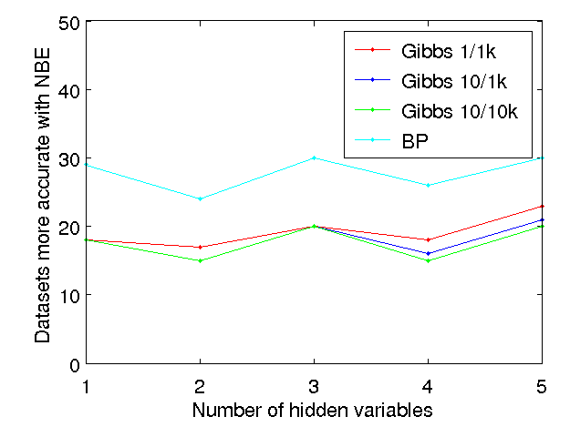
Single variable conditional query accuracy

Slide 35
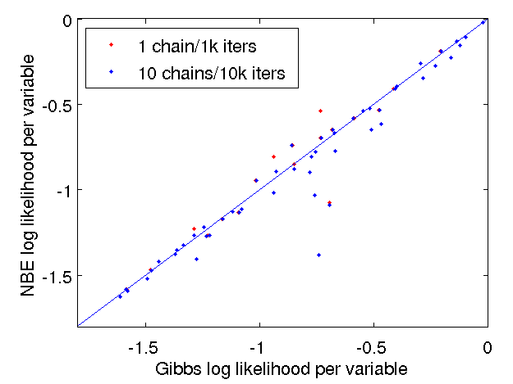
Detailed accuracy comparison

Slide 36
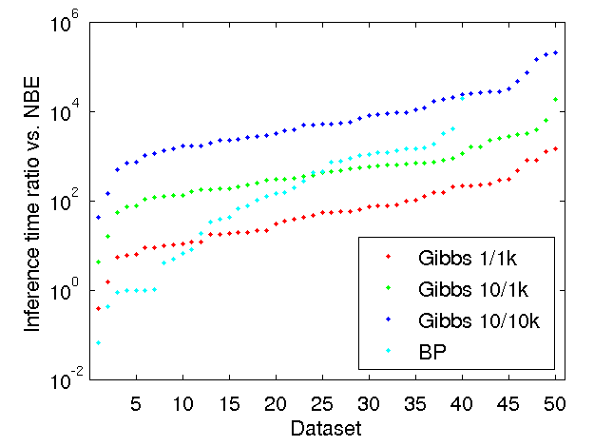
Single variable conditional query speed

Slide 37
Single variable conditional query speed
55

Slide 38
Single variable conditional query speed
5,200
55

Slide 39
Single variable conditional query speed
5,200
420
55

Slide 40
Single variable conditional query speed
200,000
5,200
420
55

Slide 41
Conditional queries of up to 5 variables
Examples
1-5 query variables
All other variables are evidence
NBE exact inference vs. Gibbs sampling

Slide 42
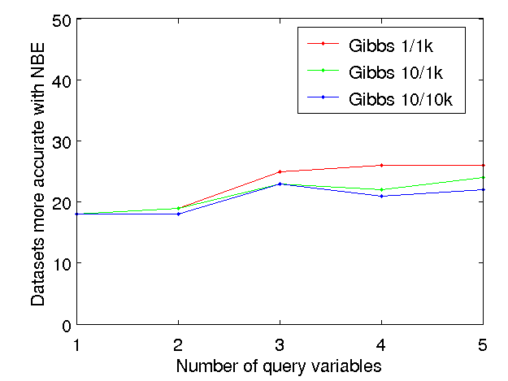
Multiple variable conditional query accuracy

Slide 43
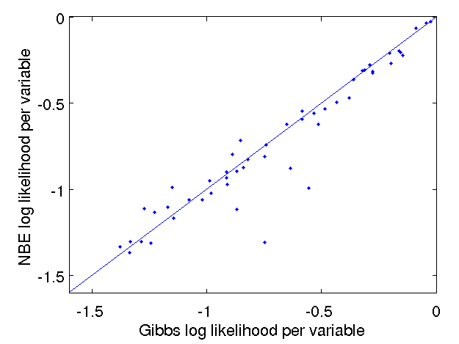
Detailed accuracy – 1 variable

Slide 44
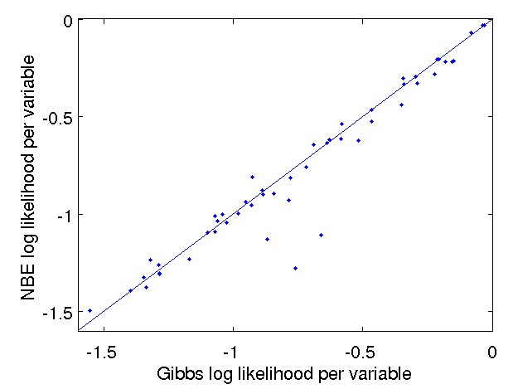
Detailed accuracy – 5 variables

Slide 45
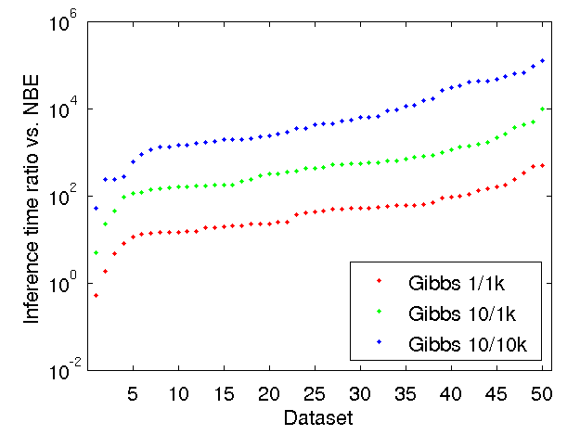
Multiple variable conditional query speed

Slide 46
Multiple variable conditional query speed
130,000
4,200
430
42

Slide 47
Summary of results
Marginal queries
  NBE at least as accurate as Gibbs sampling
  NBE thousands, even millions of times faster
Conditional queries
  Easy for Gibbs: few hidden variables
  NBE almost as accurate as Gibbs
  NBE still several orders of magnitude faster
  Belief propagation often failed or ran slowly

Slide 48
Outline
Contributions
Background
  General probability estimation
  Naïve Bayes and Bayesian networks
Naïve Bayes Estimation (NBE)
Experiments
  Methodology
  Results
Conclusion and Future Work

Slide 49
Conclusion
Compared to Bayesian networks, NBE offers:
  Similar learning time
  Similar accuracy
  Exponentially faster inference
Lessons
  Simple models are sometimes the best models.
  Even when simple models do worse, the simplicity and speed may be worthwhile.
  Naïve Bayes is good for a lot more than classification and clustering.

Slide 50
Contributions (yes, again)
Reminder that naïve Bayes can solve more general probabilistic problems.
NBE algorithm for training naïve Bayes models.
Extensive empirical evaluation on 50 datasets.

Slide 51
Future work
Compare related mixture models, such as Mixture of Trees (Meila & Jordan, 2000).
Extend NBE to relational domains.
Investigate specific applications of NBE.

