Slide 1
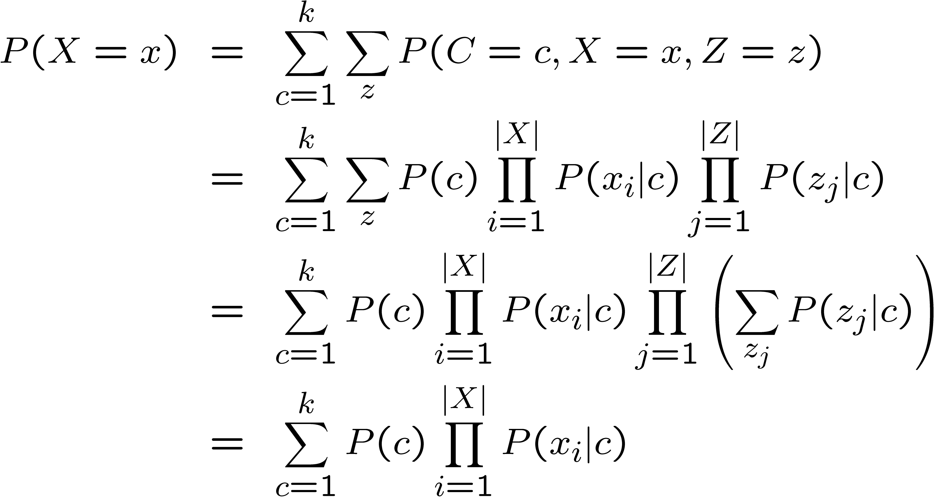
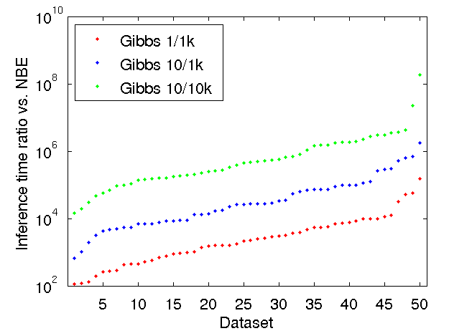
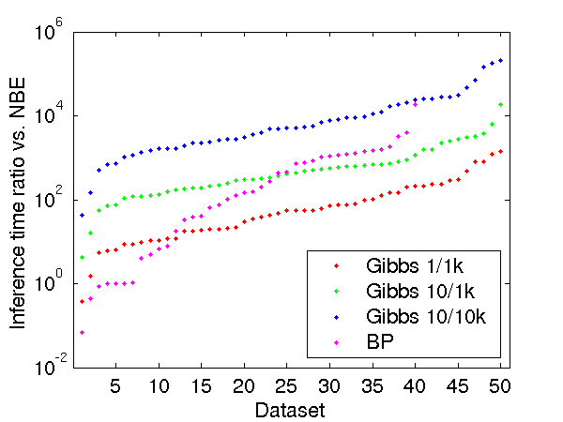
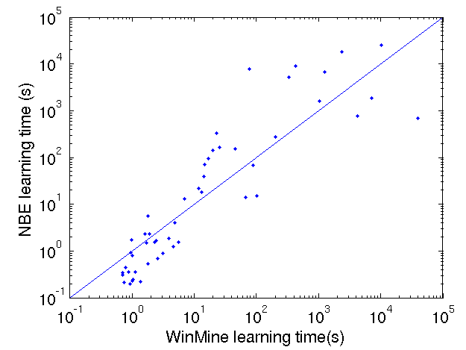
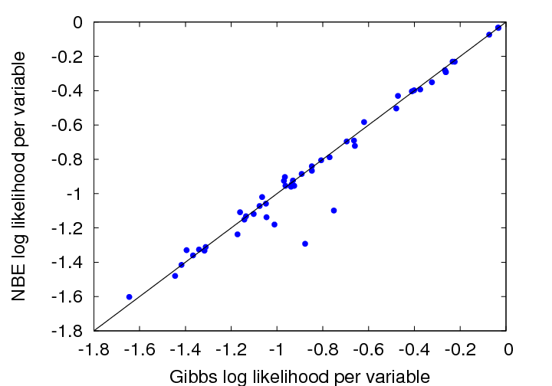
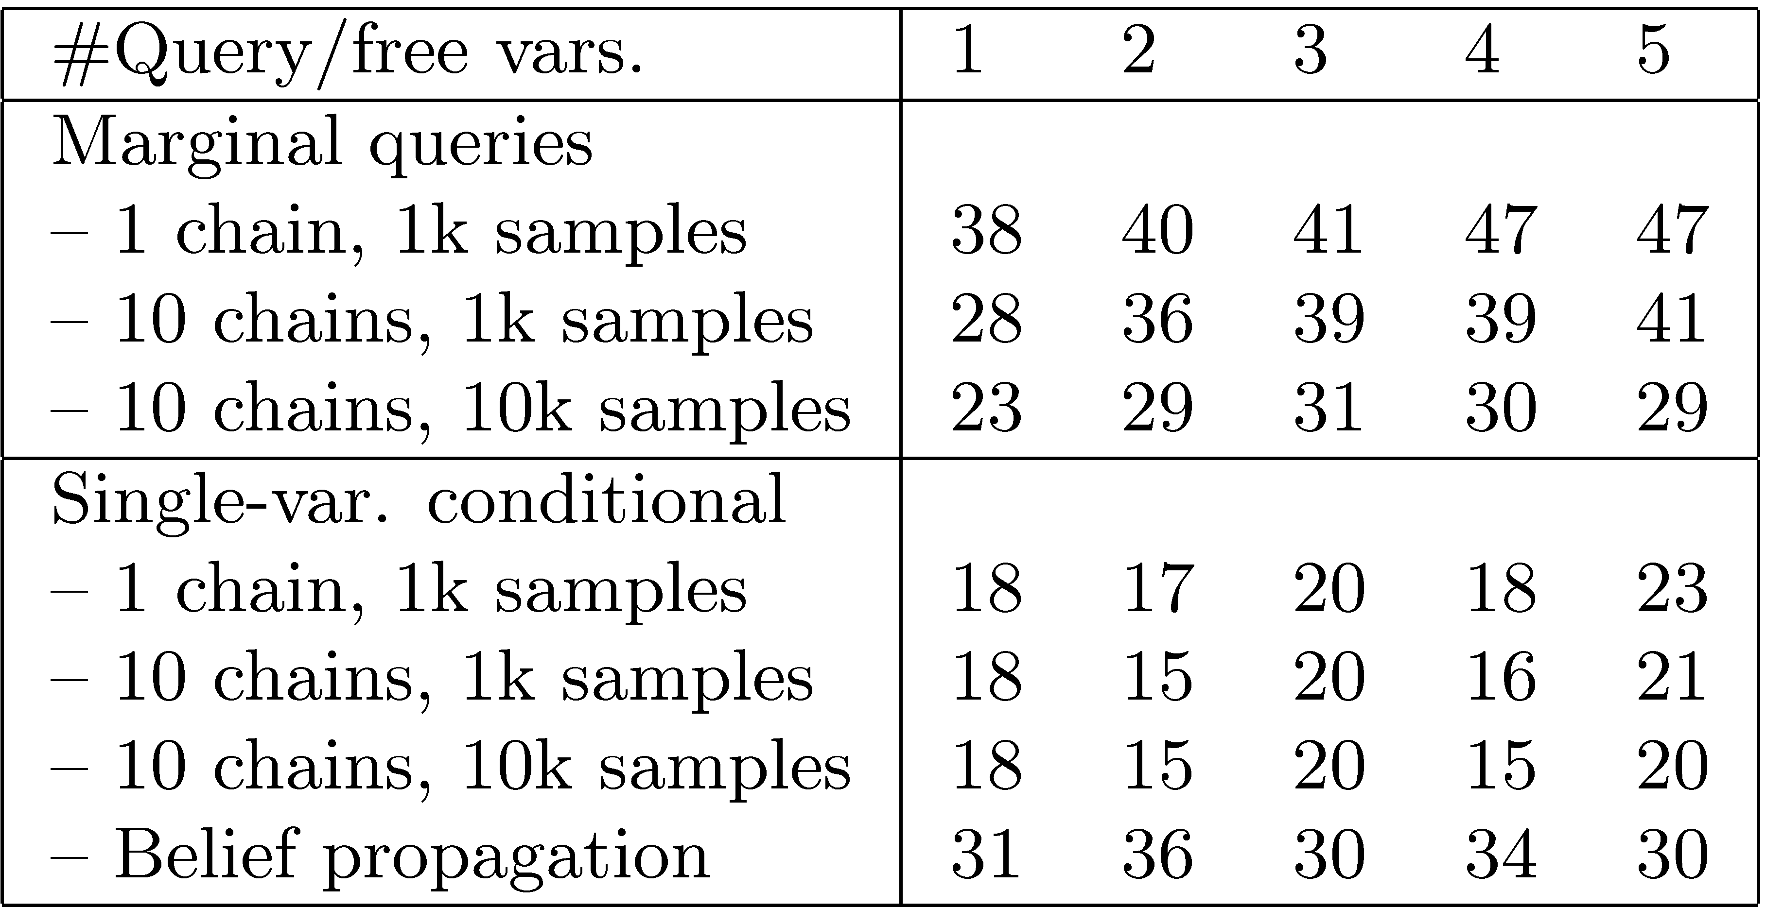
C
Naïve Bayes Models for Probability Estimation
Daniel Lowd
lowd@cs.washington.edu
X₁
X₂
X₃
…
X_{n}
Pedro Domingos
pedrod@cs.washington.edu
Background
Naïve Bayes Estimation (NBE)
The Task: General Purpose Probability Estimation
Want to efficiently:
  1. Learn joint probability distributions from data: Pr(X₁,X₂,…,X_{n})
  2. Compute conditional and marginal probabilities: Pr(X₃,X₄ | X₁,X₆)
Applications: collaborative filtering, web click prediction, robotics, etc.
The State-of-the-Art: Bayesian Networks
Bayesian networks efficiently represent joint probability distributions by exploiting conditional independencies among the variables. Greedy structure learning tends to work well; parameter learning is simple ML estimation.
The Problem: Inference
Exact Bayesian network inference is #P-complete! (Worse than NP-hard.)
Approximate inference algorithms have limitations:
  Gibbs sampling is slow and convergence is difficult to detect
  Belief propagation may not converge and its answers may be wrong
The Overlooked Solution: Naïve Bayes Mixture Models
Naïve Bayes models feature linear inference time. They are widely used for clustering and classification, but rarely for general purpose probability estimation. Naïve Bayes models assume that each variable X_{i} is conditionally independent given an auxiliary variable, C.
In classification: C is the observed class variable (e.g., Bayesian spam filters)
In clustering: C is the unobserved cluster variable (e.g., AutoClass)
In our application, C is also unobserved. Unlike clustering, our goal is probability estimation, not cluster discovery.
Learning
If C was observed, learning would be easy. Since it is hidden, we iterate two steps:
  Use current model to “fill-in” C for each example (E-step)
  Use filled-in values to adjust model parameters (M-step)
In the limit, we can represent any probability distribution.
In practice, model size is limited by the number of training examples.
Inference
NBE inference is linear in the number of query variables.
Here’s the derivation for marginal queries:
1. Sum out non-query variables, Z
2. Apply naïve Bayes assumption
3. Rearrange terms
4. Simplify
Conditional probabilities can be expressed as ratios of marginal probabilities.
repeat
Add k clusters, initialized with training examples
repeat
E-step: Assign examples to clusters
M-step: Re-estimate model parameters
Every 5 iterations, prune low-weight clusters
until convergence (according to validation set)
k = 2k
until convergence (according to validation set)
Execute E-step and M-step twice more, including validation set
Experimental Results
We compared NBE to Bayesian networks trained using Max Chickering’s WinMine Toolkit.
The Data
50 datasets (47 from the UCI machine learning repository)
Varying from: 5 to 1,648 vars; 57 to 67,507 examples; 2 to 41 states per var
Learning Time: Similar Accuracy: Similar
Query Speed: Exponentially Faster!
Marginal queries
Conditional queries
These graphs show the ratio of approximate Bayesian network inference to exact NBE inference. NBE is as much as 200,000 times faster!
Conclusion
Query Accuracy: Similar
We compared NBE to two Bayesian network approximate inference algorithms: Gibbs sampling (3 configurations) and belief propagation.
Even when NBE lost on a majority of the datasets, almost all scores were very close (much like the accuracy graph).
Compared to Bayesian networks, NBE offers:
  Similar learning time
  Similar accuracy
  Exponentially faster inference
Try it yourself! Download an open-source reference implementation from:
http://www.cs.washington.edu/ai/nbe
Number of datasets (out of 50) on which NBE wins. Due to memory issues, belief propagation failed on 10 datasets.

