Slide 1
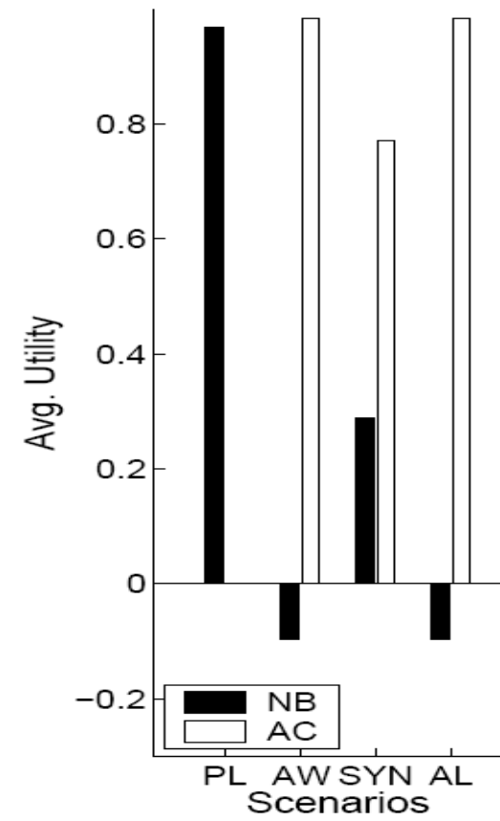
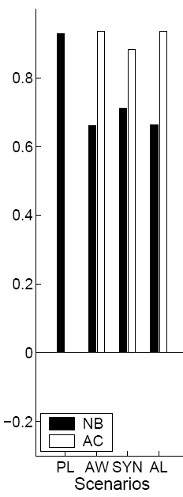
Foundations of Adversarial Machine Learning
Daniel Lowd
University of Washington
lowd@cs.washington.edu
Christopher Meek
Microsoft Research
meek@microsoft.com
Pedro Domingos
University of Washington
pedrod@cs.washington.edu
Thesis
Preliminaries
“If you know the enemy and know yourself, you need not fear the result of a hundred battles.”
-- Sun Tzu, The Art of War
By modeling adversarial problems mathematically, we can gain deeper insights and develop much more robust and general solutions.
-
-
-
X₂
x
X₂
X₂
X₂
+
X₁
+
X₁
+
X₁
X₁
A classifier, c(x), maps
n-dimensional feature vectors (instances) to classes + and −
An adversarial cost function, a(x), represents a preference for some instances over others.
Adversary’s task: Choose
x to minimize a(x) subject
to c(x) = −.
Classifier’s task: Choose new c’(x) to minimize
(cost-sensitive) error.
Anticipating Adversaries
Reverse-Engineering Classifiers
Background
Background
Rather than simply responding to an adversary’s attacks, we would like to
pre-empt them using knowledge of the adversary’s strategies. We accomplish this by viewing the adversary and classifier as players in a
game with perfect information.
Adversary’s actions: instances in the instance space, {x ∈ X}
Classifier’s actions: classifier in the concept class, {c ∈ C}
To attack a classifier, an adversary must somehow learn enough about it to evade detection. By formalizing this learning problem, we can learn about classifier weaknesses and likely adversary strategies.
Theory: ACRE Learning
Theory: Adversarial Classification
The adversary is given one positive instance, one negative instance, and may issue membership queries to the classifier. In each query, the adversary learns the class of the chosen instance.
?
?
?
?
+
?
-
?
Finding a Nash equilibrium is intractable, so we solve an iterative scenario:
Start with a trained classifier
  Use cost-sensitive naïve Bayes
  Assume: training data is untainted
2. Compute adversary’s best action, x
  Use cost: a(x) = Σ_{i} w(x_{i}, b_{i})
  Solve knapsack-like problem with dynamic programming
  Assume: that the classifier will not modify c(x)
3. Compute classifier’s optimal response, c’(x)
  For given x, compute probability it was modified by adversary
  Assume: the adversary is using the optimal strategy
By anticipating the adversary’s strategy, we can defeat it!
?
?
A set of classifiers and cost functions is said to be
ACRE k-learnable if the adversary can always find a negative instance within a factor k of the minimum cost using a polynomial number of queries.
Theorem: Linear classifiers with Boolean features are ACRE 2-learnable under uniform linear cost functions (unit cost per change relative to some xª).
Proof Sketch: Start with the negative example, x⁻. Initially, each changed feature f contributes some weight, w_{f} , to making x⁻ negative.
We iteratively reduce the cost in two ways.
1. Remove any individual change that is unnecessary:
c(x)
xª
w_{i}
w_{j}
w_{k}
w_{l}
y
w_{l}
x⁻
Results on Spam
2. Replace any two changes with new, single change:
Datasets: Email-Data, Ling-Spam
Scenarios
  Plain (PL)
  Add Words (AW)
  Synonyms (SYN)
  Add Length (AL)
Algorithms
  Naïve Bayes (NB)
  Adversary-aware Classifier (AC)
Adversarial anticipation leads to big wins!
Email-Data
Ling-Spam
c(x)
xª
w_{i}
w_{j}
w_{k}
w_{l}
y’
w_{p}
Score
When neither modification can be made without yielding a positive example, the cost must be less than twice optimal.
Results on Spam
Data: 500k Hotmail msgs,
250k features
Adversary feature sets:
  23k words (Dict)
  1k random words (Rand)
Heuristics: Passive,
First-N, Best-N
Attack type | Naïve Bayes words (queries) | Maxent words (queries)
ACRE (Dict) | 23 (261,000) | 10 (119,000)
ACRE (Rand) | 31 (23,000) | 12 (9,000)
Passive | 112 (0) | 149 (0)
First-N | 59 (3,100) | 20 (4,300)
Best-N | 29 (62,000) | 9 (69,000)
Sources:
Nilesh Dalvi, Pedro Domingos, Mausam, Sumit Sanghai, and Deepak Verma. Adversarial classification. In KDD-2004, pages 99–108, Seattle, WA, 2004. ACM Press.
Daniel Lowd and Christopher Meek. Adversarial learning. In KDD-2005, Chicago, IL, 2005. ACM Press.
Daniel Lowd and Christopher Meek. Good word attacks on statistical spam filters. In CEAS-2005, Palo Alto, CA, 2005.

