Slide 1
Efficient Weight Learning for Markov Logic Networks
Daniel Lowd
University of Washington
(Joint work with Pedro Domingos)

Slide 2
Outline
Background
Algorithms
  Gradient descent
  Newton’s method
  Conjugate gradient
Experiments
  Cora – entity resolution
  WebKB – collective classification
Conclusion

Slide 3
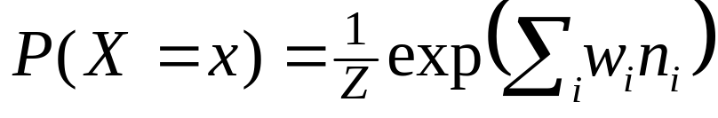
Markov Logic Networks
Statistical Relational Learning: combining probability with
first-order logic
Markov Logic Network (MLN) =
weighted set of first-order formulas
Applications: link prediction [Richardson & Domingos, 2006], entity resolution [Singla & Domingos, 2006], information extraction [Poon & Domingos, 2007], and more…

Slide 4
Example: WebKB
Collective classification of university web pages:
  Has(page, “homework”) ⇒ Class(page,Course)
  ¬Has(page, “sabbatical”) ⇒ Class(page,Student)
  Class(page1,Student) ∧ LinksTo(page1,page2) ⇒ Class(page2,Professor)

Slide 5
Example: WebKB
Collective classification of university web pages:
  Has(page,+word) ⇒ Class(page,+class)
  ¬Has(page,+word) ⇒ Class(page,+class)
  Class(page1,+class1) ∧ LinksTo(page1,page2) ⇒ Class(page2,+class2)
Notes:
GO FASTER

Slide 6
Overview
Discriminative weight learning in MLNs
is a convex optimization problem.
Problem: It can be prohibitively slow.
Solution: Second-order optimization methods
Problem: Line search and function evaluations
are intractable.
Solution: This talk!

Slide 7
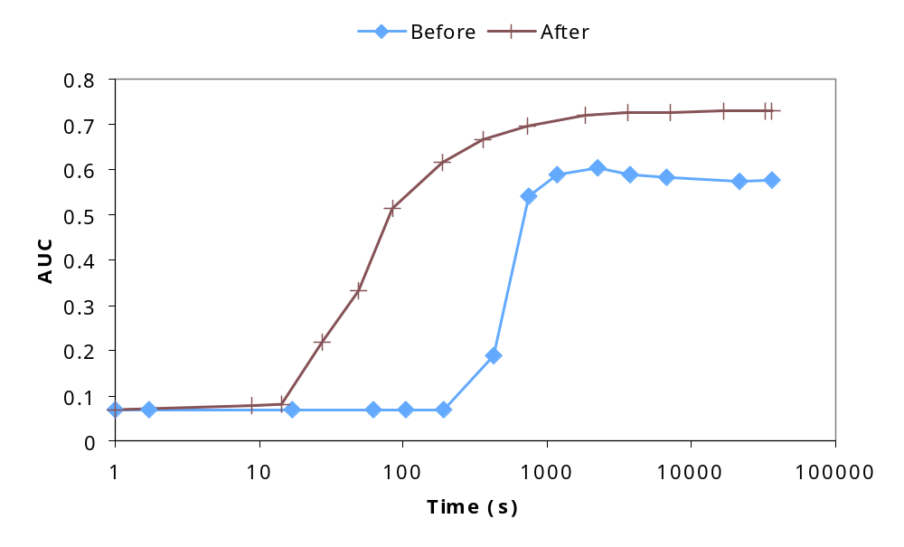
Sneak preview
Notes:
GO FASTER

Slide 8
Outline
Background
Algorithms
  Gradient descent
  Newton’s method
  Conjugate gradient
Experiments
  Cora – entity resolution
  WebKB – collective classification
Conclusion

Slide 9
Gradient descent
Move in direction of steepest descent,
scaled by learning rate:
w_{t+1} = w_{t} + η g_{t}
Notes:
GO FASTER

Slide 10
Gradient descent in MLNs
Gradient of conditional log likelihood is:
∂ P(Y=y|X=x)/∂ w_{i} = n_{i} - E[n_{i}]
Problem: Computing expected counts is hard
Solution: Voted perceptron [Collins, 2002; Singla & Domingos, 2005]
  Approximate counts use MAP state
  MAP state approximated using MaxWalkSAT
  The only algorithm ever used for MLN discriminative learning
Solution: Contrastive divergence [Hinton, 2002]
  Approximate counts from a few MCMC samples
  MC-SAT gives less correlated samples [Poon & Domingos, 2006]
  Never before applied to Markov logic

Slide 11
Per-weight learning rates
Some clauses have vastly more groundings than others
  Smokes(X) ⇒ Cancer(X)
  Friends(A,B) ∧ Friends(B,C) ⇒ Friends(A,C)
Need different learning rate in each dimension
Impractical to tune rate to each weight by hand
Learning rate in each dimension is:
η /(# of true clause groundings)

Slide 12
Ill-Conditioning
Skewed surface → slow convergence
Condition number: (λ_{max}/λ_{min}) of Hessian
Notes:
GO FASTER

Slide 13
The Hessian matrix
Hessian matrix: all second-derivatives
In an MLN, the Hessian is the negative covariance matrix of clause counts
  Diagonal entries are clause variances
  Off-diagonal entries show correlations
Shows local curvature of the error function

Slide 14
Newton’s method
Weight update: w = w + H⁻¹ g
We can converge in one step if error surface is quadratic
Requires inverting the Hessian matrix

Slide 15
Diagonalized Newton’s method
Weight update: w = w + D⁻¹ g
We can converge in one step if error surface is quadratic AND the features are uncorrelated
(May need to determine step length…)

Slide 16
Conjugate gradient
Include previous direction in new
search direction
Avoid “undoing” any work
If quadratic, finds n optimal weights in n steps
Depends heavily on line searches
Finds optimum along search direction by function evals.

Slide 17
Scaled conjugate gradient
[Møller, 1993]
Include previous direction in new
search direction
Avoid “undoing” any work
If quadratic, finds n optimal weights in n steps
Uses Hessian matrix in place of line search
Still cannot store entire Hessian matrix in memory

Slide 18
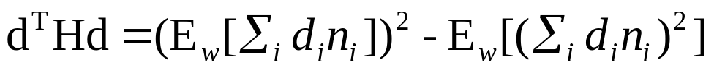
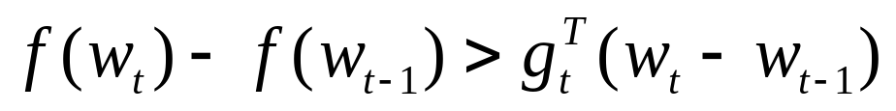
Step sizes and trust regions
[Møller, 1993; Nocedal & Wright, 2007]
Choose the step length
  Compute optimal quadratic step length: g^{T}d/d^{T}Hd
  Limit step size to “trust region”
  Key idea: within trust region, quadratic approximation is good
Updating trust region
  Check quality of approximation
  (predicted and actual change in function value)
  If good, grow trust region; if bad, shrink trust region
Modifications for MLNs
  Fast computation of quadratic forms:
  Use a lower bound on the function change:

Slide 19
Preconditioning
Initial direction of SCG is the gradient
  Very bad for ill-conditioned problems
Well-known fix: preconditioning
  Multiply by matrix to lower condition number
  Ideally, approximate inverse Hessian
Standard preconditioner: D⁻¹
[Sha & Pereira, 2003]

Slide 20
Outline
Background
Algorithms
  Gradient descent
  Newton’s method
  Conjugate gradient
Experiments
  Cora – entity resolution
  WebKB – collective classification
Conclusion

Slide 21
Experiments: Algorithms
Voted perceptron (VP, VP-PW)
Contrastive divergence (CD, CD-PW)
Diagonal Newton (DN)
Scaled conjugate gradient (SCG, PSCG)
Baseline: VP
New algorithms: VP-PW, CD, CD-PW, DN, SCG, PSCG
Notes:
GO FASTER (?)

Slide 22
Experiments: Datasets
Cora
  Task: Deduplicate 1295 citations to 132 papers
  Weights: 6141 [Singla & Domingos, 2006]
  Ground clauses: > 3 million
  Condition number: > 600,000
WebKB [Craven & Slattery, 2001]
  Task: Predict categories of 4165 web pages
  Weights: 10,891
  Ground clauses: > 300,000
  Condition number: ~7000

Slide 23
Experiments: Method
Gaussian prior on each weight
Tuned learning rates on held-out data
Trained for 10 hours
Evaluated on test data
  AUC: Area under precision-recall curve
  CLL: Average conditional log-likelihood of all query predicates

Slide 24
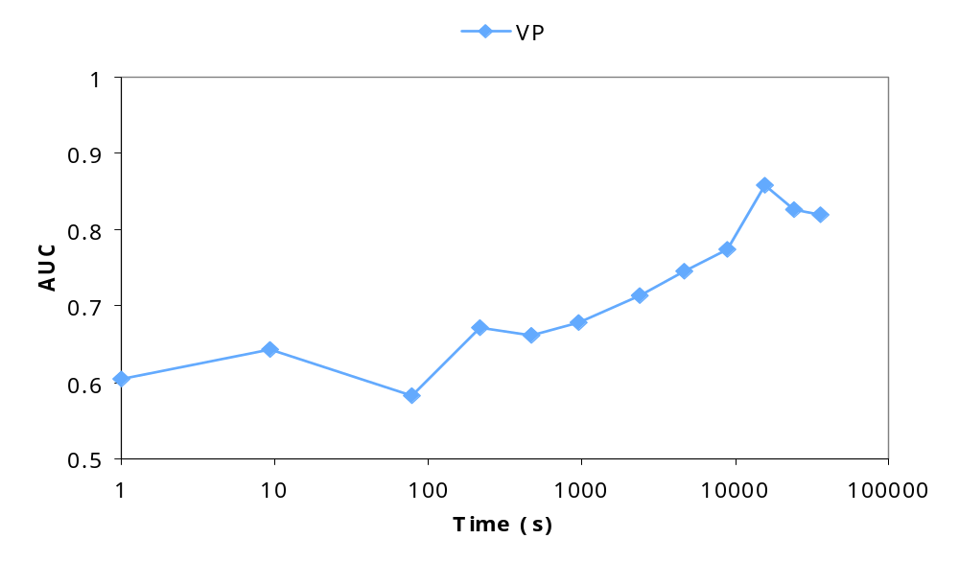
Results: Cora AUC

Slide 25
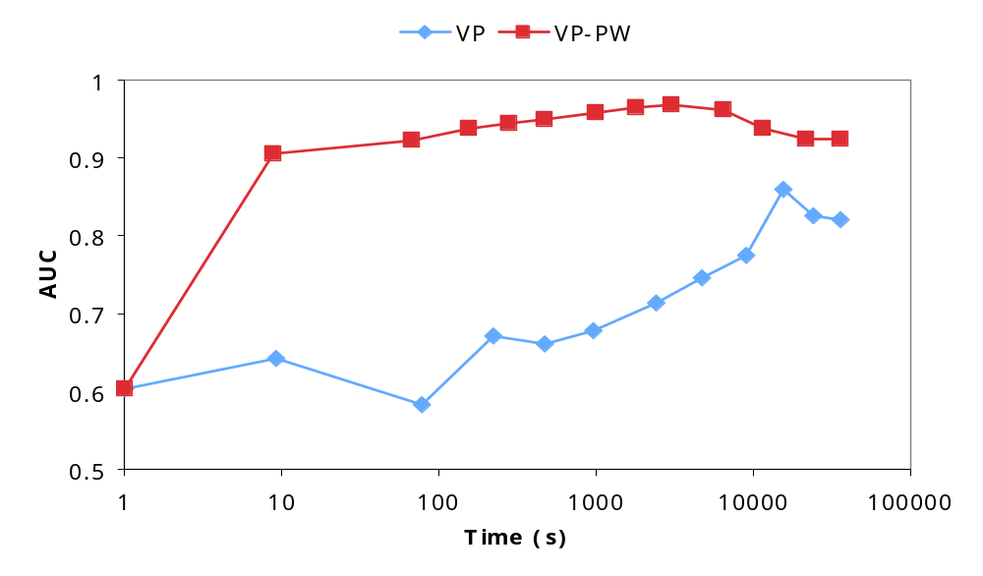
Results: Cora AUC

Slide 26
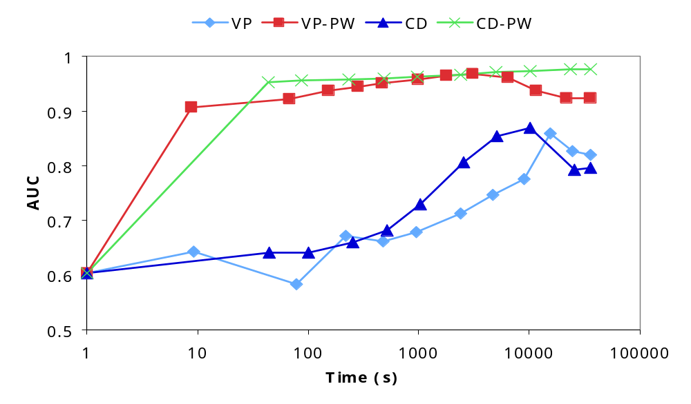
Results: Cora AUC

Slide 27
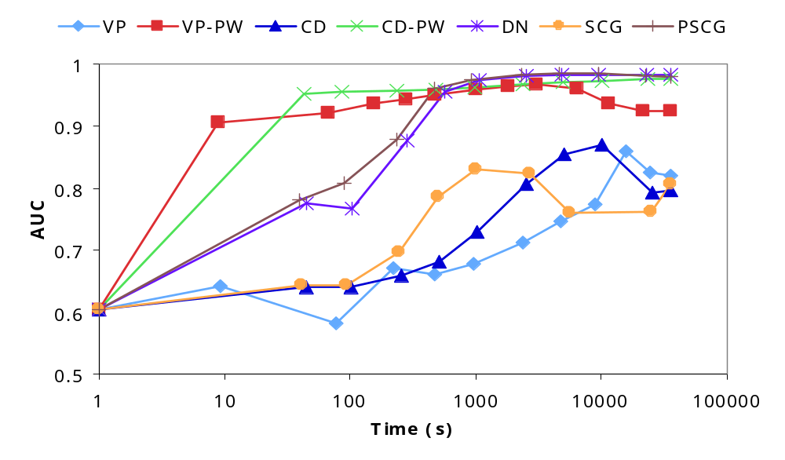
Results: Cora AUC

Slide 28
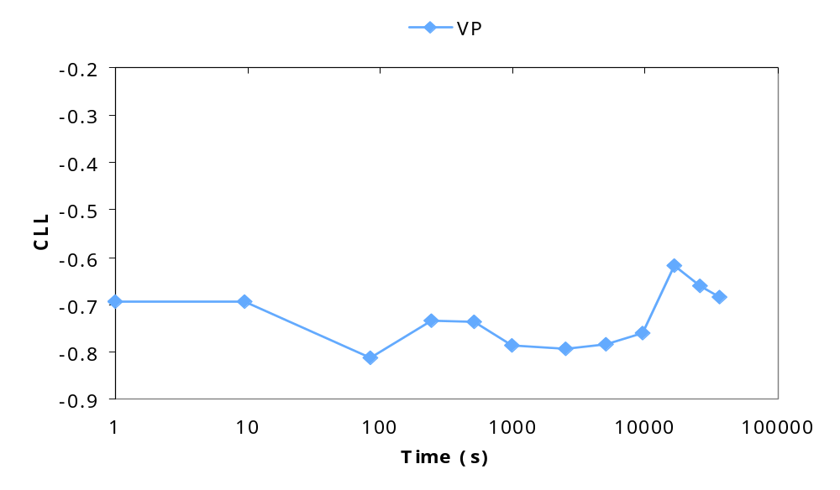
Results: Cora CLL

Slide 29
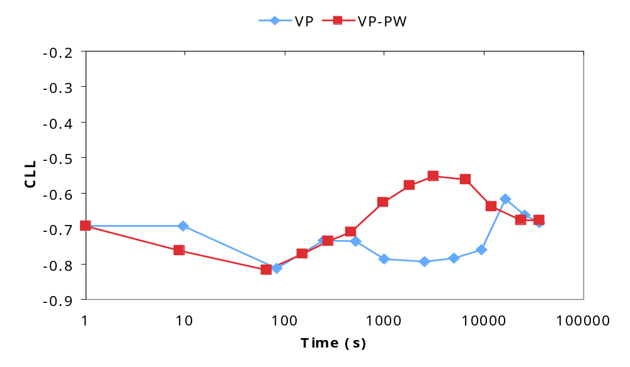
Results: Cora CLL

Slide 30
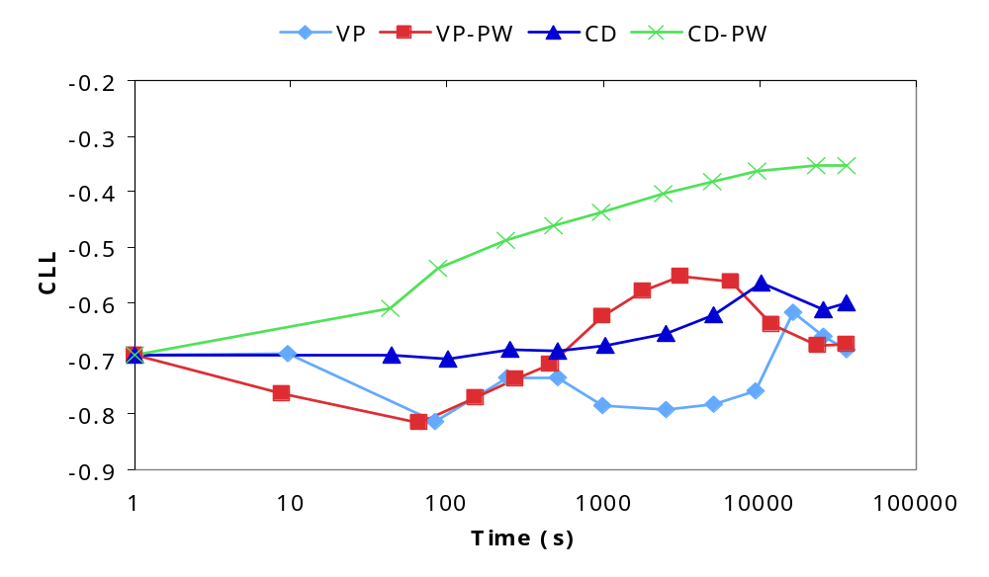
Results: Cora CLL

Slide 31
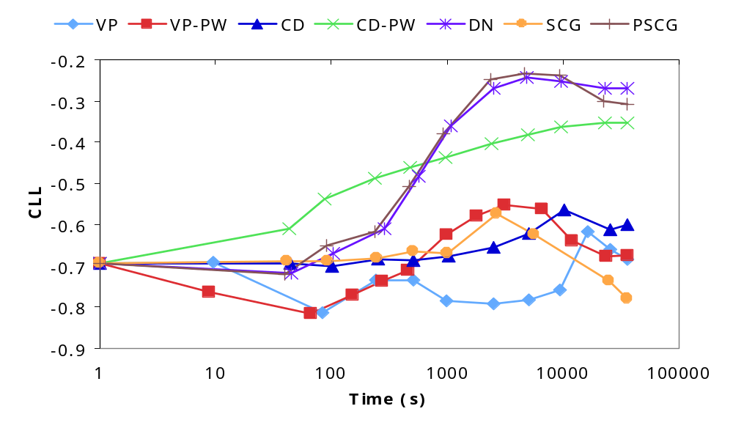
Results: Cora CLL

Slide 32
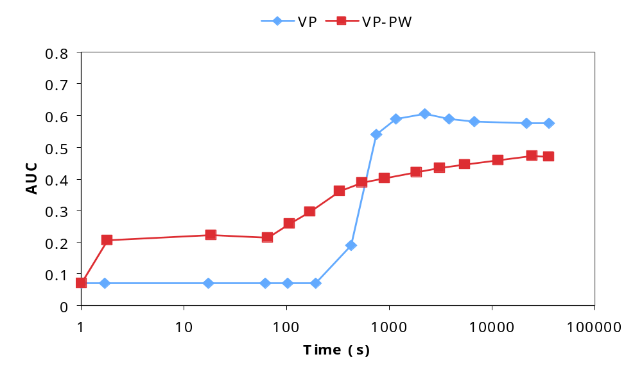
Results: WebKB AUC

Slide 33
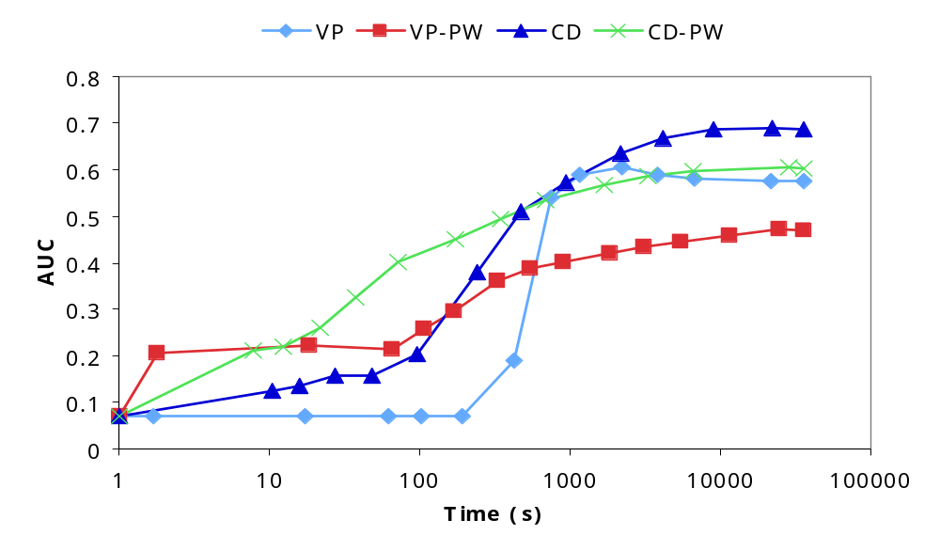
Results: WebKB AUC

Slide 34
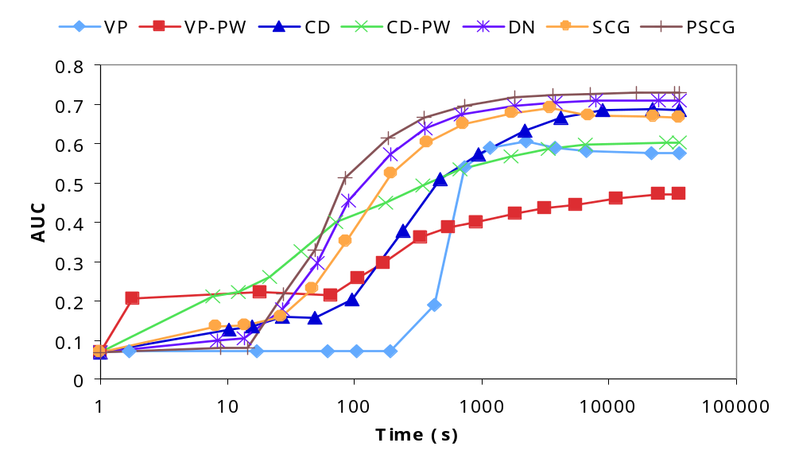
Results: WebKB AUC

Slide 35
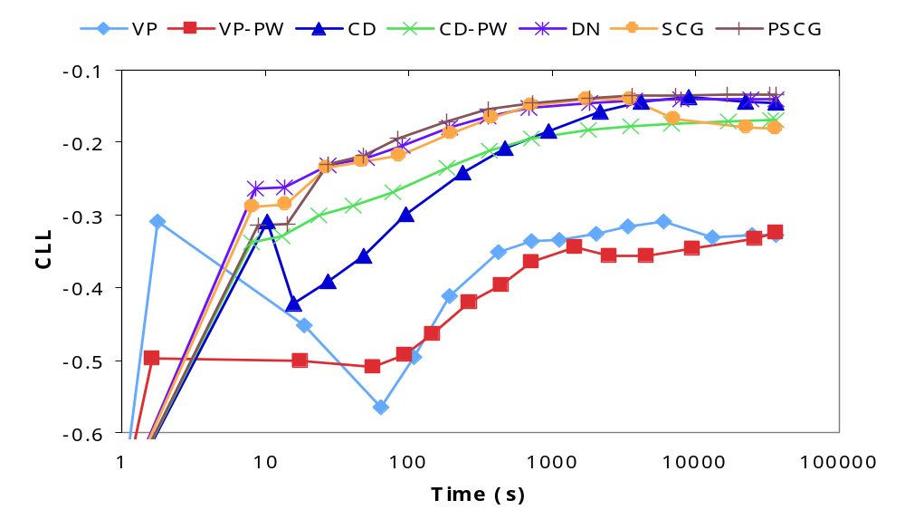
Results: WebKB CLL

Slide 36
Conclusion
Ill-conditioning is a real problem in
statistical relational learning
PSCG and DN are an effective solution
  Efficiently converge to good models
  No learning rate to tune
  Orders of magnitude faster than VP
Details remaining
  Detecting convergence
  Preventing overfitting
  Approximate inference
Try it out in Alchemy:
http://alchemy.cs.washington.edu/

