Slide 1
Recursive Random Fields
Daniel Lowd
University of Washington
June 29th, 2006
(Joint work with Pedro Domingos)

Slide 2
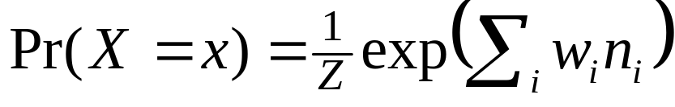
One-Slide Summary
Question: How to represent uncertainty in relational domains?
State-of-the-Art: Markov logic [Richardson & Domingos, 2004]
  Markov logic network (MLN) = first-order KB with weights:
Problem: Only top-level conjunction and universal quantifiers are probabilistic
Solution: Recursive random fields (RRFs)
  RRF = MLN whose features are MLNs
  Inference: Gibbs sampling, iterated conditional modes (ICM)
  Learning: back-propagation

Slide 3
Example: Friends and Smokers
[Richardson and Domingos, 2004]
Predicates:
Smokes(x); Cancer(x); Friends(x,y)
We wish to represent beliefs such as:
Smoking causes cancer
Friends of friends are friends (transitivity)
Everyone has a friend who smokes

Slide 4
First-Order Logic
∧
∀ x
∀ x,y,z
∀ x
Logical
∃ y
∨
∨
∧
¬Sm(x)
Ca(x)
¬Fr(x,y)
¬Fr(y,z)
Fr(x,z)
Fr(x,y)
Sm(y)

Slide 5
Markov Logic
1/Z exp(Σ …)
Probabilistic
w₁
w₃
w₂
∀ x
∀ x,y,z
∀ x
∃ y
∨
∨
Logical
∧
¬Sm(x)
Ca(x)
¬Fr(x,y)
¬Fr(y,z)
Fr(x,z)
Fr(x,y)
Sm(y)

Slide 6
Markov Logic
1/Z exp(Σ …)
Probabilistic
w₁
w₃
w₂
Σ x
Σ x,y,z
Σ x
∃ y
∨
∨
Logical
∧
¬Sm(x)
Ca(x)
¬Fr(x,y)
¬Fr(y,z)
Fr(x,z)
Fr(x,y)
Sm(y)

Slide 7
Markov Logic
1/Z exp(Σ …)
Probabilistic
w₁
w₃
w₂
Σ x
Σ x,y,z
Σ x
∃ y
∨
∨
Logical
∧
¬Sm(x)
Ca(x)
¬Fr(x,y)
¬Fr(y,z)
Fr(x,z)
Fr(x,y)
Sm(y)
This becomes a disjunction
of n conjunctions.

Slide 8
Markov Logic
1/Z exp(Σ …)
Probabilistic
w₁
w₃
w₂
Σ x
Σ x,y,z
Σ x
∃ y
∨
∨
Logical
∧
¬Sm(x)
Ca(x)
¬Fr(x,y)
¬Fr(y,z)
Fr(x,z)
Fr(x,y)
Sm(y)
In CNF, each grounding
explodes into 2^{n} clauses!

Slide 9
Recursive Random Fields
f₀
w₁
w₃
w₂
Probabilistic
∑_{x} f_{3,x}
∑_{x} f_{1,x}
∑_{x,y,z} f_{2,x,y,z}
w₉
w₄
w₅
w₆
w₈
w₇
∑_{y} f_{4,x,y}
Sm(x)
Ca(x)
Fr(x,y)
Fr(y,z)
w₁₀
w₁₁
Fr(x,z)
Fr(x,y)
Sm(y)
Where: f_{i,x} = 1/Z_{i} exp(Σ …)

Slide 10
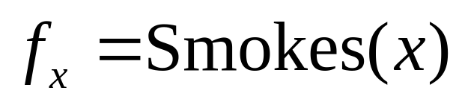
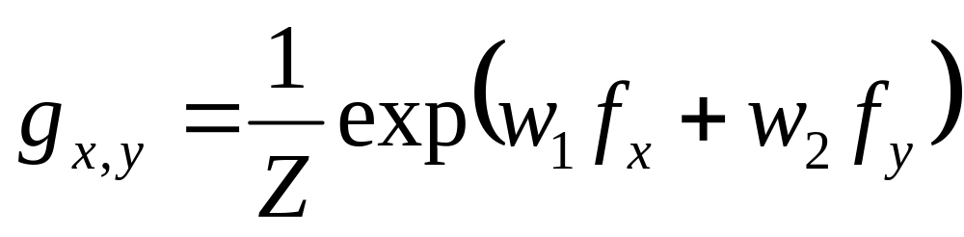
The RRF Model
RRF features are parameterized and are grounded using objects in the domain.
  Leaves = predicates:
  Recursive features are built up from other RRF features:

Slide 11
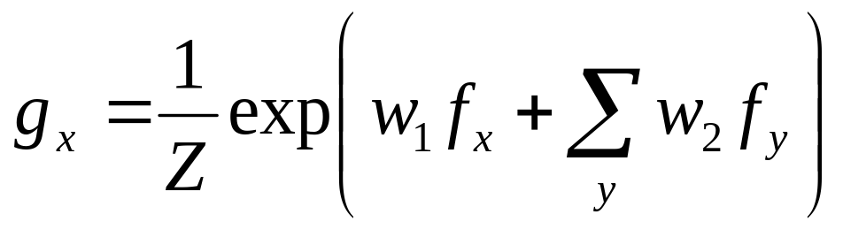
The RRF Model
RRF features are parameterized and are grounded using objects in the domain.
  Leaves = predicates:
  Recursive features are built up from other RRF features:

Slide 12
Representing Logic: AND
(x ∧ y) →
1/Z exp(w₁ x + w₂ y)
P(World)
0
1
…
n
# true literals

Slide 13
Representing Logic: OR
(x ∧ y) →
1/Z exp(w₁ x + w₂ y)
(x ∨ y) → ¬(¬x ∧ ¬y) →
−1/Z exp(−w₁ x + −w₂ y)
P(World)
0
1
…
n
# true literals
De Morgan:
(x ∨ y) ⬄ ¬(¬x ∧ ¬y)

Slide 14
Representing Logic: FORALL
(x ∧ y) →
1/Z exp(w₁ x + w₂ y)
(x ∨ y) → ¬(¬x ∧ ¬y) →
−1/Z exp(−w₁ x + −w₂ y)
∀ a: f(a) →
1/Z exp(w x₁ + w x₂ + …)
P(World)
0
1
…
n
# true literals

Slide 15
Representing Logic: EXIST
(x ∧ y) →
1/Z exp(w₁ x + w₂ y)
(x ∨ y) → ¬(¬x ∧ ¬y) →
−1/Z exp(−w₁ x + −w₂ y)
∀ a: f(a) →
1/Z exp(w x₁ + w x₂ + …)
∃ a: f(a) → ¬(∀ a: ¬f(a))
−1/Z exp(−w x₁ + −w x₂ + …)
P(World)
0
1
…
n
# true literals

Slide 16
Distributions MLNs and RRFs can compactly represent
Distribution | MLNs | RRFs
Propositional MRF | Yes | Yes
Deterministic KB | Yes | Yes
Soft conjunction | Yes | Yes
Soft universal quantification | Yes | Yes
Soft disjunction | No | Yes
Soft existential quantification | No | Yes
Soft nested formulas | No | Yes

Slide 17
Inference and Learning
Inference
  MAP: iterated conditional modes (ICM)
  Conditional probabilities: Gibbs sampling
Learning
  Back-propagation
  RRF weight learning is more powerful than MLN structure learning
  More flexible theory revision

Slide 18
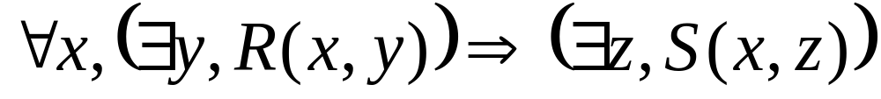
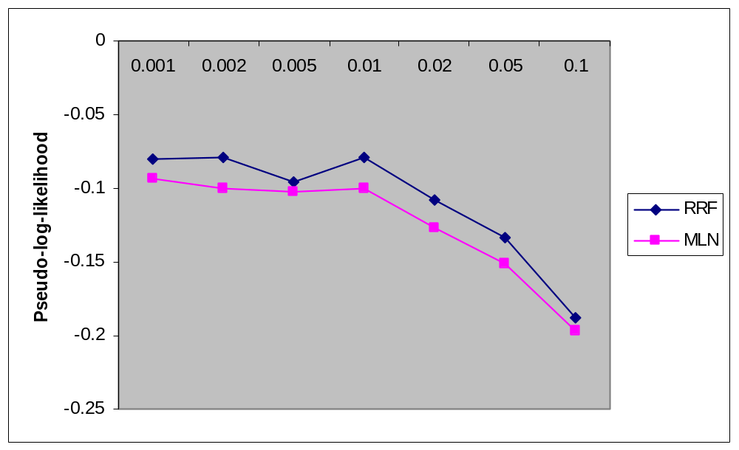
Current Work:
Probabilistic Integrity Constraints
Want to represent probabilistic version of:

Slide 19
Conclusion
Recursive random fields:
+ Compactly represent many distributions MLNs cannot
+ Make conjunctions, existentials, and nested formulas probabilistic
+ Offer new methods for structure learning and theory revision
– Less intuitive than Markov logic

