Slide 1
Introduction to Search Relevance Ranking- Session III – Knowedge Distillation
Tutorial Link: https://dlranking.github.io/dlrr/
Data source: https://huggingface.co/datasets/xglue
XGLUE: A New Benchmark Dataset for Cross-lingual Pre-training, Understanding and Generation)
Presenters: Xue Li, Keng-hao Chang
Date: August 14th, 2022

Slide 2
Agenda
Knowledge distillation
Case study in DistilBert
Case study in Microsoft Ads for Ranking
The colab

Slide 3

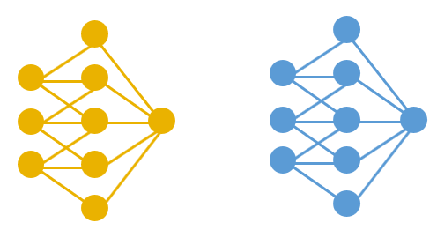

Pre-train and fine-tune
Natural Language Processing
Pre-train on unsupervised tasks, e.g. Language Modeling
Fine-tune on downstream NLP tasks, e.g. Question Answering
Large & powerful NLP models, even beat human!
Pre-train
cheap large data
on related domain
Fine-tune
Expensive well-labeled data
on downstream task

Slide 4
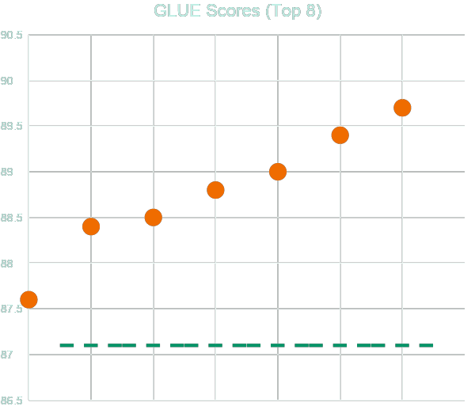
GLUE – General Language Understanding Evaluation
T5 89.7
ALBERT-ensemble 89.4
ALICE v2 large ensemble 89.0
FreeLB-RoBERTa-ensemble
88.8
RoBERTa 88.5
XLNet-Large-ensemble 88.4
MT-DNN-ensemble 87.6
Human Baseline 87.1
https://gluebenchmark.com/leaderboard/, 2019-11-12

Slide 5
How large are pre-trained NLP models?
CDSSM
ELMo
GPT-2
BERT
XLM
XLNet
RoBERTa
43M
93M
1.5B
340M
665M
340M
340M
10/17
03/18
10/18
02/19
06/19
07/19

Slide 6
Call outs
Will cover
Knowledge distillation
Practices of knowledge distillation
Will not cover
Other smaller model techniques (Albert, Electra)

Slide 7
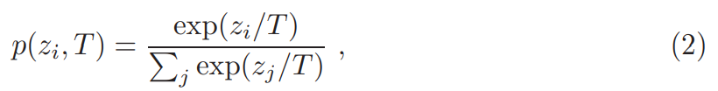
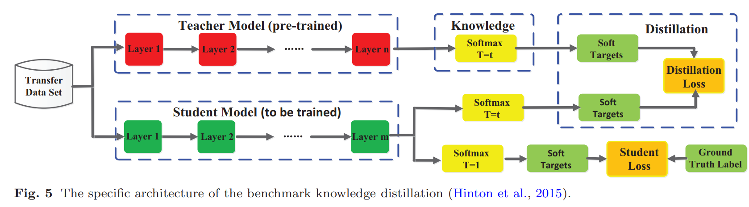
Response level knowledge distillation
Vs. Logits
Soft label, dark knowledge, Hinton
Analogous to label smoothing
Limited to supervision learning
Notes:
Knowledge Distillation: Principles, Algorithms, Applications - neptune.ai
2006.05525.pdf (arxiv.org)
Knowledge distillation in deep learning and its applications - PMC (nih.gov)

Slide 8
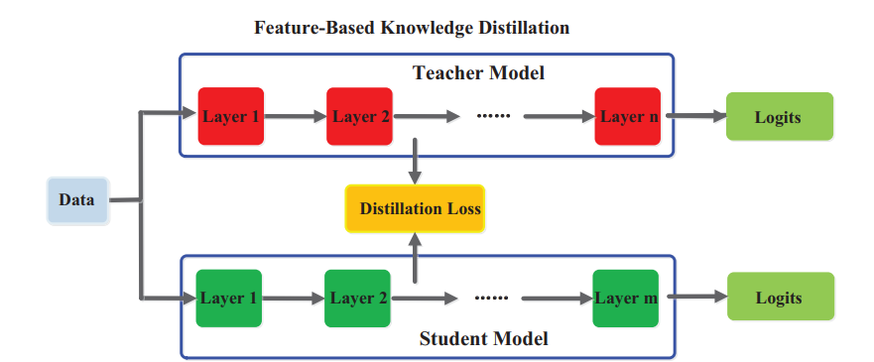
Feature-based knowledge distillation
L2-norm distance, L1-norm distance, cross entropy loss, cosine loss

Slide 9
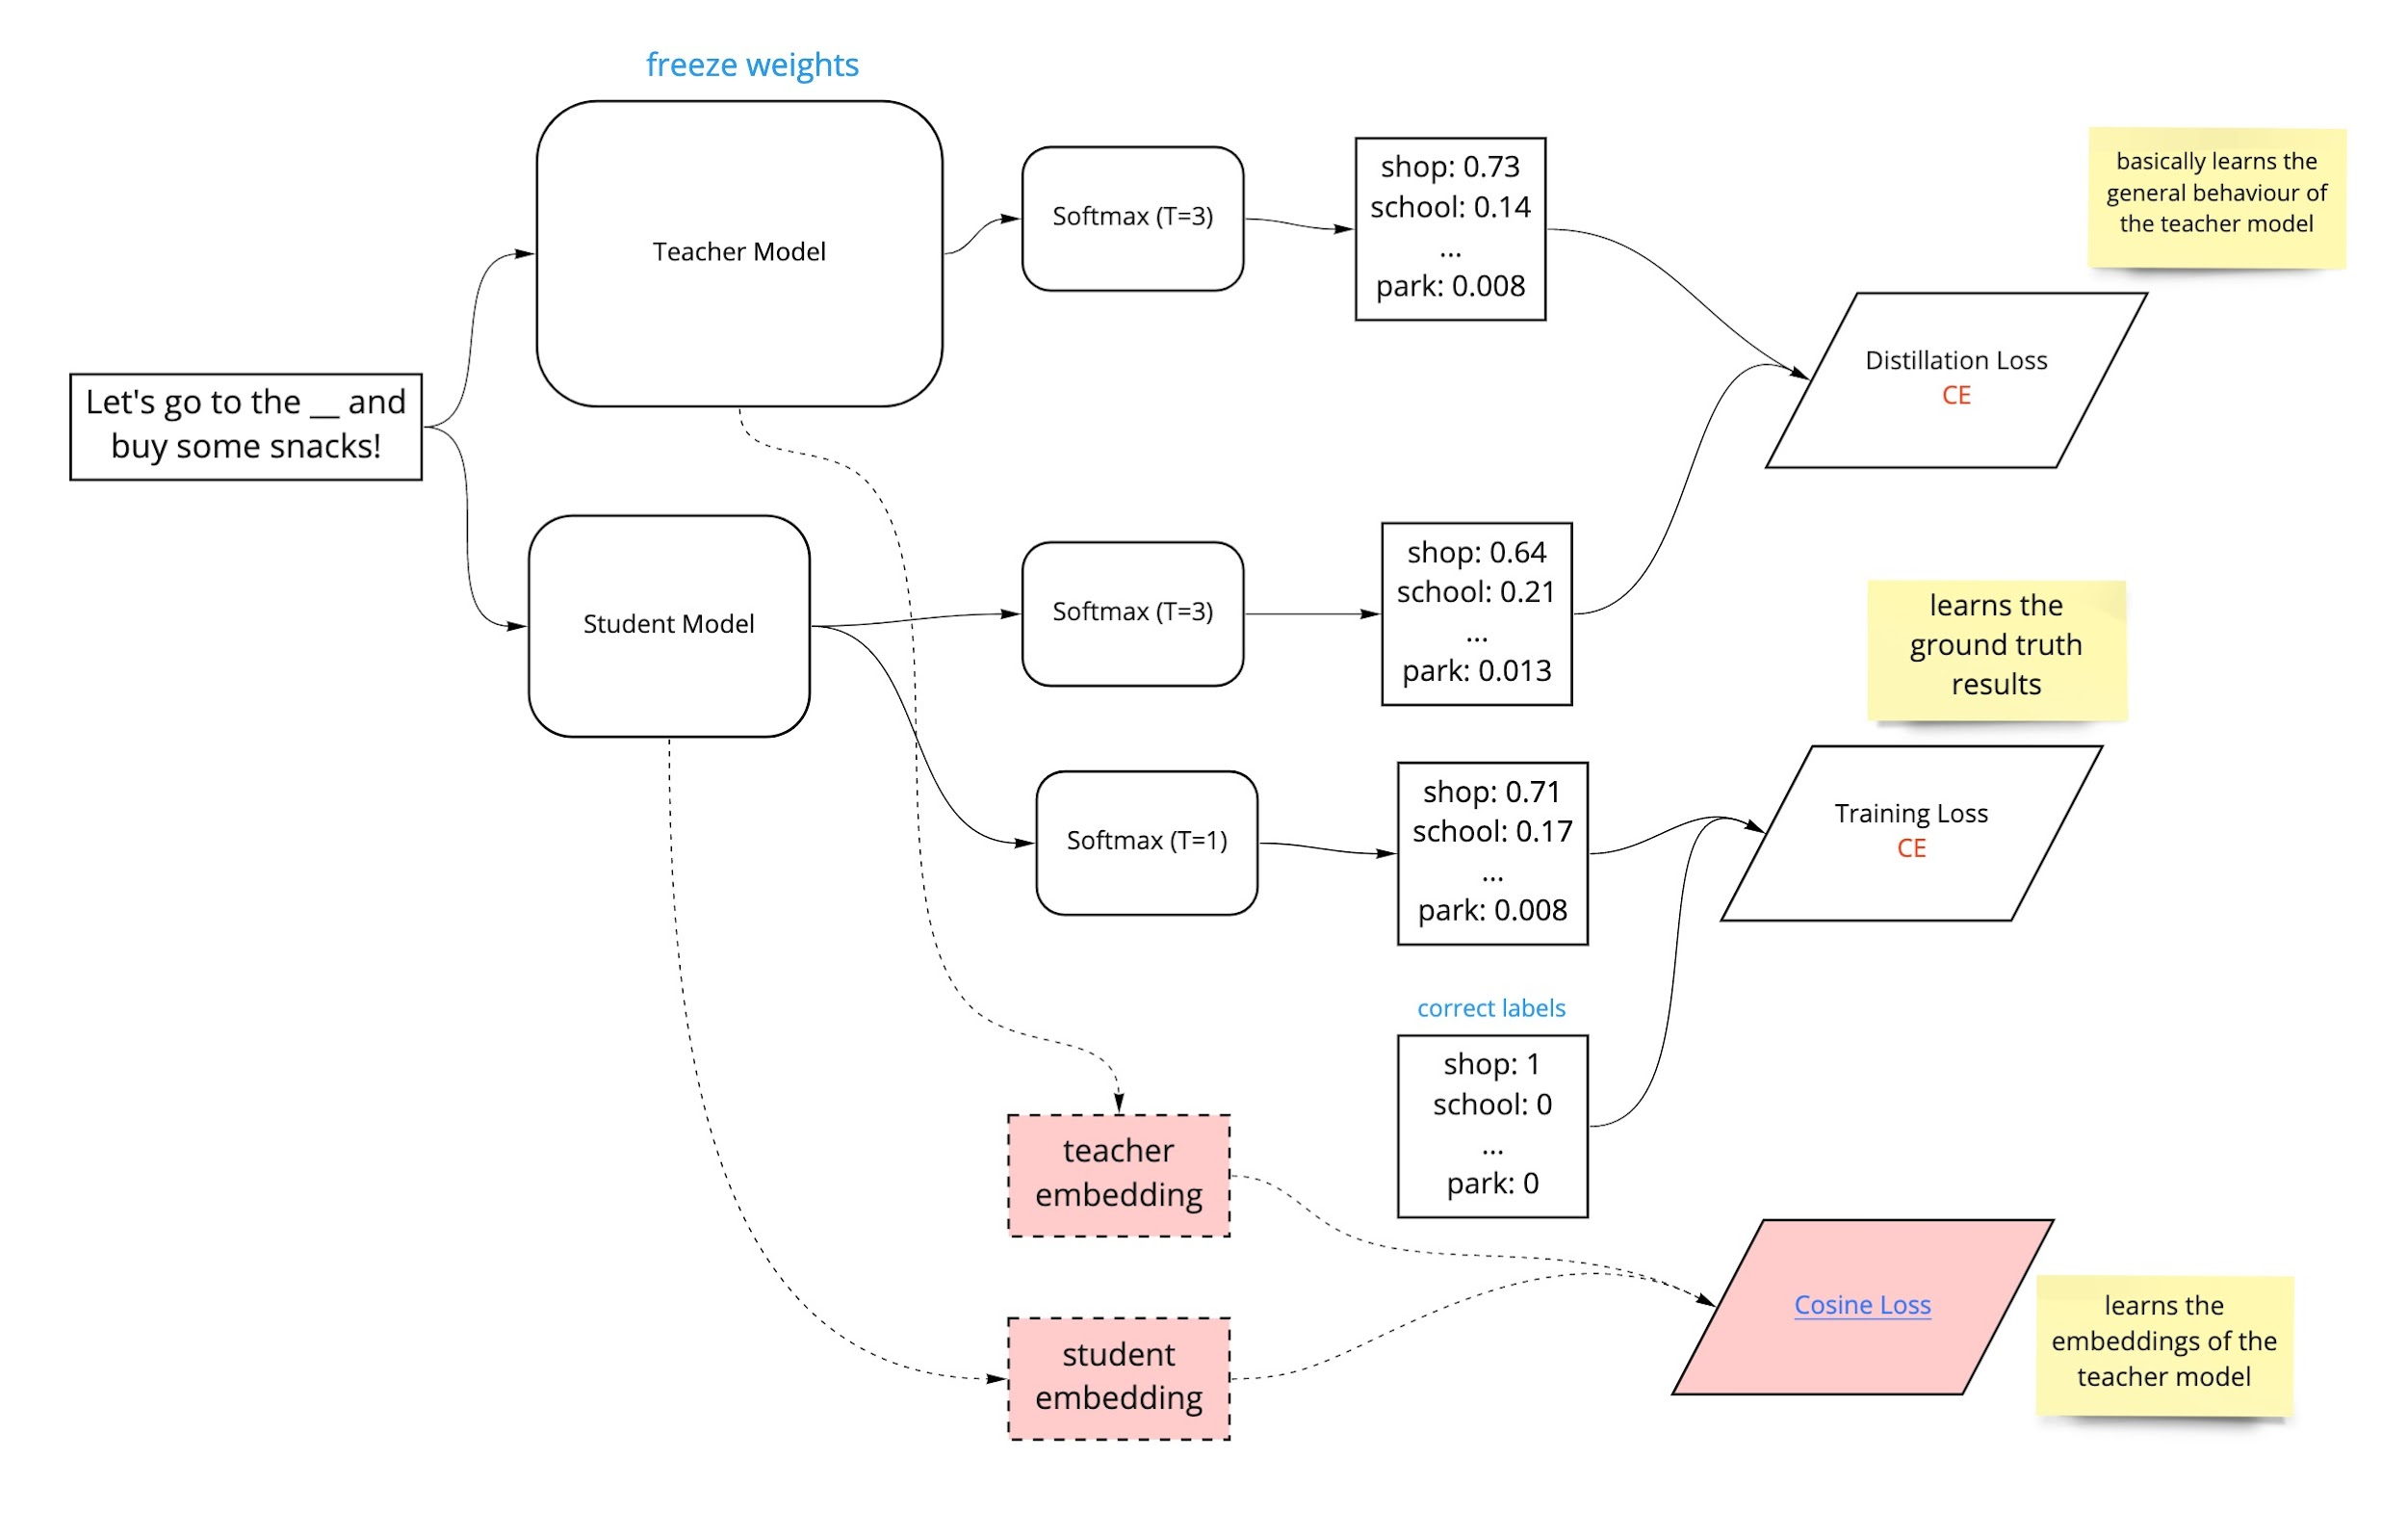
Case study: distillBert
3 losses
Distillation loss
Training loss
Cosine loss
DistillBERT model retains almost 97% of the original BERT-base model's language undersetanding when evaluated on GLUE benchmarks. In addition to this, it is 40% smaller and 60% faster at inference.

Slide 10
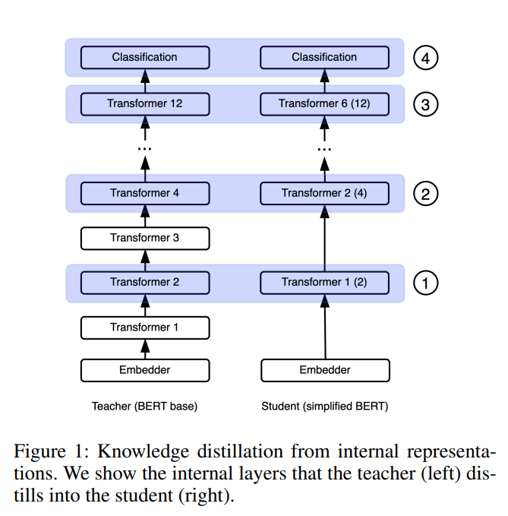
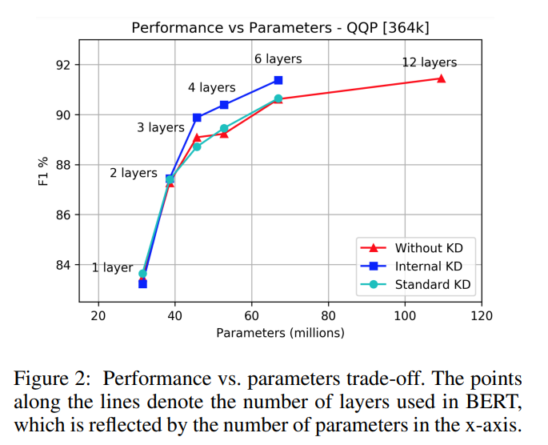
Case study: Knowledge Distillation from Internal Representations

Slide 11
Offline distillation
Online distillation
Both teacher and student are updated simutaneously
Self distillation

Slide 12
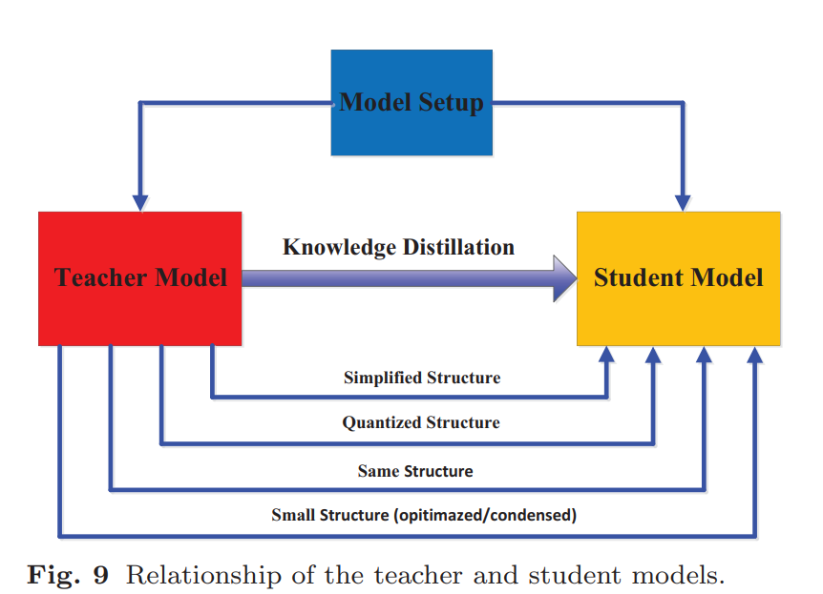
Residual learning

Slide 13
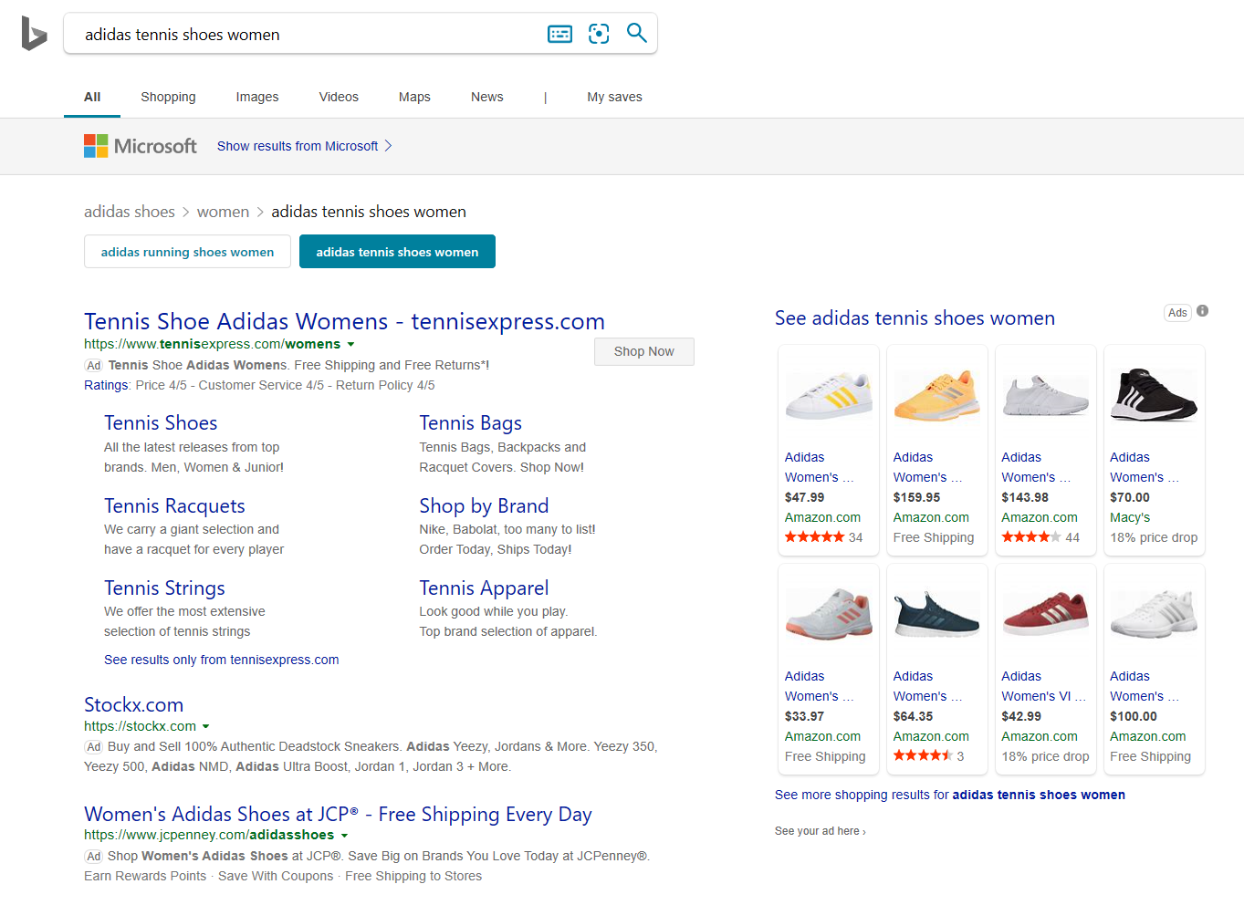
Case study: search relevance ranking at Microsoft Ads
Point-wise relevance score
Used as externality in ranking
pDefect = 1-Relevance
Bid * pClick – w*pDefect
Text Ads #1
Product Ads
Text Ads #2
Text Ads #3

Slide 14
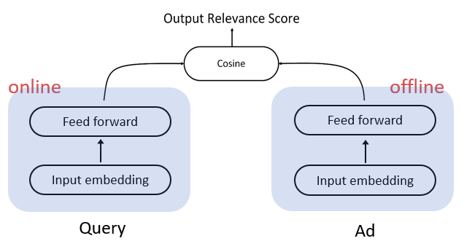
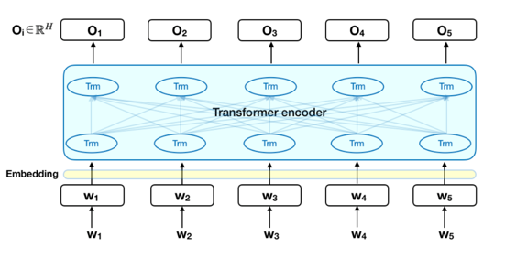
Choice of student model
Two tower
CDSSM, TwinBert
Doc embedding is offline computed
BERT-like
cannot support fast compute, latency prohibitive.

Slide 15
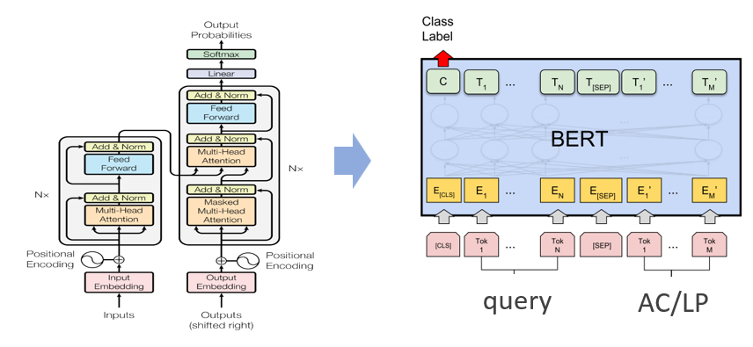
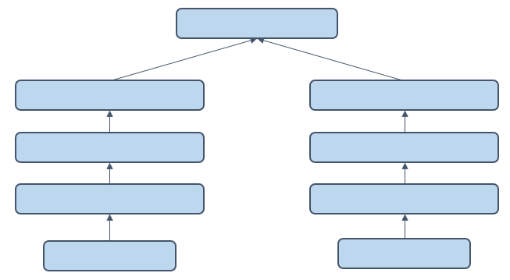
Knowledge distillation for search Relevance
Teacher Training
<query, ad, label>
<query, ad, label>
<query, ad, label>
Constructing tasks
Narrow the gap between pre-trained
models and target tasks
…
Query
Ad
teacher
Step 1: train teachers via MTL
Inference Data
Score both labeled / unlabeled data
<query, ad>
<query, ad>
<query, ad>
<query, ad, score>
<query, ad, score>
<query, ad, score>
<query, ad, label>
<query, ad, label>
<query, ad, label>
<query, ad, label, score>
<query, ad, label, score>
<query, ad, label, score>
…
…
…
…
Student Training
Step 2: score unlabeled and labeled data
Train a deployable student model
Using scored unlabeled data
Student Fine-tuning
Step 3: train deployable model by scores
Step 4: fine-tune by label-aware loss
Fine-tune student model
Using scored labeled data
Learning Fast Matching Models from Weak Annotations, WWW'19

Slide 16





Recipe of AdsBERT Distillation
Initialization
Pre-trained BERT
340M params
Pretrain
MLM/NSP
400M Ads data
MTL Finetune
8 ad tasks
40M samples
Inference
Vast amount
Proper distribution
Distillation
CDSSM keep 70% AUC gain

Slide 17
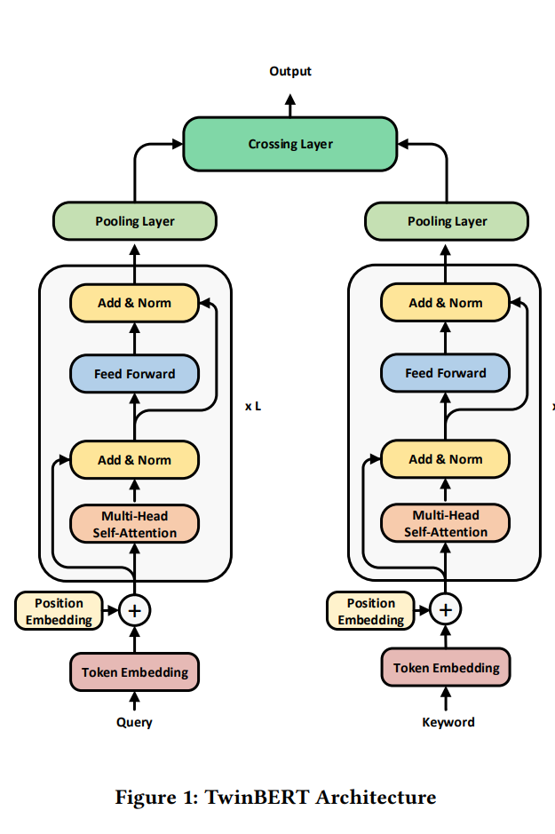
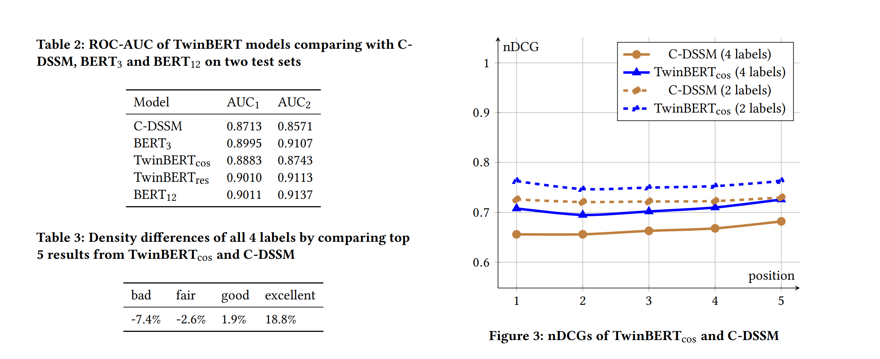
Case study: TwinBert

Slide 18
Colab
QADSM task in xGLUE dataset, which is extracted from real Bing Ads traffic.

Slide 19
Appendix

Slide 20
After seeing a lot of examples, the network can act as a maximum likelihood estimator, but it needs to be exposed to many examples before it can assign good probabilities, as the labels it sees are samples from a distribution with extremely high variance.
If you’ve done transfer learning before, you can see where this is going. The big idea is: We can take a large pre-trained model like BERT, called the teacher, fine-tune it on the target task if it differs from the pre-training task, use it to predict the probabilities for our data, then use the probabilities as “soft labels” for the target model, the student. This way we can communicate the target distribution to the network with fewer examples! This also corresponds to training a student to reproduce the behavior of the teacher as accurately as possible, but with fewer parameters.
Notes:
Distilling knowledge from Neural Networks to build smaller and faster models (floydhub.com)
as explained by the paper Distilling the Knowledge in a Neural Network, as TT becomes larger the Kullback–Leibler divergence becomes more and more similar to applying MSE Loss to the raw scores.
towards-automated-distillation-a-systematic-study-of-knowledge-distillation-in-natural-language-processing.pdf (amazon.science)
f. [10] compared Kullback-Leibler divergence and mean squared error objectives in KD for image classification models, finding that the mean squared error performs better

Slide 21
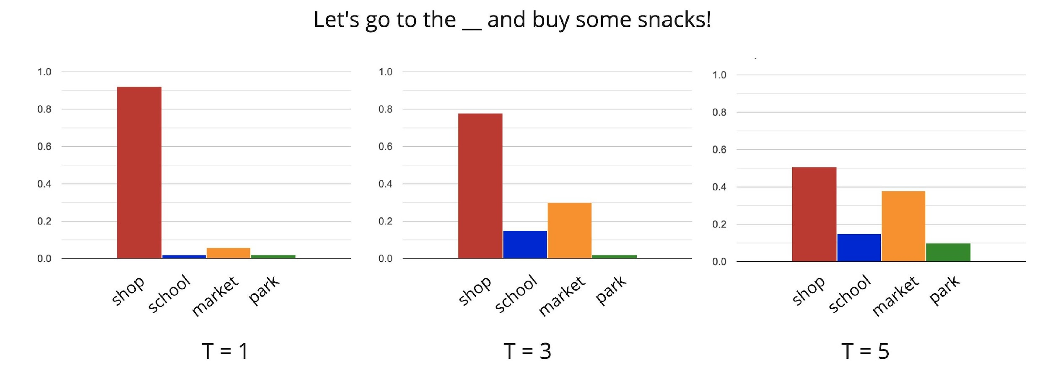
Case study: DistilBert
CP_KD_7.jpg (2503×1597) (alexnim.com)
Knowledge Distillation of Language Models (alexnim.com)
DistillBERT model retains almost 97% of the original BERT-base model's language undersetanding when evaluated on GLUE benchmarks. In addition to this, it is 40% smaller and 60% faster at inference.
Notes:
ENLSP NeurIPS Workshop 2021 | ENLSP highlights some fundamental problems in NLP and speech processing related to efficiency of the models, training and inference for the general ML and DL communities. (neurips2021-nlp.github.io)
Efficient KD for NLP and speech, efficient intermediate layer distillation, and teacher-free distillation
Improving KD for large classification problems (e.g., text generation and machine translation with a very large number of output classes)
Theory of KD (e.g., how does KD work?)
6229-Article Text-9454-1-10-20200516.pdf Knowledge Distillation from Internal Representations

Slide 22
Relation-based knowledge distillation

Slide 23
Case study: Acoustic Modeling by Amazon Alexa
Parthasarathi and Strom (2019) leveraged student-teacher training to generate soft targets for 1 million hours of unlabeled speech data where the training dataset consisted only of 7000 hours of labeled speech.
The teacher model produced a probability distribution over all the output classes. The student model also produced a probability distribution over the output classes given the same feature vector and the objective function optimized the cross-entropy loss between these two distributions. Here, knowledge distillation helped simplify the generation of target labels on a large corpus of speech data.

Slide 24
Separability enables fast retrieval via ANN
Query
Ad
Online computing
by query-model
Offline computing
by ad-model
ANN search
…
query vector
ad vectors
stored as table
Notes:
ANN: Approximate Nearest Neighbor

