Slide 1
Introduction to Search Relevance Ranking- Session I
Tutorial Link: https://dlranking.github.io/dlrr/
Data source: https://huggingface.co/datasets/xglue
XGLUE: A New Benchmark Dataset for Cross-lingual Pre-training, Understanding and Generation)
Presenters: Linsey Pang, WeiLiu, Stephen Guo
Date: August 14th, 2022

Slide 2
Agenda
Overview of search relevance ranking
Traditional IR models
Machine Learning approaches
Evaluation Metrics
Hands-on Session

Slide 3


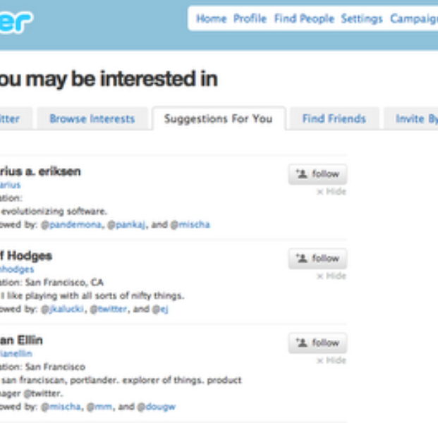
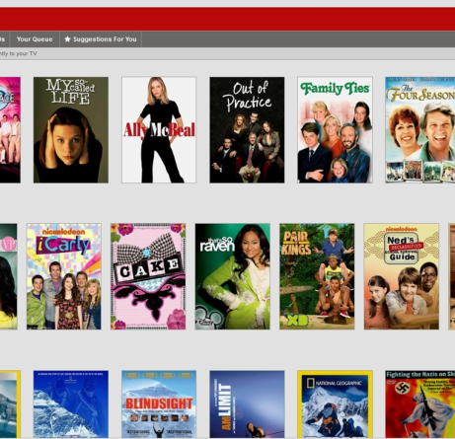
Applications
Recommender Systems— Given a user profile and purchase history, rank the retrieved candidates items to find personalized products for the user.
Question Answering System — Given a question, retrieve top answers for questions posed in natural language.
Search Engines— Given a textual query, provide ranked list of web pages results by relevance score.

Slide 4
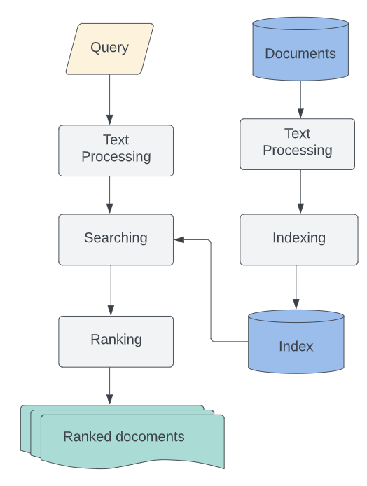

Information Retrieval System-IR system
Given a query (q) and a collections (d) of documents,
relevance ranking algorithms /models determine how
relevant each document is for the given query.
for each input x = (q, d) where q is a query and d is a document;
r= f(x) is relevance score function for each input.

Slide 5
IR Ranking Algorithms
Vector space Model
Probabilistic IR: BIM(the binary independence model), BM25
Learn to Rank (machine learning approaches)

Slide 6
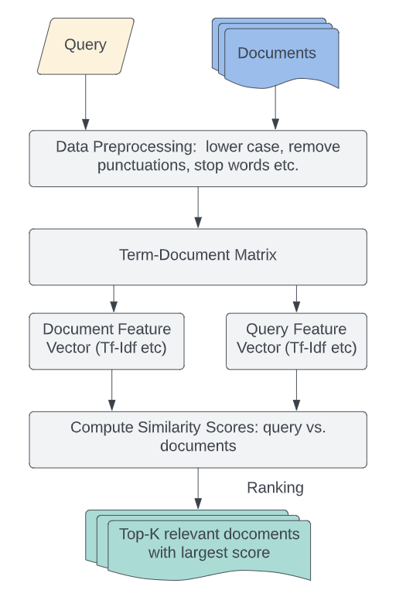
Classical ranking Algorithms - Vector space Model
What is vector space model?
Compute a vector embedding (e.g. using TF-IDF, Word2Vec, Doc2Vec, BERT etc ) for each query and document, and then compute the relevance score f(x) = f(q, d) as the cosine similarity between the vectors embeddings of q and d.

Slide 7
Classical ranking Algorithms - Vector space Model
Problem Statement:
Given a set of points S in vector space M and a query point Q ∈ M, find the closest point S to Q.
Steps:
Vectorize all documents – that gives S.
Vectorize the query – that gives Q.
Compute distance D between Q and S.
Sort D in ascending order- providing indices of most similar documents in S .
Return top-k of S

Slide 8
Classical ranking Algorithms - Vector space Model
3. Demo: (TF-IDF vector feature)
TF= term frequency is the number of times a term occurs in a document
IDF= inverse of the document frequency, given as : IDF= log(N/df), where df is the document frequency-number of documents containing a term
For instance: total number of documents =2 ; TF matrix and IDF matrix are given:
Terms/Docs | d1 | d2 | query
t1(red) | 1 | 1 | 0
t2(dog) | 1 | 1 | 0
t3(ball) | 1 | 1 | 0
t4(runs) | 1 | 0 | 1
t4(slow) | 0 | 1 | 0
DF | IDF
2 | 0
2 | 0
2 | 0
1 | 0.30103
1 | 0.30103

Slide 9
Classical ranking Algorithms - Vector space Model
3. TF-IDF matrix
TF-IDF Matrix
Term/Docs | d1 | d2 | query
t1(red) | 0 | 0 | 0
t2(dog) | 0 | 0 | 0
t3(ball) | 0 | 0 | 0
t4(runs) | 0.30103 | 0 | 0.30103
t4(slow) | 0 | 0.30103 | 0

Slide 10
Classical ranking Algorithms - Vector space Model
2. Similarity Metrics:
Cosine Similarity
Jaccard distance
Kullback-Leibler divergence
Euclidean distance

Slide 11
Classical ranking Algorithms - Vector space Model
3. Steps:
Load documents and search queries into the R programming environment as list objects.
Preprocess the data by creating a corpus object with all the documents and query terms, removing stop words, punctuations using tm package.
Creating a term document matrix with tf-idf weight setting available in TermDocumentMatrix() method.
Separate the term document matrix into two parts- one containing all the documents with term weights and other containing all the queries with term weights.
Now calculate cosine similarity between each document and each query.
For each query sort the cosine similarity scores for all the documents and take top-k documents having high scores.

Slide 12
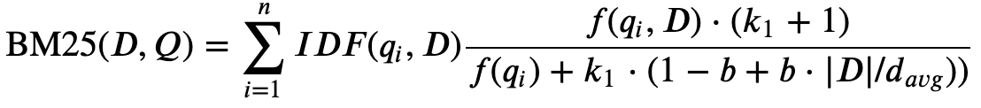
Classical ranking Algorithms - BM25
BM25 (Best Match 25)
Improves upon TFIDF by treating relevance as a probability problem
Formula:
f(qi,D) is the number of times of query term qi occurs in Document
|D| is the number of words in document D
D_avg is the average number of words per document
B and k1 are hyperparameters of BM25
Notes:
http://ethen8181.github.io/machine-learning/search/bm25_intro.html
https://www.elastic.co/blog/practical-bm25-part-2-the-bm25-algorithm-and-its-variables
https://www.youtube.com/watch?v=FYil7LtpyN0

Slide 13
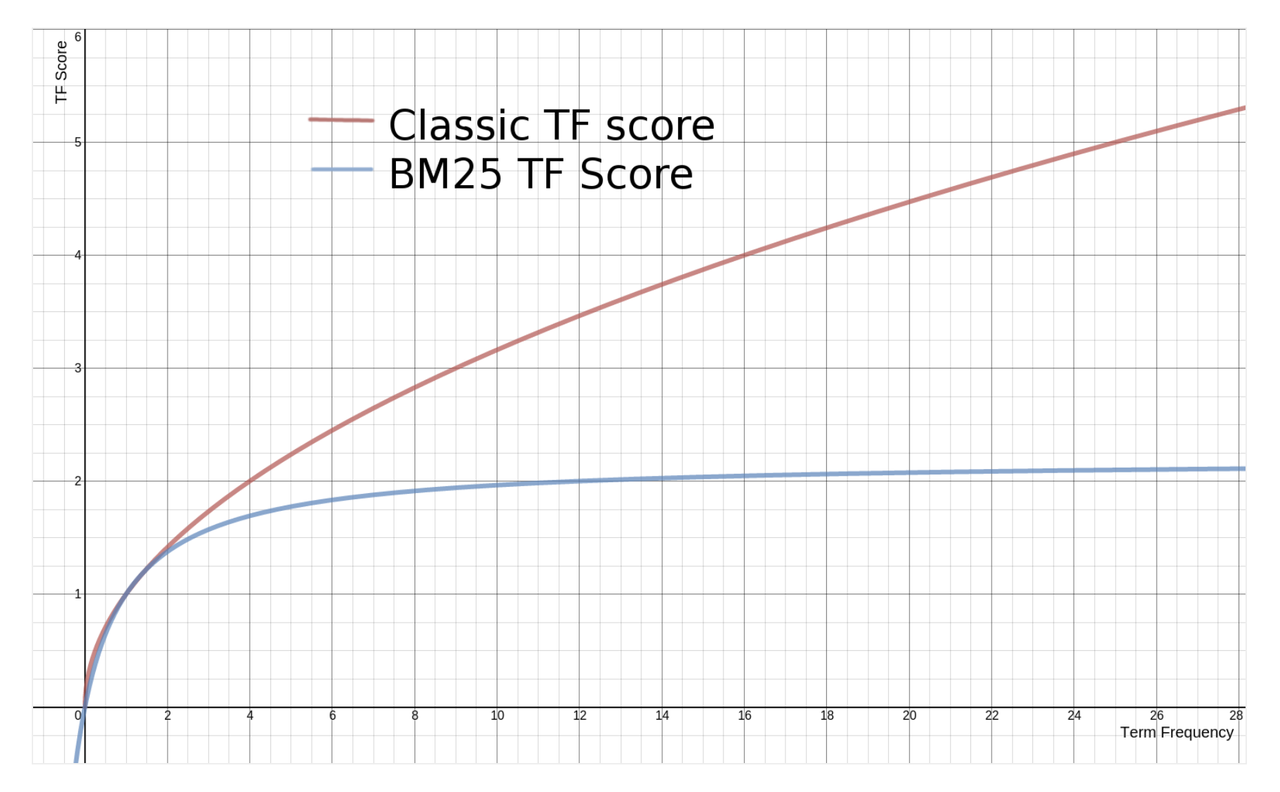
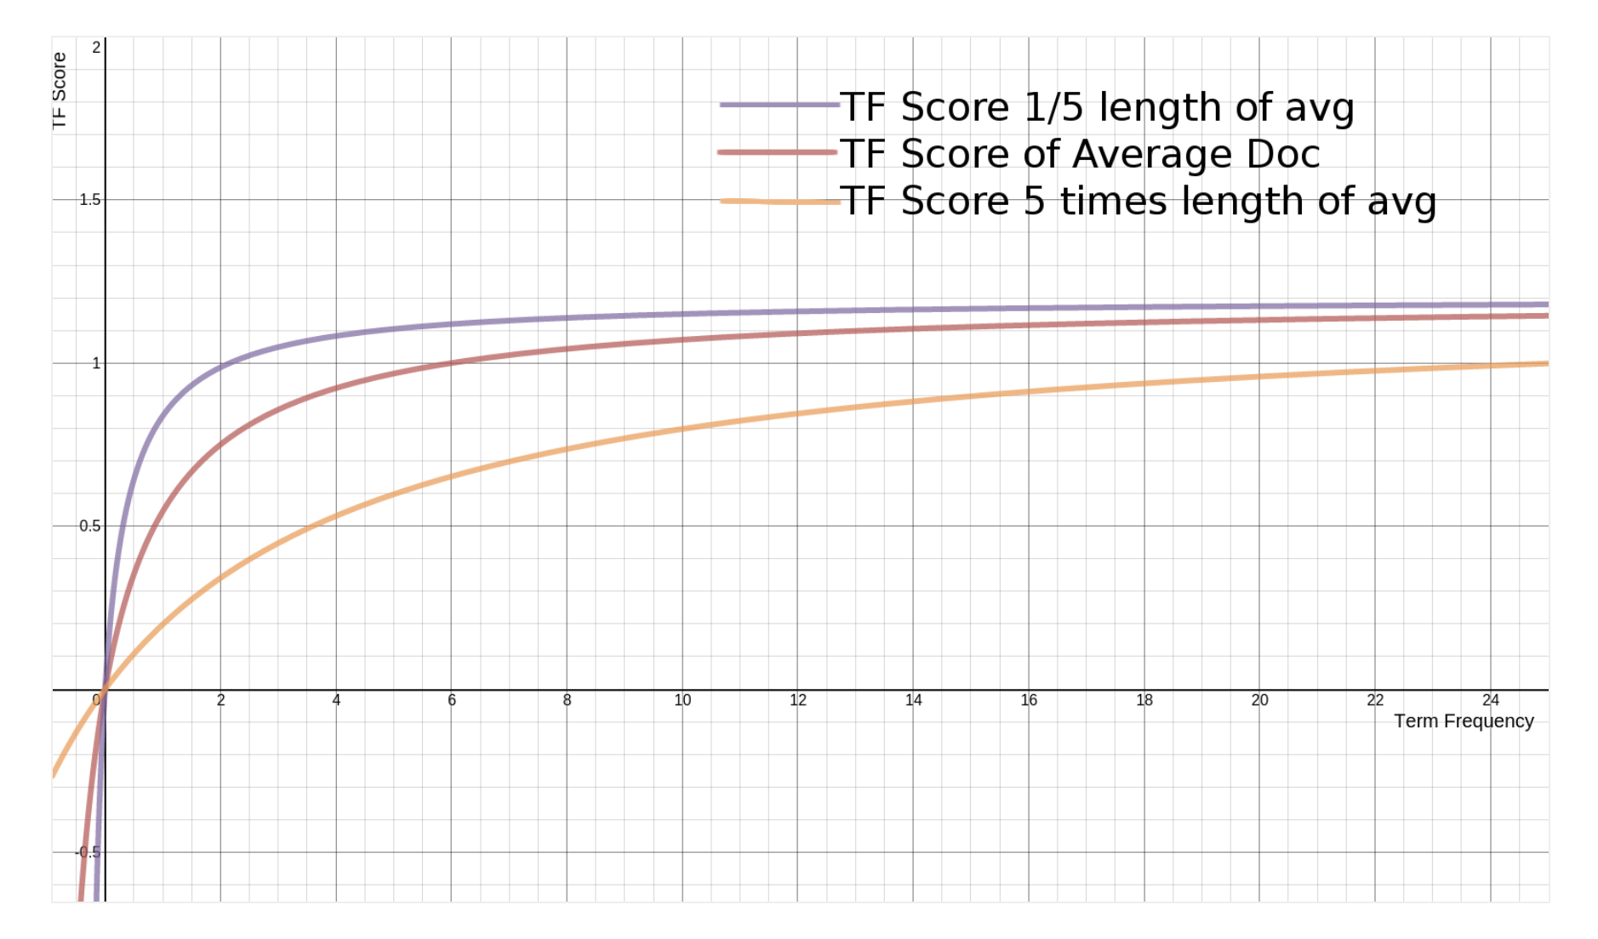
Classical ranking Algorithms - BM25
BM25 variables:
f(qi,D) is “how many times does the ith query term occur in document D?”. The more times the query term(s) occur a document, the higher its score will be.
k1 is a variable which helps determine TF(term frequency) saturation . The higher the value, the slower the saturation.
|D|/d_avg : the more terms in the document that does not match input query, the lower the document's score should be.
b (bound 0.0 ~ 1.0) : b is bigger, the effects of the document length compared to the average length are more amplified.

Slide 14
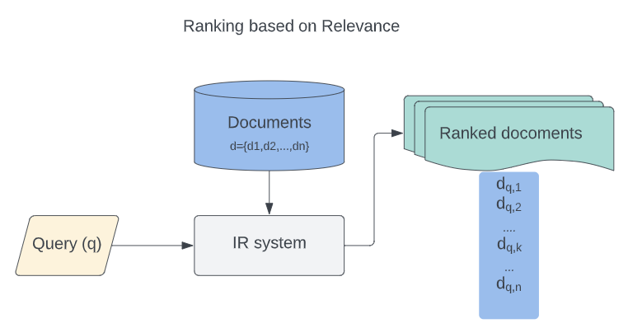
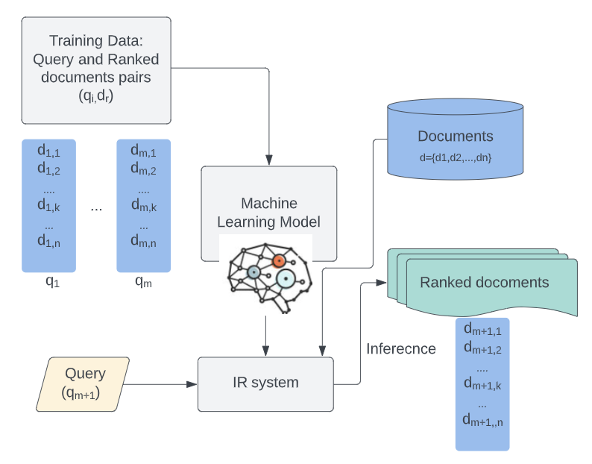
Machine learning ranking Algorithms - overview
Traditional
Machine learning
A Short Introduction to Learning to Rank
Notes:
See
A Short Introduction to Learning to Rank

Slide 15
Machine learning ranking Algorithms - overview
Learning to rank or Machine-learned ranking:
It is the application of machine learning, typically supervised, semi-supervised or reinforcement learning, in the construction of ranking models for information retrieval systems.
Training data consists of lists of items with some partial order specified between items in each list. This order is typically induced by giving a numerical or ordinal score or a binary judgment (e.g. "relevant" or "not relevant") for each item.
The goal of constructing the ranking model is to rank new, unseen lists in a similar way to rankings in the training data.
Approaches: pointwise, pairwise, listwise
Cost functions:

Slide 16
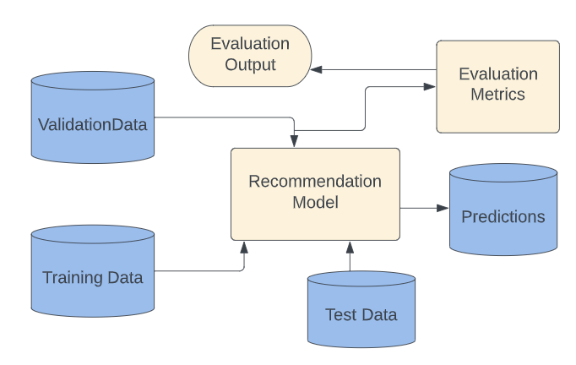
Machine learning ranking Algorithms - evaluation
a training set is fed to a recommendation algorithm which produces a recommendation model that can be used to generate new predictions.
To evaluate the model a held out test set is fed to the learned model where predictions are generated for each query document pair.
3. Predictions with known labels (true value) are then used as an input to the evaluation algorithm to produce evaluation results.
Notes:
See
A Short Introduction to Learning to Rank

Slide 17
Relevance Performance Metrics
Binary assessments:
Precision: fraction of recommended docs that are relevant = P(relevant|recommended)
Recall: fraction of relevant docs that are recommended = P(recommended|relevant)
Precision = TP/(TP+FP) = # of recommendations are relevant/# of items are recommended
Recall = TP/(TP+FN) = # of recommendations are relevant/# of all possible relevant items
 | Relevant | NonRelevant
Recommended | TP | FP
Not-Recommended | FN | TN
Notes:
https://queirozf.com/entries/evaluation-metrics-for-ranking-problems-introduction-and-examples

Slide 18
Ranking Performance Metrics
Binary relevance
Precision@K (P@K)
Recall@K(R@K)
F1@K(F@K)
Mean Average Precision (MAP)
Mean Reciprocal Rank (MRR)
Multiple levels of relevance
Normalized Discounted Cumulative Gain (NDCG)
Notes:
https://queirozf.com/entries/evaluation-metrics-for-ranking-problems-introduction-and-examples

Slide 19
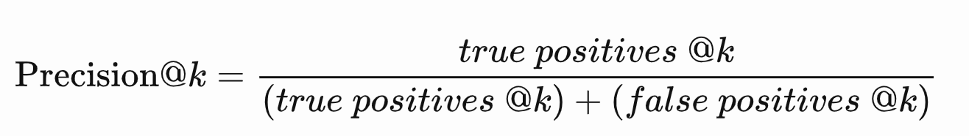

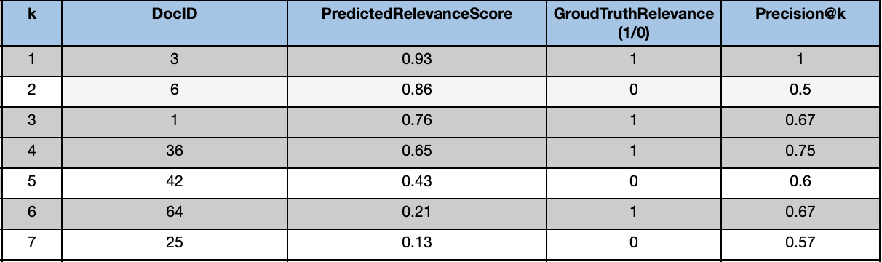
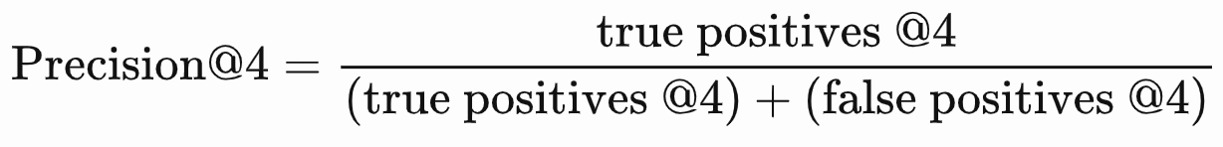
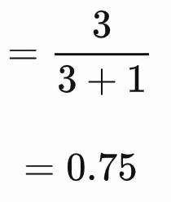
Ranking Performance Metrics
Precision @k: precision evaluated only up to the k-th prediction
Notes:
https://queirozf.com/entries/evaluation-metrics-for-ranking-problems-introduction-and-examples
https://datascience.stackexchange.com/questions/92247/precisionk-and-recallk

Slide 20
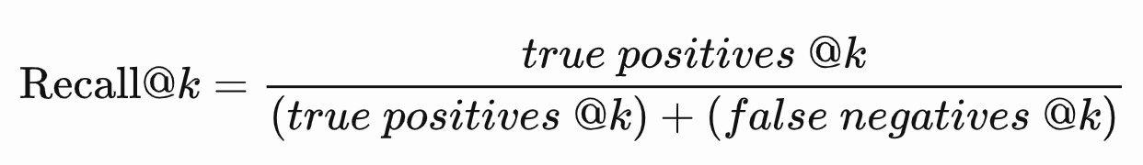
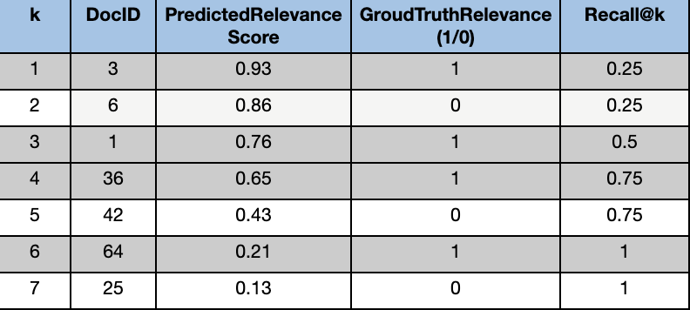
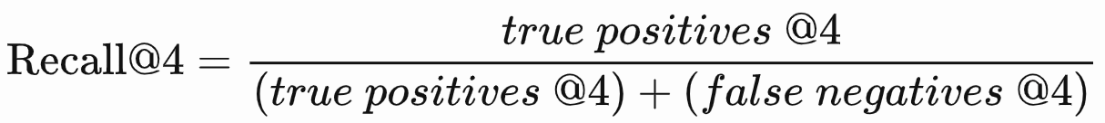
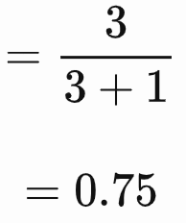
Ranking Performance Metrics
Recall @k: Recall evaluated only up to the k-th prediction
Notes:
https://queirozf.com/entries/evaluation-metrics-for-ranking-problems-introduction-and-examples

Slide 21
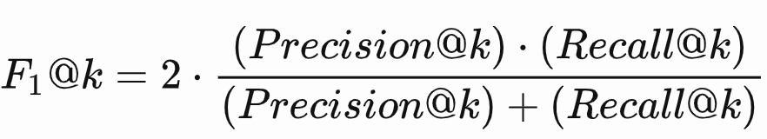

Ranking Performance Metrics
F1 @k : F1 Score ranking only consider the top k prediction
AP(Average Precision): average of precision @k
Notes:
https://queirozf.com/entries/evaluation-metrics-for-ranking-problems-introduction-and-examples

Slide 22
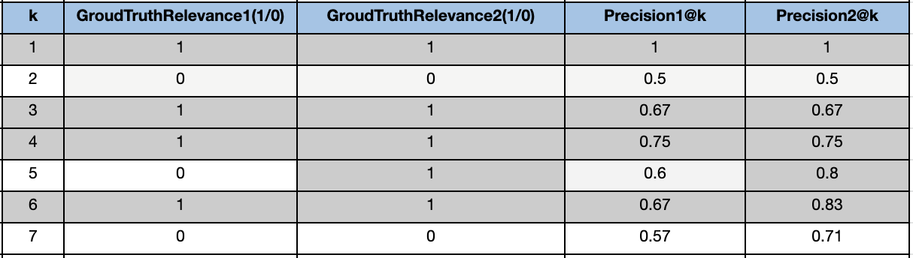
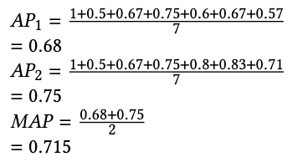
Ranking Performance Metrics
MAP(Mean Average Precision): Average Precision across multiple queries/rankings; or it is a simple average of AP over all examples in a validation set.It is a simple average of AP over all examples in a validation set.
MAP is macro-averaging: each query counts equally
MAP assumes user is interested in finding many relevant documents for each query
Notes:
https://queirozf.com/entries/evaluation-metrics-for-ranking-problems-introduction-and-examples

Slide 23
Ranking Performance Metrics
AP (average precision): measures how correct of a model’s ranked prediction for a single data point
MAP(mean average precision): measures how correct a model’s ranked predictions, on average, over a whole validation set. It is computed as mean of AP over all data points in validation set.
Notes:
https://queirozf.com/entries/evaluation-metrics-for-ranking-problems-introduction-and-examples

Slide 24
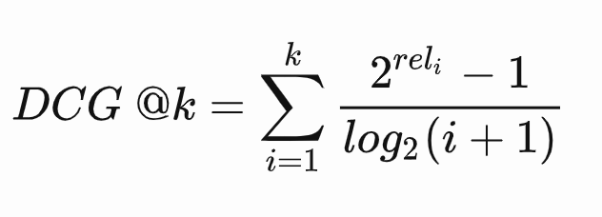
Ranking Performance Metrics
DCG: Discounted Cumulative Gain
where reli is the relevance of the document at index i, reli equals 1 if document i is relevant and 0 otherwise.
One advantage of DCG over other metrics is that it also works if document relevances are a real number. In other words, when each document is not simply relevant/non-relevant , but has a relevance score instead.
Uses graded relevance as a measure of usefulness, or gain, from examining a document
Two assumptions:
Highly relevant documents are more useful than marginally relevant documents
The lower the ranked position of a relevant document, the less useful it is for the user, since it is less likely to be examined
Notes:
https://queirozf.com/entries/evaluation-metrics-for-ranking-problems-introduction-and-examples
https://web.stanford.edu/class/cs276/handouts/lecture8-evaluation_2013_1_per_page.pdf

Slide 25
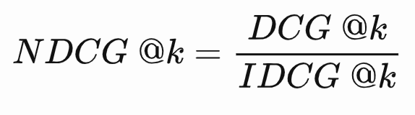
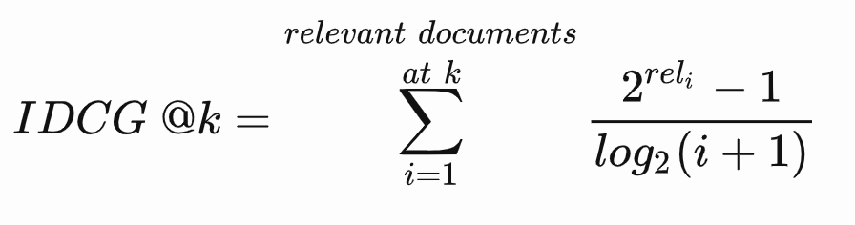
Ranking Performance Metrics
NDCG: Normalized Discounted Cumulative Gain
normalize the DCG score by the maximum DCG at each threshold k
.Where IDCG @k is the best possible value for DCG @k, i.e. the value of DCG for the best possible ranking of relevant documents at threshold k
Notes:
https://queirozf.com/entries/evaluation-metrics-for-ranking-problems-introduction-and-examples

Slide 26
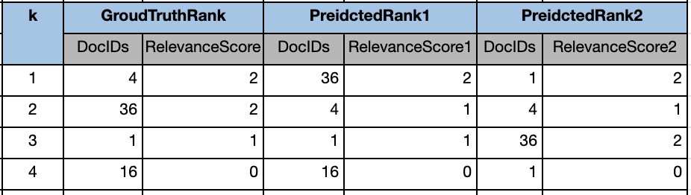
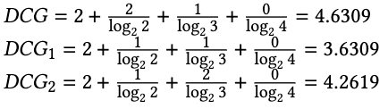
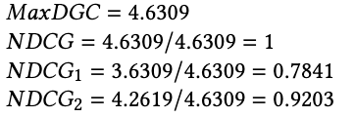
Ranking Performance Metrics
Notes:
https://queirozf.com/entries/evaluation-metrics-for-ranking-problems-introduction-and-examples

Slide 27
Ranking Performance Metrics
NDCG
Normalized value
Applicable to compare between queries
Measure a model performance by average NDCG values for each data point in the validation set.
Notes:
https://queirozf.com/entries/evaluation-metrics-for-ranking-problems-introduction-and-examples

Slide 28

Ranking Performance Metrics: MRR
MRR (Mean Reciprocal Rank) :
evaluate systems that return a ranked list of answers to queries
For a single query, the RR: reciprocal rank , where rank is position of the highest-ranked documents in (i.e. 1,2,3,...,rank, N in returned in a query)
For multiple queries , the Mean Reciprocal Rank is the average of all queries’ reciprocal ranks (RR)
Higher MRRs mean relevant results are close to the top of search results
Lower MRRs indicate poorer search quality, with the right answer farther down in the search results.
Notes:
https://queirozf.com/entries/evaluation-metrics-for-ranking-problems-introduction-and-examples

Slide 29
XGLUE dataset

Slide 30
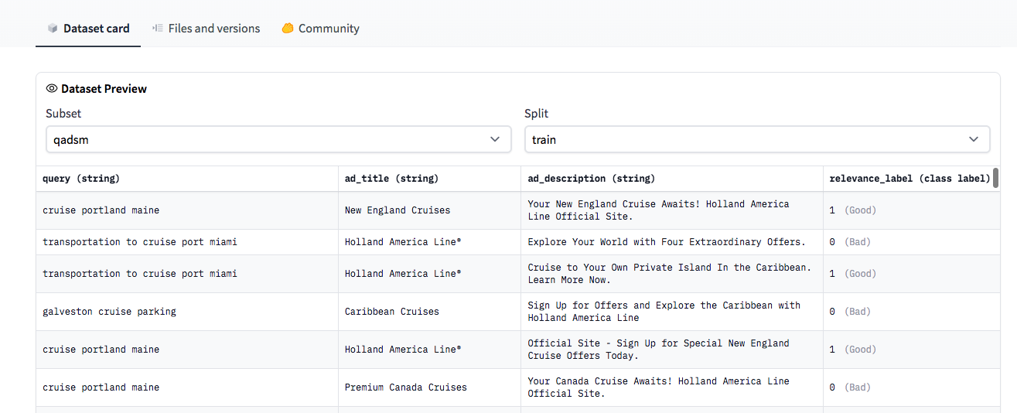
XGLUE - QADSM dataset
QADSM: Microsoft Query-Ad Matching dataset

Slide 31
XGLUE - QADSM dataset
Dataset size:
Train | train | (100000, 4)
Validation | validation.en | (10000, 4)
 | validation.de | (10000, 4)
 | validation.fr | (10000, 4)
test | test.en | (10000, 4)
 | test.de | (10000, 4)
 | test.fr | (10000, 4)

Slide 32
Hands-on session
Tutorial website: Link:
Data Source : XGLUE: A New Benchmark Dataset for Cross-lingual Pre-training, Understanding and Generation
Download: XGLUE (https://huggingface.co/datasets/xglue )
Colab:
Vector Space Model:
BM25:

Slide 33
Thank you!

