Slide 1
From Laser Scan to BIM
Turning a raw 3D scan into structured building elements — automatically
Automated Point-Cloud Post-Processing Pipeline
Demo · DLR Group · Computational Design

Slide 2
How It Works: End-to-End Workflow
One automated pipeline takes the raw scan and outputs model-ready building geometry.
1
2
3
4
5
Input Point Cloud
Point Segmentation (4 classes: floor, ceiling, wall, other)
Ceiling & Floor
Wall
Openings (door & window & opening)
Output: floors, ceilings, walls, doors & windows — as clean, model-ready geometry (BIM)

Slide 3
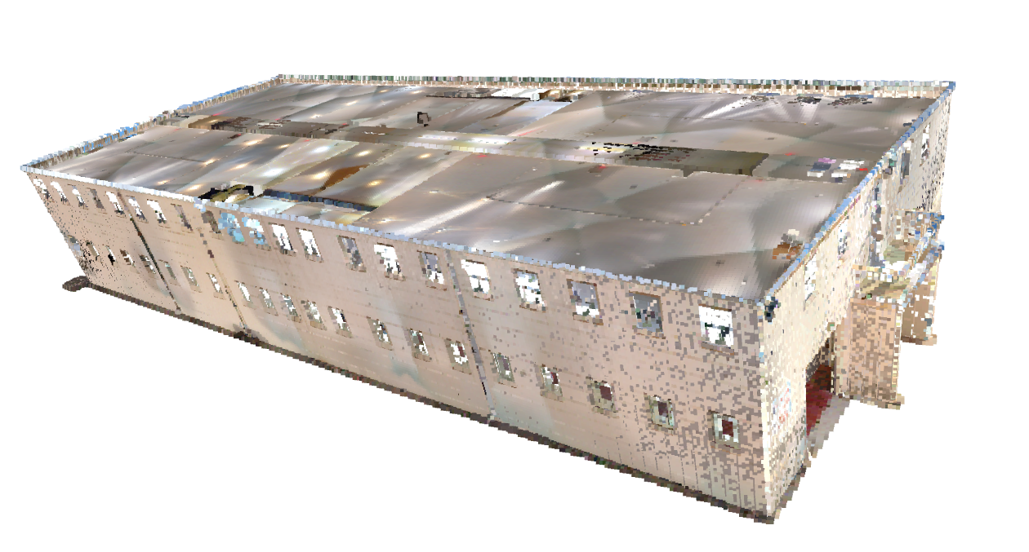
1
STEP 1
Input: The 3D Scan
A laser scanner captures the building as millions of 3D points.
• Each point has a 3D position and color: x y z r g b
• unstructured — just dots, no label yet
WyomingStateFair_Laramie
Notes:
E57 image

Slide 4
2
STEP 2
Understanding the Scan: Segmentation
Revit model labels every point as one of four basic types.
• PointNet++ model
• Every point is sorted into Floor, Ceiling, Wall, or Other
The four point types
Floor
Ceiling
Wall
Other
Notes:
Model: pointnet++

Slide 5
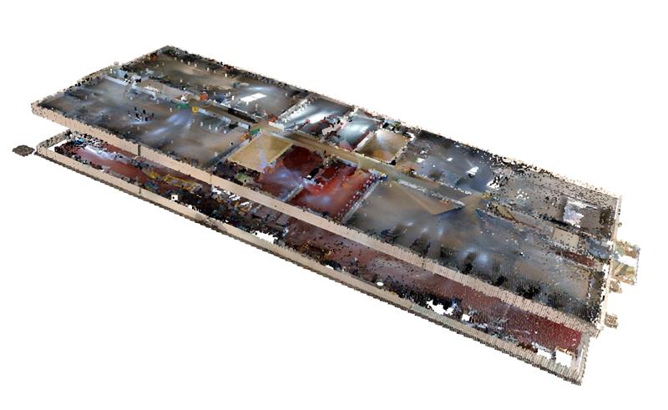
3
STEP 3
Floors & Ceilings
Turn labeled points into clean, flat floor and ceiling surfaces.
• DBSCAN clustering
• RANSAC plane fitting
• Convex hull for boundary edge points
• Replaces scattered dots with clean, simple shapes
# DBSCAN EPS = 0.5
MIN_SAMPLES = 10
# Floor RANSAC DIS_THR_F = 1
RANSAC_N_F = 10
NUM_ITER_F = 1000
ALPHA_F = 1
# Ceiling RANSAC DIS_THR_C = 4
RANSAC_N_C = 10
NUM_ITER_C = 1000
ALPHA_C = 1
PROJECTED_BINS = 300
RESIZE_WIDTH = 400 INT_THR = 35 SCORE_THR = 0.55 VERT_THR = 10 HORI_THR = 0.1 BUFFER_THR = 2
Notes:
Plane fitting (RANSAC), convex hull alphashape

Slide 6
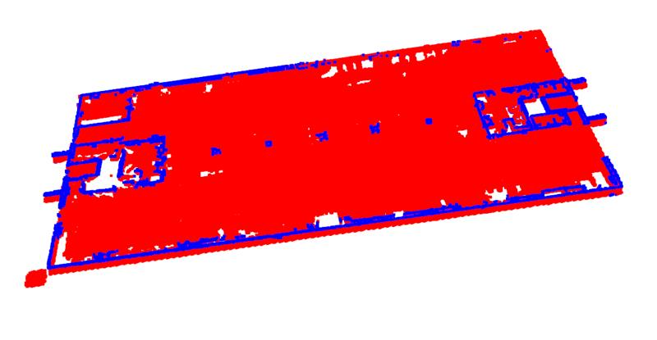
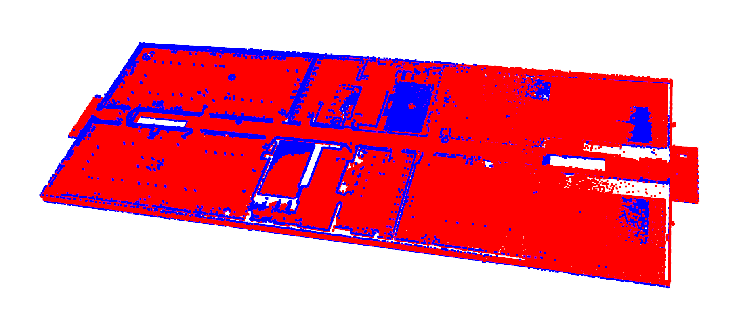
3
STEP 3
Floors & Ceilings
Turn labeled points into clean, flat floor and ceiling surfaces.
• DBSCAN clustering
• RANSCAN plane fitting
• Convex hull for boundary edge points
• Replaces scattered dots with clean, simple shapes
Notes:
Plane fitting (RANSAC), convex hull alphashape

Slide 7
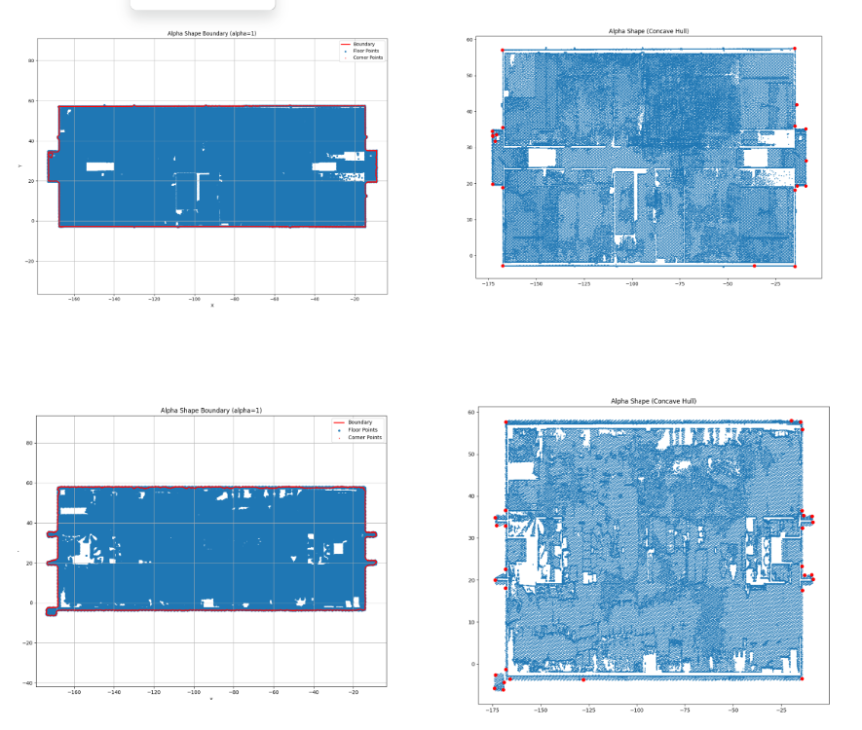
3
STEP 3
Floors & Ceilings
Turn labeled points into clean, flat floor and ceiling surfaces.
• DBSCAN clustering
• RANSCAN plane fitting
• Convex hull for boundary edge points
• Replaces scattered dots with clean, simple shapes
Notes:
Plane fitting (RANSAC), convex hull alphashape

Slide 8
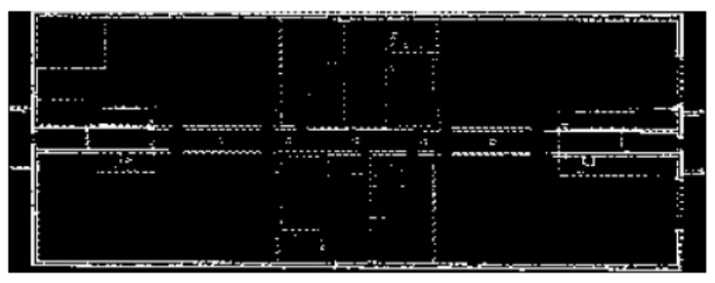
4
STEP 4
Walls
Reconstruct the room layout from the wall points.
• project points to floor and create 2D histogram image
• line segmentation
• separate vertical and horizontal lines
• merge adjacent lines
Notes:
Line segmentation model

Slide 9
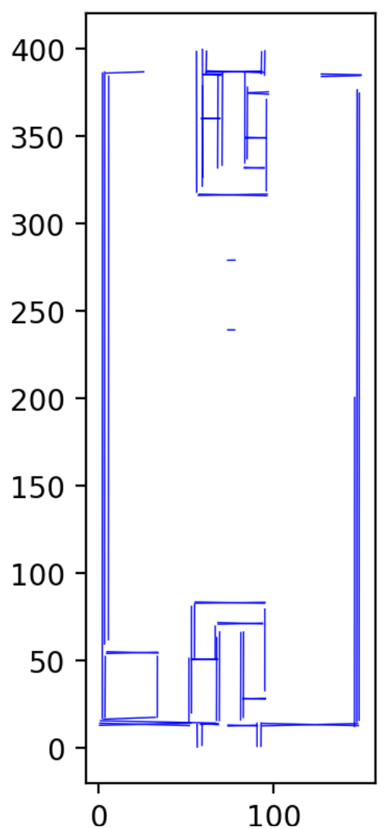
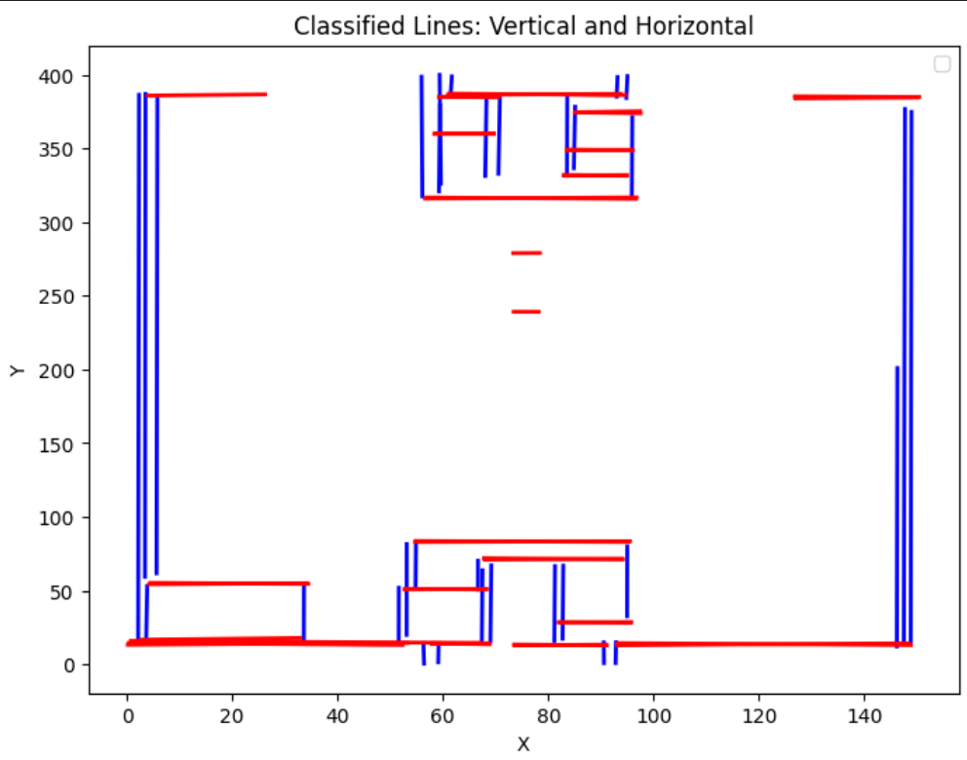
4
STEP 4
Walls
Reconstruct the room layout from the wall points.
• project points to floor and create 2D histogram image
• line segmentation
• separate vertical and horizontal lines
• merge adjacent lines
Notes:
Line segmentation model

Slide 10
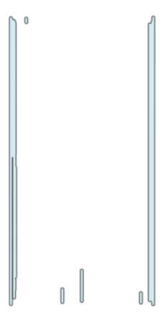
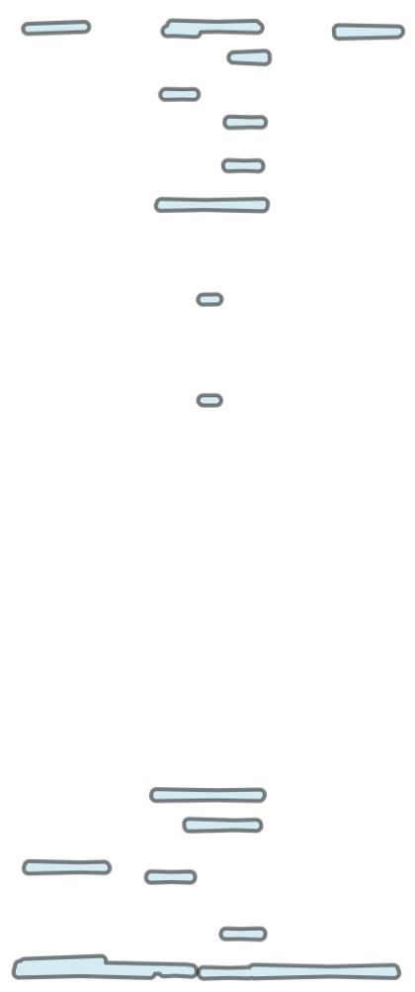
4
STEP 4
Walls
Reconstruct the room layout from the wall points.
• project points to floor and create 2D histogram image
• line segmentation
• separate vertical and horizontal lines
• merge adjacent lines
Notes:
Line segmentation model

Slide 11
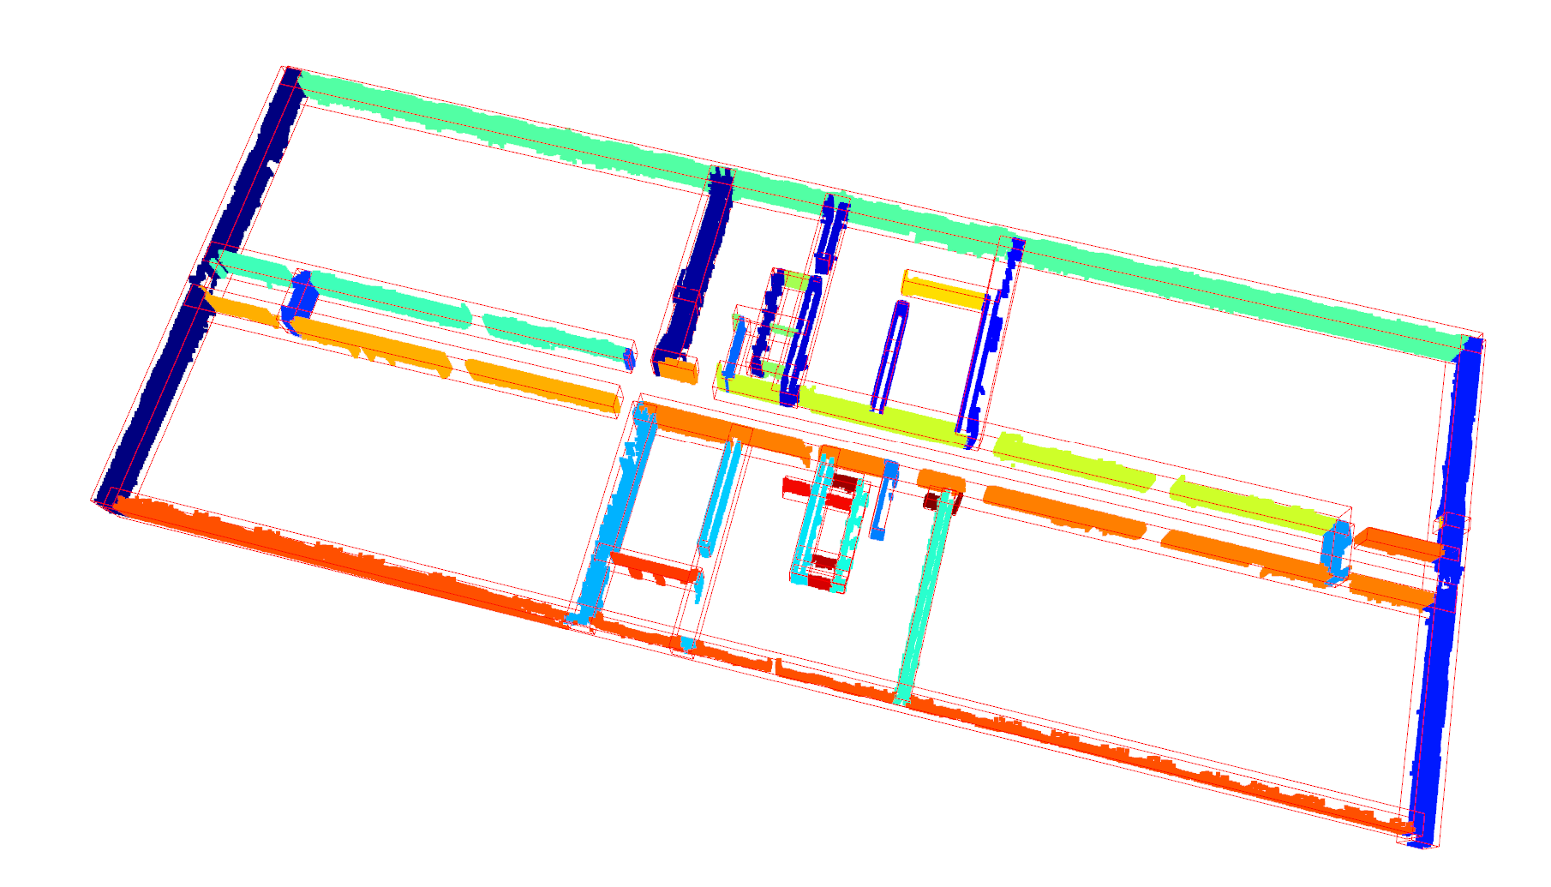
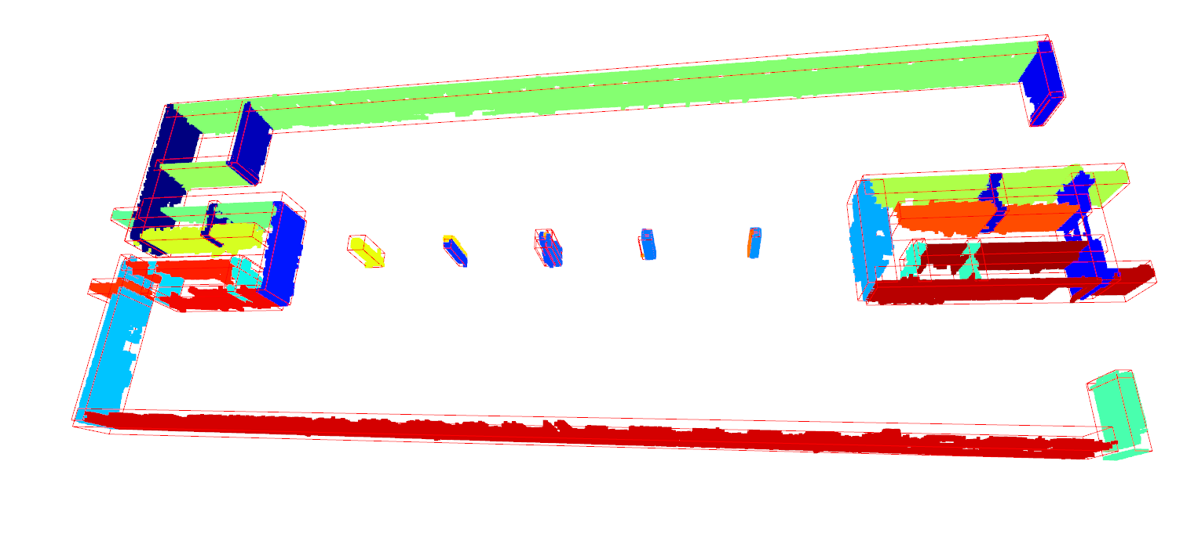
4
STEP 4
Walls
Reconstruct the room layout from the wall points.
• project points to floor and create 2D histogram image
• line segmentation
• separate vertical and horizontal lines
• merge adjacent lines
Notes:
Line segmentation model

Slide 12
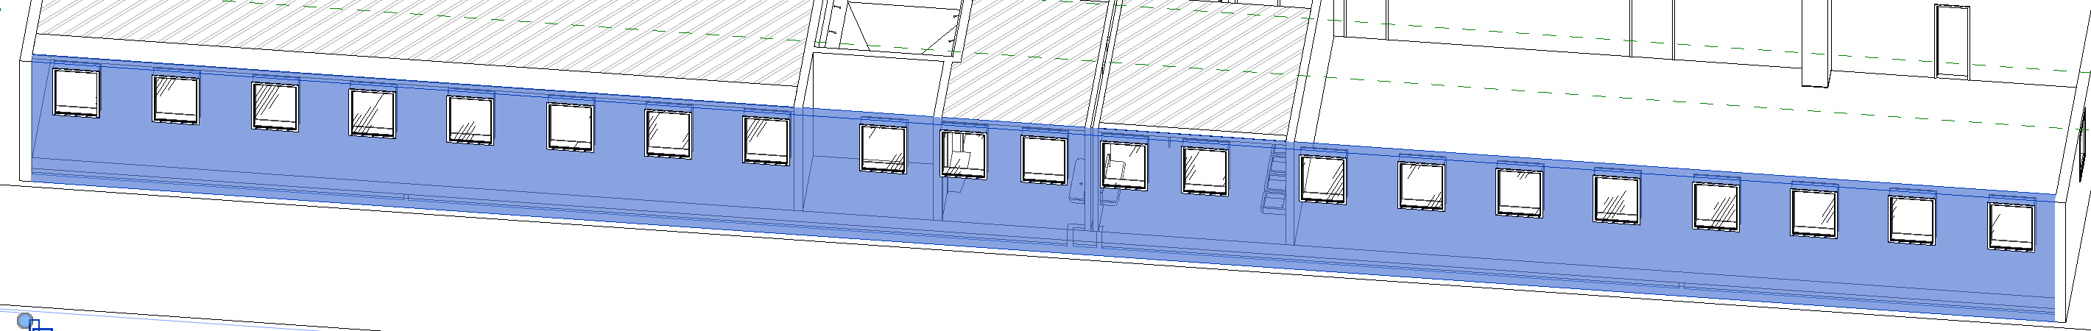
5
STEP 5
Doors & Windows & Openings
Find openings on each predicted wall
• GroundingDino model: image + text prompt
• image: true color/projected histogram
• text prompt: window/door/opening
Notes:
Groundingdino, log(count) image histogram

Slide 13
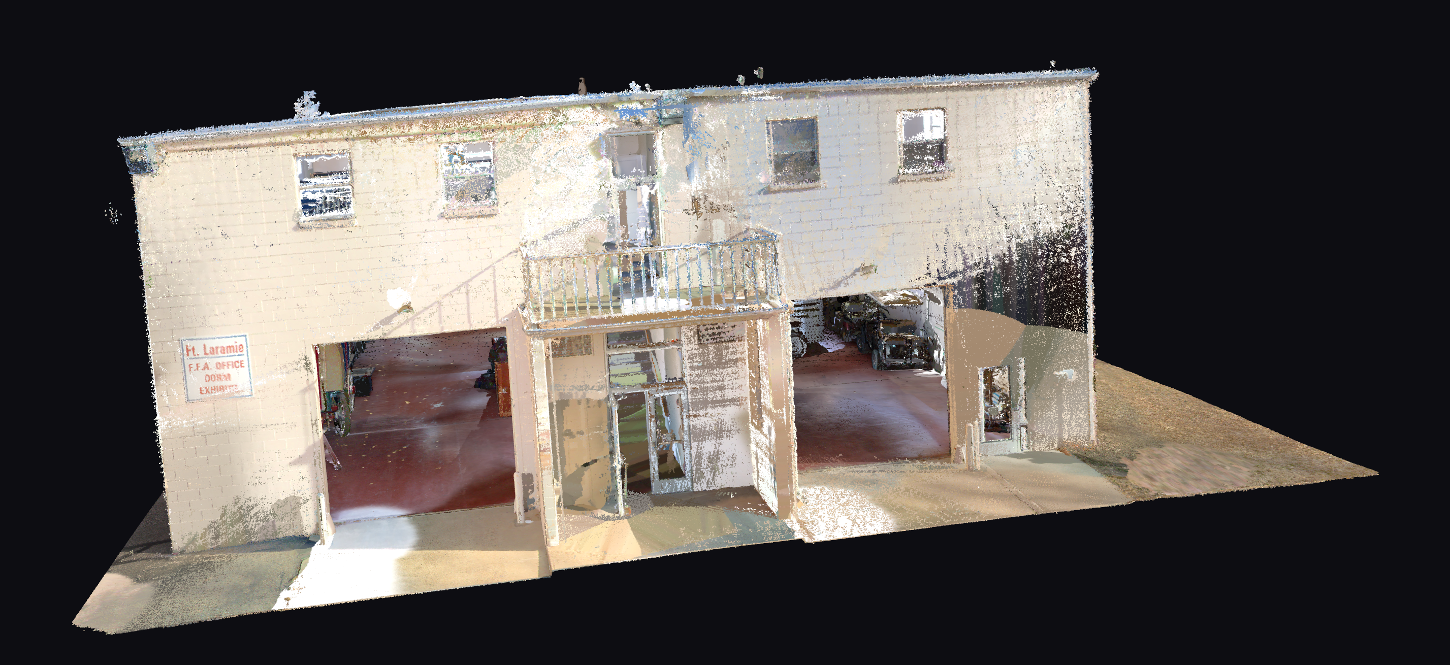

Slide 14
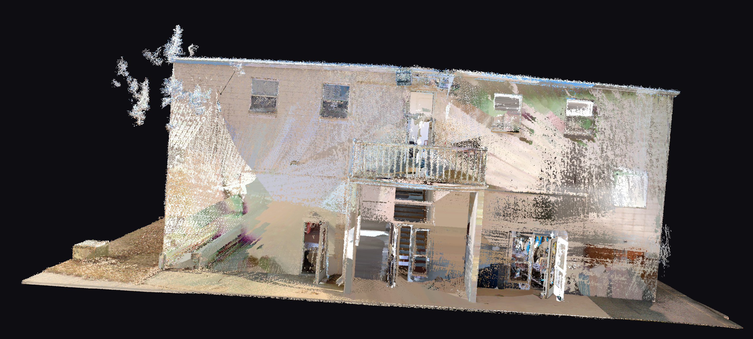

Slide 15
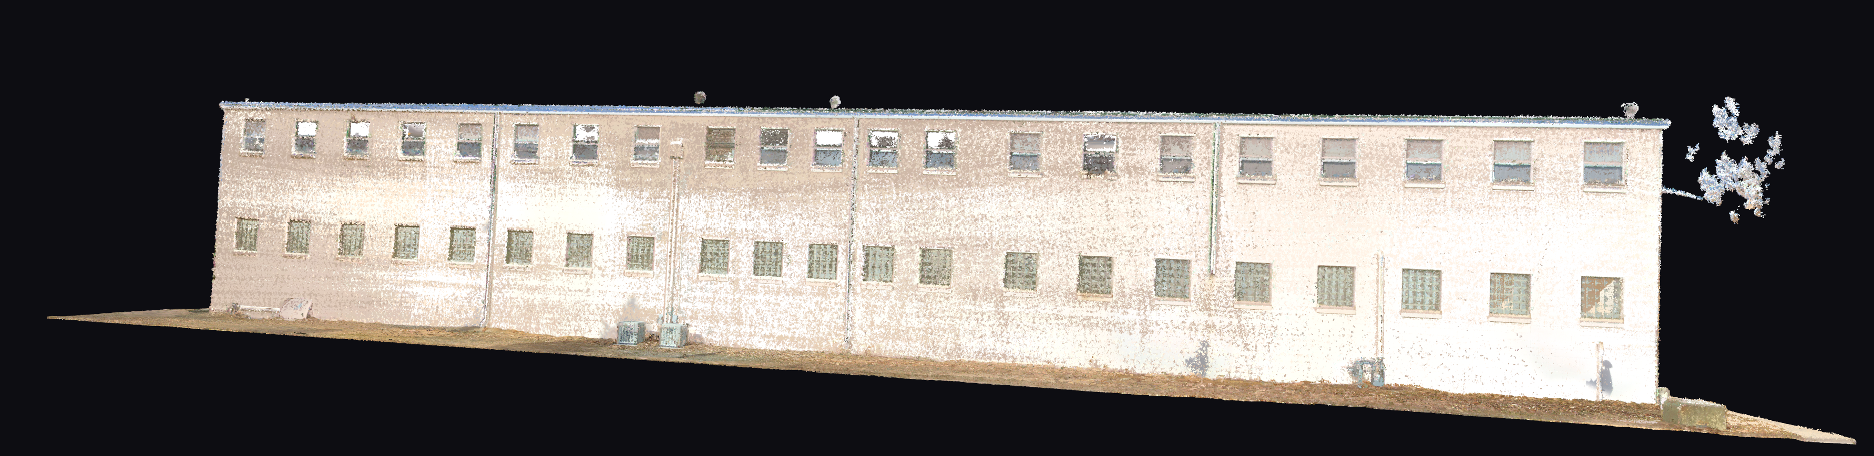

Slide 16
