Slide 1
Digital Portfolio
STUDENT NAME: SARVESH D L
REGISTER NO AND NMID: 2428B0350 /9AC7DCE380B431996B848A5553D4CF51
DEPARTMENT: B.Sc.COMPUTER SCIENCE WITH DATA ANALYTICS
COLLEGE: KPR COLLEGE OF ARTS SCIENCE AND RESEARCH
UNIVERSITY:BARATHIYAR UNIVERSITY

Slide 2
PROJECT TITLE:
In the rapidly evolving digital era, technology trends change faster than ever before. Students, professionals, and industries often face challenges in identifying which technologies are most relevant today and which will shape the future. Without a clear understanding of these trends, there is a risk of outdated skills and missed opportunities. This project aims to explore favorite technologies of the present and analyze future trends that will drive innovation, efficiency, and growth.

Slide 3


AGENDA
Problem Statement
Project Overview
End Users
Tools and Technologies
Portfolio design and Layout
Features and Functionality
Results and Screenshots
Conclusion
Github Link
3/21/2024 Annual Review

Slide 4

PROBLEM STATEMENT
In today’s fast-growing digital world, technology is advancing at an unprecedented rate. New tools, frameworks, and innovations are continuously being introduced, making it difficult for individuals, students, and industries to decide which technologies to adopt and which trends to prepare for in the future. Without proper awareness, there is a risk of relying on outdated skills, reduced competitiveness, and missed opportunities in education, research, and careers.This project focuses on identifying the most popular and favorite technologies of the present while also analyzing emerging future trends that have the potential to transform industries, improve efficiency, and create new possibilities. It aims to bridge the gap between current knowledge and future demands, helping learners and professionals stay updated and future-ready.

Slide 5

PROJECT OVERVIEW:
This project explores the most widely used and favorite technologies of the present while examining the future trends that are expected to revolutionize industries and society. It highlights technologies such as Artificial Intelligence, Data Science, Cloud Computing, Cybersecurity, and Web Development, which have become highly relevant today. At the same time, it analyzes emerging trends like Quantum Computing, Extended Reality (AR/VR), 5G, Blockchain, and Internet of Things (IoT) that are shaping the future.The aim of this project is to provide insights into how these technologies impact education, business, healthcare, and everyday life. By studying both current technologies and future possibilities, this project enables learners, professionals, and organizations to prepare for upcoming challenges, adopt innovation, and remain competitive in a rapidly changing digital landscape.

Slide 6

WHO ARE THE END USERS?
Students & Learners – to understand current technologies and prepare for future skills.
Educators & Researchers – to explore emerging innovations and integrate them into academics.
IT Professionals & Developers – to upgrade skills and adapt to new tools and frameworks.
Industries & Organizations – to adopt relevant technologies for growth and competitiveness.
General Public – to gain awareness of trends that influence daily life and society.

Slide 7

TOOLS AND TECHNIQUES
Programming Languages: Python, Java, C++, JavaScript
Web Technologies: HTML, CSS, React, Node.js
Data & AI Tools: TensorFlow, Scikit-learn, R, Tableau
Cloud Platforms: AWS, Microsoft Azure, Google Cloud
Databases: MySQL, PostgreSQL, MongoDB
Emerging Tech Tools: Blockchain frameworks, AR/VR kits, IoT devices
Techniques: Data Analysis, Machine Learning, Cybersecurity practices, Automation

Slide 8
POTFOLIO DESIGN AND LAYOUT
Modern Interface – clean, attractive, and easy to navigate.
Consistent Theme – uniform colors, fonts, and visual style.
Categorized Sections – separate parts for current technologies and future trends.
Visual Representation – use of charts, infographics, and icons.
Interactive Elements – links, demos, or sample visuals of technologies.
Responsive Layout – adaptable for presentations, web, and mobile view.
Highlighting Impact – focus on how each technology contributes to present and future growth.
8

Slide 9
FEATURES AND FUNCTIONALITY
Highlight of Favorite Technologies – overview of the most used tools and platforms today.
Future Trend Analysis – insights into upcoming innovations shaping industries.
Comparative View – differences between present technologies and future possibilities.
Visual Demonstrations – screenshots, diagrams, and real-world use cases.
User-Friendly Structure – simple layout for easy understanding.
Knowledge Integration – combining theoretical concepts with practical examples.
Scalability – adaptable for research, learning, or organizational use.

Slide 10

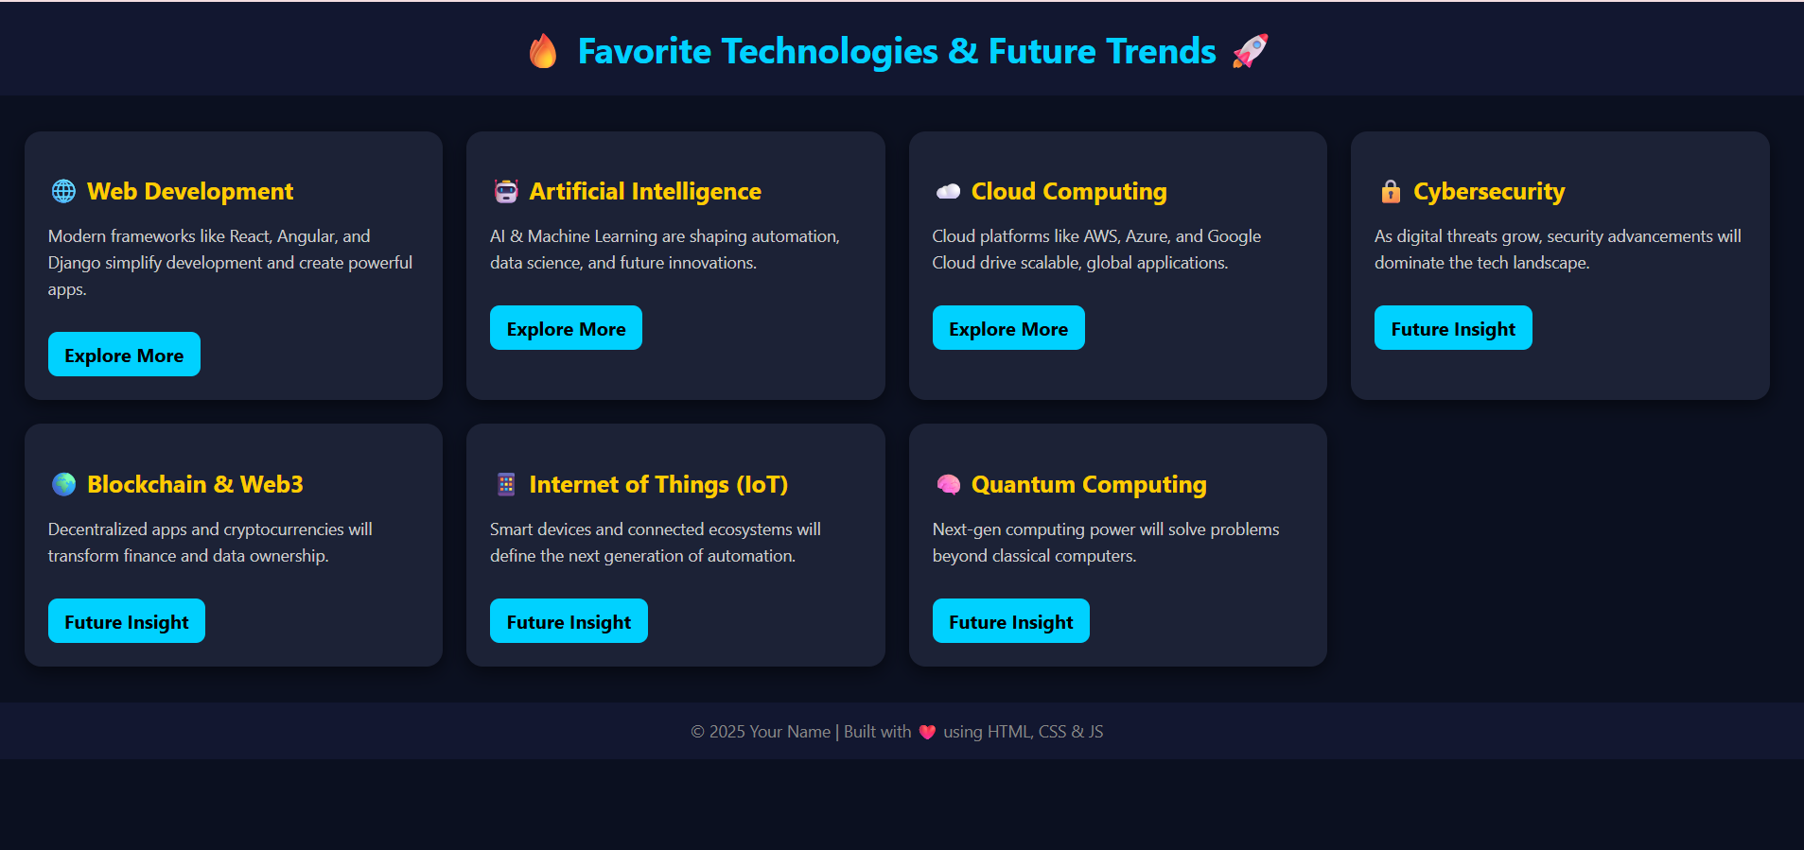
RESULTS AND SCREENSHOTS
Identified the most popular technologies in current use.
Highlighted key future trends influencing industries.
Provided insights into skill development and career readiness.
Showcased how emerging technologies can solve real-world problems.
Enhanced awareness of technology adoption for learners and professionals.
3/21/2024 Annual Review
10

Slide 11
CONCLUSION
Technology is evolving rapidly, creating new opportunities and challenges.
Current favorite technologies like AI, Data Science, and Cloud Computing are shaping today’s world.
Future trends such as Quantum Computing, AR/VR, Blockchain, and IoT will drive innovation in the coming years.
Awareness and adoption of these technologies are essential for students, professionals, and industries to remain competitive.
This project bridges the gap between present tools and future possibilities, ensuring readiness for a technology-driven future.
11

Slide 12
GITHUB LINK:
https://sarvesh28b24-svg.github.io/sarvesh/

