Slide 1


Evaluating Recommender System Stability with Influence-Guided Fuzzing
David Shriver¹, Sebastian Elbaum¹, Matthew B. Dwyer¹, David S. Rosenblum²
¹University of Virginia ²National University of Singapore

Slide 2






Instability
A small dataset change can lead to large recommendation changes
Data
Algorithm
Recommender System
Data + Δ
Algorithm
Recommender System

Slide 3
Challenge
How can we find small dataset changes that induce drastic recommendation changes?
Data
Algorithm
Dataset
Changes
Recommender System

Slide 4
Insight
We can infer an approximate model of the implicit relationships learned by the algorithm
Data
Algorithm
Model
Infer
Recommender System
Approximate Model

Slide 5
Solution
We can leverage inferred models to generate dataset modifications that are more likely to induce instability
Data
Algorithm
Model
Infer
Recommender System
Guided Fuzzing
Approximate Model

Slide 6









Recommender Systems
Entertainment
News
E-commerce
Social Networking
Safe drug prescriptions
Aircraft collision avoidance

Slide 7

Core Components
Data
Algorithm
1
2
3
4
Recommender System

Slide 8



Intuition for Stability
Adding a single new rating
changes the recommendations for every user
Alice
Bob
Carol
= Rating Value
= Top recommended item

Slide 9
Insight
Data
Algorithm
Model
Recommender System
Approximate Model

Slide 10


Our Approach to Evaluating Stability
1
Oracle
Stability
Data
Algorithm
2
1
3
2
1
4
3
2
4
3
Recommender System
4
Influence Modelling
Models
Dataset Fuzzing
Modified Data
Algorithm
1
1
2
2
1
3
3
2
4
4
3
Updated Recommender System
4

Slide 11





Inferring Influence
D
A
Oracle
Stability
Recommender System
Infer Influence
M
Fuzz Dataset
D’
A
Recommender System
User
Item
Attribute
Rating

Slide 12
Inferring Influence
D
A
Oracle
Stability
Recommender System
Infer Influence
M
User
Fuzz Dataset
D’
A
Recommender System
Influence Score
Alice
1
Bob
2
Carol
0
2
User
Alice
has rated
3
movies
Carol
, of which
2 are
0 are
Bob
1 is
recommended to other users

Slide 13



Fuzzing Datasets
D
A
Oracle
Stability
Recommender System
Infer Influence
M
Fuzz Dataset
D’
A
Recommender System
Influence Type:
User
Item
Attribute
Rating
Modification Type:
Add
Remove
Change

Slide 14








Fuzzing Datasets
D
A
Oracle
Stability
Recommender System
Infer Influence
M
Fuzz Dataset
D’
A
Recommender System

Slide 15
Fuzzing Datasets
D
A
Oracle
Stability
Recommender System
Infer Influence
M
Fuzz Dataset
D’
A
Recommender System
Influence Score
Alice
1
Bob
2
Carol
0
Bob has the highest influence score.
We add a new random rating for Bob.

Slide 16
Oracle
D
A
Oracle
Stability
Recommender System
Infer Influence
M
Fuzz Dataset
D’
A
Recommender System
1
2
Stability
Compute Distance
3
Compute
Distance
Threshold
4
TopOut
1
2
Stability Oracle
3
4

Slide 17

Oracle
D
A
Oracle
Stability
Recommender System
Infer Influence
M
TopOut
Fuzz Dataset
D’
A
Recommender System
TopOut Distance = 0
TopOut Distance = 1

Slide 18




Study
4 Recommender Algorithms
How effective are influence models for guiding the generation of instability inducing modifications?
MovieLens dataset
100,000 ratings
3 Baseline Heuristics
3 Modification Set Sizes
1, 10, 100

Slide 19
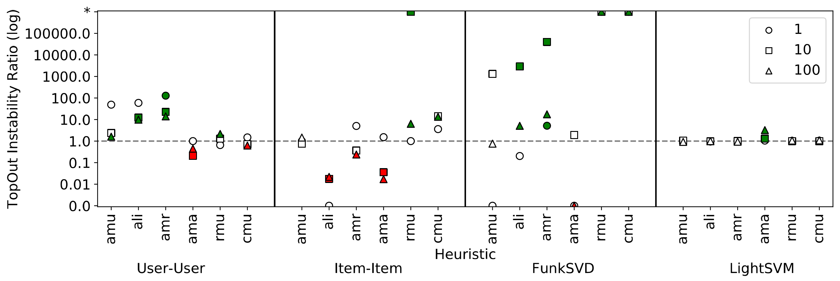
Results

Slide 20
Influence-guided fuzzing is more effective than random fuzzing, when using an appropriate influence model

Slide 21
Study
Data
How can we choose an appropriate influence model when the recommender algorithm is a black box?
Round Robin Selection
Fuzz One Modification
Influence-Guided Fuzzing Heuristics
Repeat Until Budget Depleted

Slide 22
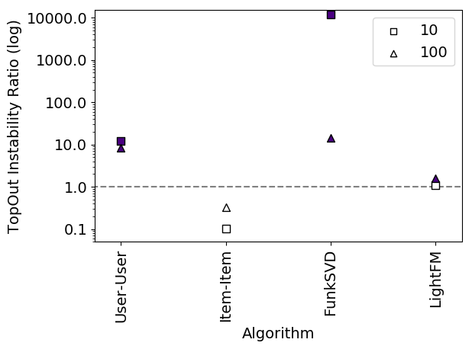
Results

Slide 23
Using a portfolio approach is effective for fuzzing modification sets that induce significant change

Slide 24
Questions?

