Slide 1
UX/UI 정기 세미나

Slide 2
윈도우 매니저
MacOS의 Paralles Desktop (가상환경 플랫폼)에서
Ubuntu Server 16.04로 실행
X11 + openbox / Wayland + weston
벤치마크는 x11perf로 실행(circle / dot / rectangle)

Slide 3
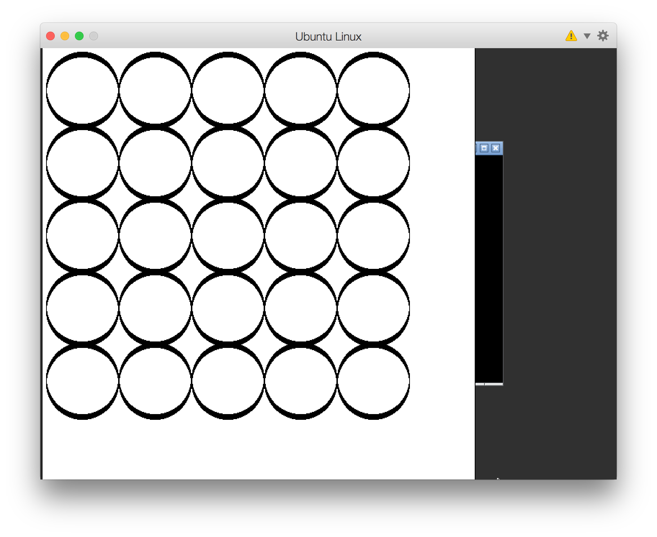
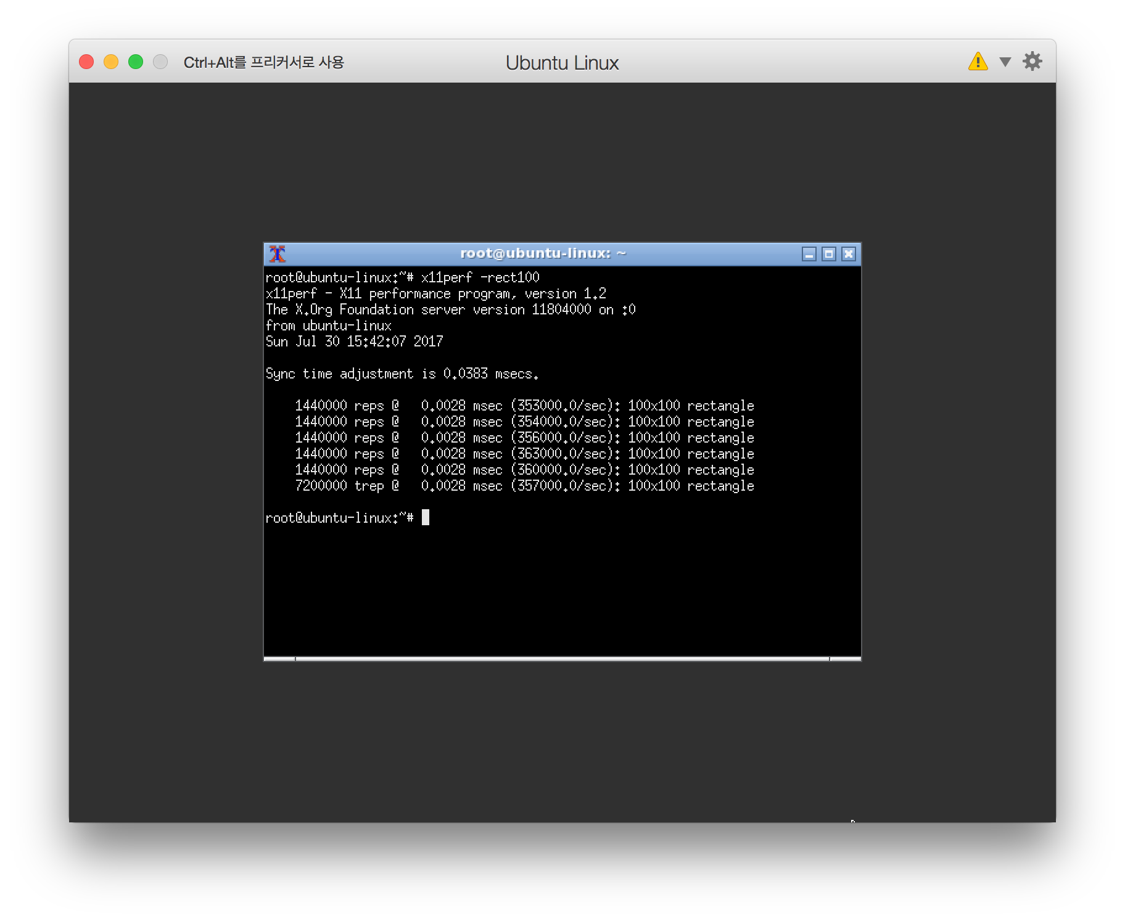
X11 / openbox (Ubuntu Server 16.04)

Slide 4
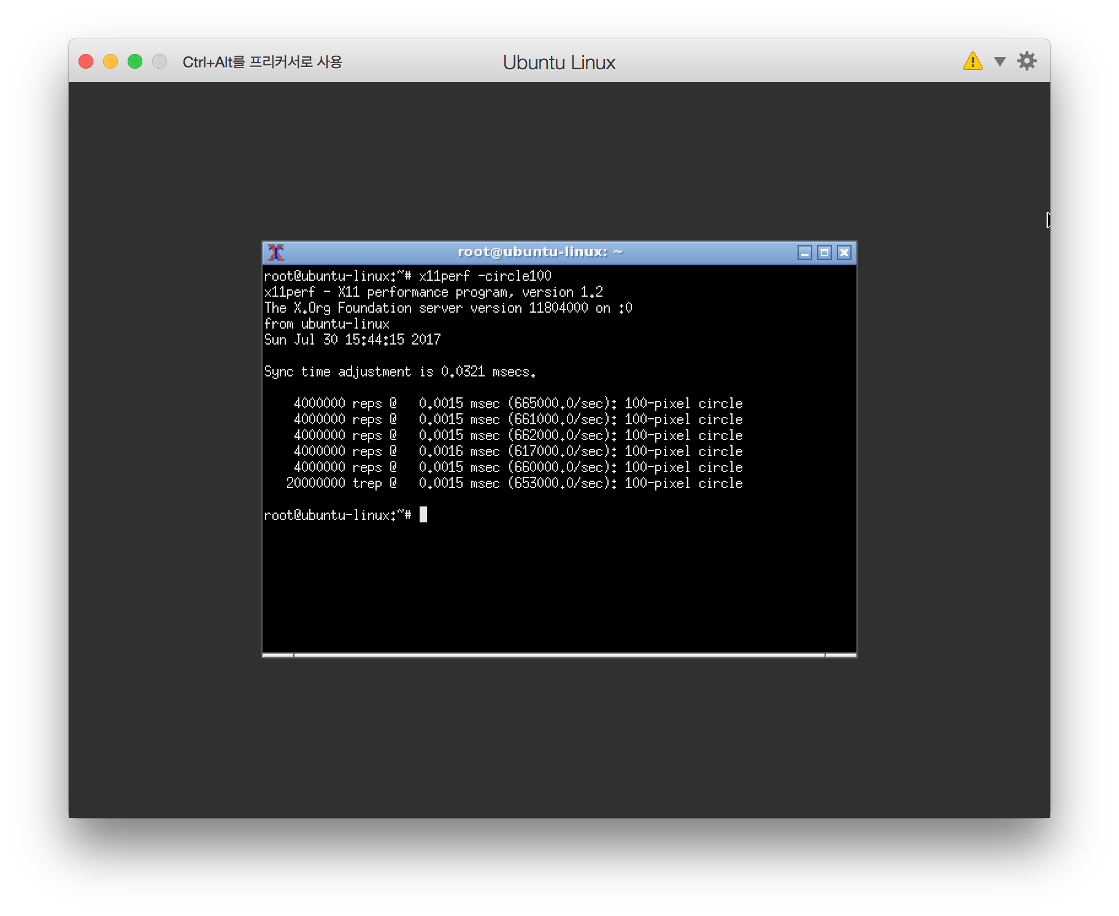
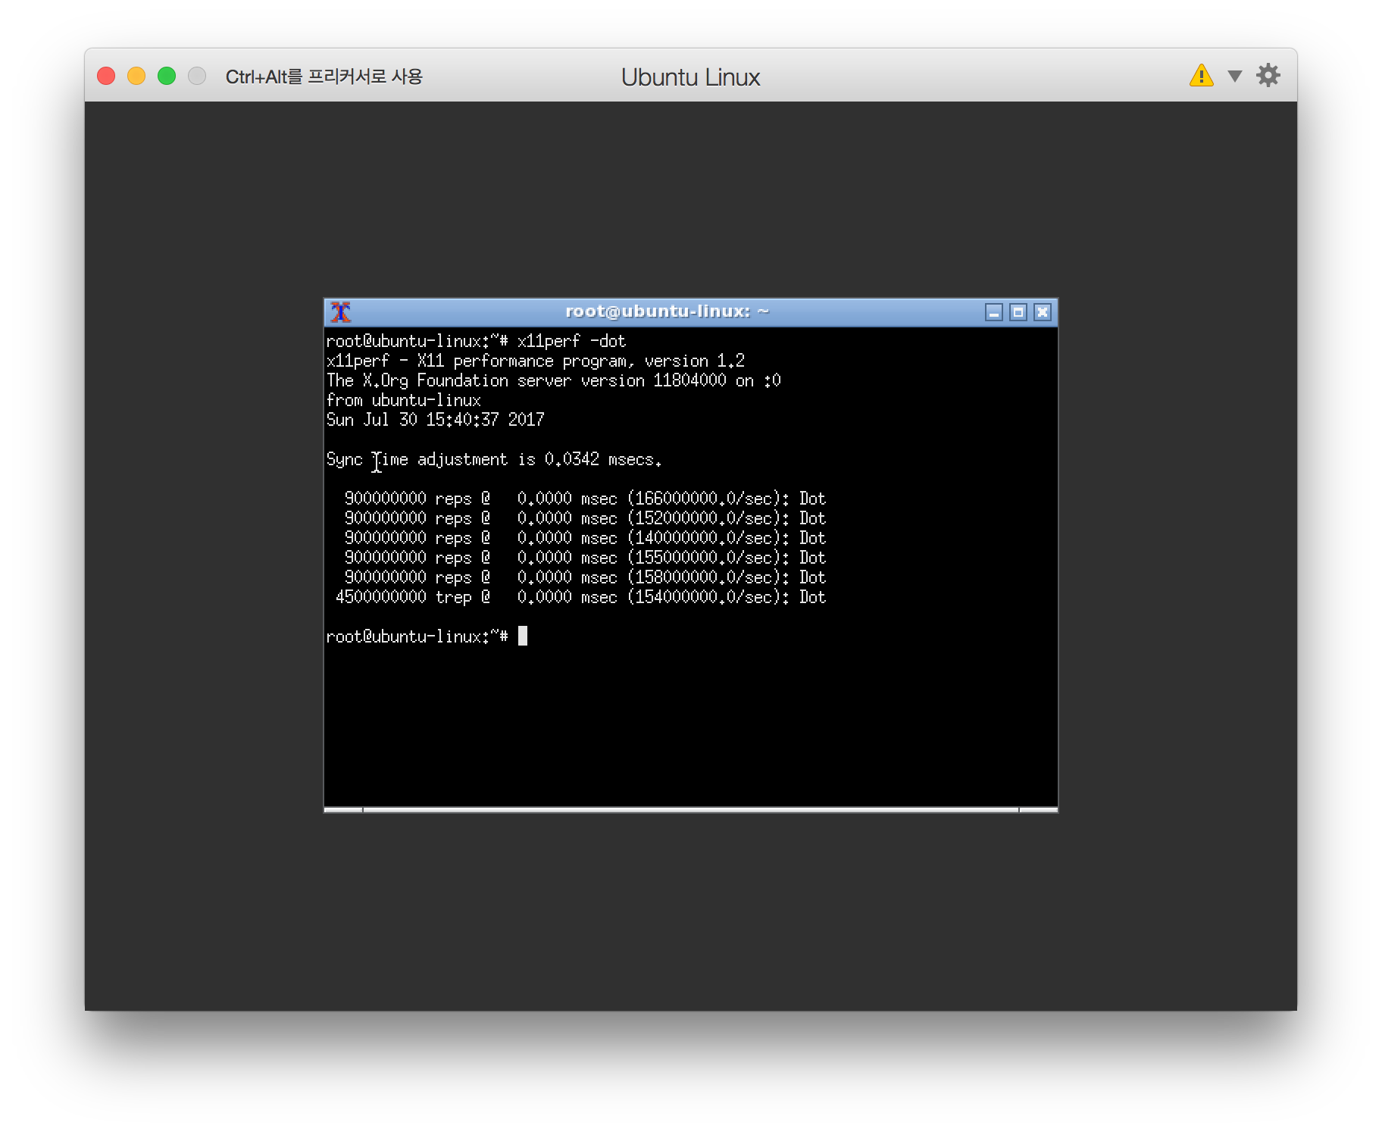
X11 / openbox

Slide 5
Wayland / weston (Ubuntu 16.04)
sudo apt-add-repository ppa:wayland.admin/daily-builds
sudo apt-get update && sudo apt-get install weston xwayland
https://github.com/wayland-project/wayland-build-tools

Slide 6
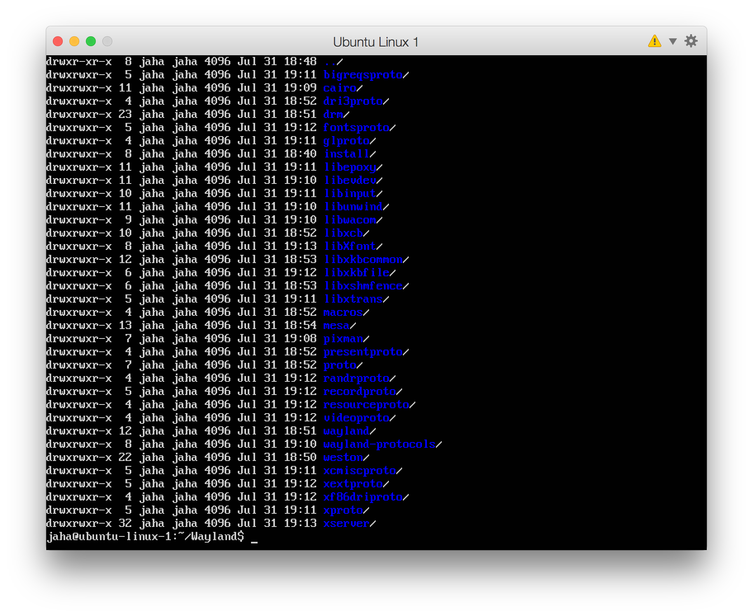
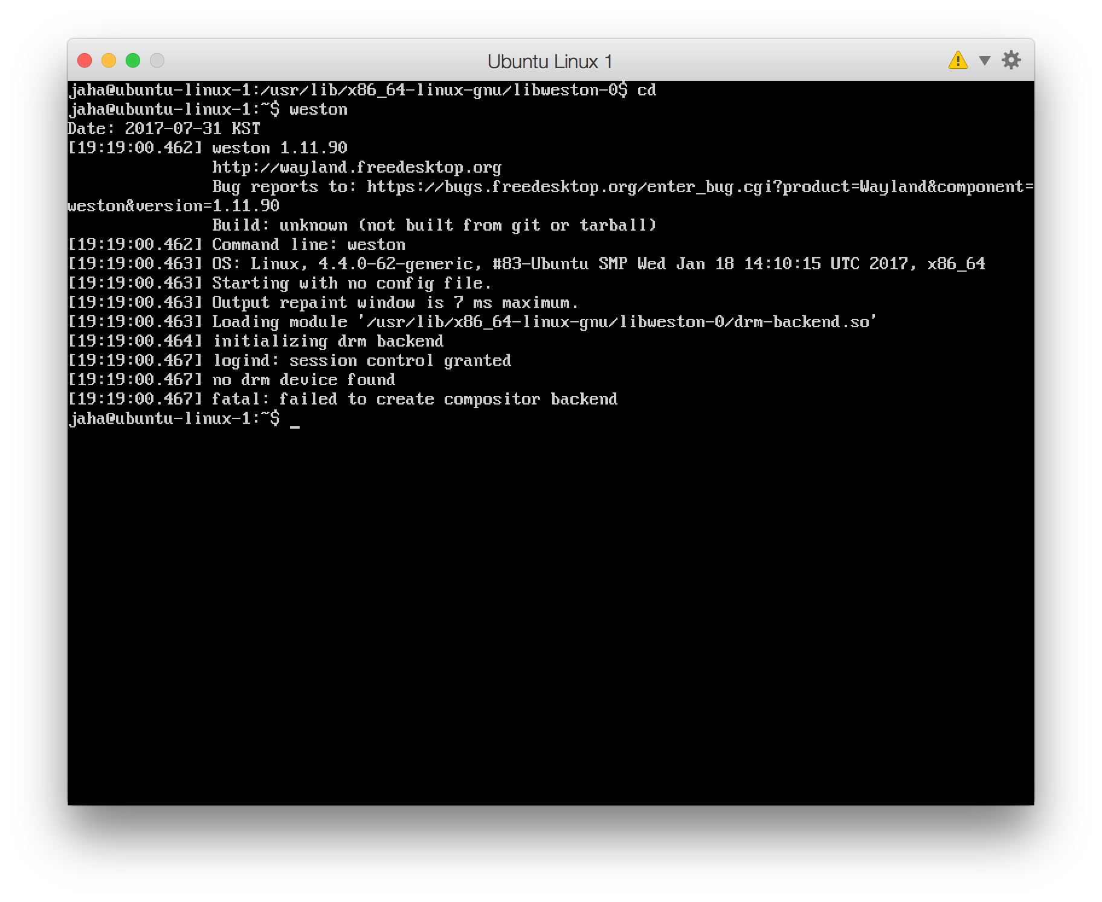
Wayland / weston
no drm device found
failed to create compositor backend

