Slide 1
Quality framework overview

Slide 2
Current Status
Limitted resource
Refactor frequency

Slide 3

automatic code review tool

Slide 4

Unit test

Slide 5

Functional test

Slide 6
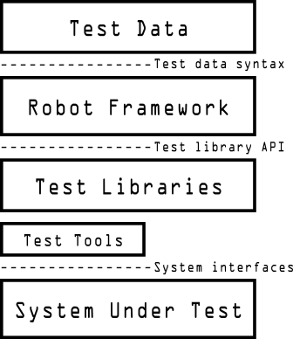
Robort framework

Slide 7

Performance test

Slide 8

Intregration & report

Slide 9
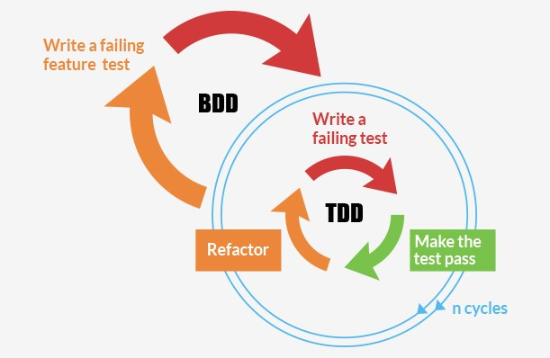
TDD&BDD

Slide 10
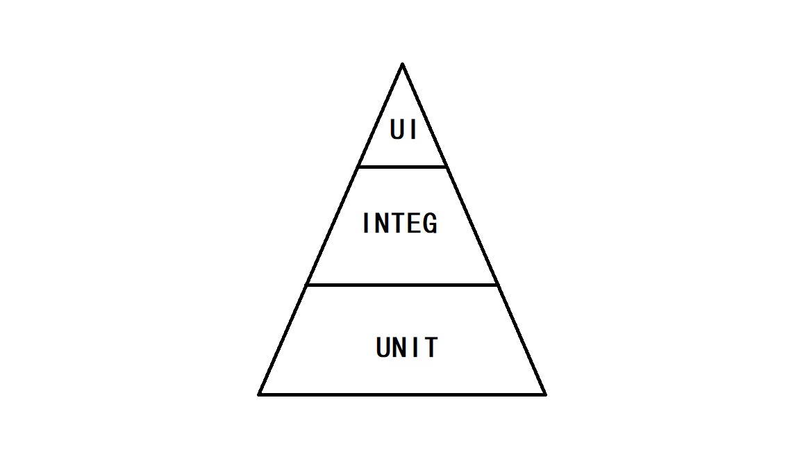
Case number

