Slide 1
Generate Code Coverage

Slide 2
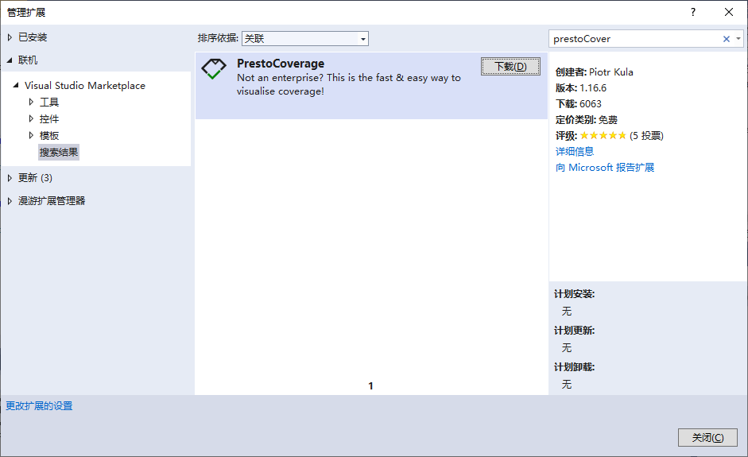
PrestoCoverage

Slide 3
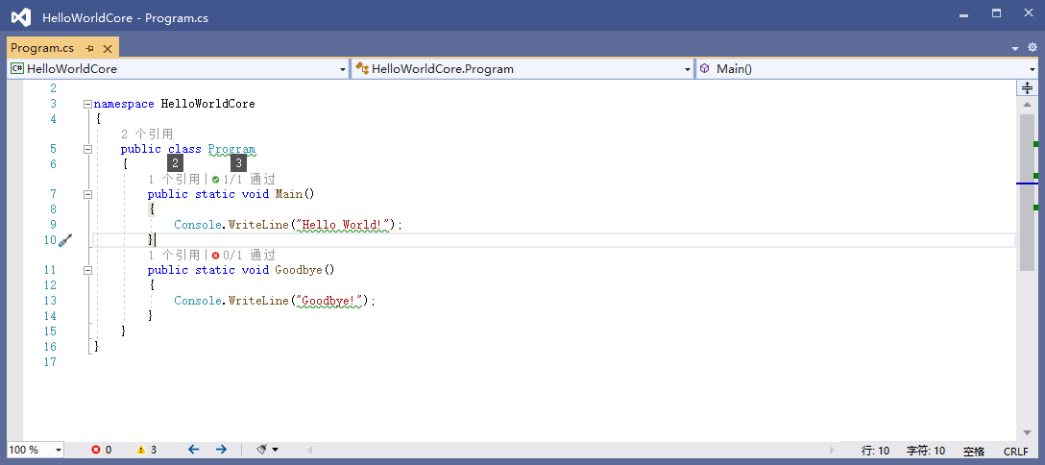
PrestoCoverage

Slide 4
Risk
REQUIRES 2017 15.8 or later!
!!!! 2019 LIMITED SUPPORT (Working on a fix!) !!!!
Use Coverlet(known issue) to generate .NET Core coverage reports.
Install PrestoCoverage to instantly show you which lines were vistied by your tests.
https://github.com/ppumkin/PrestoCoverage

