Slide 1
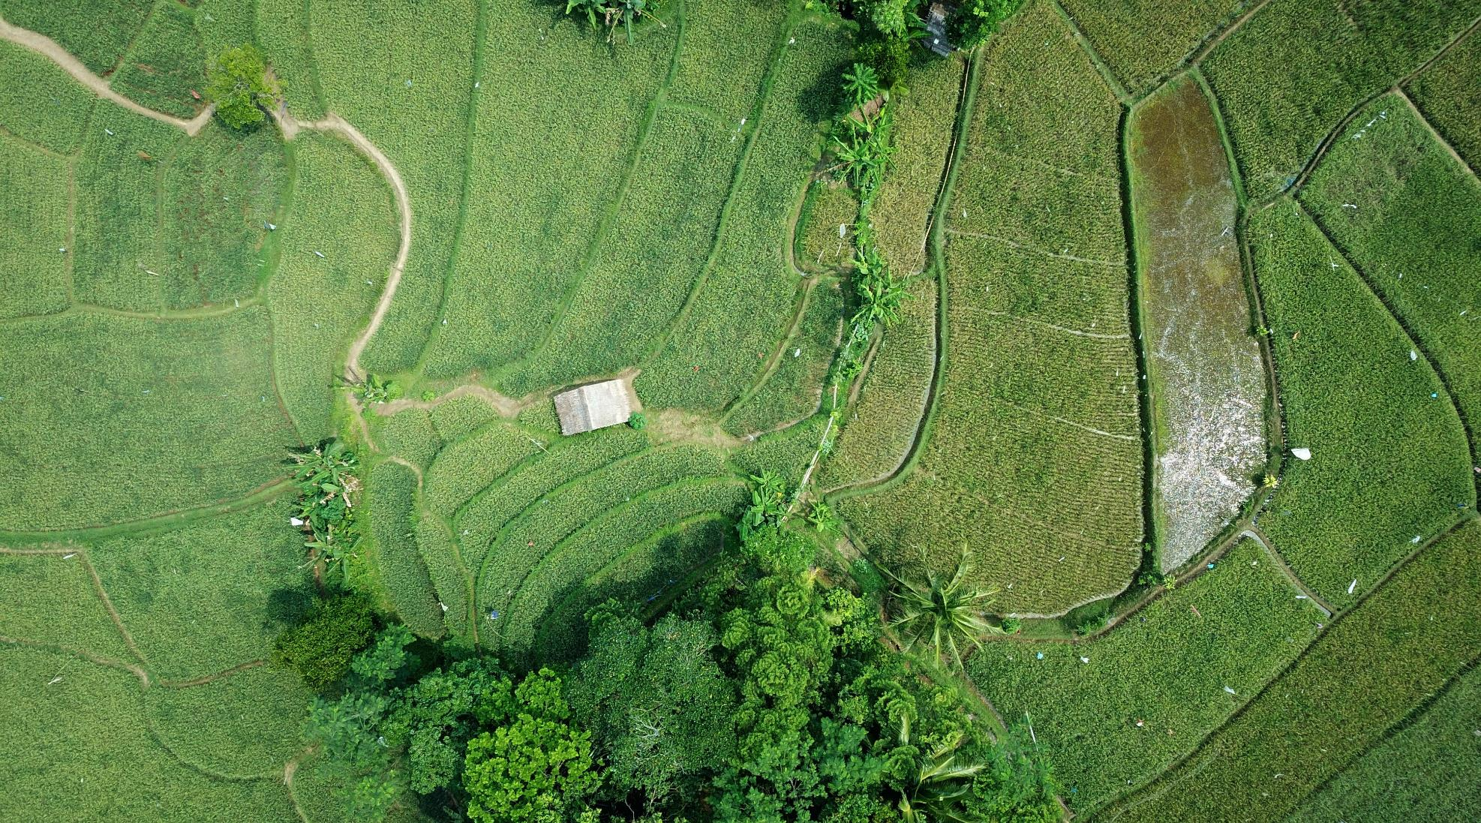


Analysis of War and Agricultural Production
A report on the impact of disorder events on agricultural markets

Slide 2

About Me
Why this topic?
Time spent working with multinational agricultural corporations such as Bayer Crop Science got me thinking….
I am a current MSc. student at WGU, who has worked as a data professional for over 6 years. I have experience working with and analyzing data in many areas, including industry and agriculture. Most recently I have been involved in developing reporting strategies and recommendation engines for a product start up that connects creatives with nonprofits and political organizations and gives them tools for the complete hiring and project management lifecycle.

Slide 3



The Problem – where is the research?
Agriculture
Social Disruption
Industry Impact
Agriculture is an industry with immense human importance, impacts to it are keenly felt by both local people and international stakeholders.
Societal and political instability such as armed conflict and violent protest can impact markets of all types in areas where it occurs.
War and disorder events may have an impact on the agriculture industry in affected areas – but little focused research has been done

Slide 4
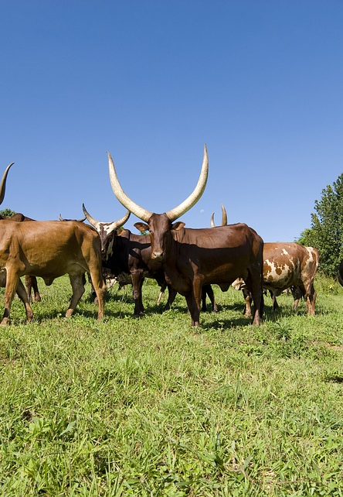



The Proposal
Collect Data
Analyze
Predict
Identify datasets containing information on ag production value by country and year, and on number of disorder events by number and year. Join the datasets to create one dataset.
Using the combined data, establish whether there is or is not a relationship between disorder events and agricultural production, esp. in terms of monetary value.
Build a regression model to predict the impact an increase in violent events will have on local agricultural markets.

Slide 5
The Hypotheses
H1: # of disorder events in a country has a negative impact on the growth % of its agricultural production value in most subindustries.
H0: # of disorder events in a country has no impact on the growth % of its agricultural production value in most subindustries.

Slide 6
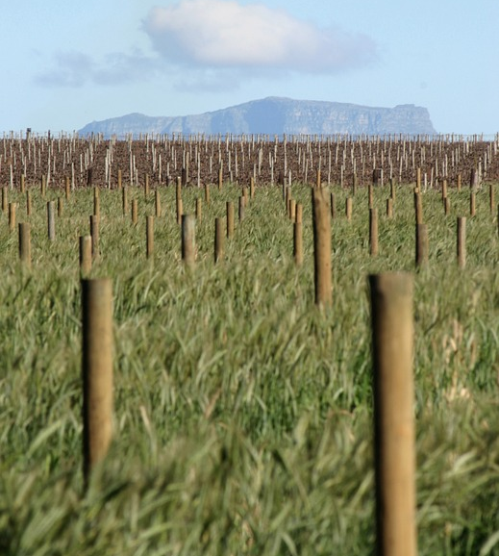
The Data
Data for this project was located online and downloaded in csv and excel formats from the Food and Agricultural Organization of the United Nations and the Armed Conflict Location & Event Data Project websites, respectively. (Statistics, 2020) (Global Food & Agriculture Statistics, 2020) (Curated Data | ACLED, 2020)
The two source datasets were cleaned and combined by joining on country and year. Two unique columns were produced for analysis - % change gross production value from previous year by market, country and year, and % change # of disorder events from previous year by country and year. Data was subsetted to include only observations from African countries between the years of 1997 and 2017 to avoid issues with missing data. The resultant dataset contained 7 columns and 41377 observations.
Licensing for both datasets is public provided credit is given as specified on the UN and ACLED websites. (Curated Data | ACLED, 2020) (UNdata | conditions of use, 2020)

Slide 7
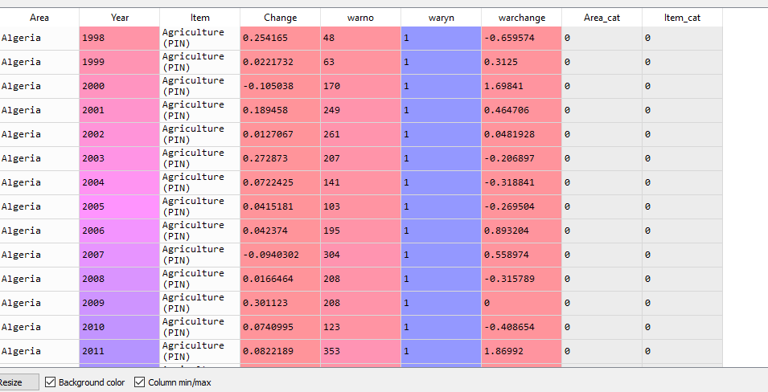

Slide 8
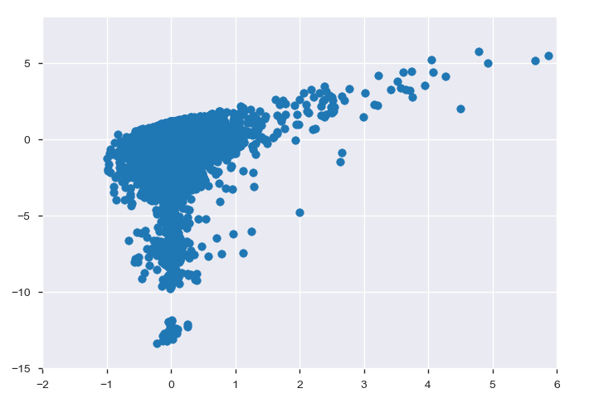
The Process
Exploration
How was cleaning and analysis conducted?
Profiled using pandas_profiling, revealing y variable skewness
Variance Inflation Factor calculated for all variables, resulting in removal of 2 variables from model inclusion due to multicollinearity concerns
Simple linear model built, residuals of y variable plotted to evaluate distribution.
Y variable residuals proved non-normal thus a data regularization strategy was needed.
Cleaning
Data loaded using pandas read_csv and read_excel.
Country naming convention standardized between datasets using country_converter.
Continent added to dataset using Pycountry_convert
Subsetted to include African countries, years 1997-2017
Main x and y variables (% changes year over year) calculated.
Excess variables and outliers removed.

Slide 9
The Process
Model Development
How was cleaning and analysis conducted?
Hypothesis Testing
Log transform used to transform y variable due to skewed residuals.
Models evaluated: Random Forest, Linear Regression, Polynomial regression (degree of 5), Random Forest with Polynomial Features, and Lasso regression (alpha = .01).
Models tested using KFold cross validation, 4 folds, explained variance scoring.
Model chosen: Random Forest with Polynomial Features.
Parameters optimized for Random Forest with Polynomial Features.
Model trained with optimized parameters and tested on test data set derived from original data.
Testing was done using partial Spearman correlation.
Control variables for x (% change # of disorder events from previous year for country): warno, Area_cat (country), waryn
Control variables for y (% change gross production value from previous year for country, market): Item_cat (market), Area_cat (country)

Slide 10
Notes on Methods (& Limitations)
Data and Testing
Modeling
Variance Inflation Factor: Measure of multicollinearity. VIF for a variable = ratio of total model variance to variance of a model with one independent variable. (Tavares, 2017)
Partial Correlation (Spearman): Partial correlation measures the association between 2 variables while controlling for the influences of other independent variables. A limitation of partial correlation is that it is based on the simple correlation coefficient, which is not ideal for use where the relationship is not linear. The skewness of the dependent variable led to the choice of Spearman correlation over Pearson. ("Partial Correlation Analysis - Multiple Correlation", 2010)
Data availability: A major limitation of this analysis is lack of data for countries outside of Africa, for years not between 1997-2017, and for possible confounding factors such as natural disaster events and weather patterns.
Data cleaning: The Python packages used to clean this dataset were pycountry_convert and country_converter. Though they were ultimately functional, the Regex they used to standardize country names and assign continent names was incomplete at best, and the code ran long. Timely data cleaning was an impediment to the completion of this project.
KFold: KFold was used to evaluate the suitability of models and later, of parameter sets for the chosen modeling technique. It was selected as a cross validation method because validating against multiple folds of data can help to counteract issues with unbalanced data.
Random Forest Regression: Supervised learning algorithm, uses ensemble modeling to counteract the weaknesses of decision trees. It was difficult to find a way to visualize the Random Forest model. Other limitations of Random Forest are; lack of easy interpretation and inability to predict values outside the range of the data it was trained on. (Kho, 2018)
Log transform regularization: Data regularization was necessary due to the skewness of the target variable, natural log transformation was chosen for this purpose. Regularization is a technique of shrinking coefficients toward 0 to reduce variance without losing important data features.
Polynomial features: These were used in conjunction with Random Forest modeling to improve the model’s ability to fit what might be an unusual curve. Polynomial regression is vulnerable to the presence of outliers, thus outliers were removed from the dataset before analysis commenced.

Slide 11

Results/Findings
The Hypothesis
The Predictive Model
The null hypothesis was rejected; analysis establishes that there is a slim yet statistically significant correlation between % change in number of disorder events and % change in gross production value in ag markets, for African countries between the years of 1997 and 2017.
A model for predicting % change in a country’s agricultural production value for a given year based on changes in the number of violent events occurring within the country that year was developed using Random Forest with Polynomial Features. The model was carefully optimized, yet still only produced an R2 score of .65 or around 65% accuracy

Slide 12
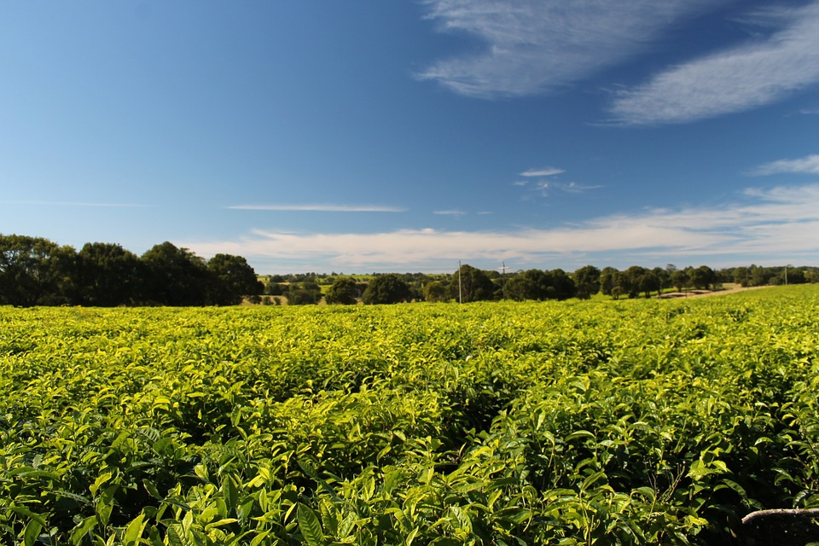
Summary
Future work:
Expansion of the dataset / identification of important controls; such as natural disaster events, religion, poverty rates, demographic homogeneity, and international aid received.
Obtain data for a wider range of countries and for a larger span of time.
Recommendation:
Stakeholders in international agricultural markets should conduct further research.
Benefits:
Improved model could be used to help ag companies, governments and nonprofits test simulated interventions / develop strategies for protecting the agricultural industry in times of social upheaval.
Protect the investments of large agricultural companies and small farmers + improve local food security in times of socio-political tension.
Implications, recommendations, benefits

Slide 13
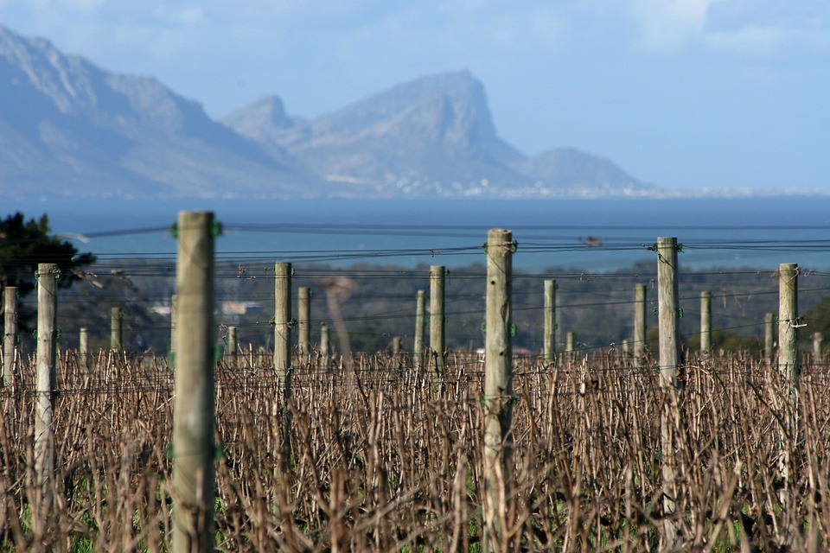



Thank You
Desiree Teter
dteter@wgu.edu

Slide 14
Sources
Battacharyya, S. (2018). Ridge and Lasso Regression: L1 and L2 Regularization. Medium. Retrieved 22 October 2020, from https://towardsdatascience.com/ridge-and-lasso-regression-a-complete-guide-with-python-scikit-learn-e20e34bcbf0b.
Curated Data | ACLED. ACLED. (2020). Retrieved 22 October 2020, from https://acleddata.com/curated-data-files/.
Global Food & Agriculture Statistics. Kaggle.com. (2017). Retrieved 22 October 2020, from https://www.kaggle.com/unitednations/global-food-agriculture-statistics.
Harris, Charles R. (2020) Array programming with NumPy, Nature, 585, 357–362 (2020), DOI:10.1038/s41586-020-2649-2
Hunter, John D. (2007) Matplotlib: A 2D Graphics Environment, Computing in Science & Engineering, 9, 90-95, DOI:10.1109/MCSE.2007.55
Kho, J. (2018). Why Random Forest is My Favorite Machine Learning Model. Medium. Retrieved 28 October 2020, from https://towardsdatascience.com/why-random-forest-is-my-favorite-machine-learning-model-b97651fa3706
Koehrson, W. (2018) Hyperparameter Tuning the Random Forest in Python. Medium. Retrieved 22 October 2020, from https://towardsdatascience.com/hyperparameter-tuning-the-random-forest-in-python-using-scikit-learn-28d2aa77dd74.
McKinney, W. (2010) Data Structures for Statistical Computing in Python, Proceedings of the 9th Python in Science Conference, 51-56 (publisher link)
Minitab Editor. (2020). Enough Is Enough! Handling Multicollinearity in Regression Analysis. Blog.minitab.com. Retrieved 22 October 2020, from https://blog.minitab.com/blog/understanding-statistics/handling-multicollinearity-in-regression-analysis.
Partial Correlation Analysis - Multiple Correlation. Explorable.com. (2010). Retrieved 28 October 2020, from https://explorable.com/partial-correlation-analysis.
Pedregosa, F. (2011) Scikit-learn: Machine Learning in Python, Journal of Machine Learning Research, 12, 2825-2830 (publisher link)
Statistics. Food and Agriculture Organization of the United Nations. (2020). Retrieved 22 October 2020, from http://www.fao.org/statistics/en/.
Tavares, E. (2017). Variance Inflation Factor (VIF) Explained - Python. Etav.github.io. Retrieved 22 October 2020, from https://etav.github.io/python/vif_factor_python.html.
UNdata | conditions of use. Data.un.org. (2020). Retrieved 22 October 2020, from https://data.un.org/Host.aspx?Content=UNdataUse.

