Slide 1
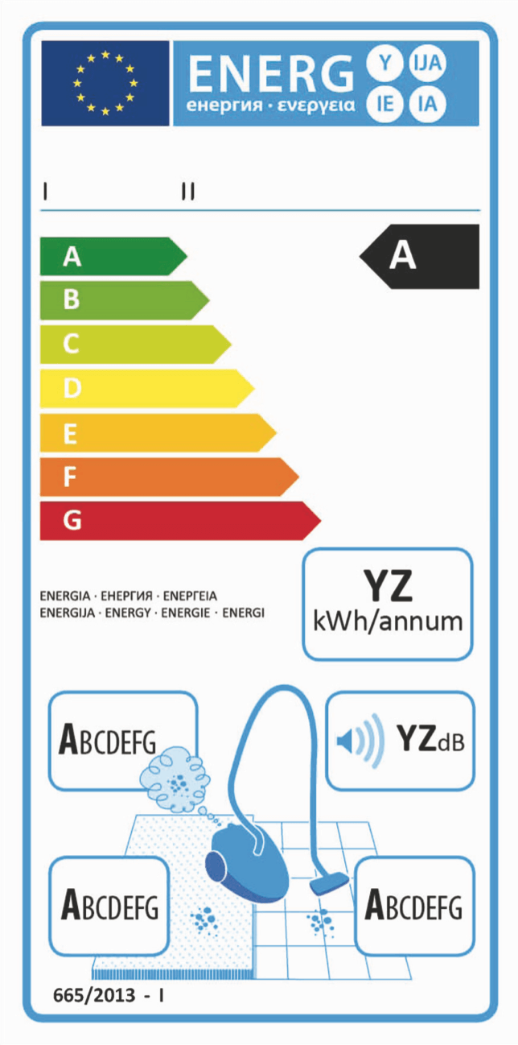



①
②

Slide 2


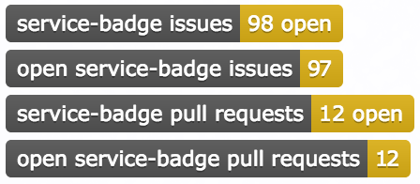
API
Client
①
②

Slide 3

Label Service
①
③
API
Client
②

Slide 4
Label Service
①
③
API
Client
②

Slide 5

Label Service
①
②
API
Client
③
②
Service Discovery

Slide 6
Label Service
①
②
API
Client
③
②
Service Discovery

Slide 7
Home
Document
Label
Document
API
Client
①
②

