Slide 1
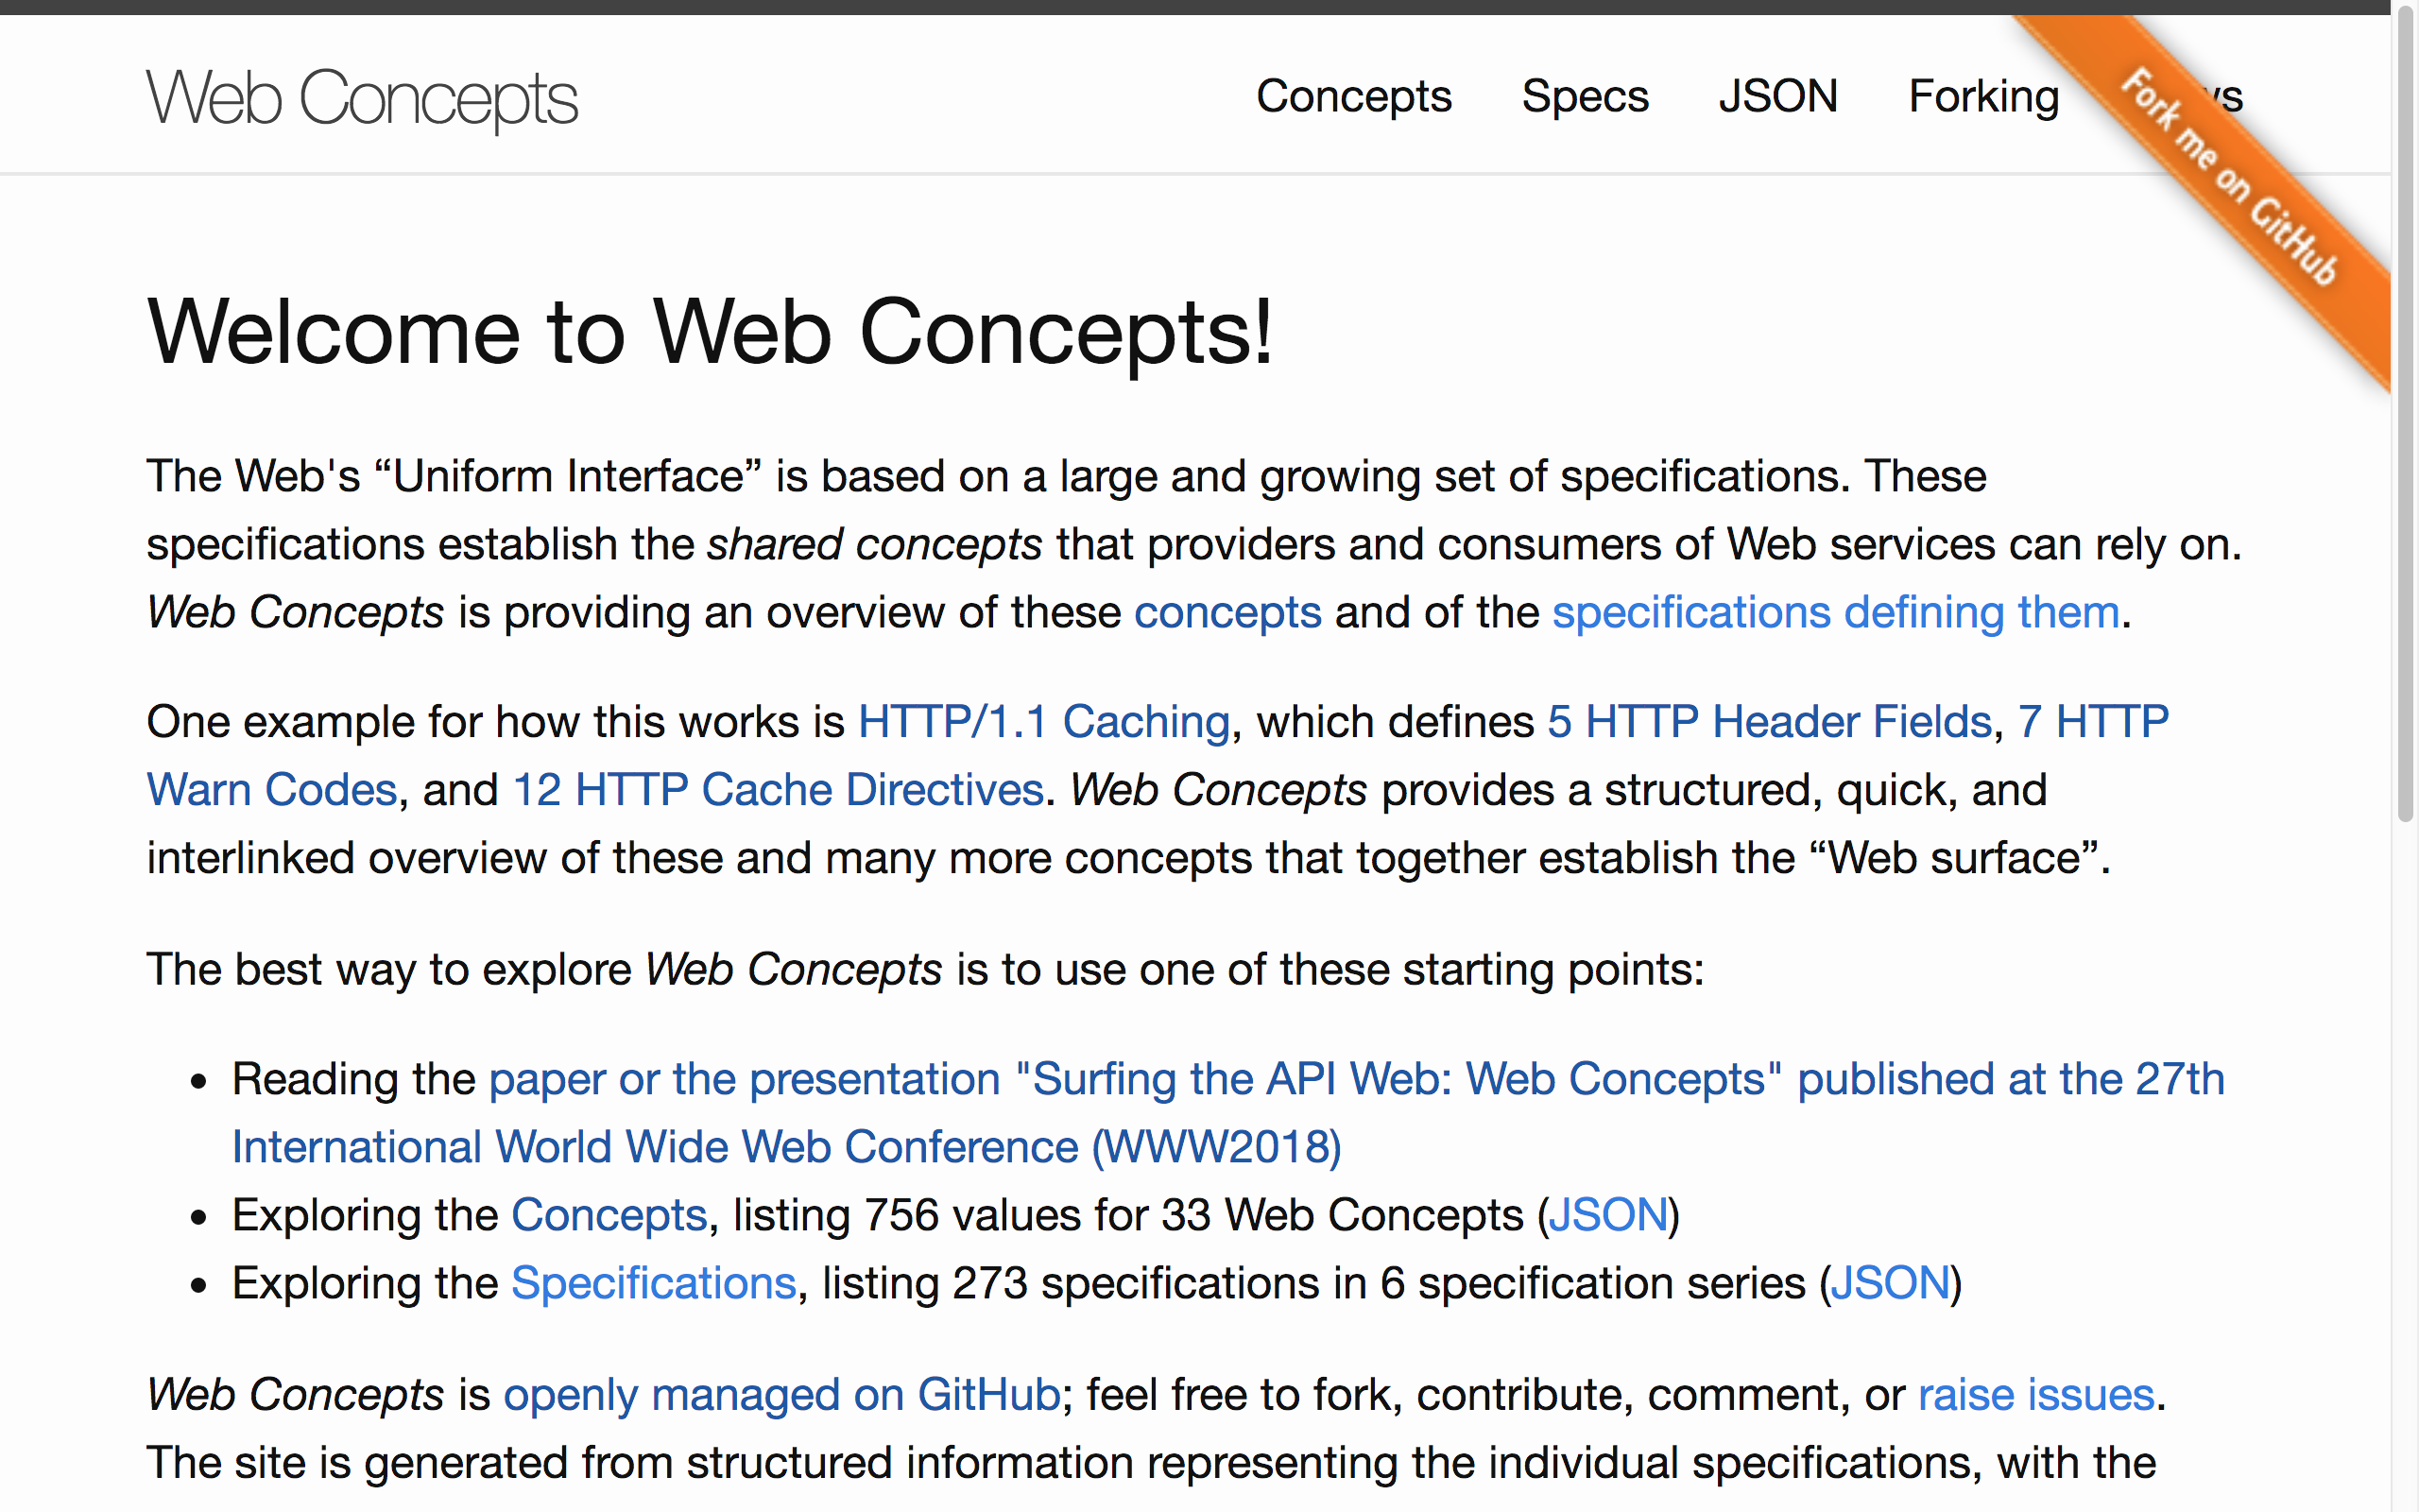
Organization
& Series
Specification
Specification
Specification
Specification
Organization
& Series
Specification
Specification
Specification
Specification
specs.xml
specX.xml
specX.xml
specX.xml
specX.xml
specX.xml
concepts.xml
specX.xml

