Slide 1
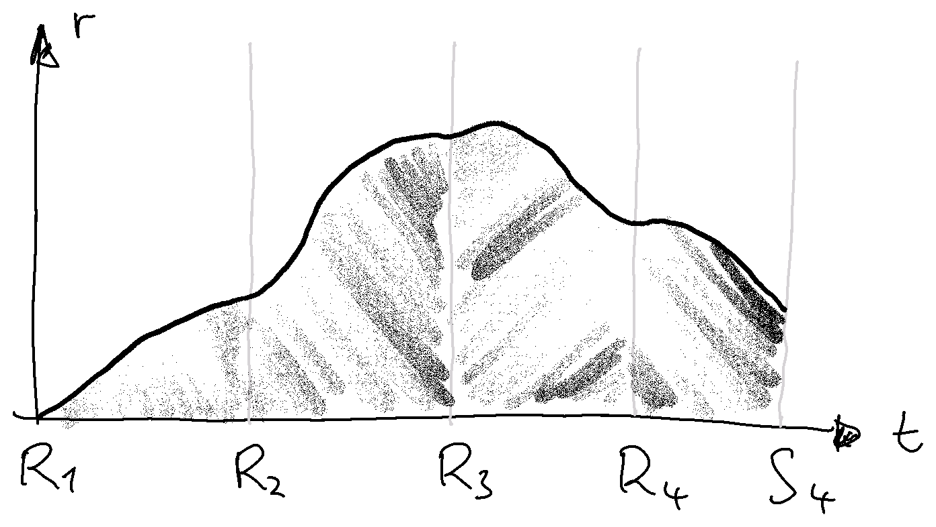
$$V=\sum_{i=1}^{n}{\int_{R_{i}}^{S_{i}}{r dt}}$$

Slide 2
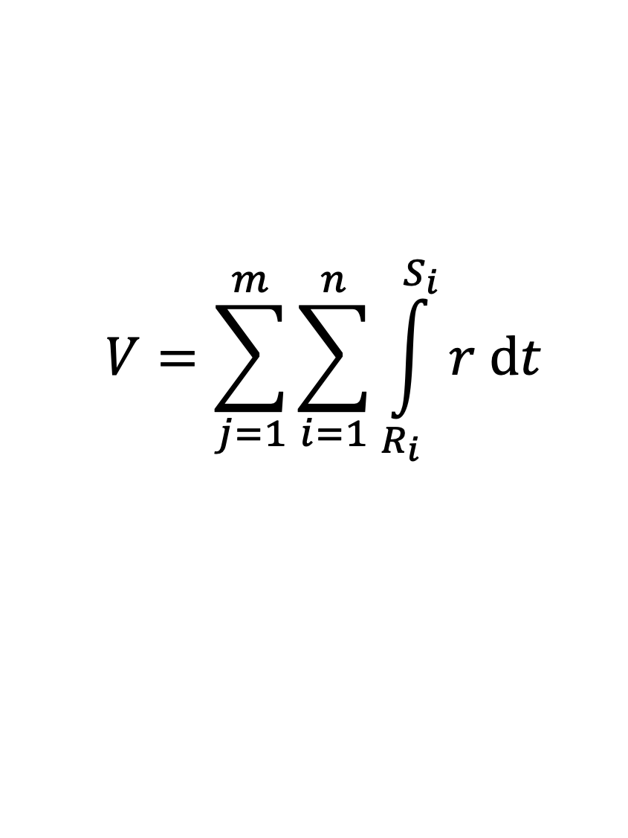
$$V=\sum_{j=1}^{m}{\sum_{i=1}^{n}{\int_{R_{i}}^{S_{i}}{r dt}}}$$

