Slide 1
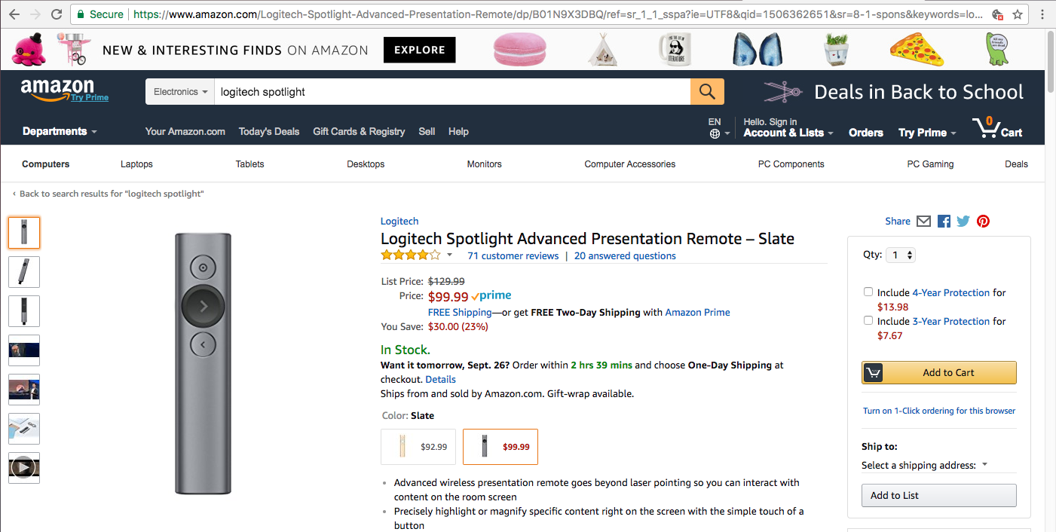
For Machines
/robots.txt
/sitemap.xml
/
/help.html
/conditions-of-use.html
/privacy-notice.html
schema.org
For Humans
For Machines and Humans

