Slide 1
Deep-LDA and Me
Dominykas Lukauskis
05/02/2021

Slide 2
What I’ll talk about today
Learning CVs using neural nets - Deep LDA
OPES - an improvement on metaD?
Combining Deep-LDA with OPES
Future uses

Slide 3
The Basics
The FES of physical systems - islands of metastability in a sea of improbable configurations.
These metastable states are connected by narrow passageways that allow rare but crucial transitions from one state to another to take place.
Most methods need the entire transition between the metastable states (path-based), while new methods only need the states themselves (fluctuation-based)

Slide 4
Harmonic Linear Discriminant Analysis (HLDA)
Get small set of descriptors capable of discriminating between the states.
The expectation value of the descriptors and their covariance matrices are computed from short unbiased runs in the two basins.
Use linear discriminant analysis (LDA) to obtain CVs that are linear combinations of the input descriptors.

Slide 5
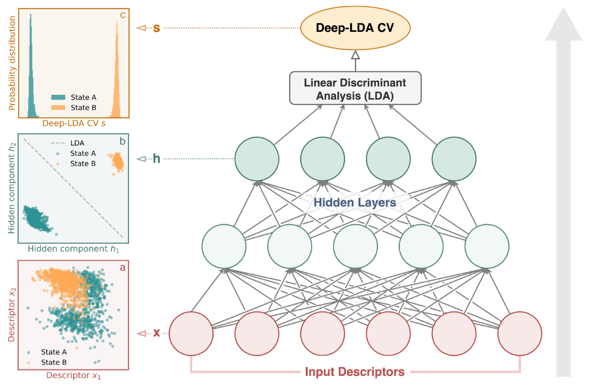
Notes:
Figure 1. Scheme of the construction of the Deep-LDA CV. A set of physical descriptors are used as inputs of a feed-forward neural network. A nonlinear transformation is made by the NN via the composition of several hidden layers. In the last layer, a linear discriminant analysis is performed, the direction of maximal separation between classes is determined, and the CV is obtained. To better illustrate the workings of Deep- LDA, we report three panels on the left-hand side of the figure. In panel a, we show the distribution of a pair of typical input descriptors and note how they do not distinguish state A from state B. In panel b, we plot the distribution of a pair of variables from the topmost hidden layer, along with the LDA boundary projected in this space. At this stage, after the nonlinear transformation, states A and B are linearly separable. In panel c, we report the probability distribution of the Deep-LDA CV for the two states.
exploration

Slide 6
Basic Work Flow
Select a set of descriptors (CVs)
Run unbiased MD in State A and State B for a ~100 ps
Train the NN model
Use the model as a CV
Notes:
Workflow example?

Slide 7
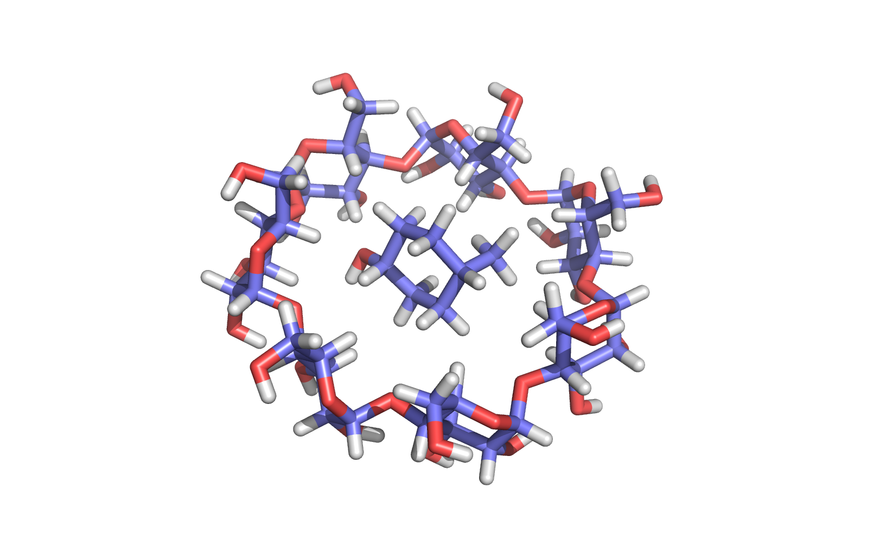

Guest-host binding in vacuum

Slide 8
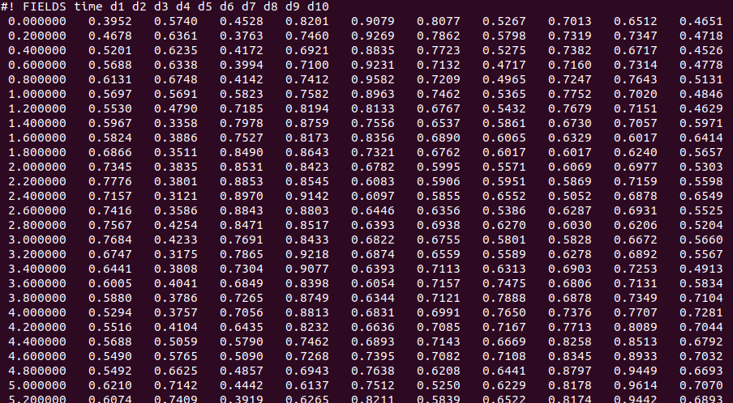
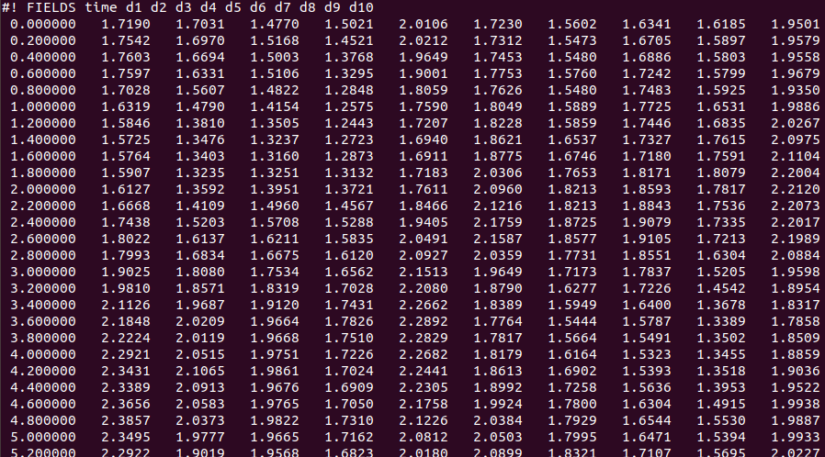
Unbiased

Slide 9
Training
For a Jupyter notebook tutorial, follow this link.

Slide 10
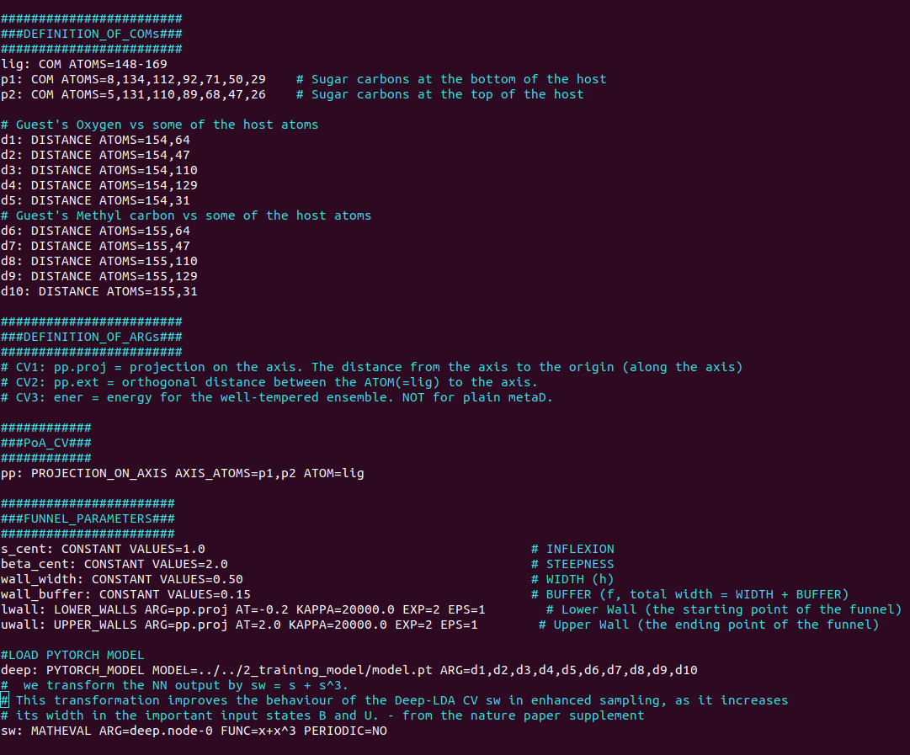
Using the model

Slide 11
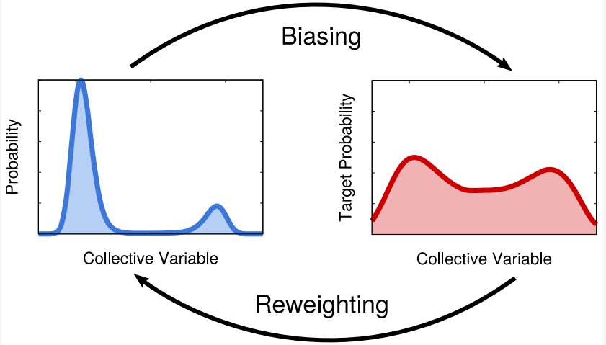
OPES

Slide 12
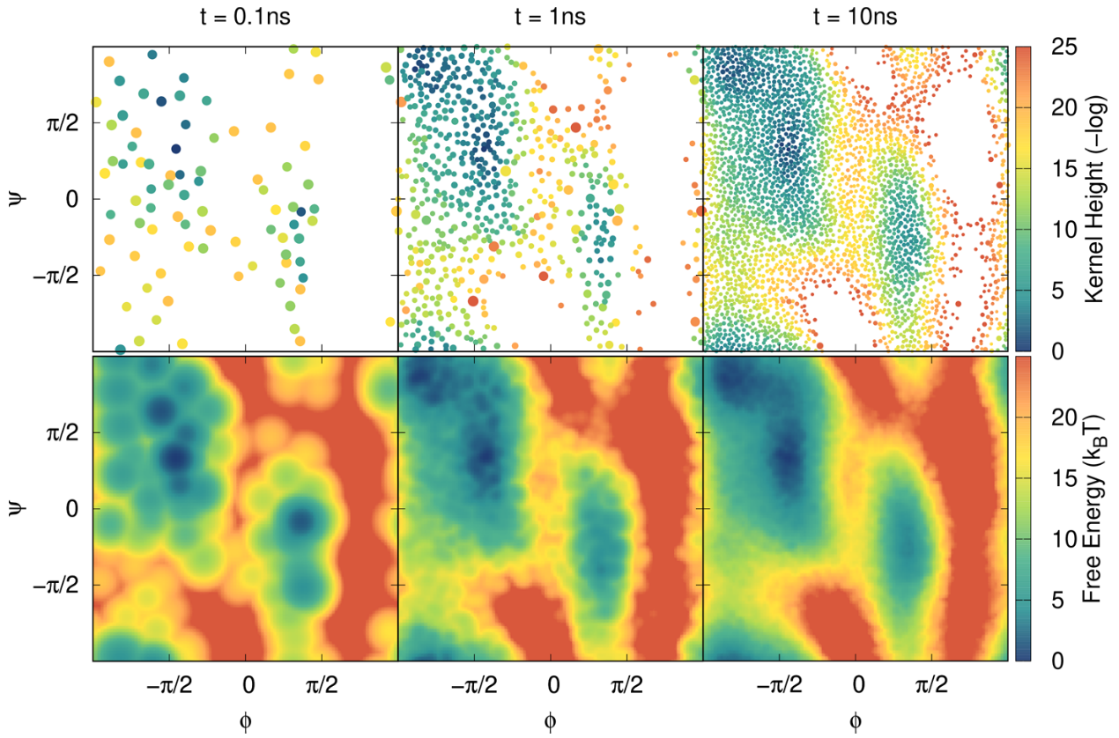

Slide 13
OPES - Pros and Cons
Very smooth convergence
Fewer free parameters
Sensitive to the choice of the CVs (worse for degenerate CVs than wt-metaD)
Needs to know the height of the barrier

Slide 14
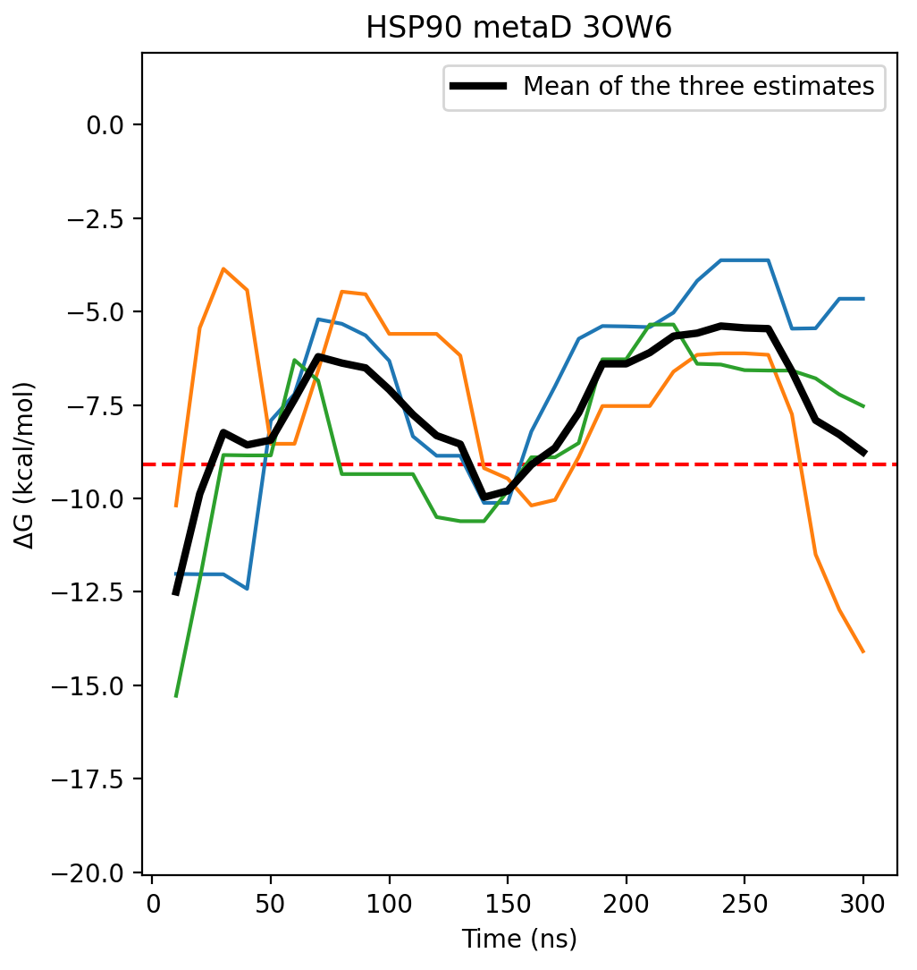
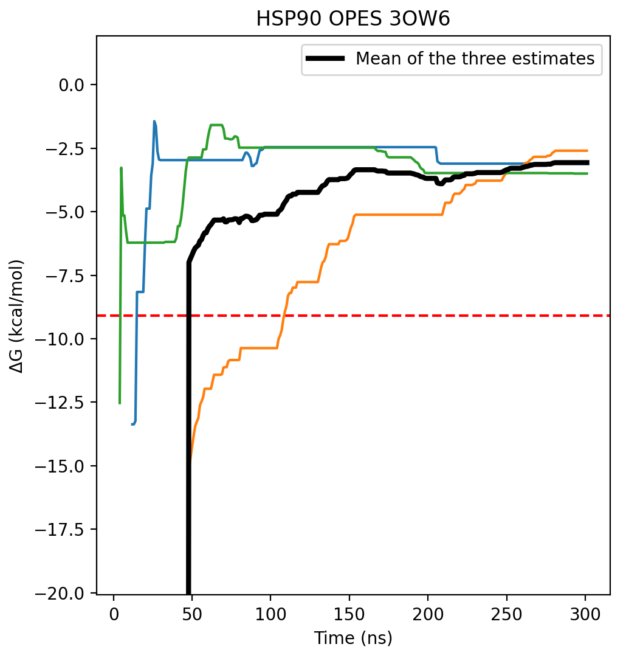
OPES with a bad CV

Slide 15
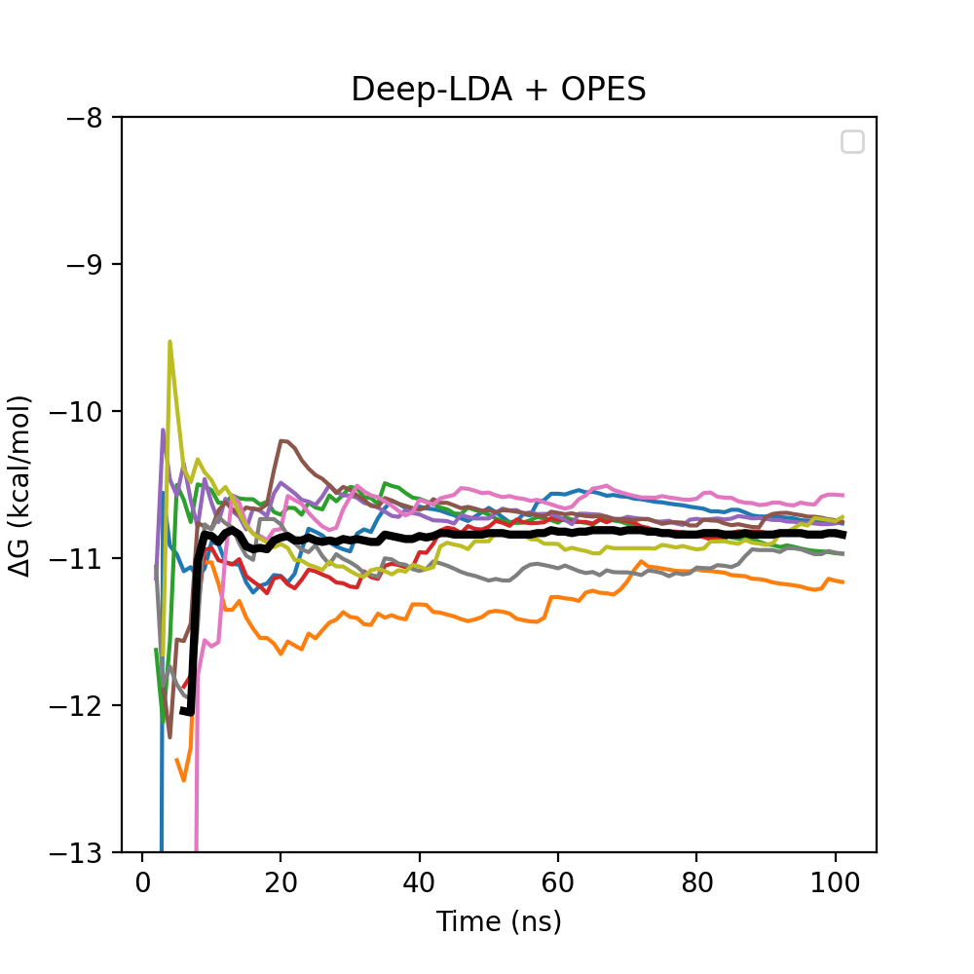
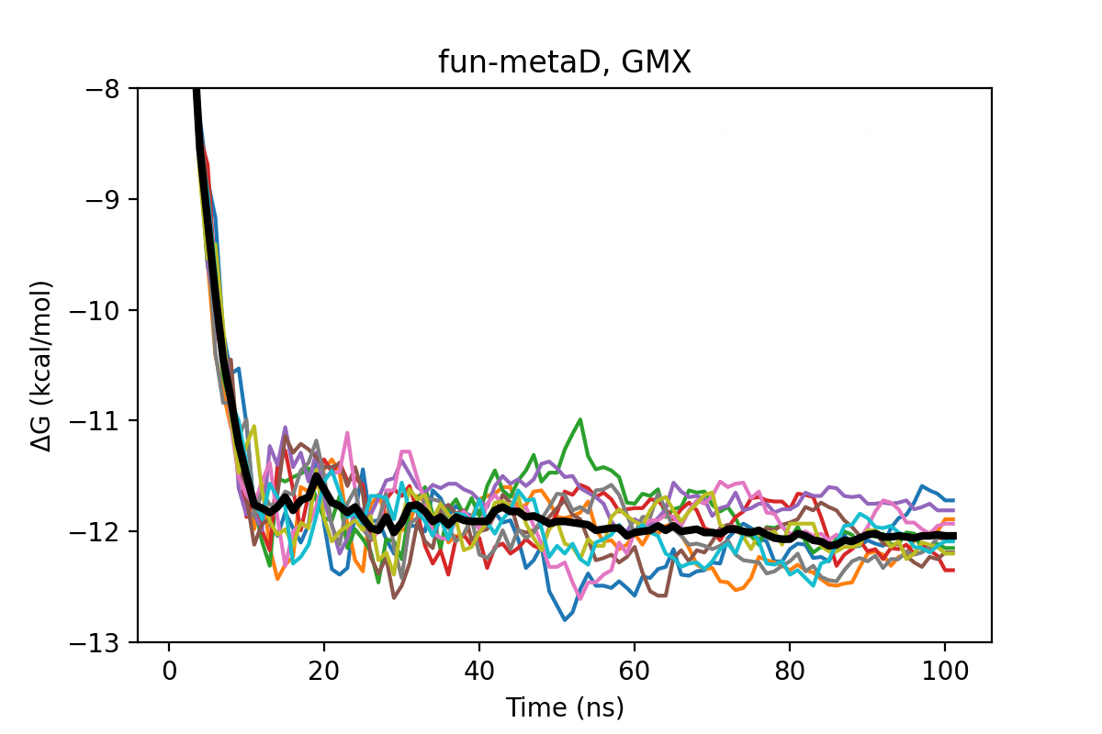
Unbiased - 1814 ns/day
fun-metaD - 1018 ns/day (55%)
Deep-LDA - 315 ns/day (16%)

Slide 16
Conclusions (so far)
Deep-LDA + OPES is not superior to wt-metaD with a simple CV, IF it is sufficient
Probably more suitable for:
Precision enhanced sampling - some cases in protein-ligand binding
Complex transitions - protein loop motions, cavity openings, large structural changes

Slide 17
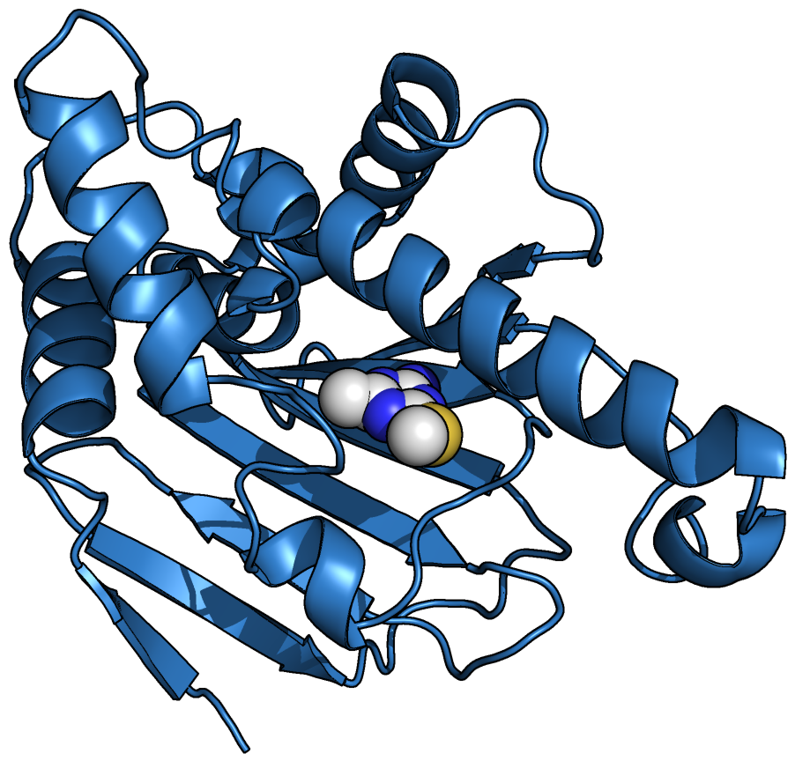
My next step
Try Deep-LDA + OPES on some of the challenging protein-ligand systems, where convergence seemed difficult.

Slide 18
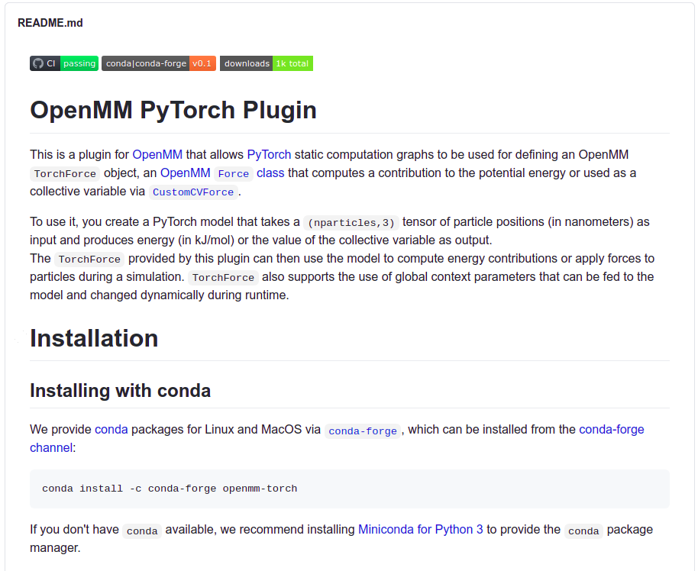

Slide 19
Bibliography
Collective Variables from Local Fluctuations - 10.1021/acs.jpclett.8b00733
Deep-LDA - 10.1021/acs.jpclett.0c00535
Deep-LDA for guest-host binding - 10.1038/s41467-020-20310-0
OPES - 10.1021/acs.jpclett.0c00497

