Slide 1
Piecewise Linear Analysis of Biological Trajectories
Daniel Barton (SM09)
PhD supervisor: Dr. Jure Dobnikar
Institute of Physics, Chinese Academy of Sciences, Beijing

Slide 2

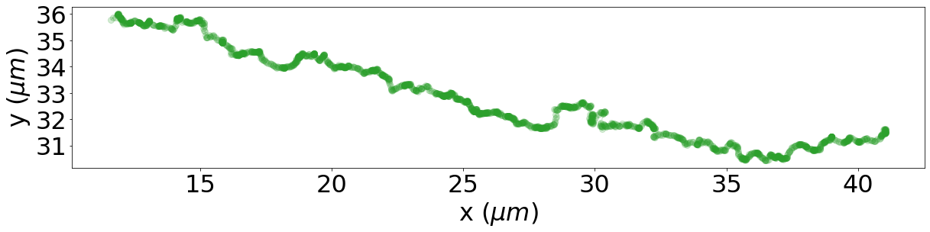
Twitching Motility
Fig 1. Skerker & Berg, 2001
Fig 2. Simplified Drawing
Fig 4. Experimental Trajectory
Fig 3. Simulation

Slide 3


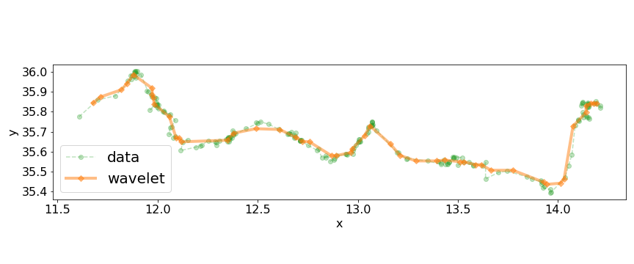
Tracking data
Fig 1. 20 seconds of Tracking Data
Fig 1. 20 seconds of Tracking Data
(μm)
(μm)
Fig 2. tracking data with wavelet smoothing
Fig 2. tracking data with wavelet smoothing
Question: Can we get more useful, more interpret-able information from this trajectory data?
Question: Can we get more useful, more interpret-able information from this trajectory data?

Slide 4
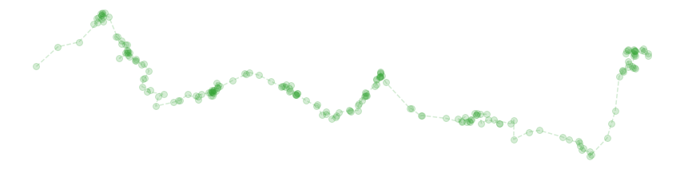

Linear Displacements
Notice that the trajectory appears to be made up of roughly linear displacements.
We imagine these displacements are connected to retraction of active filaments.
Lets try to identify them by eye first.

Slide 5
Linear Displacements
Notice that the trajectory appears to be made up of roughly linear displacements.
We imagine these displacements are connected to retraction of active filaments.
Lets try to identify them by eye first.

Slide 6
Piecewise Linear Solve
Consider N measurements taken at equal time intervals.
Lets define a global cost function
Measurements have some noise, e.g.
Draw your attention to the following two issues.
Issue 1: This cost function decreases with increasing M, in fact
Define a partition of this data as a series of M indices
In regression and machine learning, this is called “overfitting”. We want M to be just large enough to capture the piecewise linear features of the data and no larger.
for any sub-sequence of the data we could fit a linear model
Issue 2: Global optimisation by searching all possible partitions becomes quickly infeasible for even moderate data size N.
where distance to the line of a single data point is
and its common to obtain u, c by least squares optimisation. Minimise

Slide 7
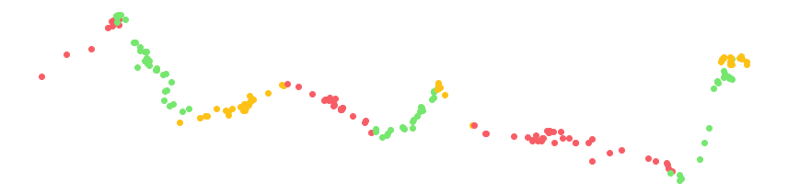
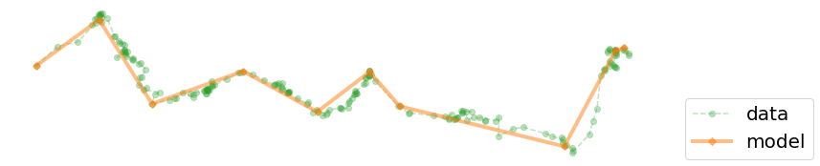
Piecewise Linear Solve
Recursively join whole piecewise segments, choosing the join that has the minimum cost at each step.
The result is a partition of the data into piecewise linear components.
Connected model.

Slide 8
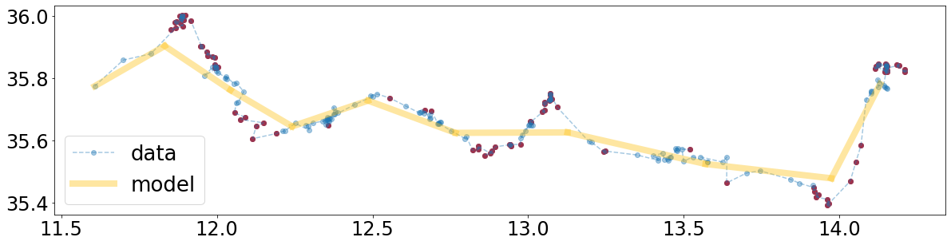
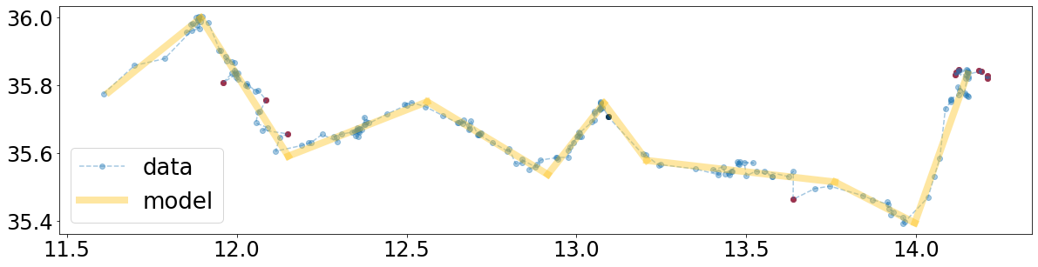
Minimum Description Length
lets define a new global cost function using an idea from information theory.
The threshold parameter R is a bias/variance trade off,
one idea is to select it from the inverse cumulative distribution function of the error distribution.
Which says that there is a 1% chance that a measurement error will be greater than 0.028.
Fig 1. Candidate piecewise curve. Outliers are red and points close to the model are blue.
This time we used simulated annealing to stochastically search the space of all piecewise linear partitions of the data.
Unfortunately this method is quite expensive.
Fig 2. Minimum description length model.

Slide 9
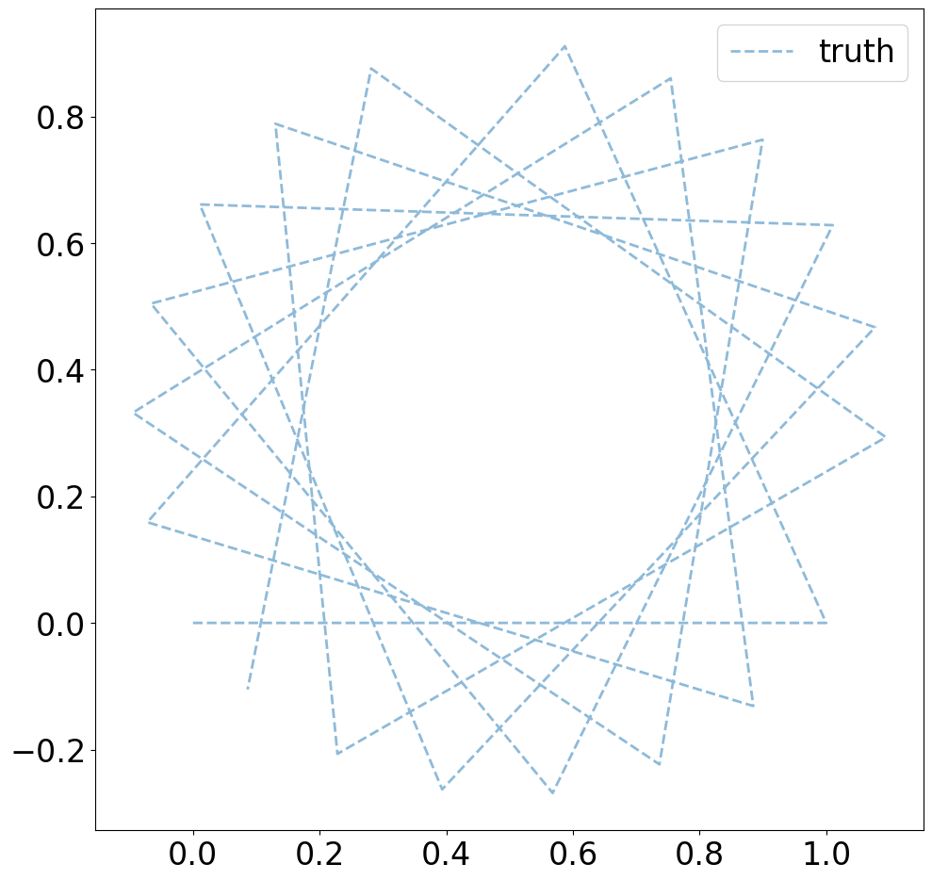
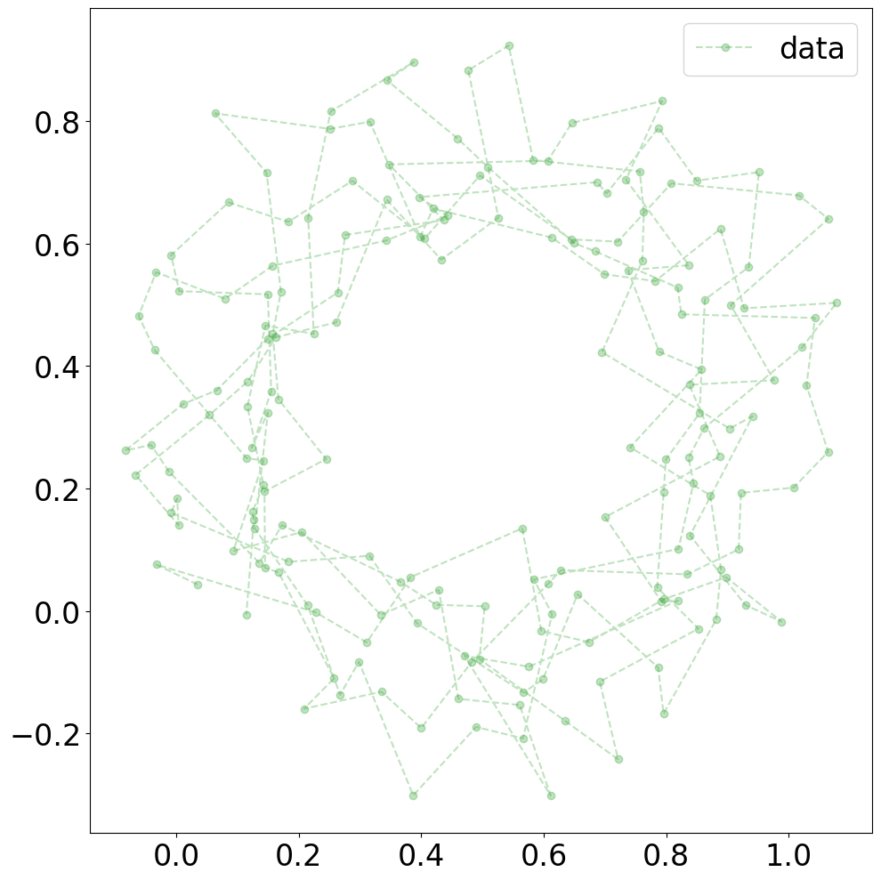
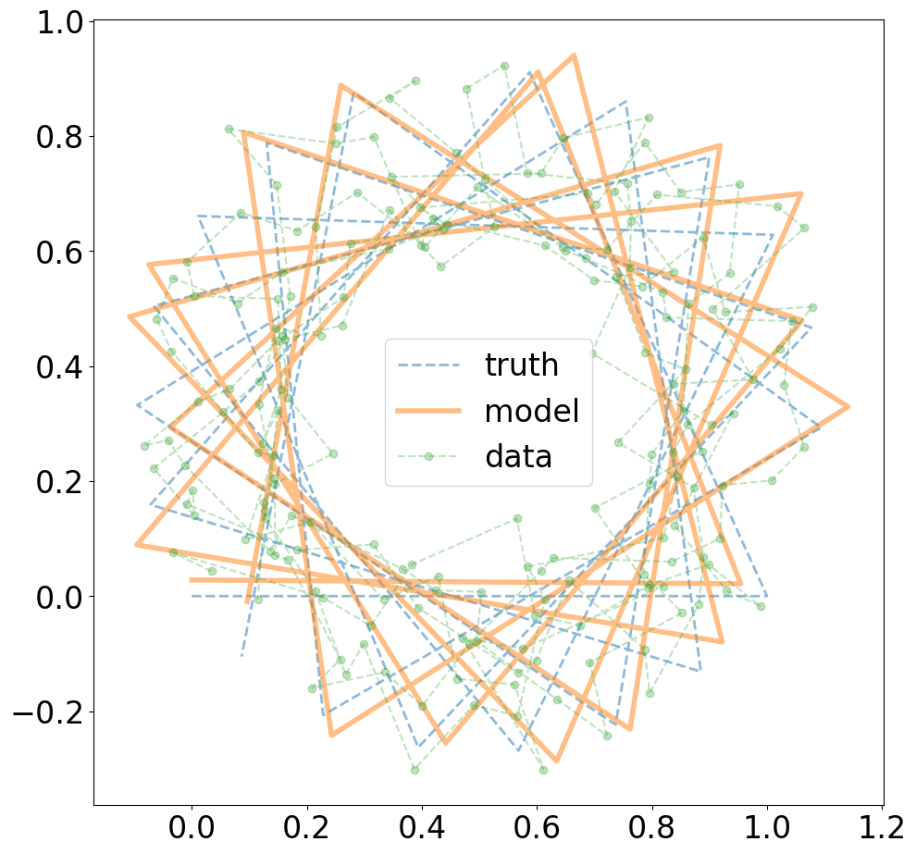
Synthetic Data
Generate 10 random points per line segment.
Piecewise linear solution

Slide 10
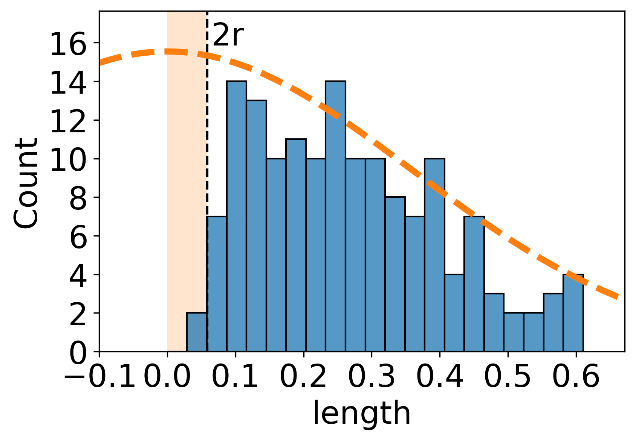
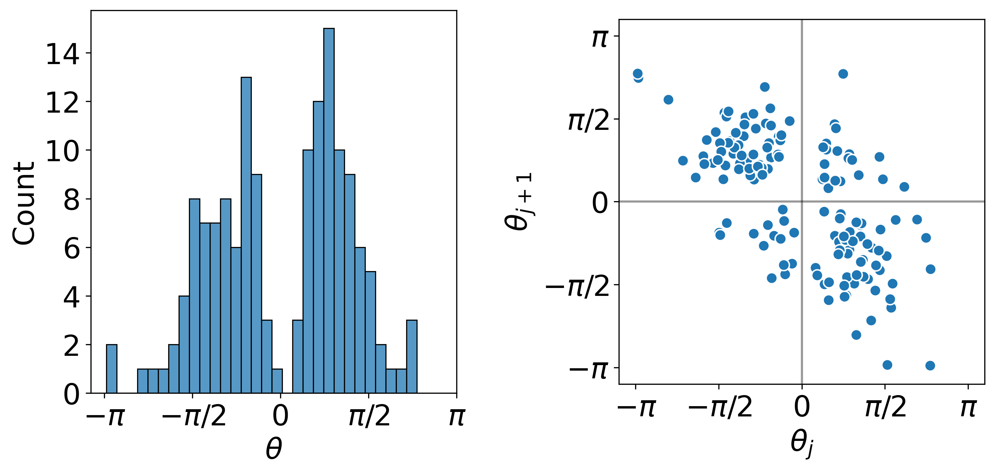
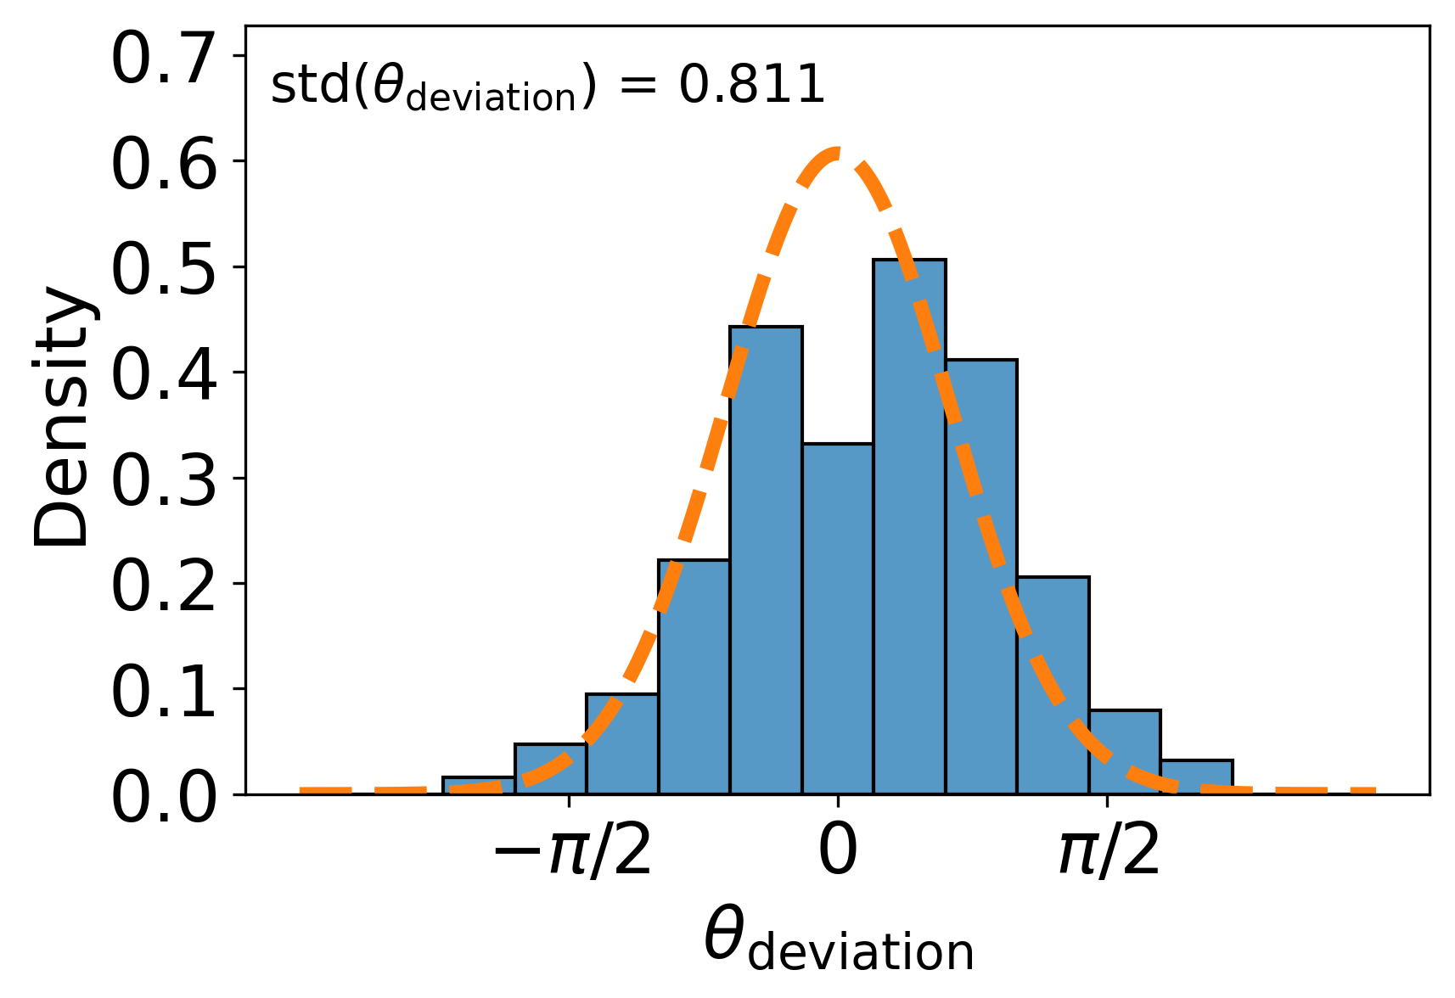
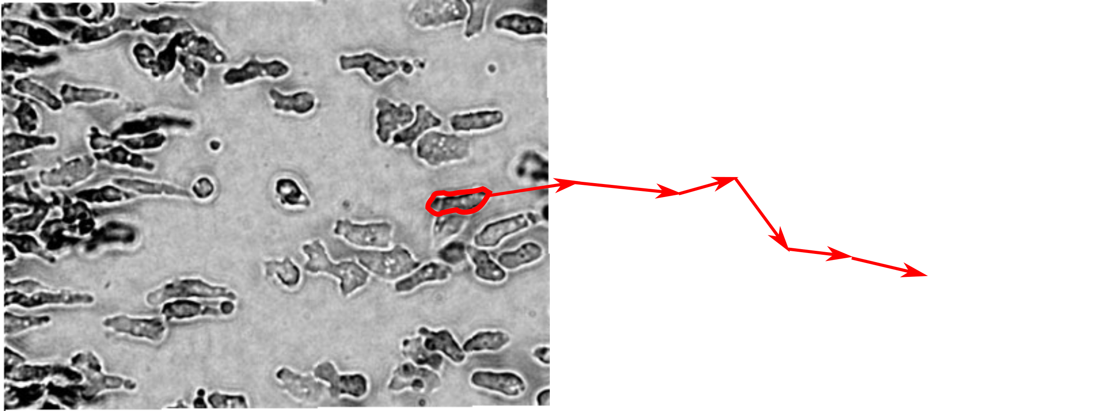
Statistics
This experimental trajectory has ~2000 data points
Segment length distribution
Sequential linear displacements are anticorrelated (corrcoef = -0.65)
Angle between body axis and velocity
This behaviour is shared with Dictyostelium (slime mold)

Slide 11
Summary
Thanks for listening
Biological trajectories are often piecewise-continuous with high noise to signal ratio.
Piecewise linear solvers exist for 1-dimensional problems, our algorithms are designed for N-dimensional trajectories.
Extracting piecewise linear features of data (if they exist!) makes analysis much easier and more rewarding.
This works for any trajectory data with piecewise structure!
Contact me: daluke.barton@gmail.com
(SM09)

Slide 12
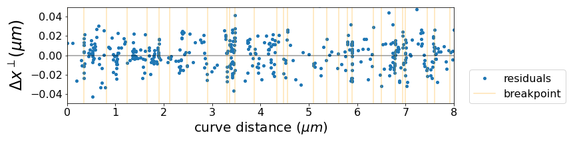
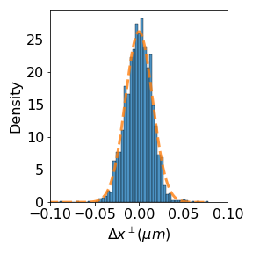
Residual Analysis
Residuals vs. curve distance
measurements clustering around breakpoints indicates low velocity/pausing between linear segments
Short timescale non-linearities would show up in the correlation between residuals.
Very short timescale non linearities implies that the bacteria makes some displacements which are beyond our spatial and temporal resolution to detect.
normal distribution of residuals
Estimated std : 0.0126
Residual std : 0.0152
“unexplained” deviation
0.0152 – 0.0126 = 0.0026

