Slide 1
group meeting
Parsimonious representation of biological twitching trajectories

Slide 2

twitching motility
Fig 1. Skerker & Berg, 2001
Fig 3. Simplified Drawing
Fig 2. Simulation

Slide 3


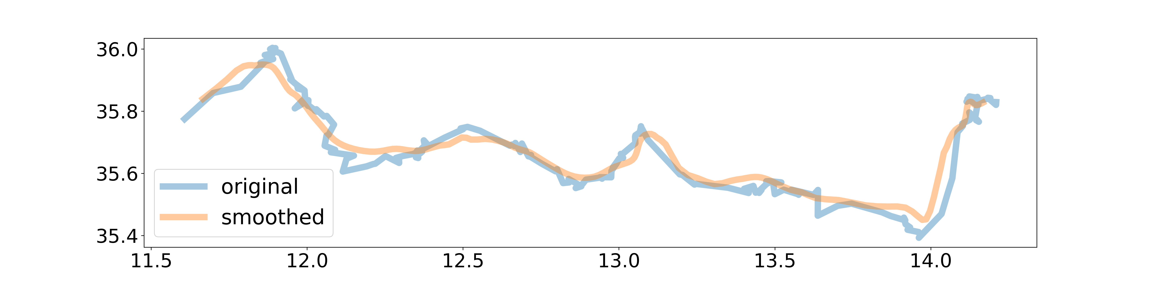
Tracking data from twitching experiments
Fig 1. 20 seconds of Tracking Data (μm)
Fig 2. tracking data with wavelet smoothing
Question: Can we get more useful, more interpret-able information from this trajectory data?

Slide 4
Intro

Slide 5
Master Slide

Slide 6
Master Slide

Slide 7
Master Slide

Slide 8
Master Slide

