Slide 1
group meeting
Parsimonious representation of biological twitching trajectories

Slide 2

Intro: twitching motility
Fig 1. Skerker & Berg, 2001
Fig 3. Simplified Drawing
Fig 2. Simulation

Slide 3


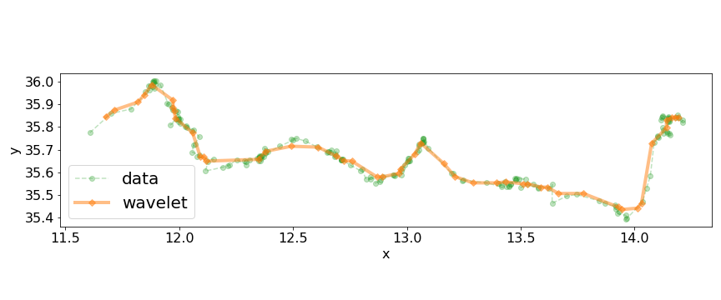
Tracking data from twitching experiments
Fig 1. 20 seconds of Tracking Data (μm)
Fig 2. tracking data with wavelet smoothing
Question: Can we get more useful, more interpret-able information from this trajectory data?

Slide 4
Piecewise Linear Solve
consider N measurements taken at equal time intervals.
Lets define a global cost function
and define a partition of this data as a series of M indices
Draw your attention to the following two issues.
Issue 1: This cost function decreases with increasing M, in fact
for any sub-sequence of the data we could do a linear fit
In regression and machine learning, this is called “overfitting”. We want M to be just large enough to capture the piecewise linear features of the data and no larger.
where distance to the line of a single data point is
Issue 2: Global optimisation by searching all possible {M, k1, …, k_M} becomes quickly infeasible for even moderate data size N.
and its common to obtain u, c by “least squares”. Minimise
Another (probably worse) option is to minimise

Slide 5
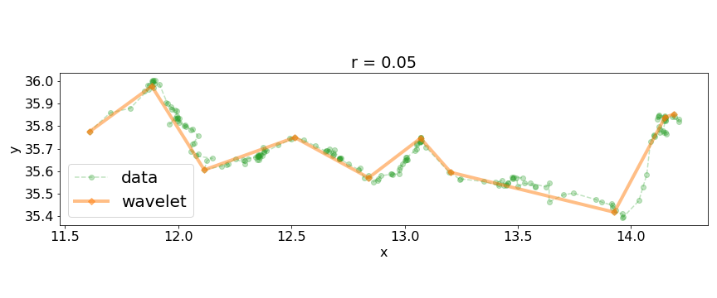
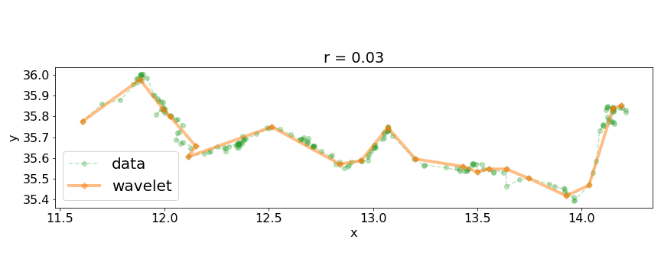
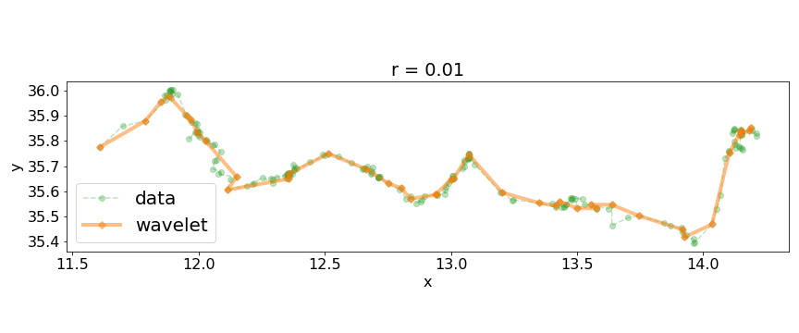
Greedy Binary Recursion
A efficient method will help us build up intuition
So that each of the N-1 linear fits contains only two points, for which a perfect fit is always available.
Now consider joining any one of the data points to its neighbours, we could write this operation in pseudocode as
there are N-2 possible join operations on the first iteration. At each interation we choose join the pair with the minimum cost
Finally lets choose a threshold cost and use it as a stopping criteria (otherwise we will continue to join data until M = 1).

Slide 6
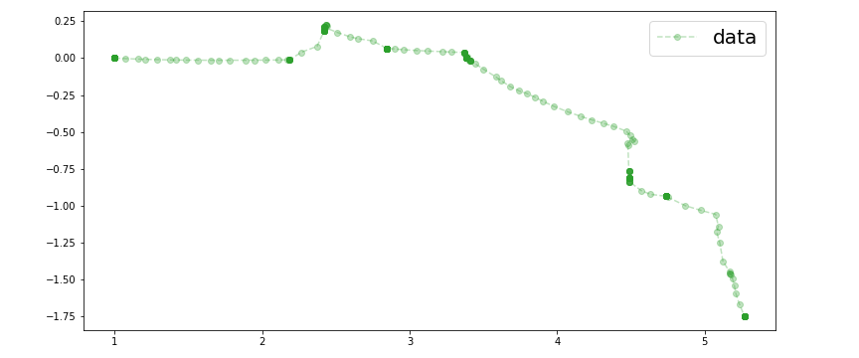
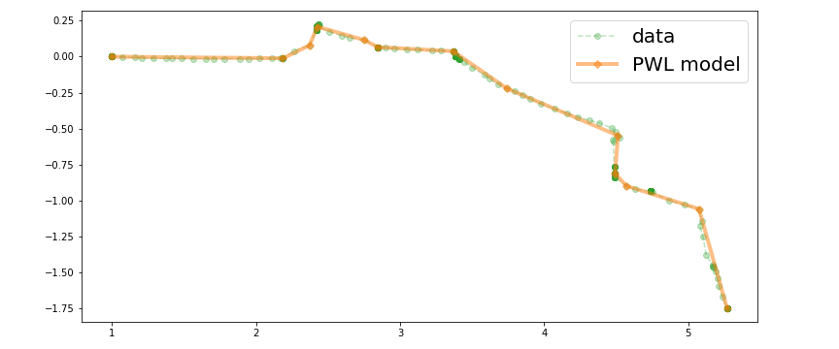
Greedy Binary Recursion on Simulated data
This method forms the basis for more advanced algorithms.
It also works well on simulated twitching trajectories which have no noise but still have some minor non-linearities.
In this case were interested in comparing simulated and real twitching trajectories, so we output data using the experimental timestep of 0.1 seconds.
We assumed the measurement errors in real data follow a normal distribution and estimated sigma using a heuristic method.
Very roughly, if we want to use the ɸ∞ cost function to extract linear features of the data with a high confidence we could use the inverse cumulative distibution function to set r, e.g.
Which says that there is a 1% chance that a measurement error will be greater than 0.028.
(2% If we consider that the error could be on either tail)
r = 0.030

Slide 7
Simmulated Annealing
A more expensive approach is to attempt to minimise the global cost function for any partition. That is

Slide 8
Master Slide

Slide 9
Master Slide

Slide 10
Master Slide

