Slide 1
running notes
PWL solver + Parameter inference

Slide 2
Master Slide

Slide 3
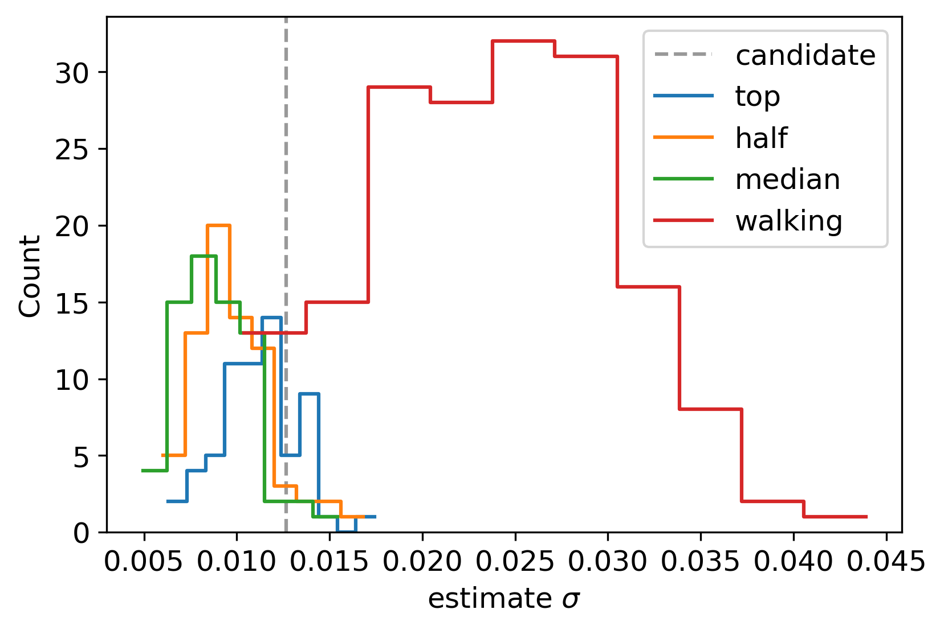
Fanjin data: estimate spatial error
spatial error estimates varying significantly within datasets.

Slide 4
Fast PWL solve

Slide 5
tabulate parameter inference data

Slide 6
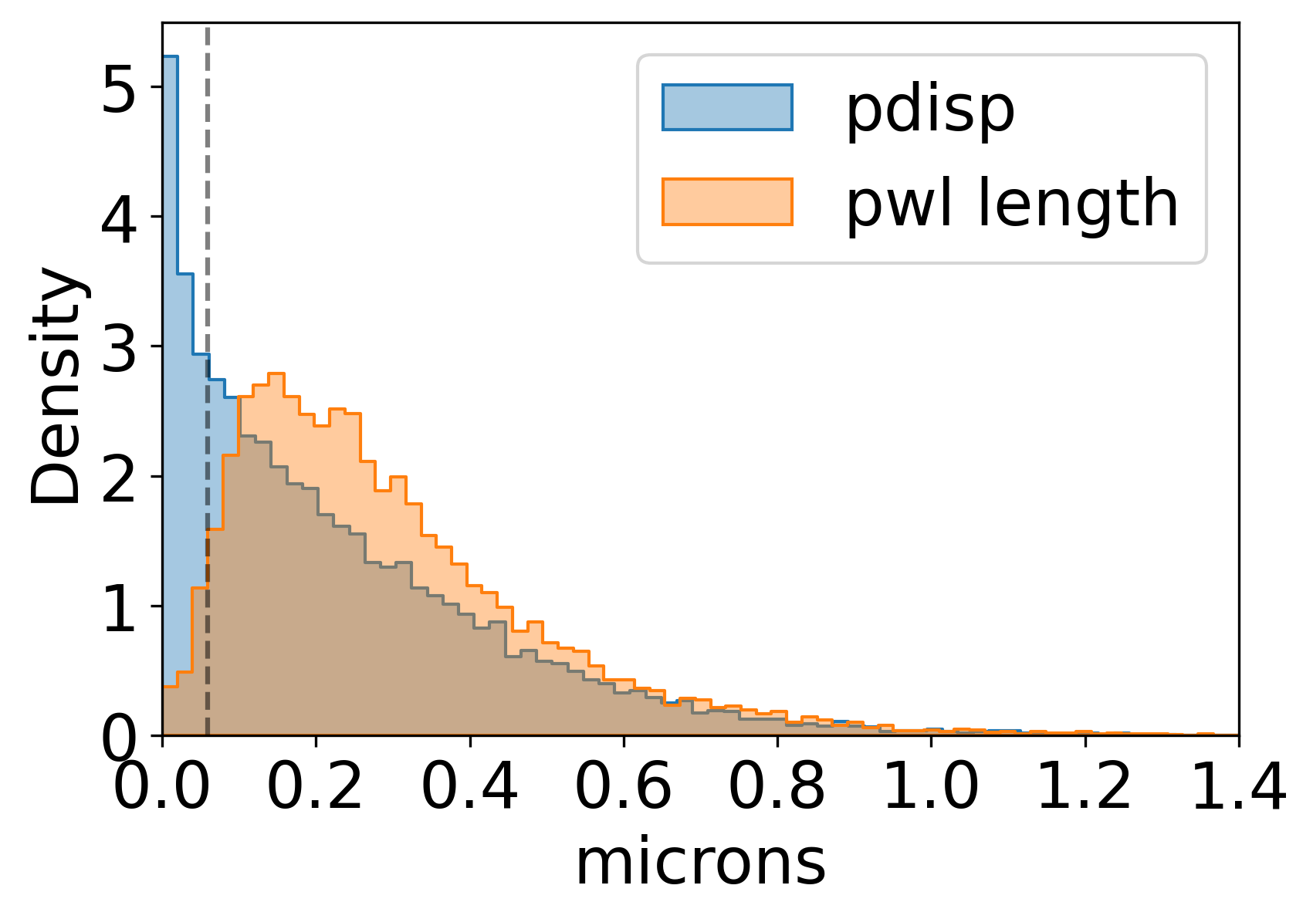
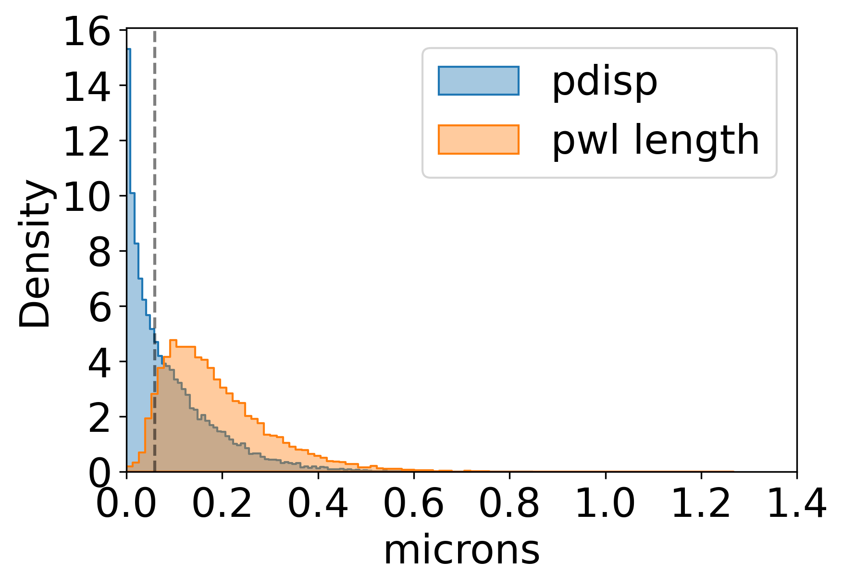
pwl/pdisp
like candidate (t7)
like top (t6)
fast moving trajectories have a smaller discrepency

Slide 7
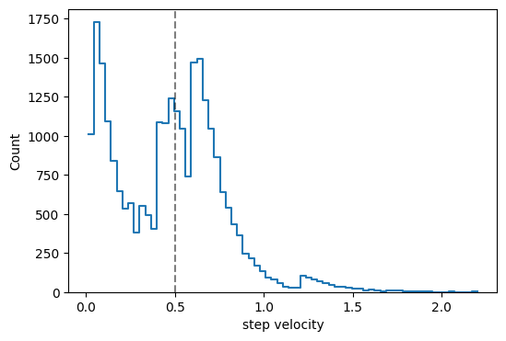
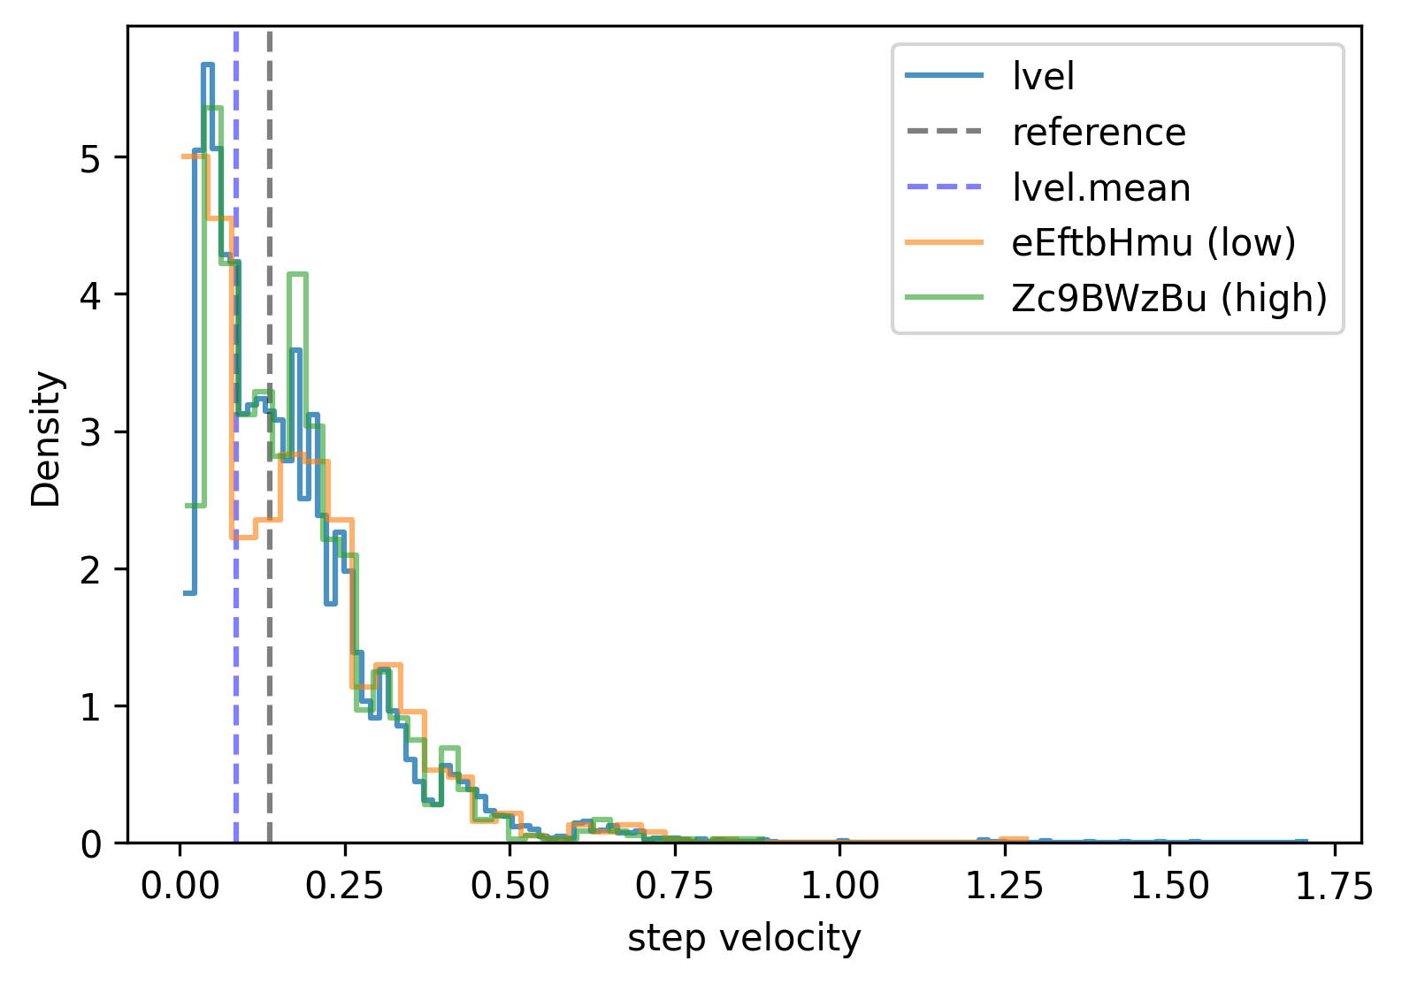
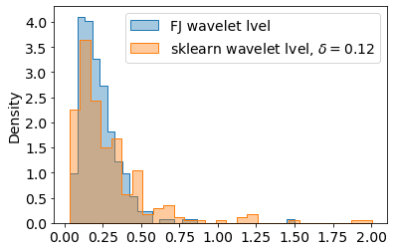
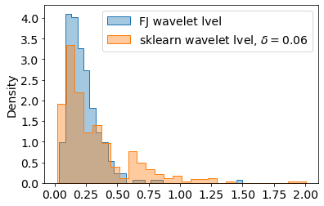
linearised speed distributions
simulated target t6 (vret=0.5)
simulated target t7 (vret=0.136)
difference between low/high kspawn manifests here?
candidate linearised velocity
r ~ 0.03 so let \delta ~ 2r
something?
vret ~ 0.5 ?

Slide 8
Master Slide

