Slide 1
group meeting 2022-10-25
Parsimonious representation of biological twitching trajectories.

Slide 2

Intro: Twitching Motion of P. Aeruginosa bacteria
Fig 1. Skerker & Berg, 2001
Fig 3. Simplified Drawing
Fig 2. Simulation

Slide 3


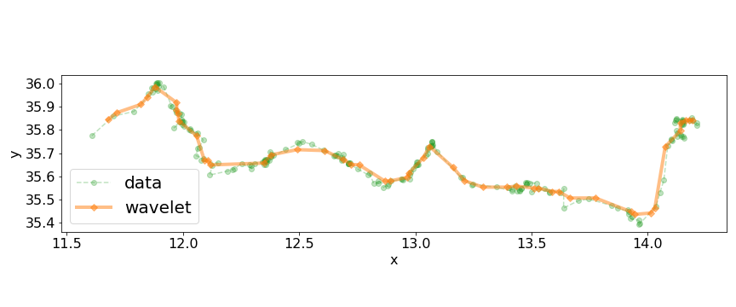
Tracking data from twitching experiments
Fig 1. 20 seconds of Tracking Data (μm)
Fig 2. tracking data with wavelet smoothing
Question: Can we get more useful, more interpret-able information from this trajectory data?

Slide 4
Piecewise Linear Solve
consider N measurements taken at equal time intervals.
Lets define a global cost function
and define a partition of this data as a series of M indices
Draw your attention to the following two issues.
Issue 1: This cost function decreases with increasing M, in fact
for any sub-sequence of the data we could do a linear fit
In regression and machine learning, this is called “overfitting”. We want M to be just large enough to capture the piecewise linear features of the data and no larger.
where distance to the line of a single data point is
Issue 2: Global optimisation by searching all possible {M, k1, …, k_M} becomes quickly infeasible for even moderate data size N.
and its common to obtain u, c by least squares optimisation. Minimise
Another (probably worse) option is to minimise

Slide 5
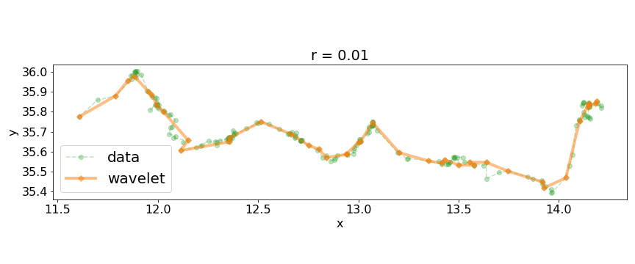
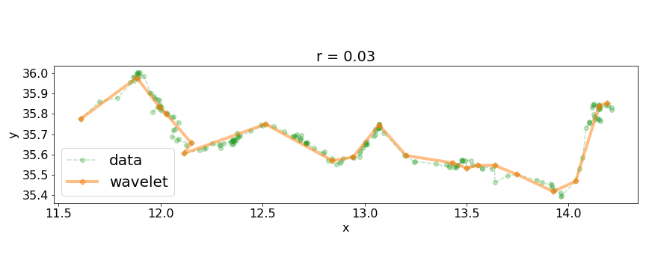
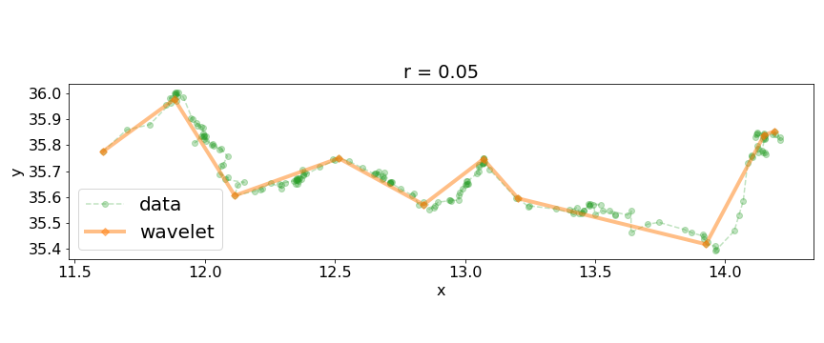
Greedy Recursion
A efficient method will help us build up intuition
So that each of the N-1 linear fits contains only two points, for which a perfect fit is always available.
Now consider joining any one of the data points to its neighbours, we could write this operation in pseudocode as
there are N-2 possible join operations on the first iteration. At each interaction we choose to join the pair with the minimum cost
Lets choose a threshold cost and use it as a stopping criteria (otherwise we will continue to join data until M = 1).
Finally obtain a connected piecewise linear model from the partition by simply selecting breakpoints from the data itself.

Slide 6
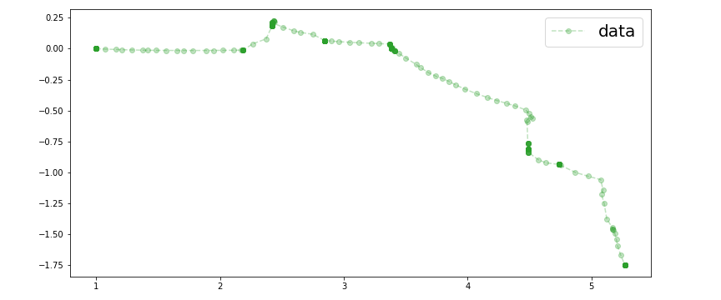
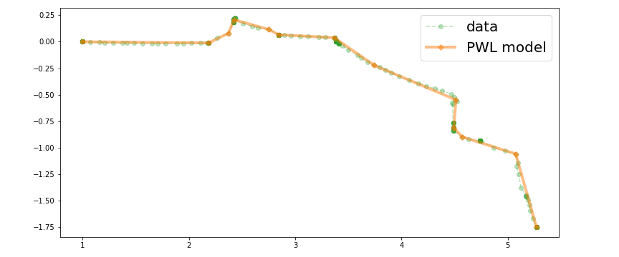
Greedy Recursion on Simulated data
This method forms the basis for more advanced algorithms.
It also works well on simulated twitching trajectories which have no noise but still have some minor non-linearities.
In this case were interested in comparing simulated and real twitching trajectories, so we output data using the experimental timestep of 0.1 seconds.
We assumed the measurement errors in real data follow a normal distribution and estimated sigma using a heuristic method.
Roughly, if we want to use the ɸ∞ cost function to extract linear features of the data with a high confidence we could use the inverse cumulative distibution function to set r, e.g.
Which says that there is a 1% chance that a measurement error will be greater than 0.028.
(2% If we consider that the error could be on either tail)
r = 0.030

Slide 7
Simulated Annealing
A more expensive approach is to stochastically (but exhaustively) search the space of partitions
Its possible that we will sometimes want to increase M, or break the constraint so long as we eventually converge a partition that satisfies the constraint.
Simulated annealing is a Monte Carlo optimisation algorithm which uses a decreasing “temperature” T to control the probability that an unfavourable transition is accepted.
for the minimal partition that nonetheless satisfies a cost condition for every piecewise element.
That is
Transitions are accepted if
Lets define the following three random transitions.
Where S is the state of the partition, and P would satisfy
We can always accept random transitions which decrease M while maintaining the constraint.
The temperature is then gradually reduced to 0 during the optimisation.

Slide 8
Simulated Annealing (Visual Aid)
< Libreoffice couldn’t handle this GIF >

Slide 9
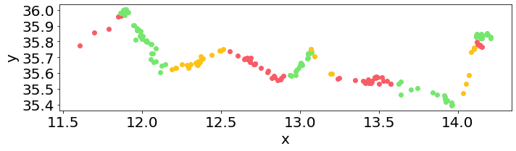

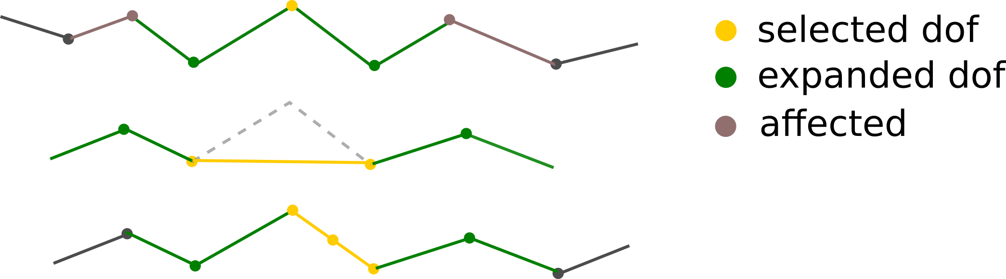
Connected PWL model
Solving for an optimal partition is not quite the same as solving for the piecewise linear model itself.
But the alternative, optimising a connected piecewise linear model, is quite expensive.
random move
Random moves
local solve

Slide 10
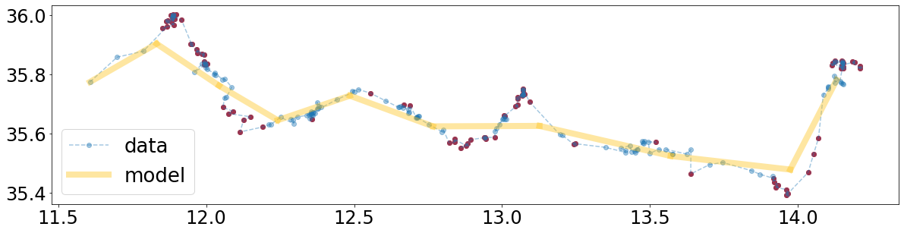
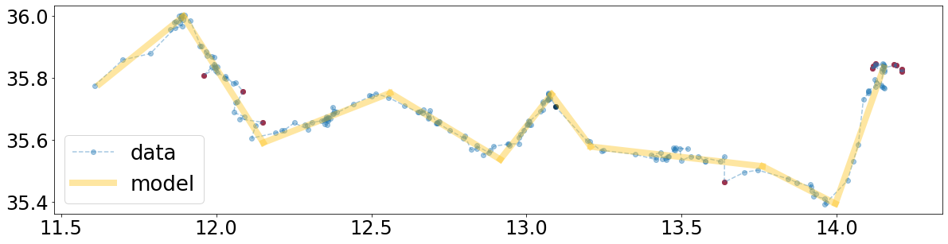
Minimum Description Length
We can solve for a connected piecewise model by reinterpreting the threshold r and defining a new global cost function using an idea from information theory.
The second summand is the number of “outliers”, points which are distance r or further from the candidate piecewise curve.
Fig 1. Initial guess with outliers (red) and points close to the model (blue)
This “description length” encodes information about both the goodness of fit and the number of piecewise components. We can search for a global minimum.
Unfortunately the description length is an integer valued function making it difficult to optimise. I use a trick here:
And other trick is to minimise the tuple
Fig 2. Minimum description length model.
Which means that removing piecewise segments is preferred if doing so leaves the description length unchanged.

Slide 11
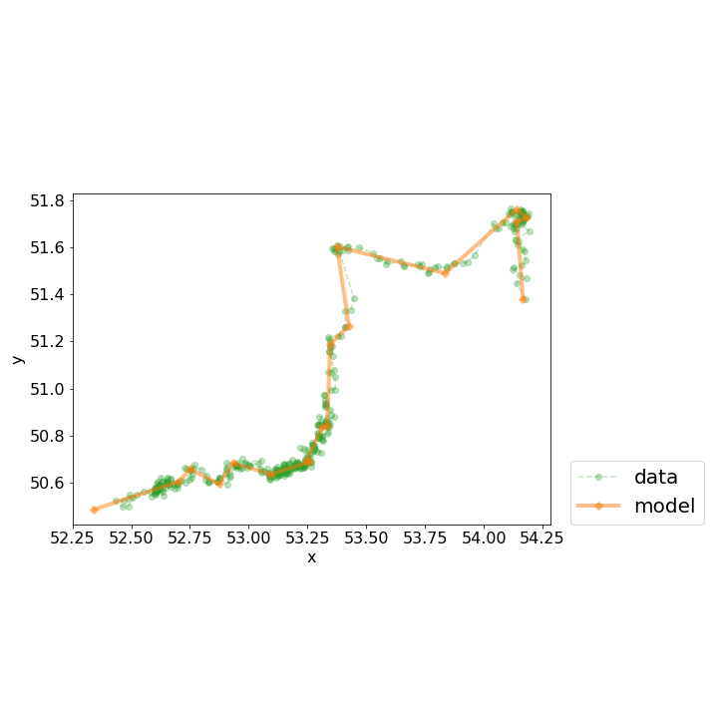
Minimum Description Length
Pro
Con
Insensitive to outliers
Conceptually simple
Arbitrary weighting of outliers and model segments
Introduces a discrete threshold into otherwise continuous variables.
Difficult to optimise directly
Threshold throws away some information
Pro/Con
Fig 1. Example trajectory showing heterogeneous velocity.
The r threshold is quite robust, but is it robust enough?

Slide 12
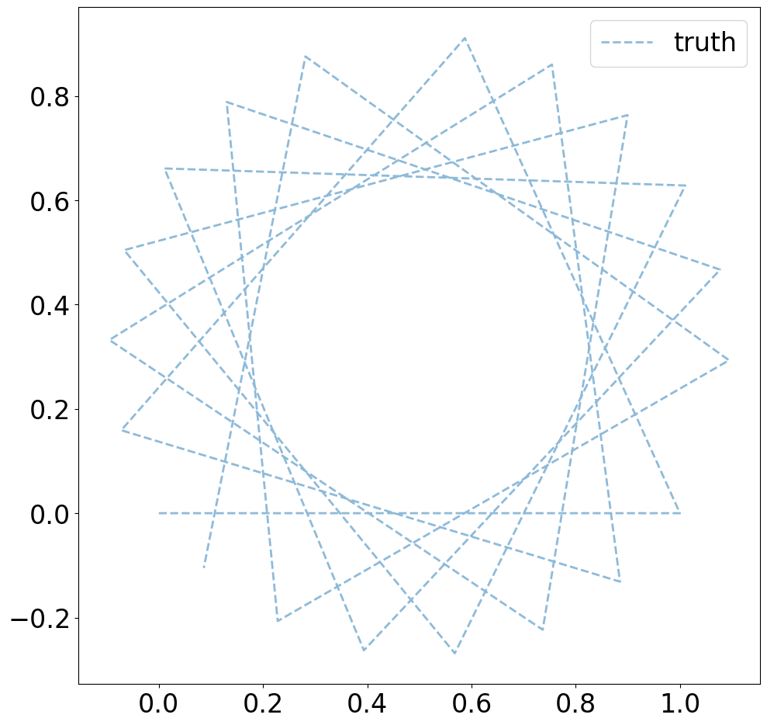
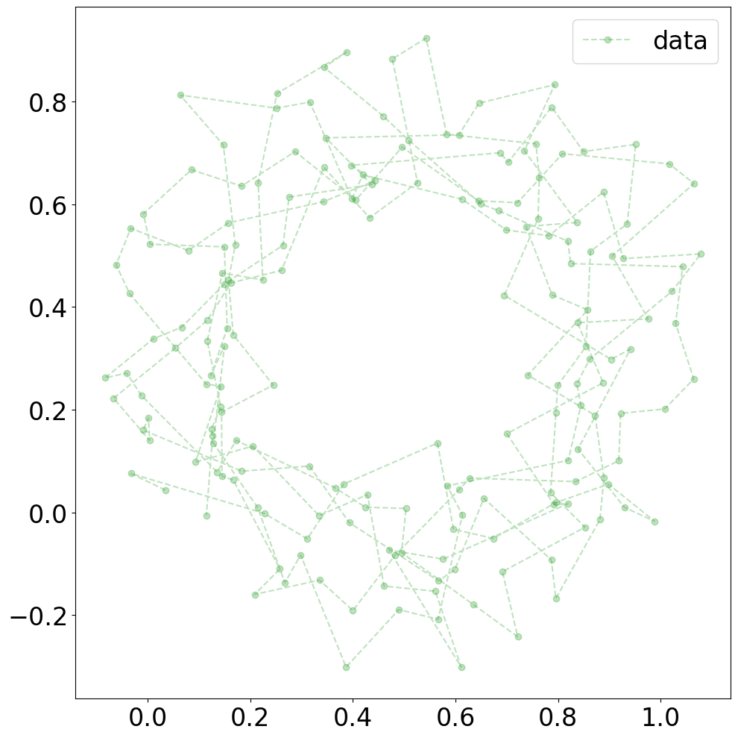
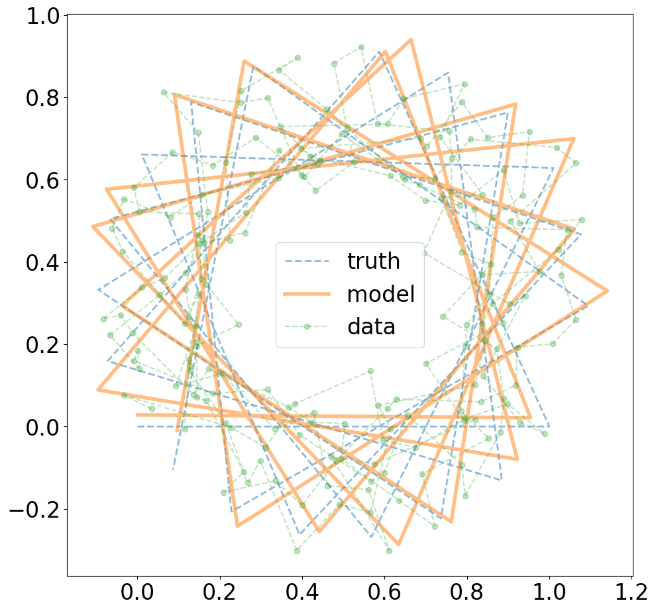
Synthetic Data Example
Generate 10 random points per line segment.
sigma = 0.1
step length = 1.0
p_threshold = 0.98
r = 0.23
sampling_dx = 0.1

Slide 13
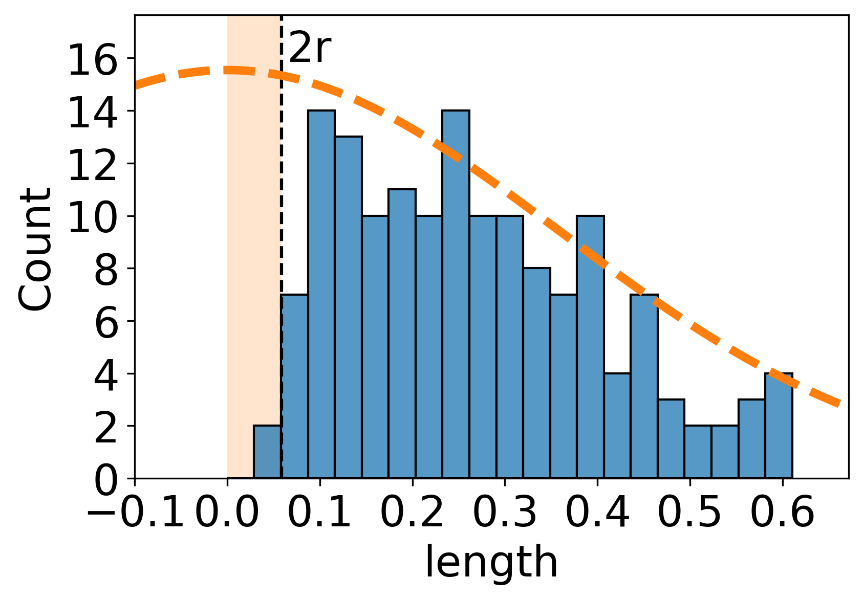
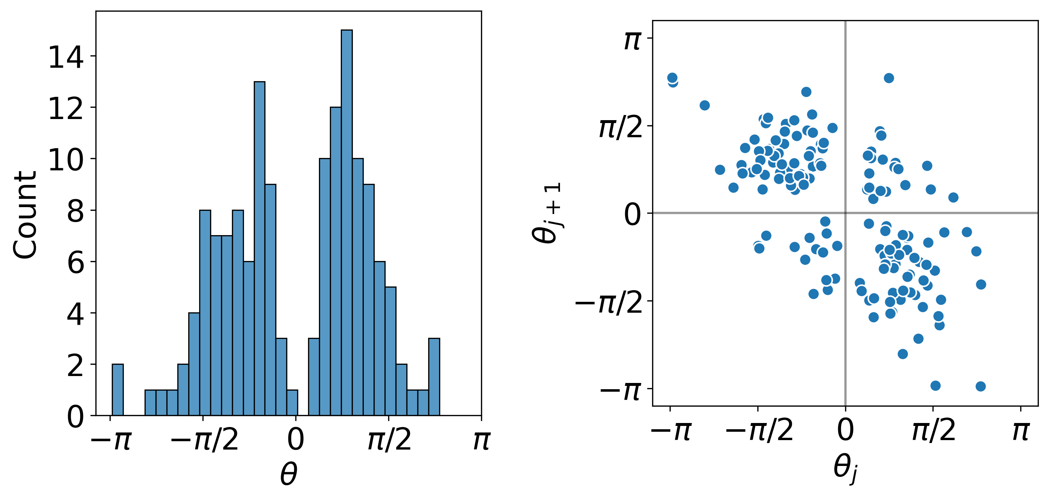
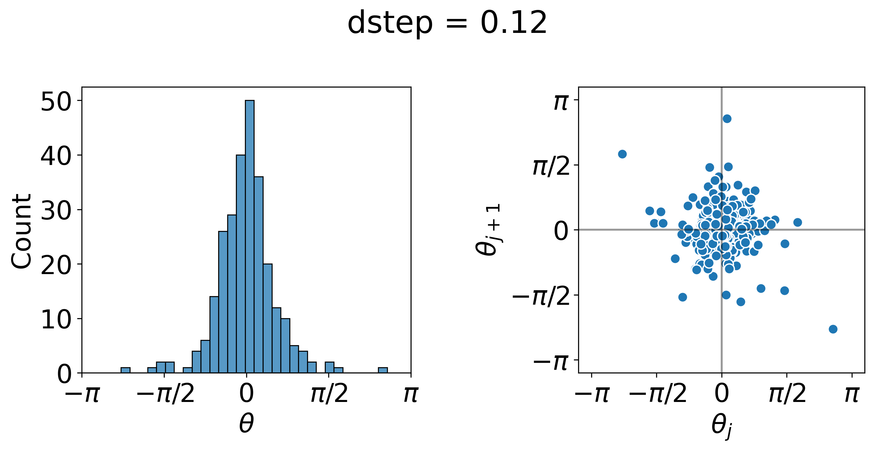
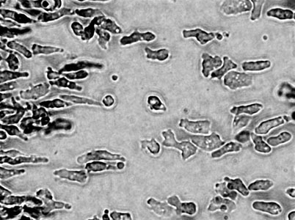
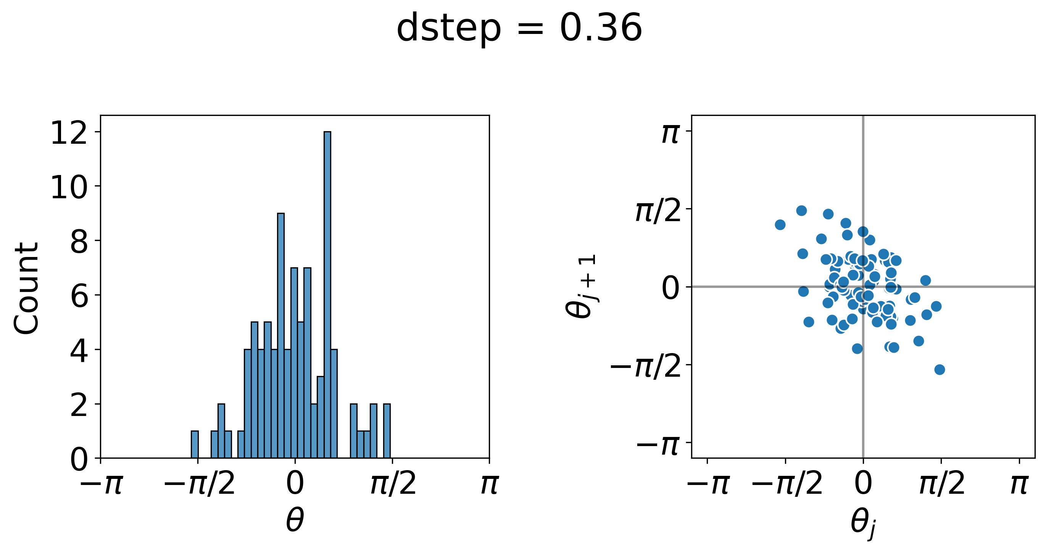
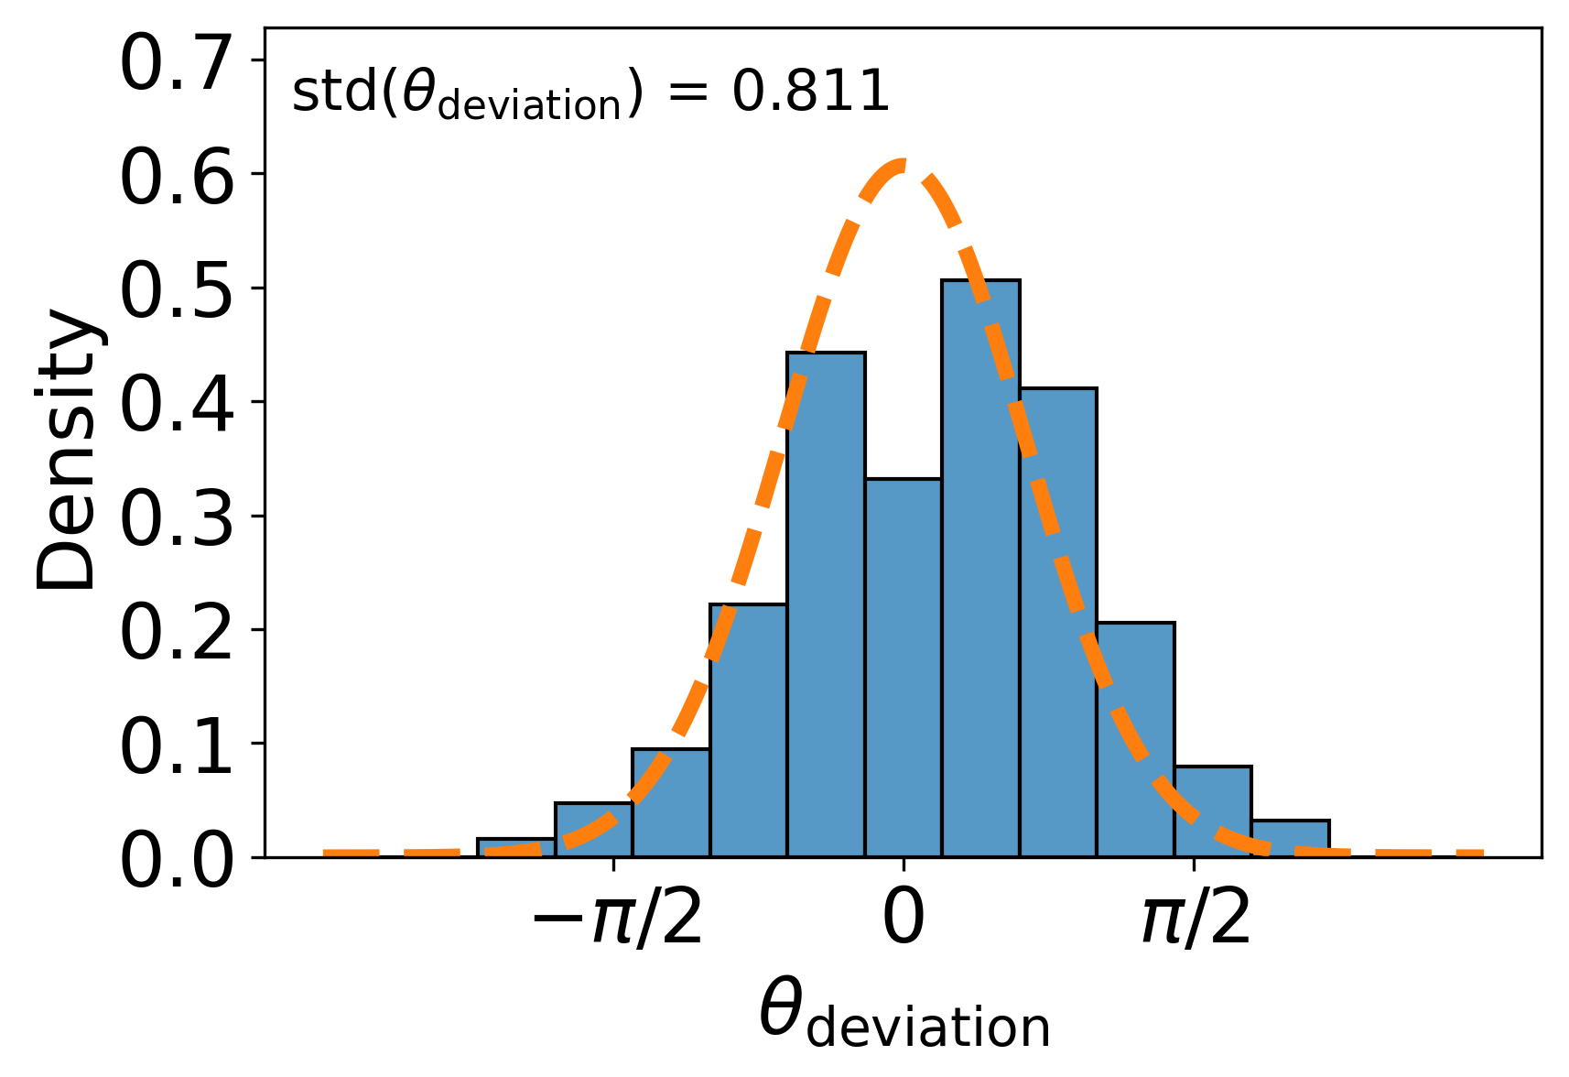
Statistics
This experimental trajectory has ~2000 data points
Segment length distribution
Sequential linear displacements are anticorrelated (corrcoef = -0.65)
The effect can be seen by a simple coarse graining with length 0.36 μm
Angle between body axis and velocity
This behaviour is shared with Dictyostelium (slime mold)

Slide 14
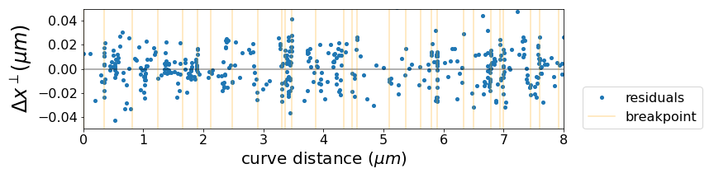
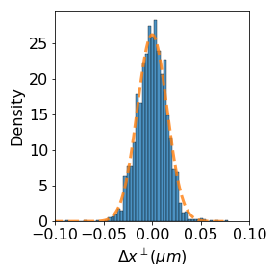
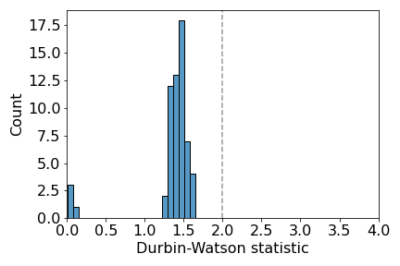
Residual Analysis
Residuals vs. curve distance
measurements clustering around breakpoints indicates low velocity/pausing between linear segments
Short timescale non-linearities would show up in the correlation between residuals.
Durbin Watson statistic. Values less than 2 indicate a positive correlation.
normal distribution of residuals
Estimated std : 0.0126
Residual std : 0.0152
“unexplained” deviation
0.0152 – 0.0126 = 0.0026
Very short timescale non linearities implies that the bacteria makes displacements which are beyond our spatial and temporal resolution to detect.
Fig. Population statistics for similar trajectories (N=60)

Slide 15
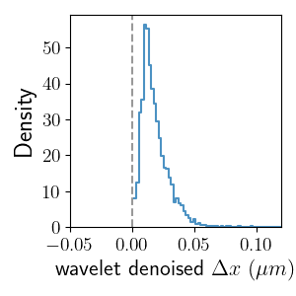
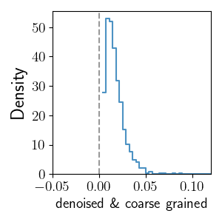
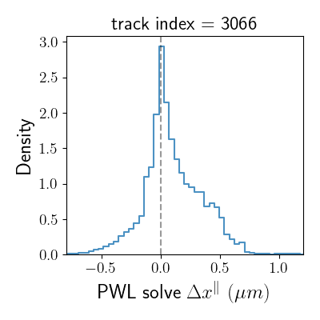
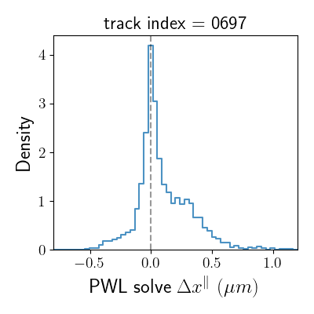
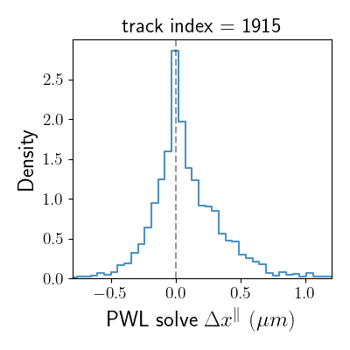
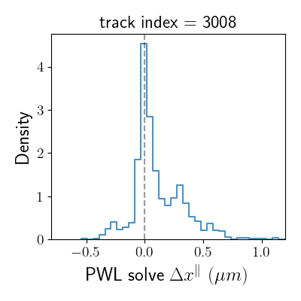
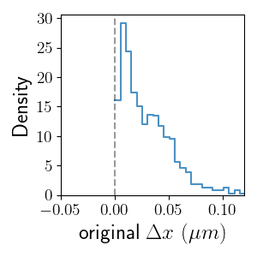
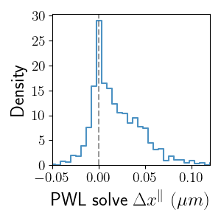
Velocity Distributions
Fanjin et al. report a bimodal velocity distribution for particular twitching trajectories.
For comparing simulated and experimental data, I usually use a denoised (wavelet transform) and coarse grained displacement distribution
Bimodal velocity distribution is a generic property? Plotting distributions for similar trajectories...
but bimodal velocity distribution is easier to spot in unprocessed 0.1s displacements.
obtained by mapping data onto PWL solution

Slide 16
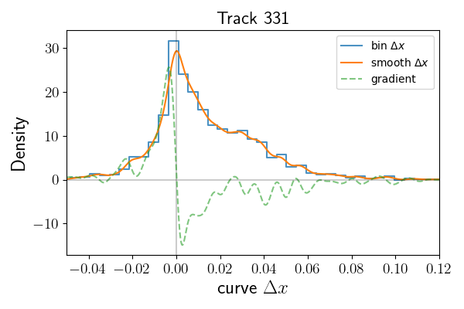
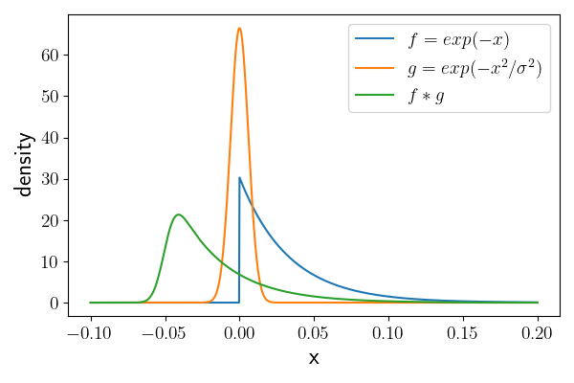
Bimodal velocity: generic property of twitching or not?
Idea 1: peak fitting
Idea 2: model fitting
Look for peaks in smoothed distribution or its gradient.
Continue by post processing the results for significant peaks.
Construct “mixture models” with e.g. exponential part and a gaussian part.
Convolve models with the error distribution and then compare to to smoothed data.

Slide 17
That’s Enough

