Slide 1
group meeting 2022-06-01
Noise reduction for piece-wise linear signals embedded in 2d.
(e.g. certain biological trajectories)

Slide 2

twitching motility
Fig 1. Skerker & Berg, 2001
Fig 3. Simplified Drawing
Fig 2. Simulation

Slide 3


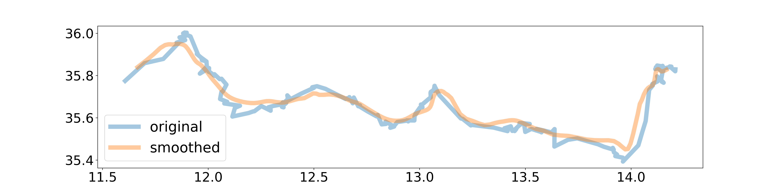
Tracking data from twitching experiments
Fig 1. 20 seconds of Tracking Data (μm)
Fig 2. tracking data with wavelet smoothing
Question: Can we get more useful, more interpret-able information from this trajectory data?

Slide 4
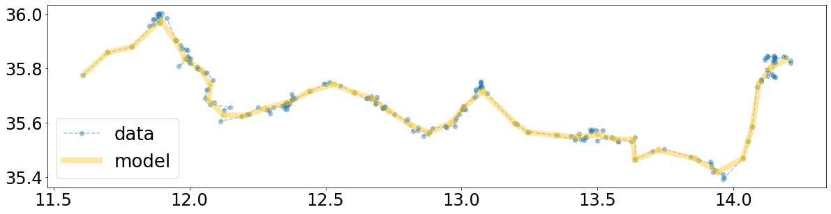
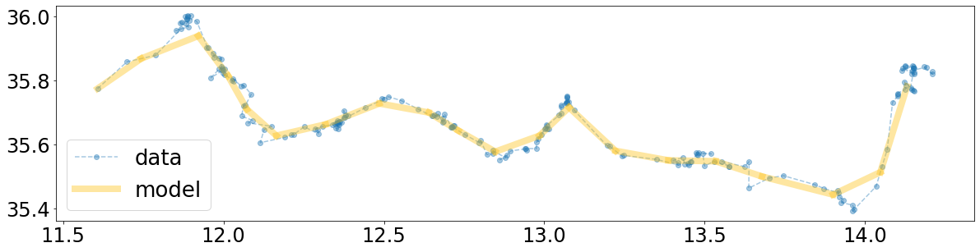
What if we only look for piece-wise linear trajectories?
M = 40
M = 20
Question: How do we select for the number of segments?

Slide 5
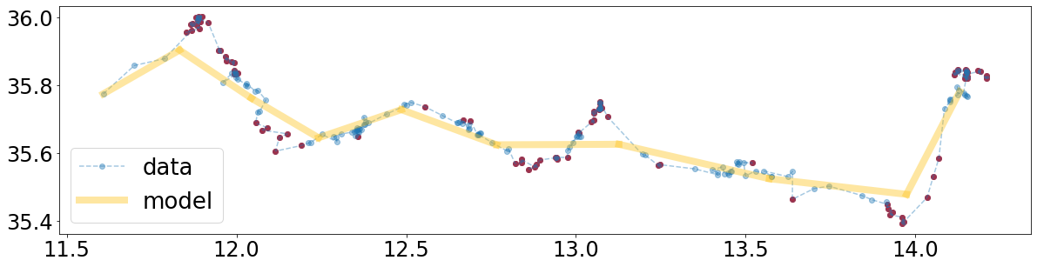
Minimum Description Length Principle
When choosing an optimal model to describe some data, the best model might be the one which describes the data using the least “information”
  This approach is quite natural for humans, e.g. Occam’s Razor
  Let M be the number of nodes in the piece-wise linear “model”, let N be the number of data points.
  Each model node is counted a 1 unit of information. M units in total
  Set a threshold r, points within r of the piece-wise linear curve are counted as part of the model, points further than r are considered outliers and counted separately. Let the number of outliers be n.
  Description Length (DL) = M + n
Fig 1. Initial guess with outliers (red) and points close to the model (blue)

Slide 6
Initial guess
M = 10
Simple Method for initial guesses.
Choose a number of segments M.
Identify the pair of adjacent data points with the minimum separation and join them together.
repeat until there are M+1 points remaining.

Slide 7
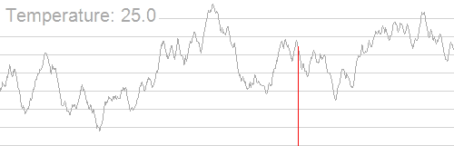
Annealing / Basin Hopping
General Idea
randomly choose a conformational change to the piece-wise linear curve, i.e. create or destroy a node.
Estimate the local minimum of the description length for this conformation
If the new description length is better than the current description length, accept the new state of the system, otherwise reject it.
go to step 1.

Slide 8
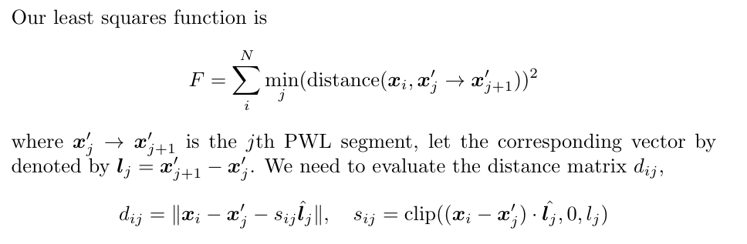
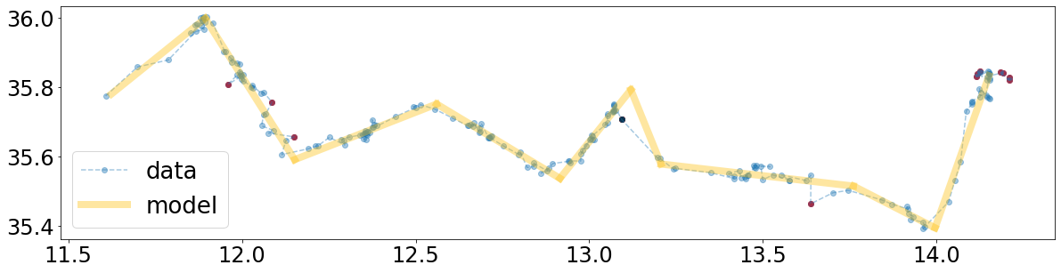
Least Squares

Slide 9
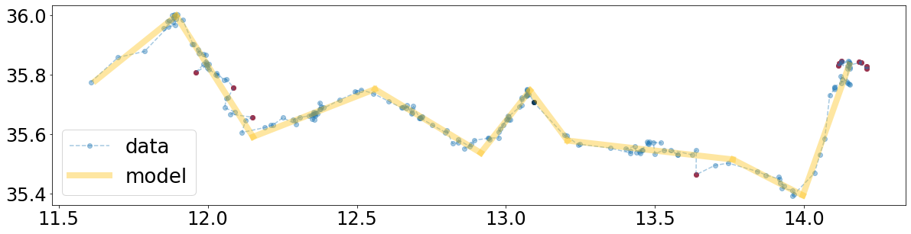
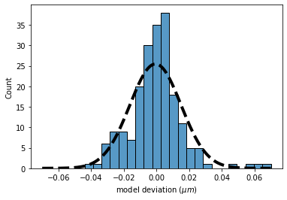
An additional Monte Carlo move
Mapping point 128 to segment 6 leads to a better global minimum
segment 6
point 128

Slide 10
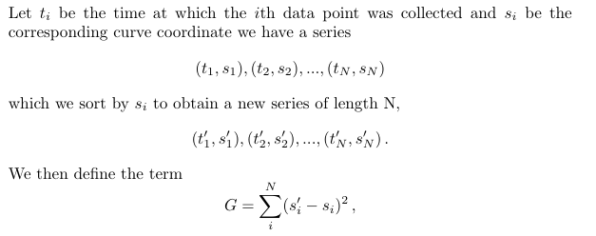
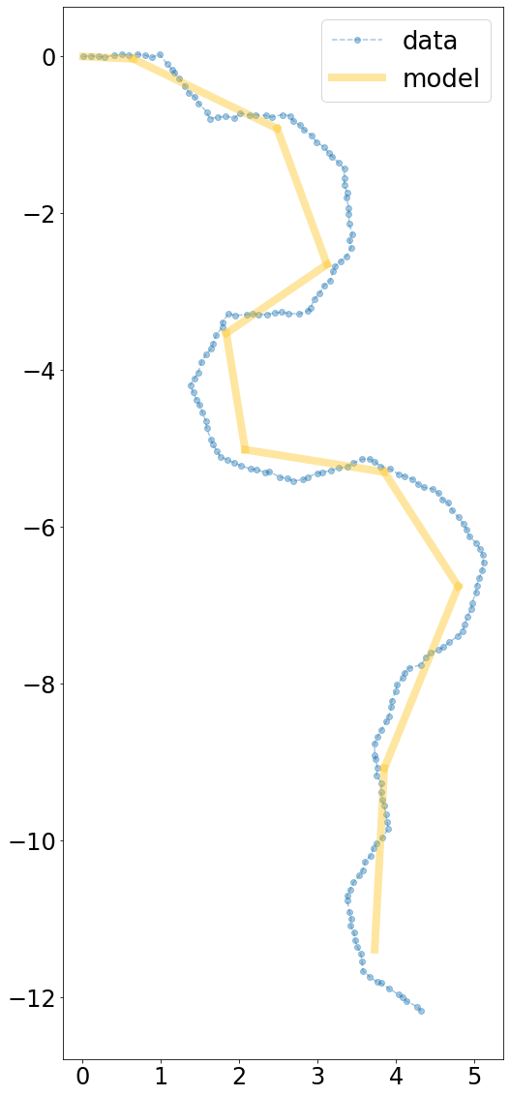
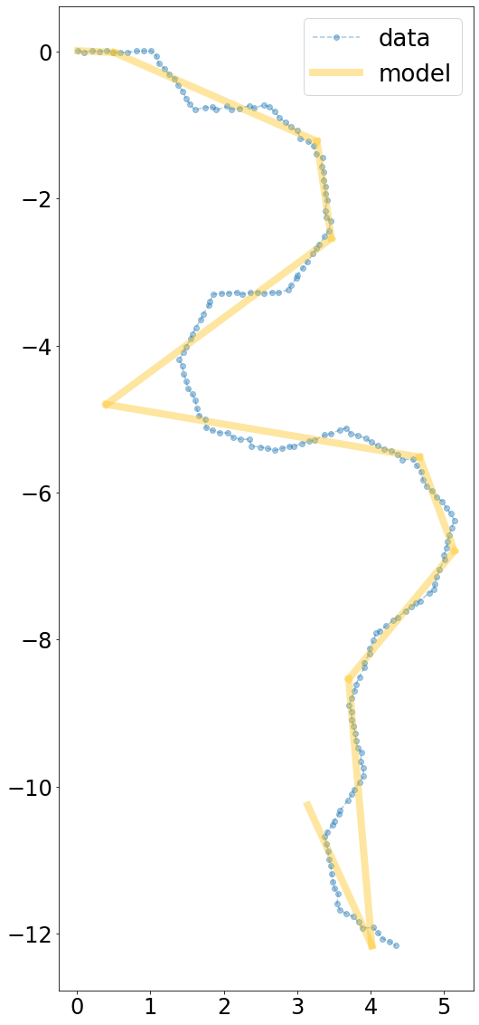
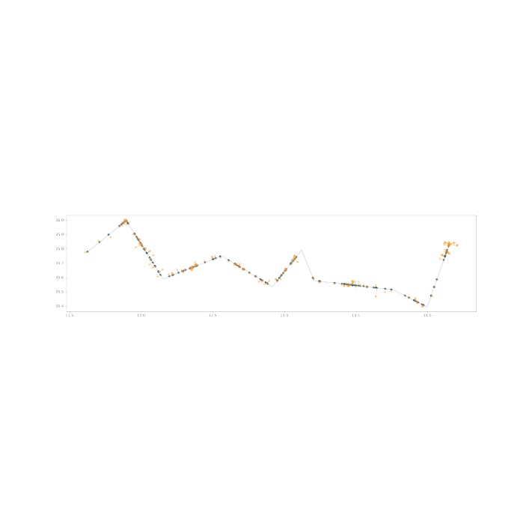
Time ordering term
Fig 1. map points back onto curve to get curve coordinates.
Fig. Initial guess + local solve, with (left) and without (right) additional ordering term.

Slide 11
Todo
Finish implementation.
Continue revising and testing implementation using synthetic data.
Analyse individual trajectories and bacteria populations.
E coli, run and tumble
P. Aeruginosa twitching

