Slide 1

Web Programming in Python with Django IAP 2013 Student Information Processing Board Luke O’Malley ‘14
Notes:
Marathon ahead of us
I assume you know Python
I will do my best to justify everything I teach
I want you to leave with an understanding of how all of the pieces work together

Slide 2
SIPB: Django Web Programming, IAP 2013
Overview
Install Django
Website Architecture
The “10,000 foot view” of Django
Running a Django Server Locally
Django Project Structure
Starting a Project and Adding an App
From URL to
Templating
Form Generation
Admin Capabilities
scripts.mit.edu

Slide 3
SIPB: Django Web Programming, IAP 2013
Class Material
mit.edu/omalley1/django
Notes:
Zip of code you’ll need

Slide 4
SIPB: Django Web Programming, IAP 2013
Install Django

Slide 5
SIPB: Django Web Programming, IAP 2013
<your terminal>$ pip install django
or
<your terminal>$ easy_install django
or
<your terminal>$ apt-get install python-django
Notes:
Django website recommends pip, but easy_install should also work

Slide 6
SIPB: Django Web Programming, IAP 2013
Websites and Their Pieces
Notes:
Websites have three layers
Front-end
Back-end
Data Management
Database

Slide 7

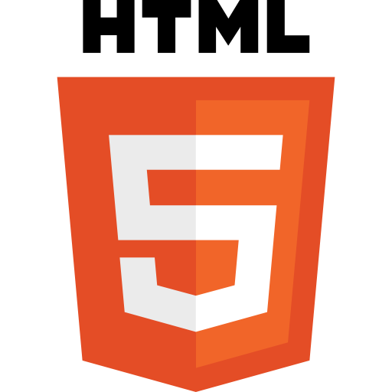

SIPB: Django Web Programming, IAP 2013
Front-end:
Broadly, it is what the user interacts with
Where data is entered and displayed
Often sends information to backend for processing and storage

Slide 8



SIPB: Django Web Programming, IAP 2013
Back-end:
Broadly, it receives data from front-end and processes and stores it
Responsible for “serving” content
Often composed of a database and management layer
frameworks
database

Slide 9
SIPB: Django Web Programming, IAP 2013
The “10,000 foot view” of Django

Slide 10
SIPB: Django Web Programming, IAP 2013
What is Django?
Notes:
Bridges the gap between what a user sees and the database
Databases are stupid and can be painful to work with, Django makes it easy
Databases include mysql, postgres, oracle, and others.

Slide 11


SIPB: Django Web Programming, IAP 2013
What is Django?
Bridges the gap between what the user sees and the database
Databases are hard, but Django makes it easy to work with them
Popular databases include:
Notes:
Bridges the gap between what a user sees and the database
Databases are stupid and can be painful to work with, Django makes it easy
Databases include mysql, postgres, oracle, and others.

Slide 12
SIPB: Django Web Programming, IAP 2013
Why Django?

Slide 13
SIPB: Django Web Programming, IAP 2013
Why Django?
Python, easy to read and understand
Don’t Repeat Yourself (DRY) Philosophy!
The community has done a lot of the thinking for you, including security

Slide 14
SIPB: Django Web Programming, IAP 2013
How Does Django Work?

Slide 15
SIPB: Django Web Programming, IAP 2013
Model-Template-View (MTV)
Model
Anything dealing with data and its representation (i.e. a user or even data validation)
Template
How data is displayed, what it looks like, this is the presentation layer
View
What data is presented to the template, the control logic, bridging models and template

Slide 16
SIPB: Django Web Programming, IAP 2013
Django gives you:
Object-relational mapper
Define Python classes
Rich way of interacting with database
Automatic admin interface
Don’t waste your time creating an admin page, Django does this for you
Elegant URL design
Regex matching
Templating system
Fill in web pages on the fly!

Slide 17
SIPB: Django Web Programming, IAP 2013
Running a Django Server Locally

Slide 18
SIPB: Django Web Programming, IAP 2013
In your terminal, from the website directory, type:
<your terminal>$ python manage.py runserver
Validating models...
0 errors found
Django version 1.4, using settings 'rsvp.settings'
Development server is running at http://127.0.0.1:8000/
Quit the server with CONTROL-C
Open your browser and visit:
localhost:8000
Notes:
Go to your browser and explore the site a bit.

Slide 19
SIPB: Django Web Programming, IAP 2013
Starting a Project
and
Adding an App

Slide 20
SIPB: Django Web Programming, IAP 2013
<your terminal>$ django-admin.py startproject <name>
Notes:
Manage.py is what you will mostly interact with, what we ran in last step
Settings.py file is an important one to edit, we’ll look at that a little later
Urls.py has our url configurations in it, also look at that later

Slide 21
SIPB: Django Web Programming, IAP 2013
This creates the following project structure:
<name>/
manage.py
<name>/
__init__.py
settings.py
urls.py
wsgi.pyls
Notes:
Manage.py is what you will mostly interact with, what we ran in last step
Settings.py file is an important one to edit, we’ll look at that a little later
Urls.py has our url configurations in it, also look at that later

Slide 22
SIPB: Django Web Programming, IAP 2013
Our Django project:
event/ <- developer added app
__init__.py
admin.py <- developer added
models.py
test.py
views.py
manage.py
rsvp/
__init__.py
settings.py
static/ <- developer added
templates/ <- developer added
urls.py
wsgi.pyls
Notes:
our project looks a bit different, we added an events app

Slide 23
SIPB: Django Web Programming, IAP 2013
Add an app:
<your terminal>$ python manage.py startapp <name>
Register it in ‘rsvp/settings.py’:
INSTALLED_APPS = (
'django.contrib.auth',
'django.contrib.contenttypes',
'django.contrib.sessions',
'django.contrib.sites',
'django.contrib.messages',
'django.contrib.staticfiles',
# Uncomment the next line to enable the admin:
'django.contrib.admin',
# Uncomment the next line to enable admin documentation:
# 'django.contrib.admindocs',
'<name>'
)
Notes:
Go to your browser and explore the site a bit.

Slide 24
SIPB: Django Web Programming, IAP 2013
From URL to Page Render

Slide 25
SIPB: Django Web Programming, IAP 2013
What happens when a user enters this in the browser?
www.your-site-domain.com
Notes:
our project looks a bit different, we added an events app

Slide 26
SIPB: Django Web Programming, IAP 2013
What happens when a user enters this in the browser?
www.your-site-domain.com
event/ <- developer added app
__init__.py
admin.py <- developer added
models.py
test.py
views.py
manage.py
rsvp/
__init__.py
settings.py
static/ <- developer added
templates/ <- developer added
urls.py
wsgi.pyls
Notes:
our project looks a bit different, we added an events app
Must register this app in settings.py!

Slide 27
SIPB: Django Web Programming, IAP 2013
‘rsvp/settings.py’ stores location of our URL config file
ROOT_URLCONF = 'rsvp.urls'
We then reference ‘rsvp/urls.py’
from django.conf.urls import patterns, include, url
urlpatterns = patterns('',
url(r'^$', 'event.views.home', name='home'),
)
Notes:
Regex matching for url, can also pass in variables via url

Slide 28
SIPB: Django Web Programming, IAP 2013
We then reference ‘events/views.py’
from django.shortcuts import render
def home(request):
return render(request, 'index.html')
Django knows where to find template directory because of ‘rsvp/settings.py’
TEMPLATE_DIRS = (
os.path.join(PROJECT_ROOT, 'templates/'),
)
Notes:
I’ve set in settings.py where my templates folder is

Slide 29
SIPB: Django Web Programming, IAP 2013
Work with Data

Slide 30
SIPB: Django Web Programming, IAP 2013
Define a model for events:
class Event(models.Model):
title = models.CharField(max_length=128)
description = models.TextField()
date = models.DateField()
location = models.CharField(max_length=128)
def __unicode__(self):
return self.title
Notes:
When you add a new model must update db with manage.py syncdb
Lots of options for fields, urlfield, charfield, textfield, also key this to objects
Imagefield
Floatfield
Filefield
EmailField
Many-to-many
One-to-one

Slide 31
SIPB: Django Web Programming, IAP 2013
Manually manipulate data using Django shell:
<your terminal>$ python manage.py shell
>>> from event.models import Event
>>> Event.objects.all()
[]
>>> e = Event(title="Birthday", date="2013-01-13 07:00”, location=“4-231”, description=“Awesome”)
>>> e.save()

Slide 32
SIPB: Django Web Programming, IAP 2013
Render a template with data:
# View to return all events
def all_events(request):
events = Event.objects.all()
return render(request, 'events.html',
{'events': events})
Return JSON:
import json
from django.http import HttpResponse
def get_events(request):
events = [event.title for event in Event.objects.all()]
return HttpResponse(json.dumps({'titles':events}), content_type="application/json")

Slide 33
SIPB: Django Web Programming, IAP 2013
Templating

Slide 34
SIPB: Django Web Programming, IAP 2013
Create a template to display all events:
{% extends "base.html" %}
{% block content %}
...
{% for event in events %}
<tr>
<td>{{ event.title }}</td>
<td>{{ event.date }}</td>
<td>{{ event.description }}</td>
<td>{{ event.location }}</td>
</tr>
{% endfor %}
...
{% endblock%}

Slide 35
SIPB: Django Web Programming, IAP 2013
‘base.html’ is extended by ‘events.html’:
<div class="container">
{% block content%}
{% endblock %}
</div>
Notes:
When you add a new model must update db with manage.py syncdb
Django provides a rich ability to search for objects by calling Event.objects.filter()

Slide 36
SIPB: Django Web Programming, IAP 2013
Form Generation
Notes:
https://docs.djangoproject.com/en/dev/intro/tutorial02/

Slide 37
SIPB: Django Web Programming, IAP 2013
Create a form from a model:
from django.forms import ModelForm
class EventForm(ModelForm):
class Meta:
model = Event
Notes:
When you add a new model must update db with manage.py syncdb
Django provides a rich ability to search for objects by calling Event.objects.filter()

Slide 38
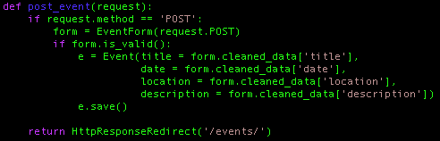
SIPB: Django Web Programming, IAP 2013
Create a form from a model:
Notes:
When you add a new model must update db with manage.py syncdb
Django provides a rich ability to search for objects by calling Event.objects.filter()

Slide 39
SIPB: Django Web Programming, IAP 2013
Adding Admin Capabilities
https://docs.djangoproject.com/en/dev/intro/tutorial02/
Notes:
https://docs.djangoproject.com/en/dev/intro/tutorial02/
Enable in urls.py
Enable in settings.py
Add admin.py to events

Slide 40
Web Programming in Python with Django IAP 2013 Student Information Processing Board Luke O’Malley ‘14
Notes:
Marathon ahead of us
I assume you know Python
I will do my best to justify everything I teach
I want you to leave with an understanding of how all of the pieces work together

