Slide 1
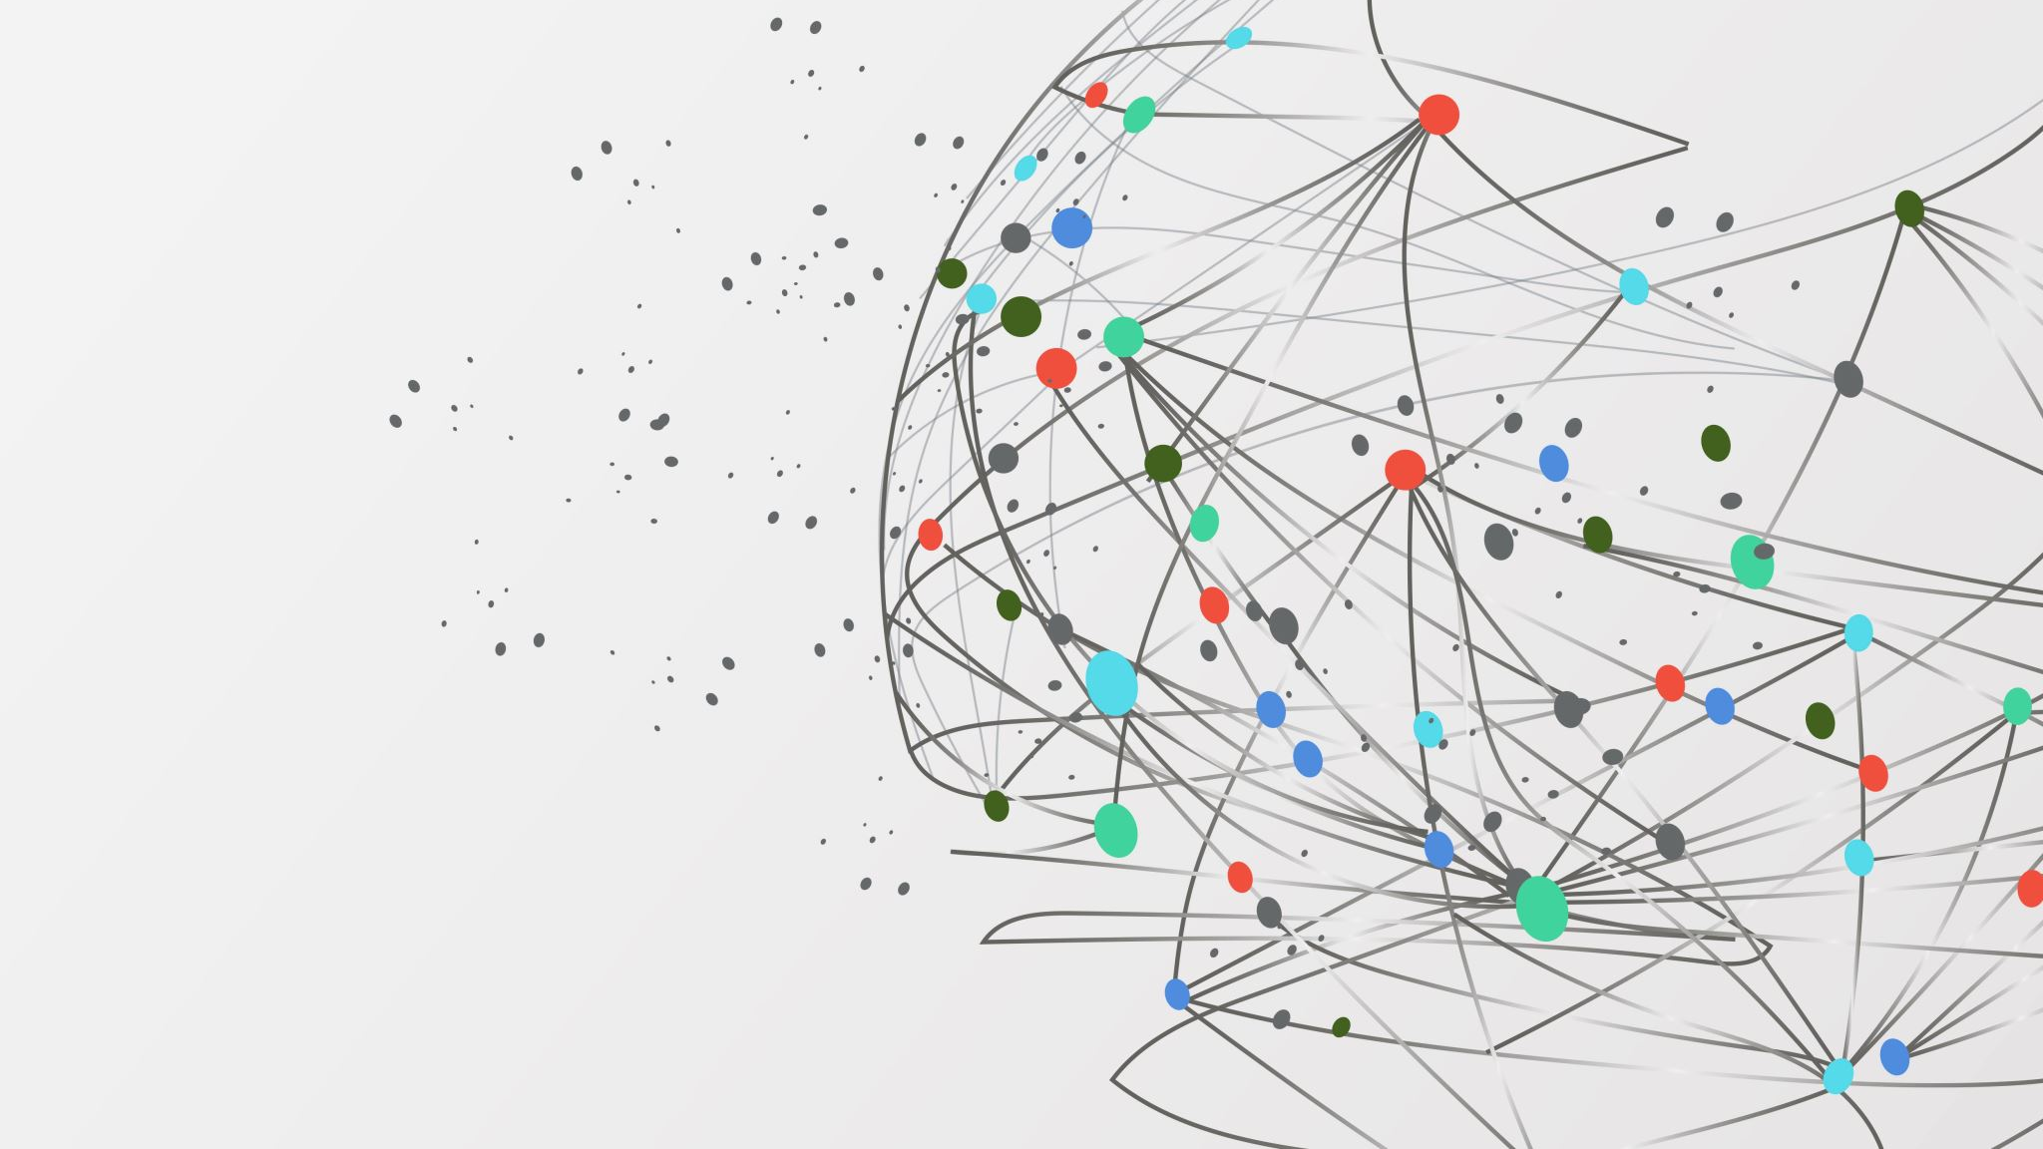
INTRODUCTION TO R
Danny Lumian, Ph.D.
Data Science Training Specialist
NIH Office of Data Science Strategy

Slide 2
Topics Covered
R platforms
R
R Studio
R Studio Cloud
R files
R script
R markdown
Basic R commands
R packages and built-in datasets
Data import and export
Data manipulation
Data Visualization
Data Analysis
Saving your work

Slide 3

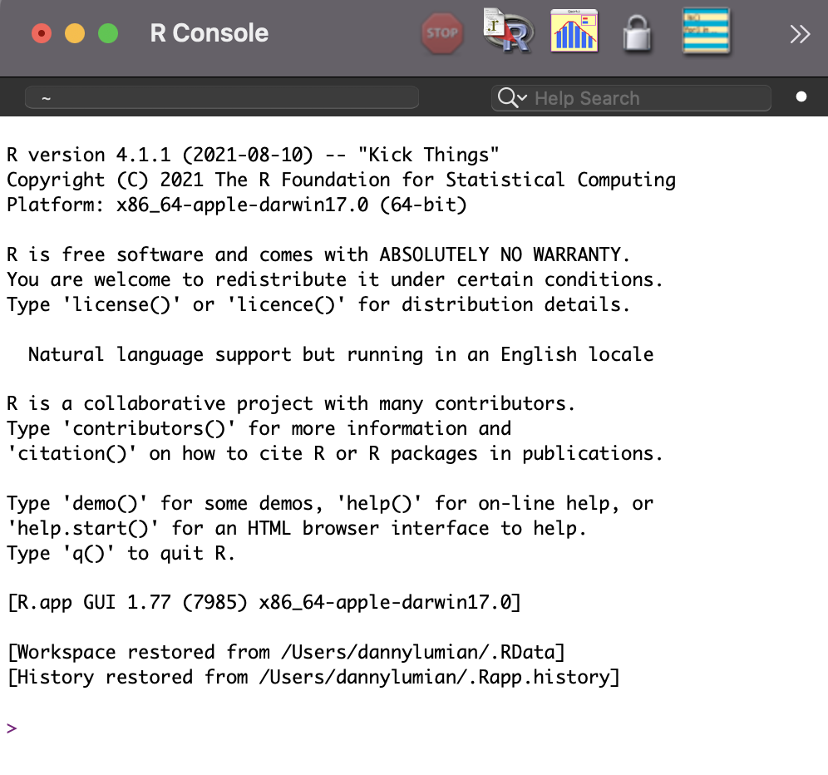
What is R?
A programming language and open-source software environment that can
Manipulate data
Visualize data
Perform statistics
Free and relatively easy to run in any environment
https://www.r-project.org/

Slide 4
What is R Studio
An integrated development environment (IDE) for R
Software that includes R, file explorer, graphics viewer, code notebook and more!
One stop shop for coding in R
https://rstudio.com/

Slide 5
