Slide 1

INTRODUCTION TO R Iris Classification Example Notebook
Danny Lumian, Ph.D.
Data Science Training Specialist
NIH Office of Data Science Strategy

Slide 2
Iris Classification
This notebook uses the built-in Iris dataset to outline a basic approach to machine learning with a decision tree classifier
There are 4 features and 1 target variable consisting of 3 groups
This notebook uses several popular machine learning libraries in R

Slide 3
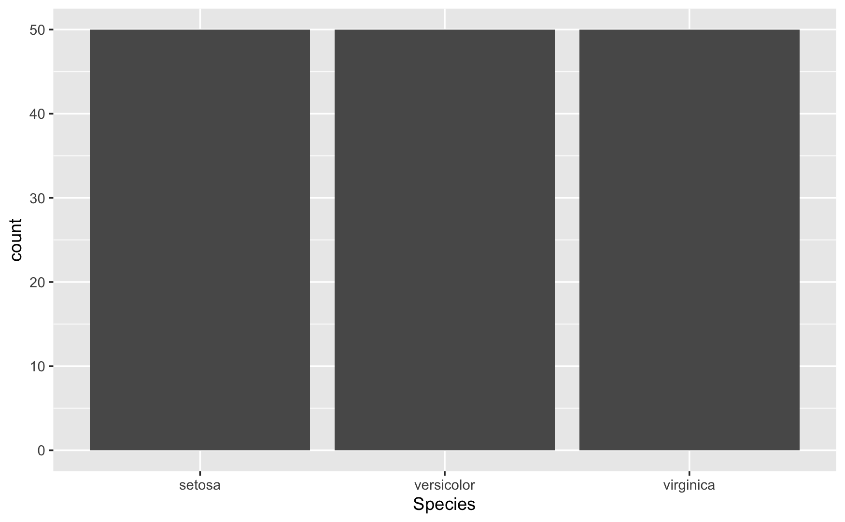
Plot the count of each target species: ggplot(data = iris, aes(x=Species)) + geom_bar()

Slide 4
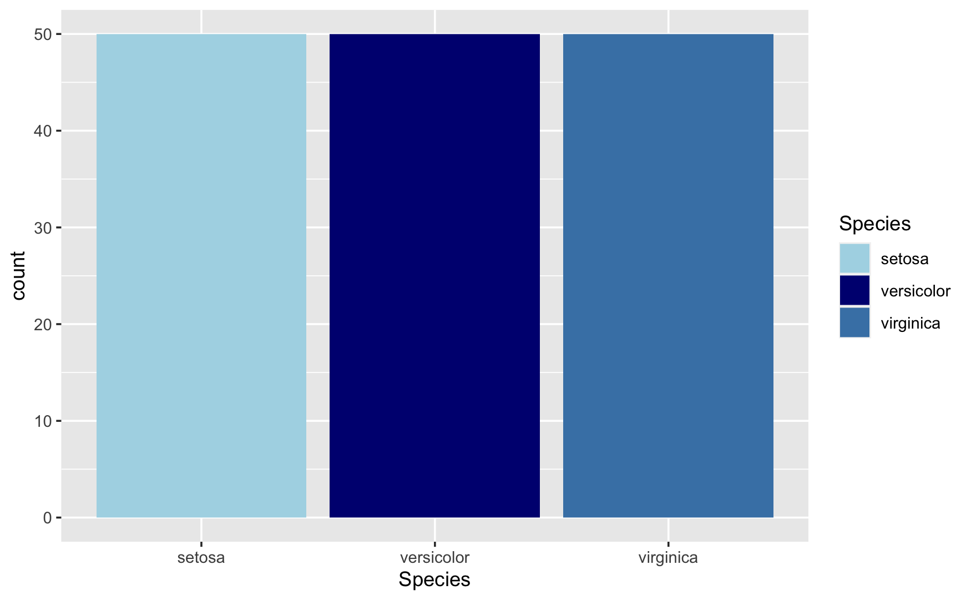
Plot the count of each target species with color: ggplot(data = iris, aes(x=Species, fill=Species)) + geom_bar() + scale_fill_manual(values = c('lightblue', 'navy', 'steelblue'))

Slide 5
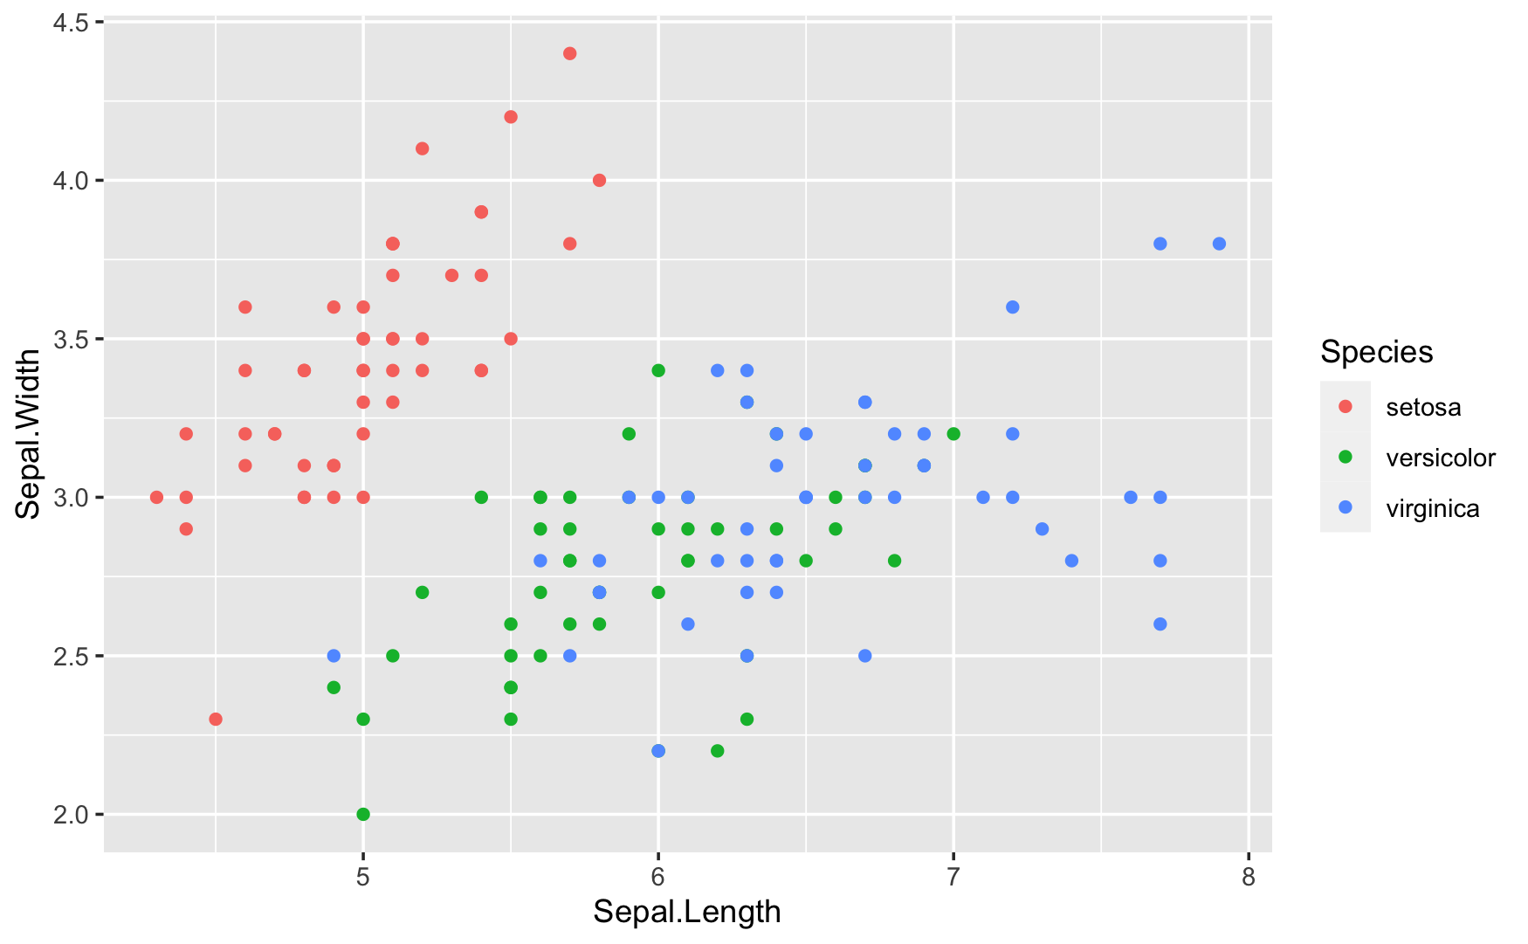
Scatter plot of Features
point1 = ggplot(data=iris, aes(x=Sepal.Length, y=Sepal.Width, color=Species))
point1 + geom_point()

Slide 6
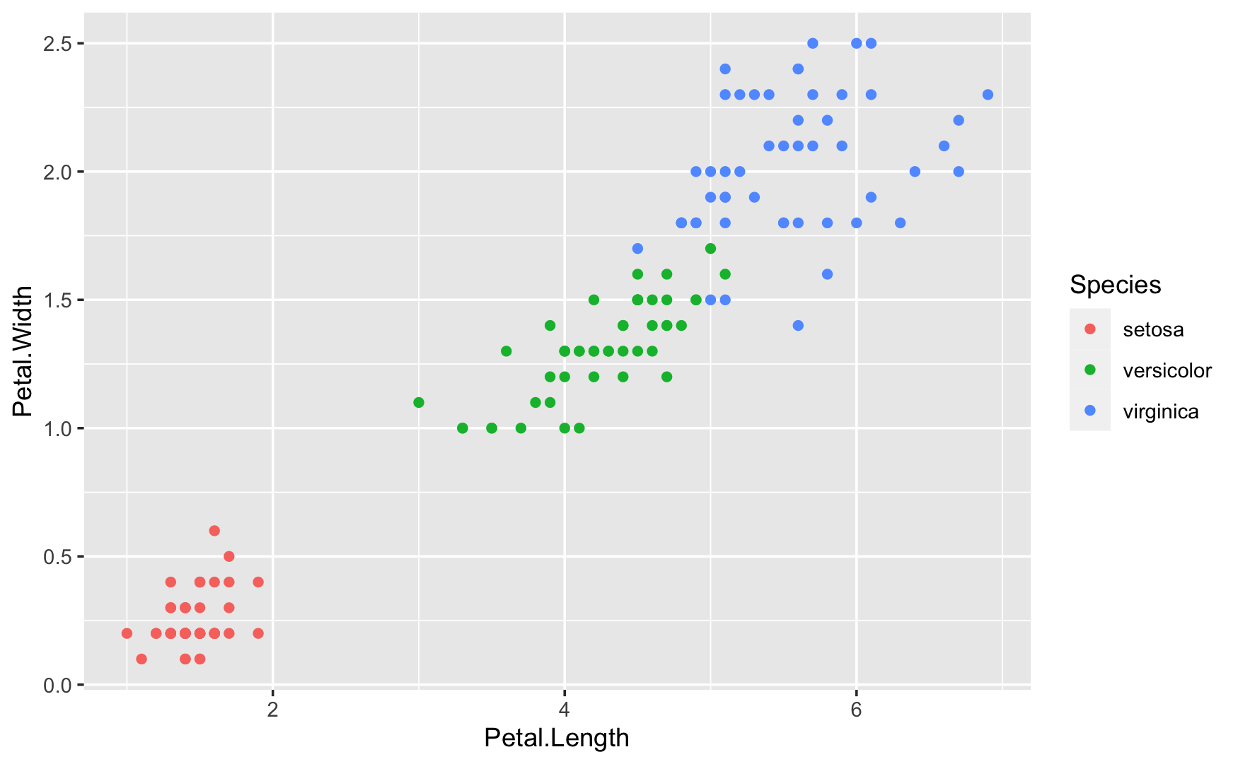
Scatter plot of Features
point1 = ggplot(data=iris, aes(x=Petal.Length, y=Petal.Width, color=Species))
point1 + geom_point()

Slide 7
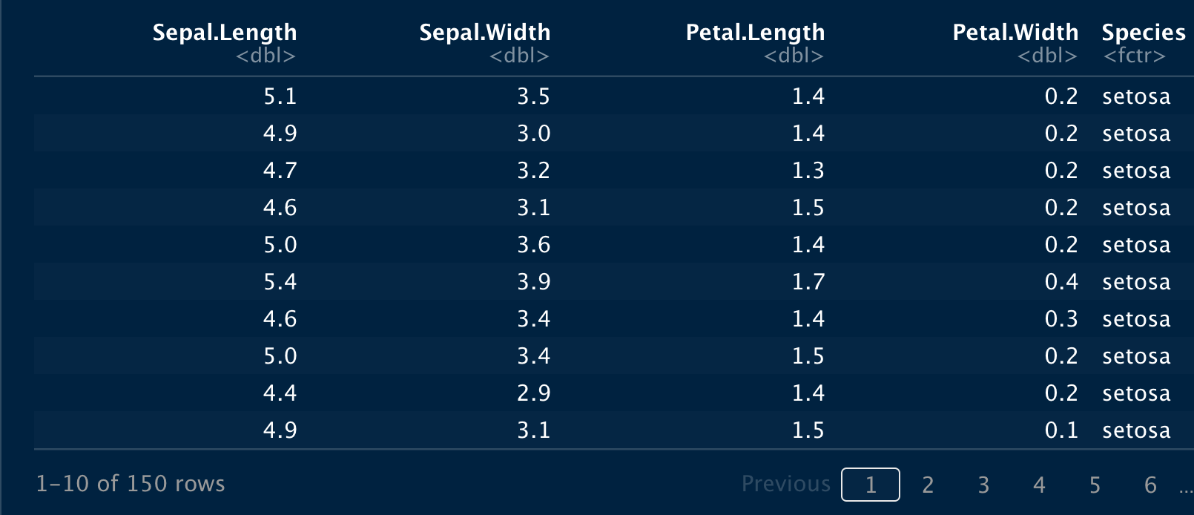
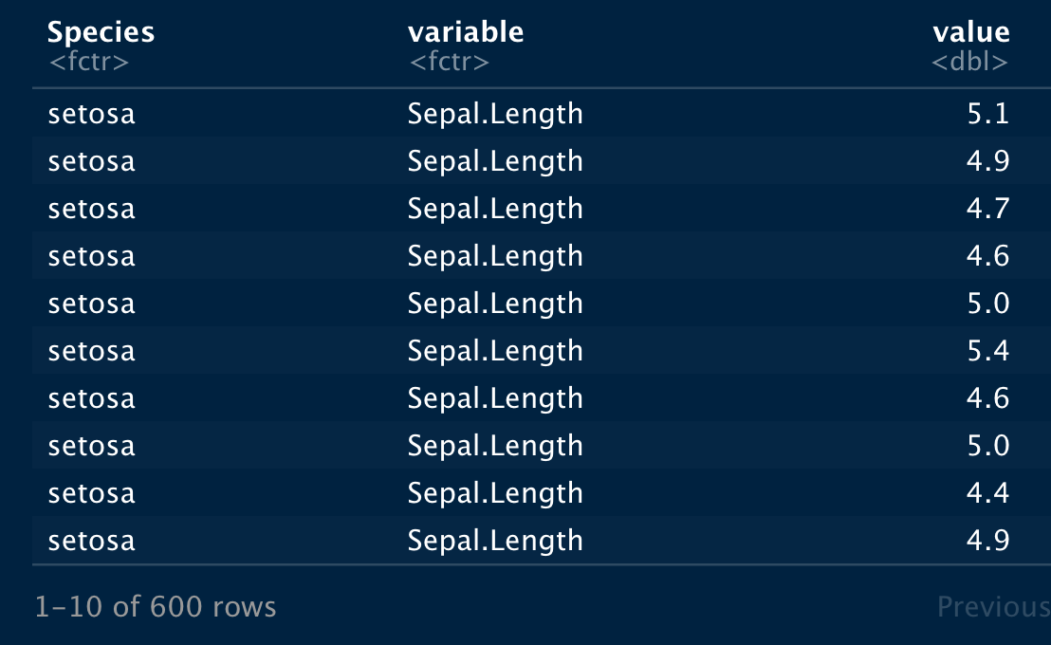
Wide Form vs Long Form Wide form has a column for each feature. Long form has a column indicating feature and a column indicating the value of that feature. Some plots in R require a long form of the data.
iris_melted <- melt(iris, id.vars="Species")
iris_melted

Slide 8
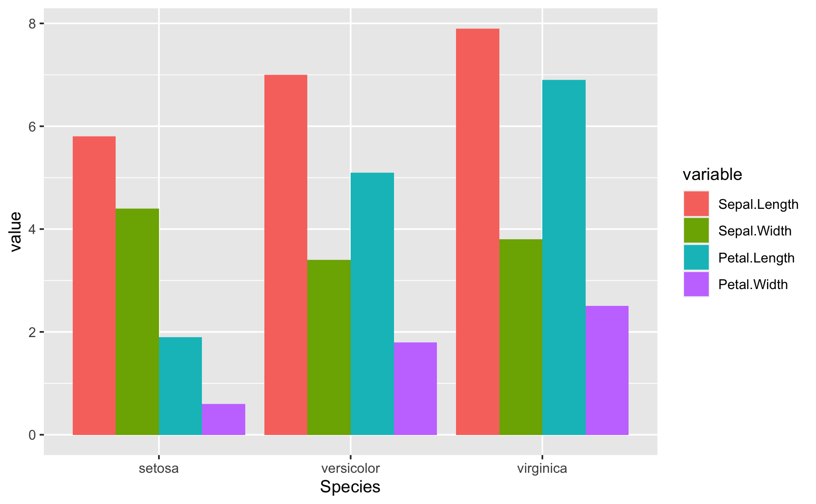
Bar Plot of all Features
bar1 = ggplot(data=iris_melted, aes(x=Species, y=value, fill=variable))
bar1 + geom_bar(stat="identity", position="dodge")

Slide 9
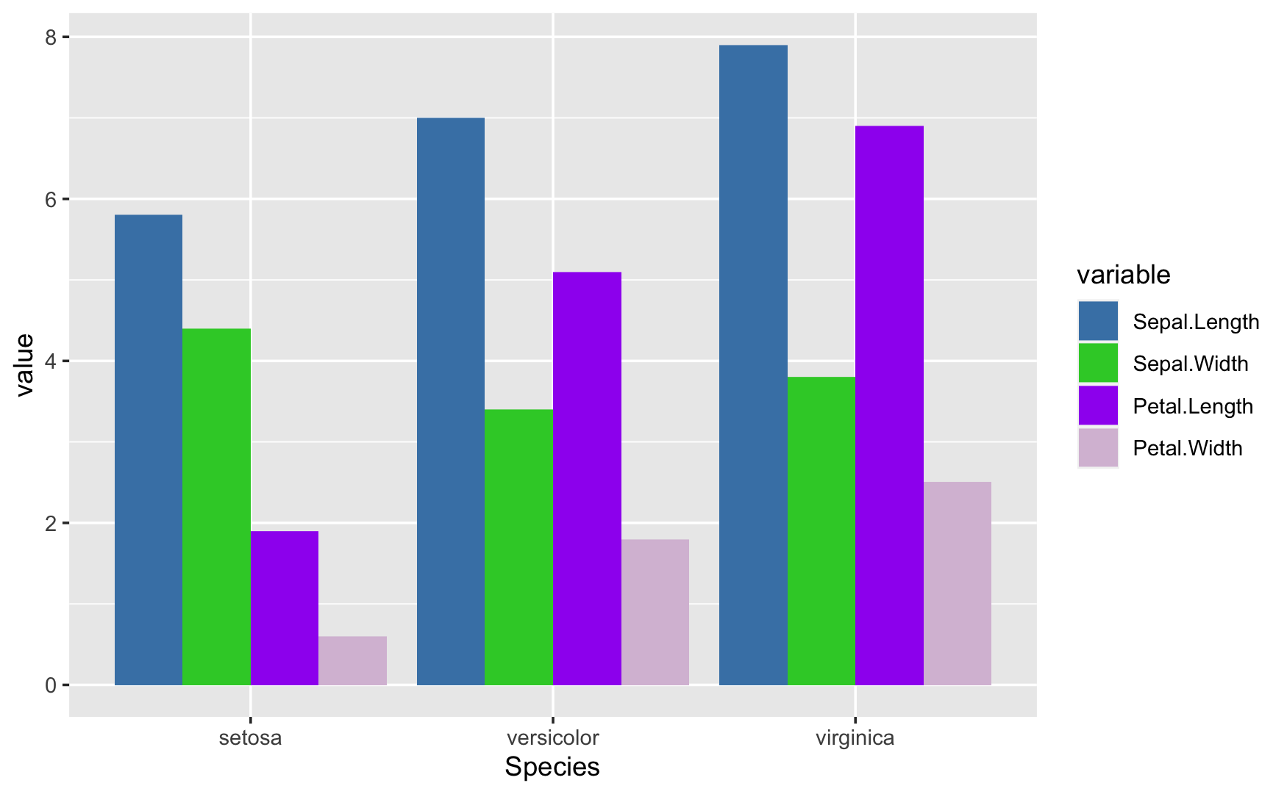
Bar Plot of all Features with Custom Colors
bar1 = ggplot(data=iris_melted, aes(x=Species, y=value, fill=variable))
bar1 + geom_bar(stat="identity", position="dodge") +
scale_fill_manual(values = c("steelblue", "limegreen", "purple", "thistle"))

Slide 10
Train-Test Split
For machine learning models, it is important to do a train-test split
The training data is used to train the model
The test data is used to validate the model on unseen data (that is, data not used in trainig)
It can be important to stratify the data so that each group of the target is equally represented
set.seed(1)
train.index = createDataPartition(iris$Species, p=.7, list=FALSE)
train <- iris[train.index, ]
test <- iris[-train.index, ]

Slide 11
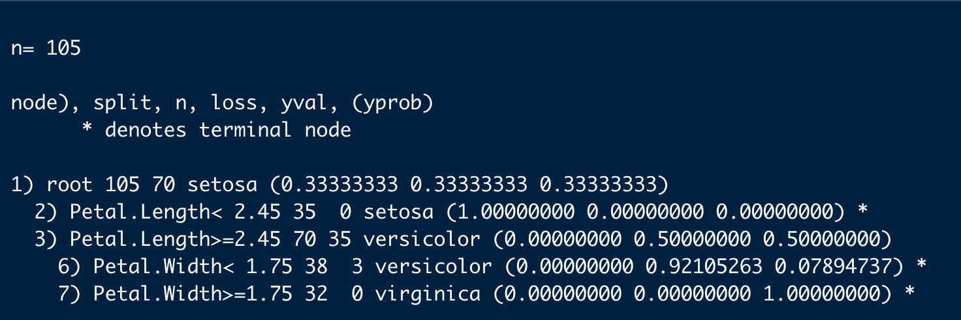
Training the model
The model is trained on the training portion of the data
Output as shown below is generated
Next we will plot this model
model <- rpart(Species ~ ., data = train, method = "class")
model

Slide 12
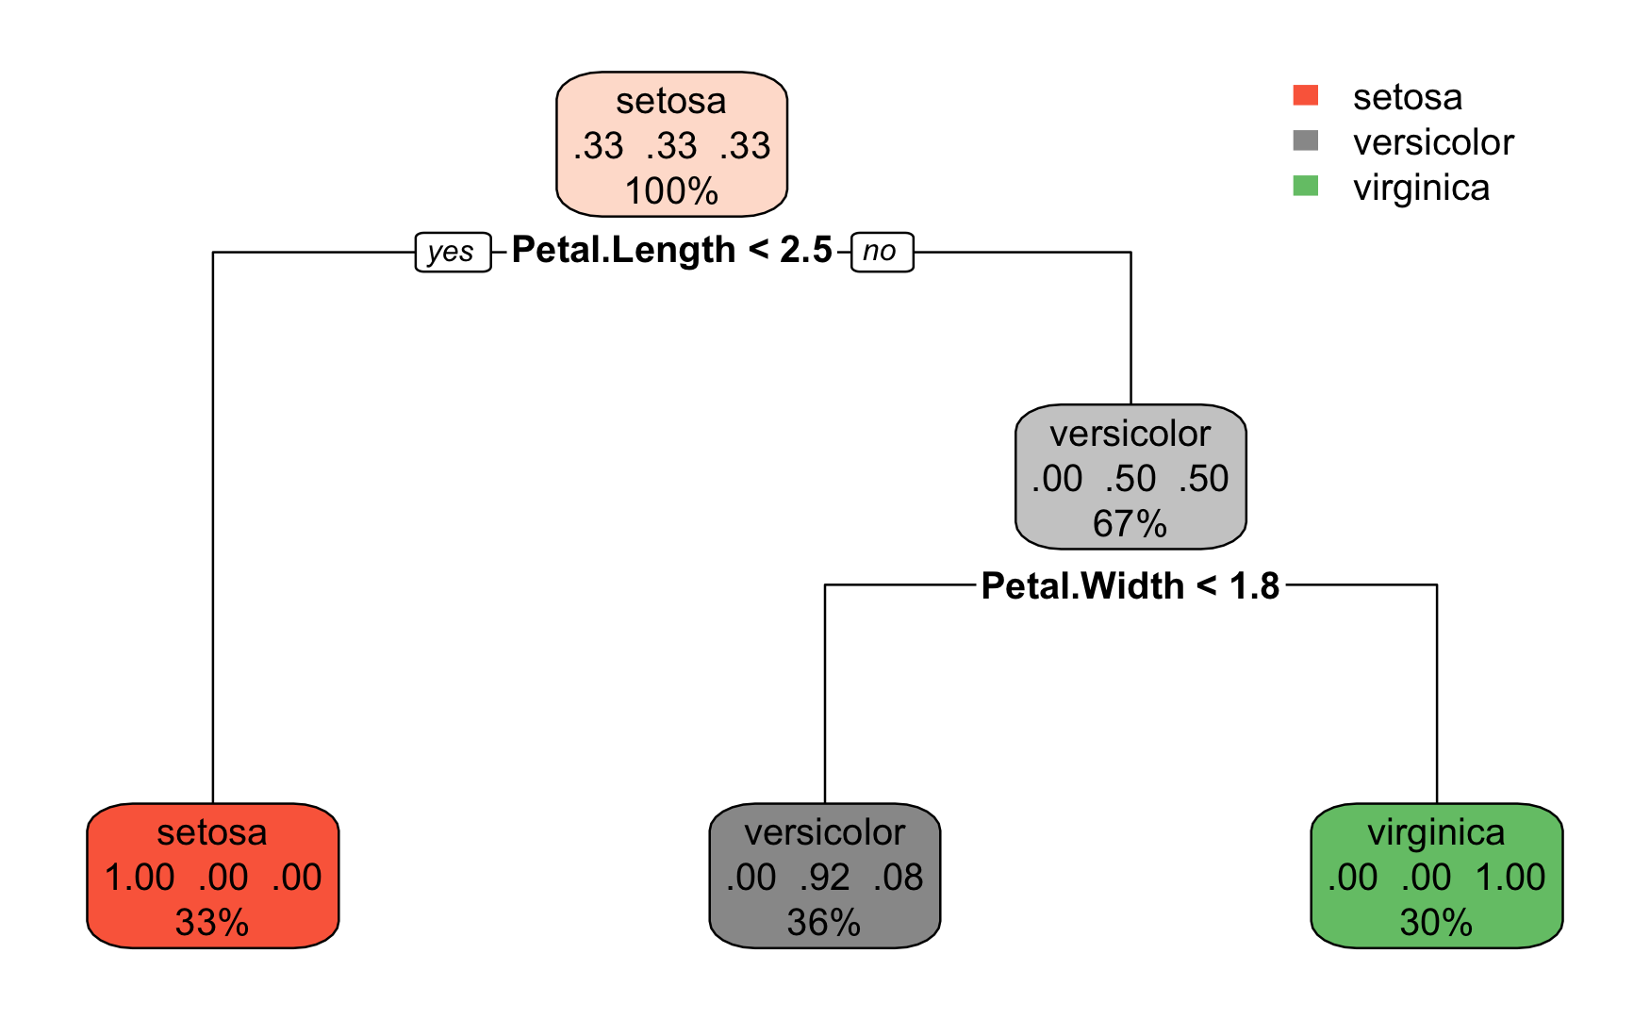
Examining the model
Using the rpart package we can plot the model
This visually shows how decisions are made
rpart.plot(model)

Slide 13
Predicting with the model Note, we predict on the test dataset
preds <- predict(model, newdata = test, type = "class")
preds

Slide 14
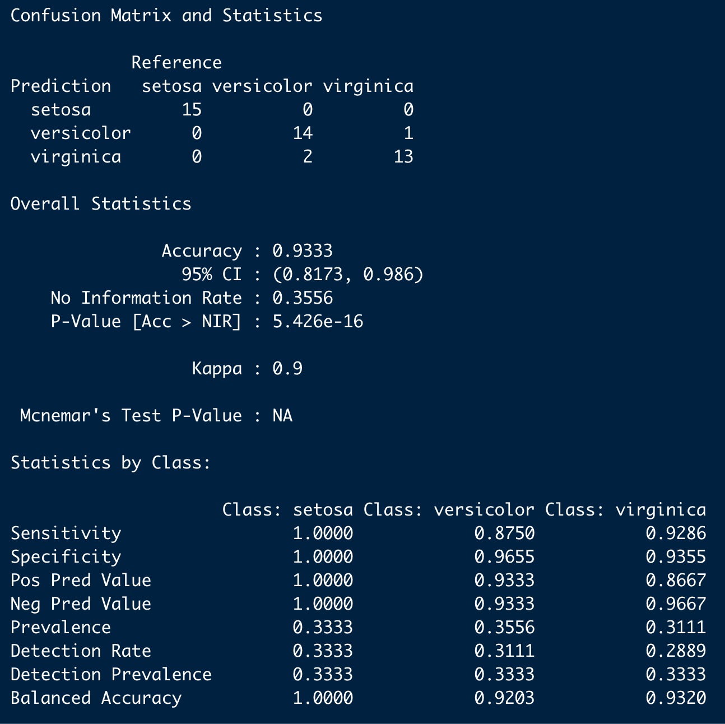
Confusion Matrix to Evaluate Results
confusionMatrix(test$Species, preds)
Note that results include accuracy of the model as well as other metrics for each class in the model.
Next we will plot the confusion matrix shown at the top of this results output.

Slide 15
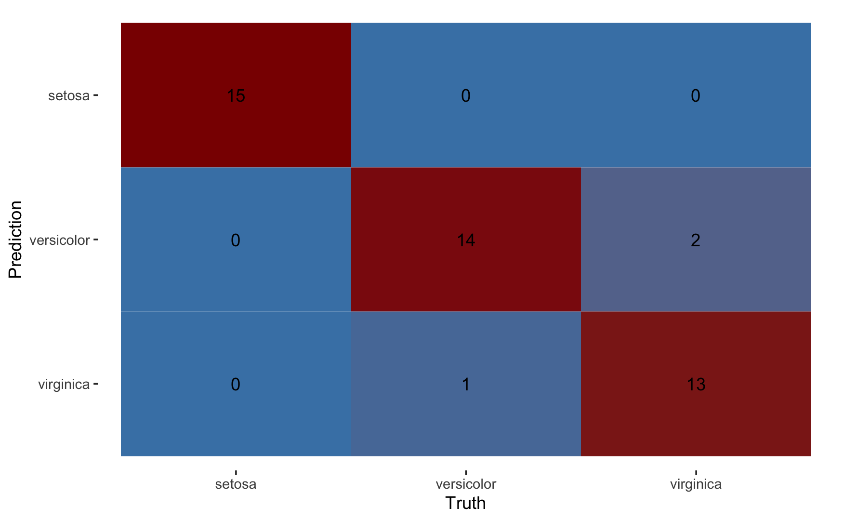
Plotting Confusion Matrix
cm <- conf_mat(test, Species, preds)
autoplot(cm, type = "heatmap") +
scale_fill_gradient(low = "steelblue", high = "darkred")

Slide 16
Model Overview and Results
We took 150 samples of 3 iris species and created a decision tree model to help classify them
Our model had good accuracy, 93%, which might have been expected given our plots of the features
From our results, we can Setosa was the most easily classified with no mistakes
There was some confusion when classifying Versicolor vs Virginica
This notebook shows the process for conducting a machine learning project in R

