Slide 1
Linear Regression in R
Danny Lumian, Ph.D.
NIH ODSS

Slide 2
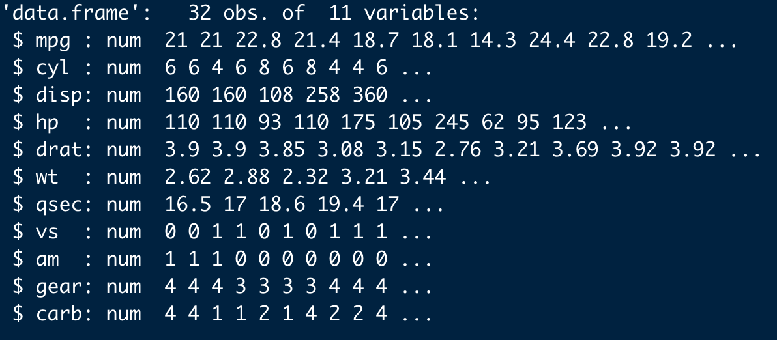
Mtcars Data

Slide 3
Linear Regression Assumptions
Linear relationship.
Multivariate normality.
No or little multicollinearity.
No auto-correlation.
Homoscedasticity.
See: http://www.sthda.com/english/articles/39-regression-model-diagnostics/161-linear-regression-assumptions-and-diagnostics-in-r-essentials/#building-a-regression-model

Slide 4
Train-Test Split
trainDataIndex = createDataPartition(mtcars$mpg, p=0.7, list = FALSE)
trainData = mtcars[trainDataIndex, ]
testData = mtcars[-trainDataIndex, ]

Slide 5
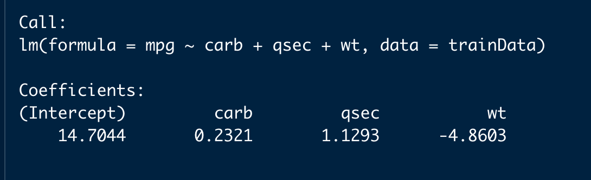
Fit the model
model <- lm(mpg ~ carb + qsec + wt, data = trainData)
The model predicts miles per gallon based on number of carburetors, quarter mile time and weight.

Slide 6
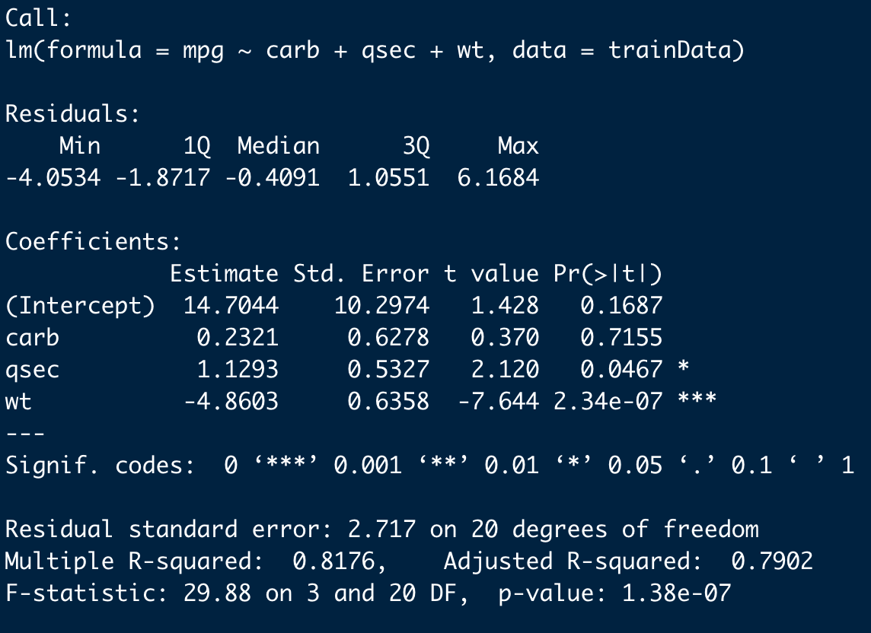
summary(model)

Slide 7
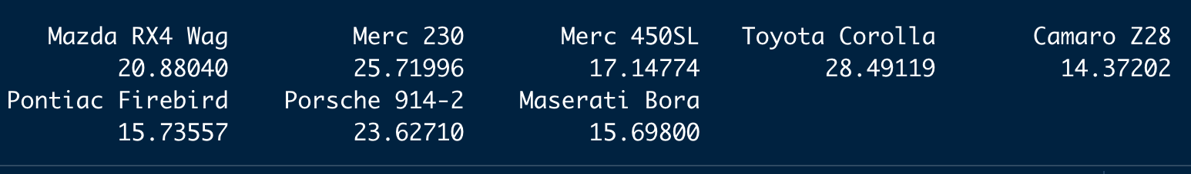
Make predictions
pred = predict(model, newdata = testData)
Predictions are made on the test data set

Slide 8
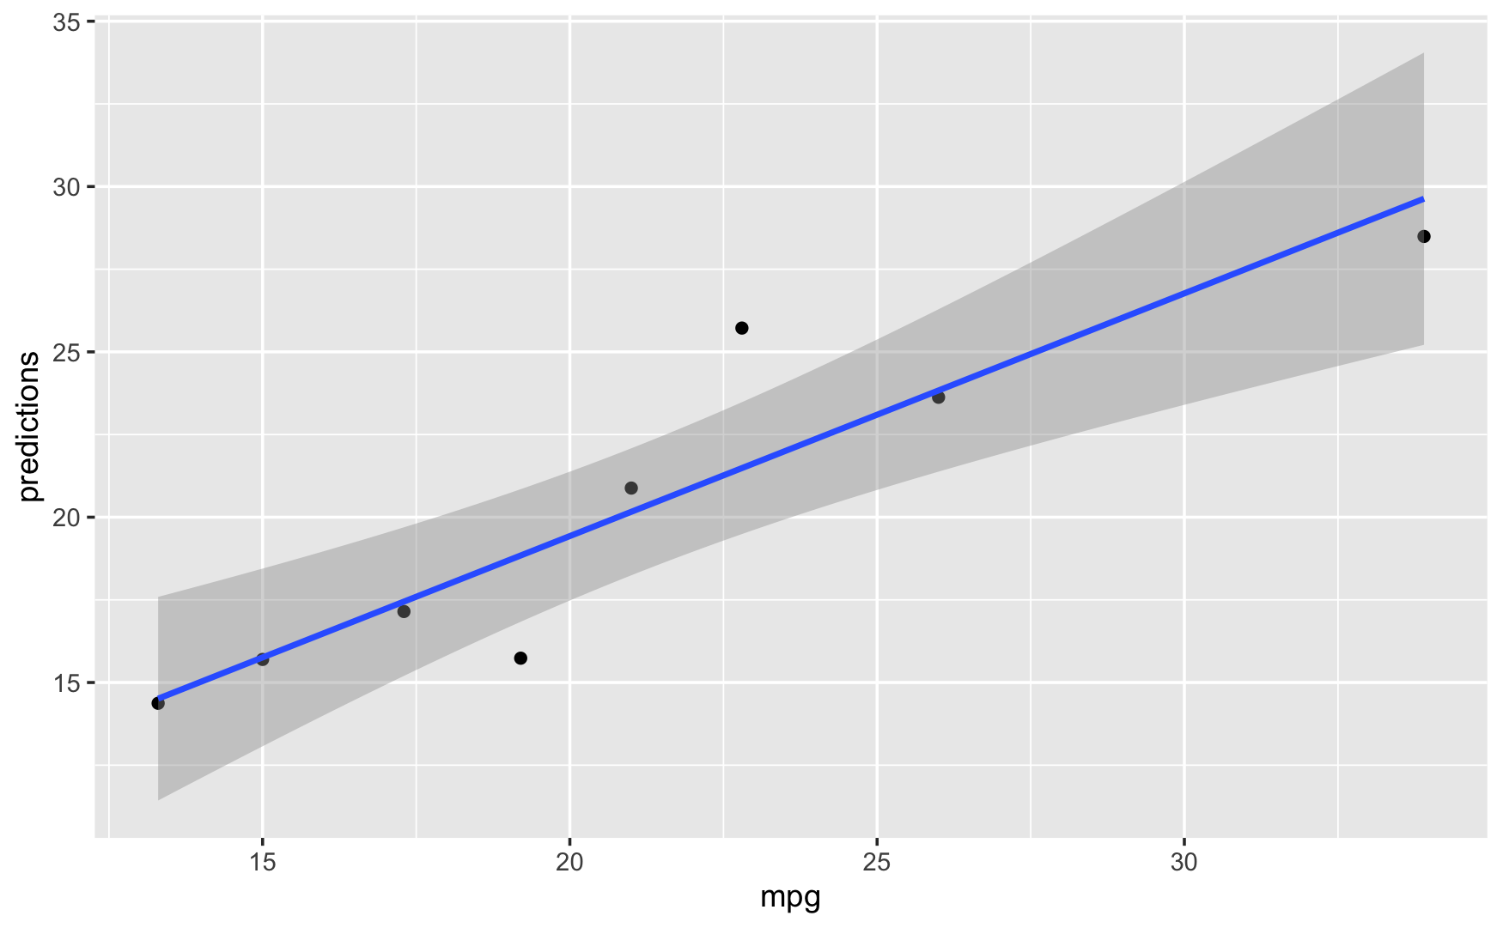
Compare predictions with actual values

