Slide 1

INTRODUCTION TO R Logistic Regression Notebook
Danny Lumian, Ph.D.
Data Science Training Specialist
NIH Office of Data Science Strategy

Slide 2
Binomial Logistic Regression
Probability that an observation falls into one of two categories
A type of classification analysis with two classes
Examples:
Is an email spam?
Is a tumor malignant?
Will a visit to a website convert into a sale?

Slide 3
mlbench package in R
https://cran.r-project.org/web/packages/mlbench/index.html
A collection of artificial and real-world machine learning benchmark problems, including, e.g., several data sets from the UCI repository.
Includes a dataset on breast cancer
Features are set as factors
Factors by default are dummy coded
So we will convert them to numeric for analysis
Target is whether a tumor is malignant or benign

Slide 4
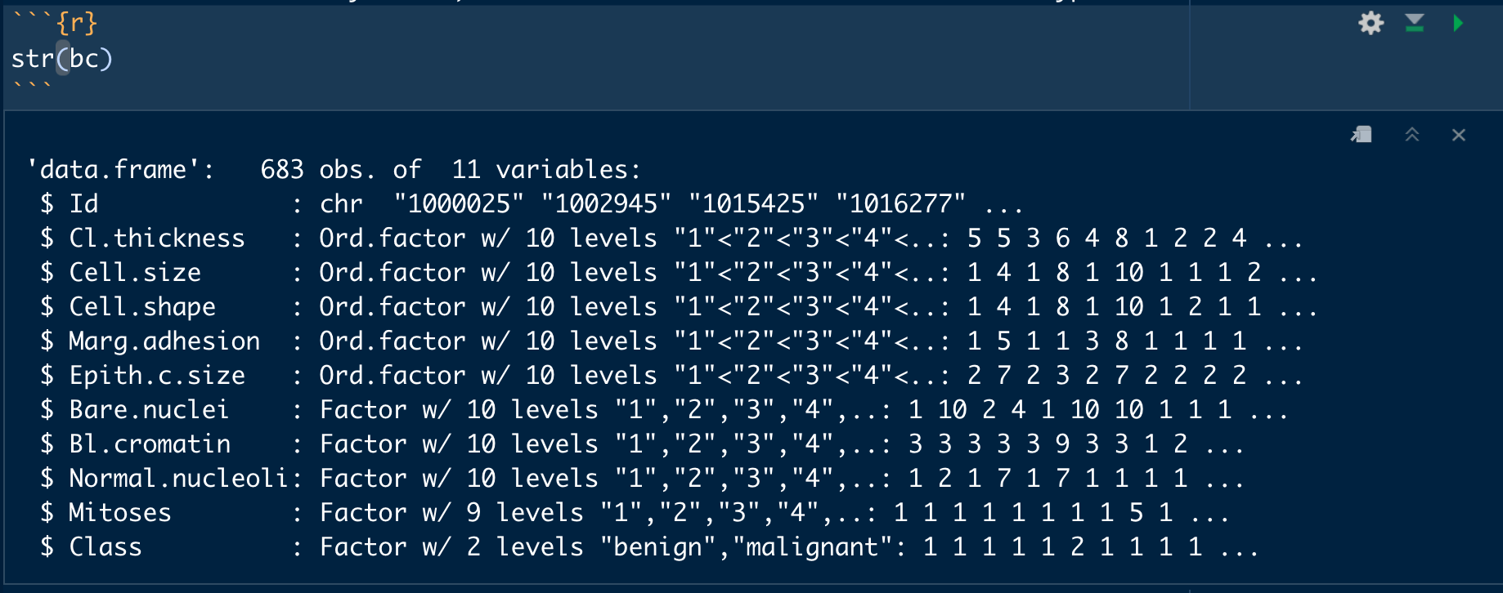
Breast Cancer Data Set

Slide 5
Creating the target as a factor
bc$Class = ifelse(bc$Class == "malignant", 1, 0)
bc$Class = factor(bc$Class, levels = c(0, 1))
summary(bc$Class)

Slide 6
Train-test Split
It is common in machine learning to create a train-test split
The train data is used to train the model
This data is “seen” by the model
The test data is used to evaluate model performance
This data is “unseen” by the model
Test metrics are usually more informative than train metrics as it shows how well the model generalizes its predictions
Common splits are 80/20 or 70/30
Can be useful to stratify data based on target

Slide 7
Creating the train-test split
trainDataIndex = createDataPartition(bc$Class, p=0.7, list = FALSE)
trainData = bc[trainDataIndex, ]
testData = bc[-trainDataIndex, ]

Slide 8
Training the model
logitmod = glm(Class ~ Cl.thickness + Cell.size + Cell.shape, family = "binomial", data = trainData)
Class is the target variable
Other columns listed are features
Family is binomial because it is a two-class classification
Data is our training data

Slide 9
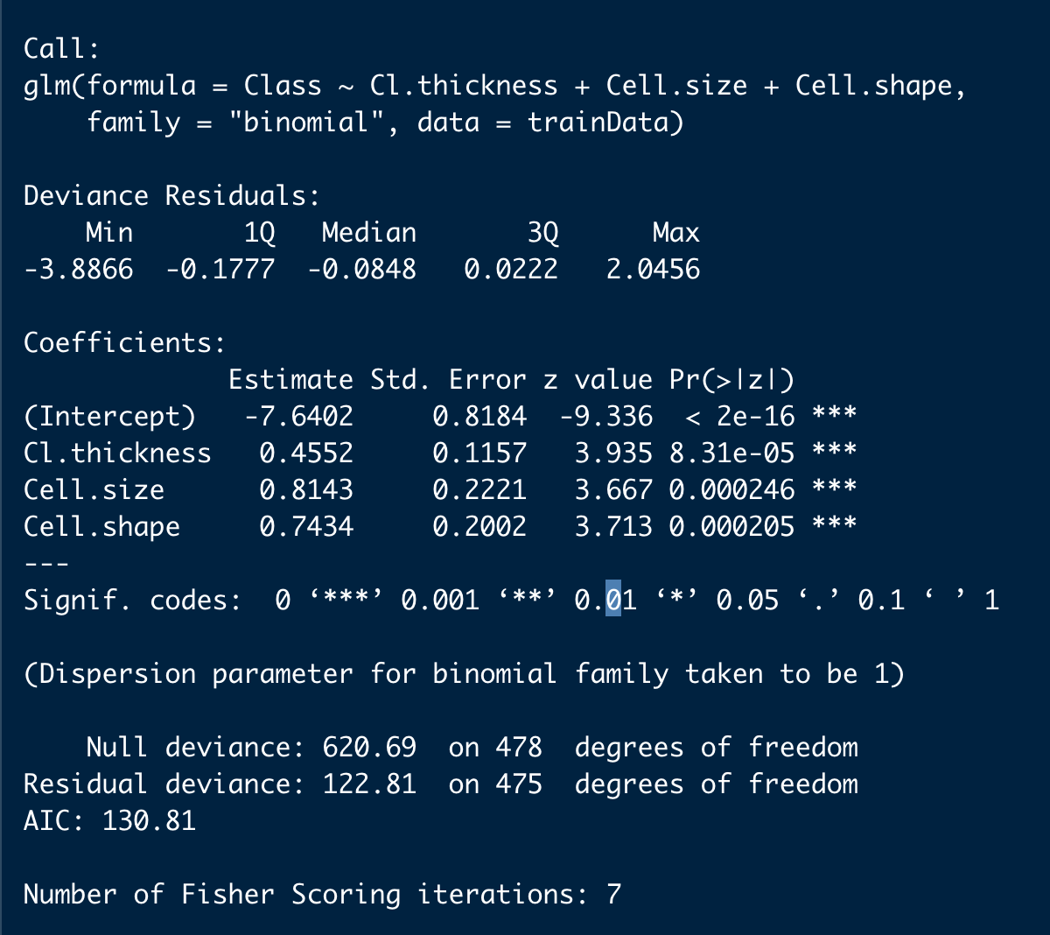
summary(logitmod)
Call: our model definition
Deviance Residuals: Describe fit of data to model
Coefficients: Impact of each factor on the model fit
Null deviance: tells us how well we can predict our output only using the intercept. Smaller is better.
Residual deviance: tells us how well we can predict our output using the intercept and our inputs. Smaller is better. The bigger the difference between the null deviance and residual deviance is, the more helpful our input variables were for predicting the output variable.
AIC: The AIC is the "Akaike information criterion" and it's an estimate of how well your model is describing the patterns in your data. It's mainly used for comparing models trained on the same dataset. If you need to pick between models, the model with the lower AIC is doing a better job describing the variance in the data.
For more info see: https://stats.stackexchange.com/questions/86351/interpretation-of-rs-output-for-binomial-regression

Slide 10
Making Predictions
pred = predict(logitmod, newdata = testData, type = "response")
Predict on testData
Type=“response”
Used for class predictions
Default is linear predictions

Slide 11
Convert probabilities to classes
y_pred_class = ifelse(pred > .5, 1, 0)
y_pred_factor = factor(y_pred_class, levels=c(0,1))
testData$preds = y_pred_factor

Slide 12
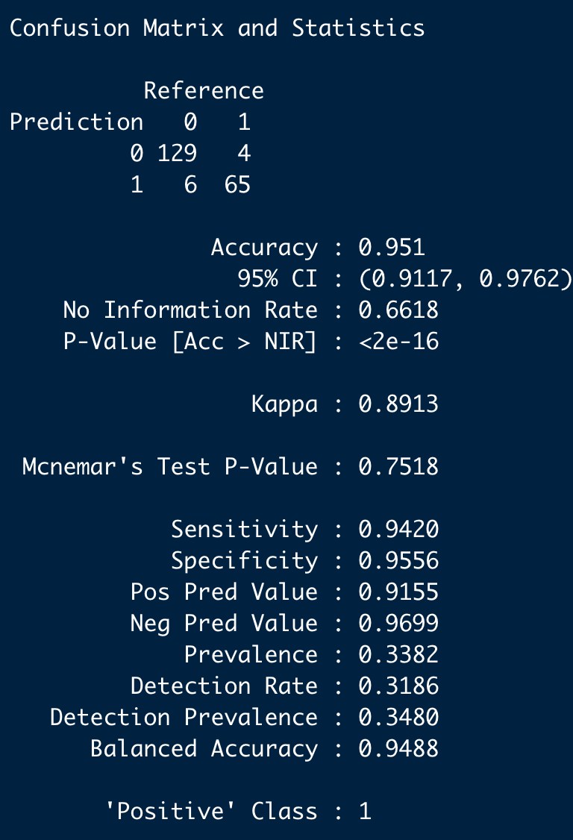
confusionMatrix(testData$Class, y_pred_factor)
Confusion matrix at top
Followed by test metrics
Key metrics
Accuracy
Sensitivity
Specificity
Positive class helps you interpret the metrics

Slide 13
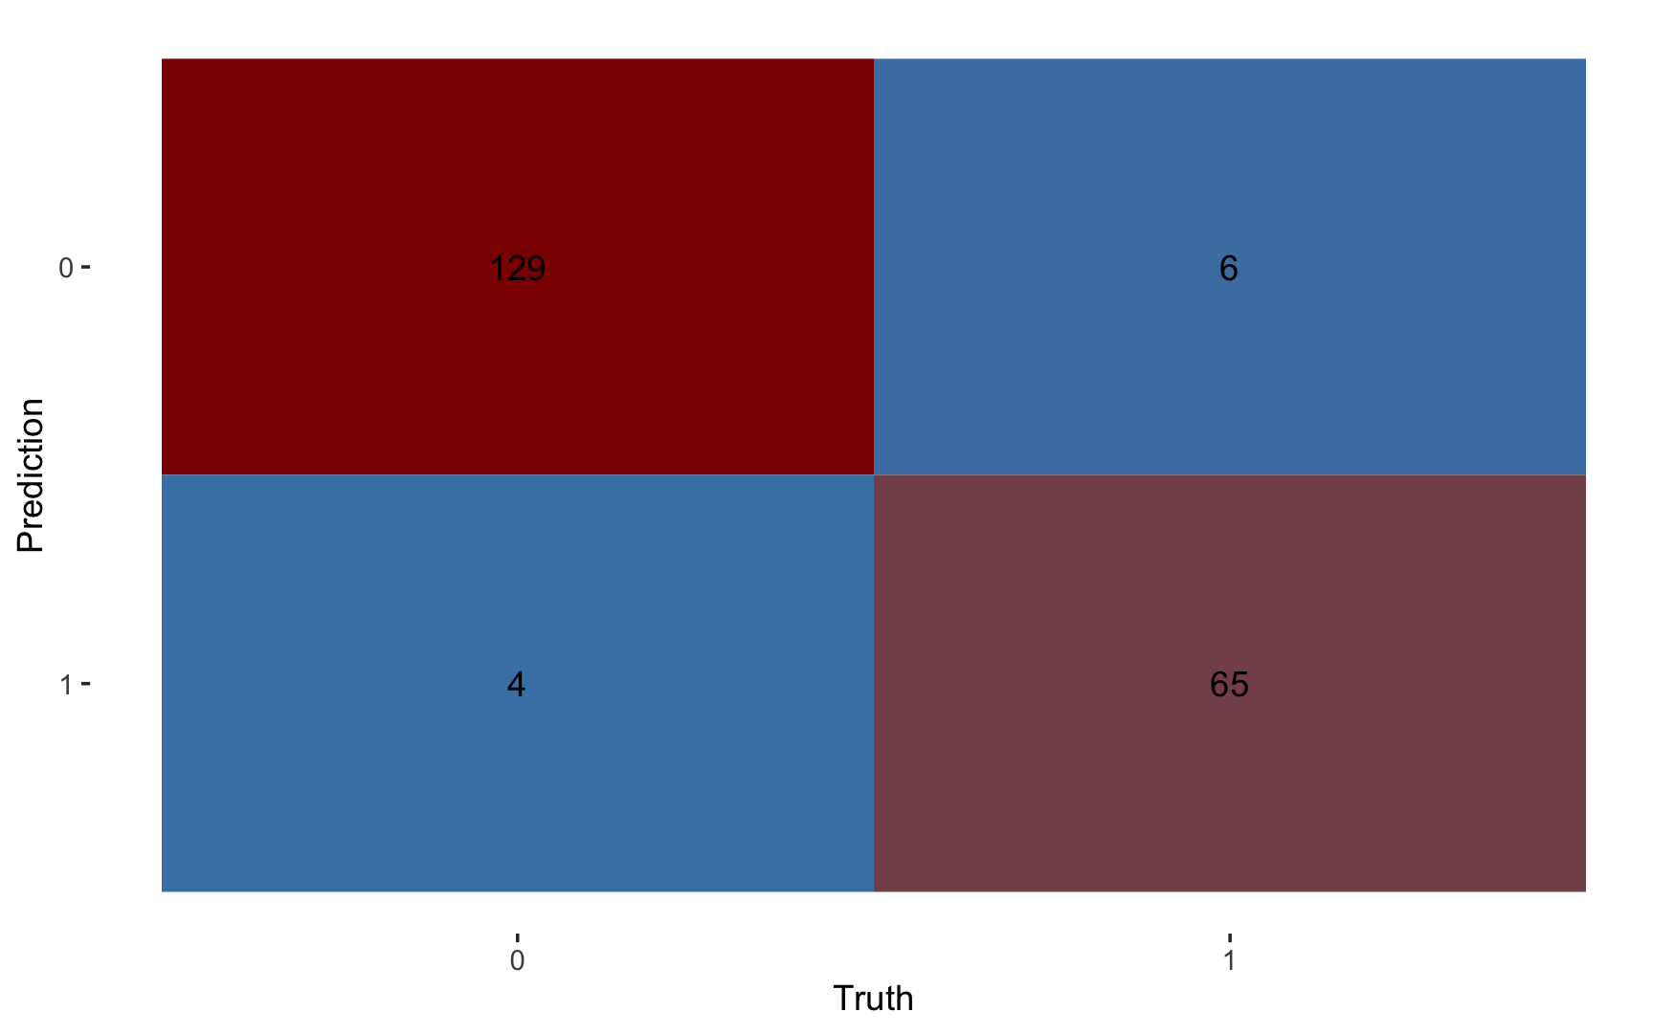
Visualize Confusion Matrix

