Slide 1

INTRODUCTION TO R Iris Classification Example Notebook
Danny Lumian, Ph.D.
Data Science Training Specialist
NIH Office of Data Science Strategy

Slide 2
Iris Classification
This notebook uses the built-in Iris dataset to outline a basic approach to machine learning with a decision tree classifier
There are 4 features and 1 target variable consisting of 3 groups
This notebook uses several popular machine learning libraries in R

Slide 3
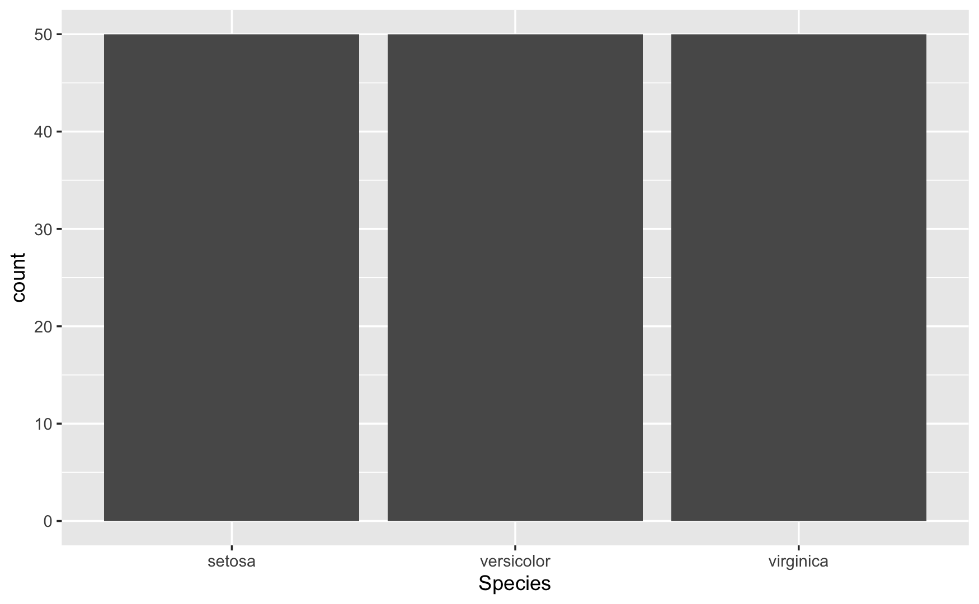
ggplot(data = iris, aes(x=Species)) + geom_bar()

Slide 4
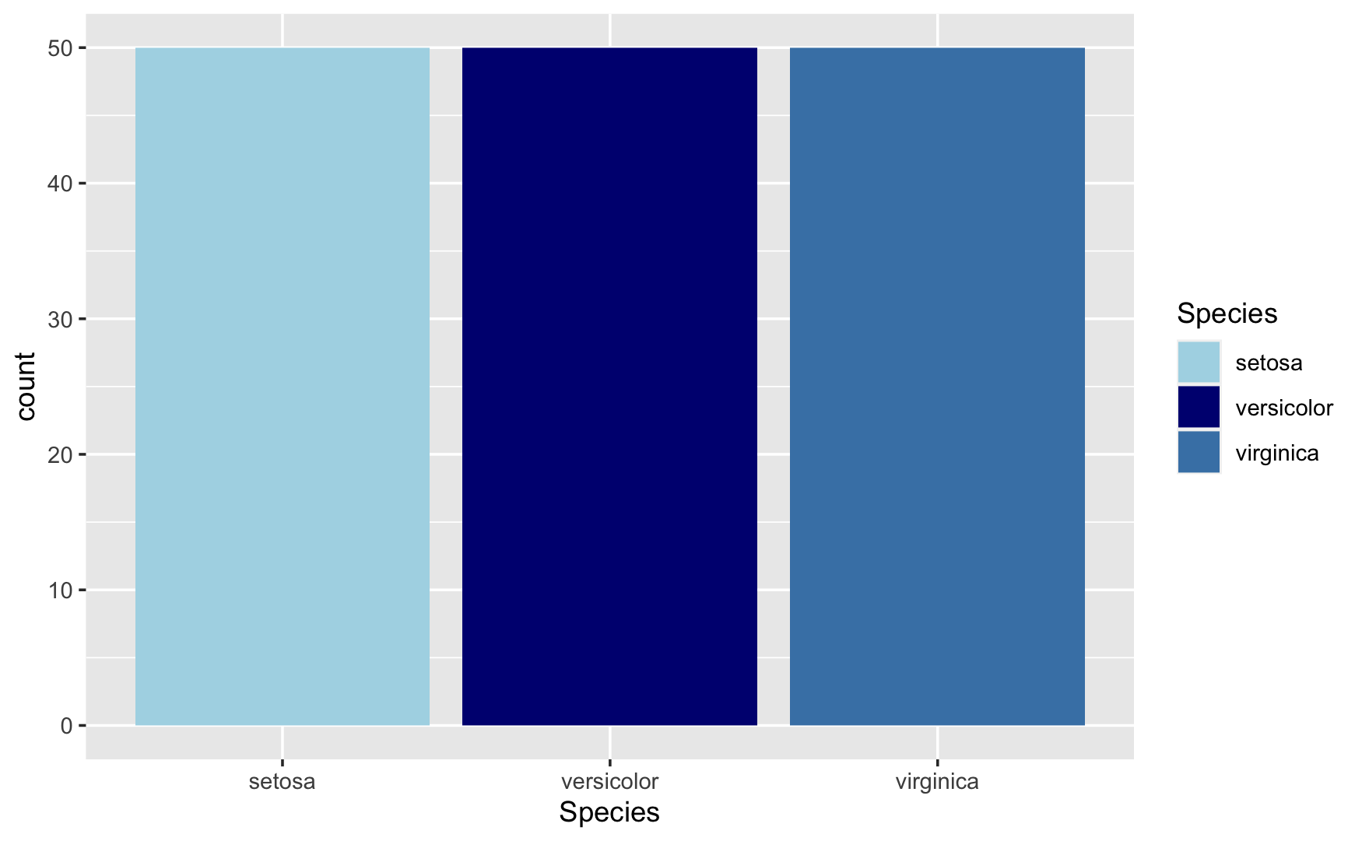
ggplot(data = iris, aes(x=Species, fill=Species)) + geom_bar() + scale_fill_manual(values = c('lightblue', 'navy', 'steelblue'))

