Slide 1

WP4 - Mapping an EU legislation landscape for MPA related acts
Anna Jorgensen
aeljor@dtu.dk

Slide 2

Methods workflow:
EUR-Lex Database
Extract EU legislation which mentions:
(1) ”marine protected”
(2) A query for every official MPA designation title within the EU and the UK.
(i.e., world heritage site, Ramsar site, etc.)
link associated document data
(1) Extract document’s legislative citations
(2) Attach documents to their assigned EU descriptors.
Network analysis
Citation network (2) term label co-occurance network
> Calculate network statistics:
Betweenness, degrees in/out, document clusters
> Calculate network statistics:
Betweenness, degrees in/out
> Assess Theme clusters
> glmms: is cluster prevalence related to betweenness and/or degree ratio?
indiginous communities
catch quota
international waters
fishing fleet
sustainable development
plasic
oil spills
gas
marine pollution

Slide 3
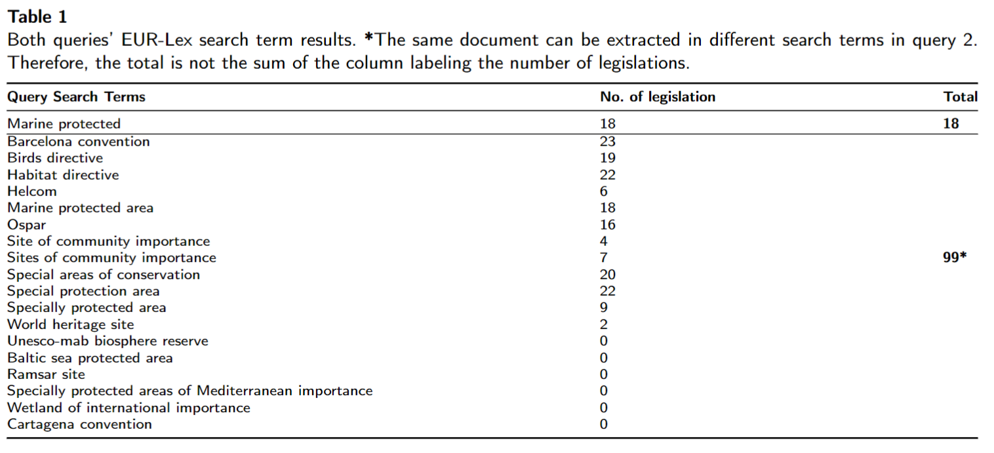
Legislation Search Results:
6 decisions, 2 directives, 10 regulations
41 decisions
16 directives
2 opinions
2 recommendations
38 regulations

Slide 4
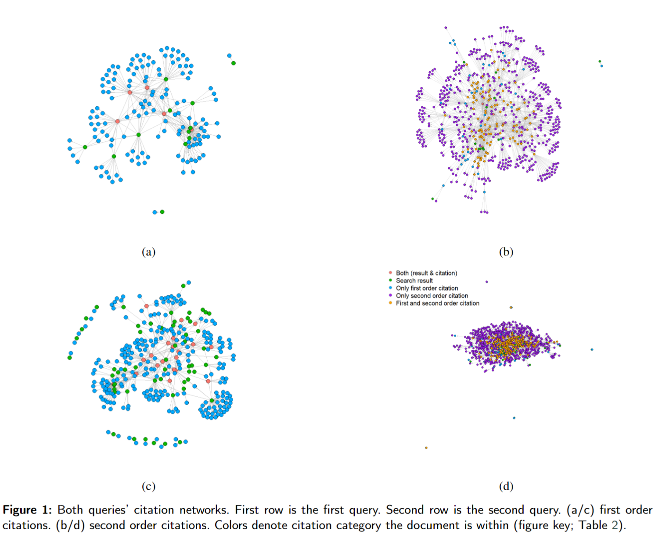
Citation networks
Some highlights:
MPA query has a strong focus on sustainable fisheries legislation
CFP has highest betweennness score in the first order network.
European maritime fisheries fund (2014-2020) highest betweenness score in second order network
Designation titles related legislation are more focused on good environmental statues:
Strategy for the Marine Environment highest betweennness score in the first order network.
EU Water Directive highest betweenness score in second order network
In the second order network, documents receiving (degree-in) the most citations discuss topics on the EU comission’s powers:
MPA query : The Committees’ role in European Commission’s implementing powers
Designation query: The decision laying down the procedures for the exercise of implementing powers conferred on the Commission

Slide 5
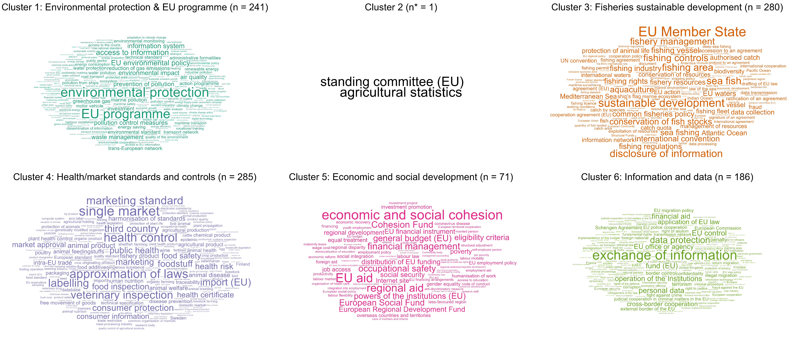
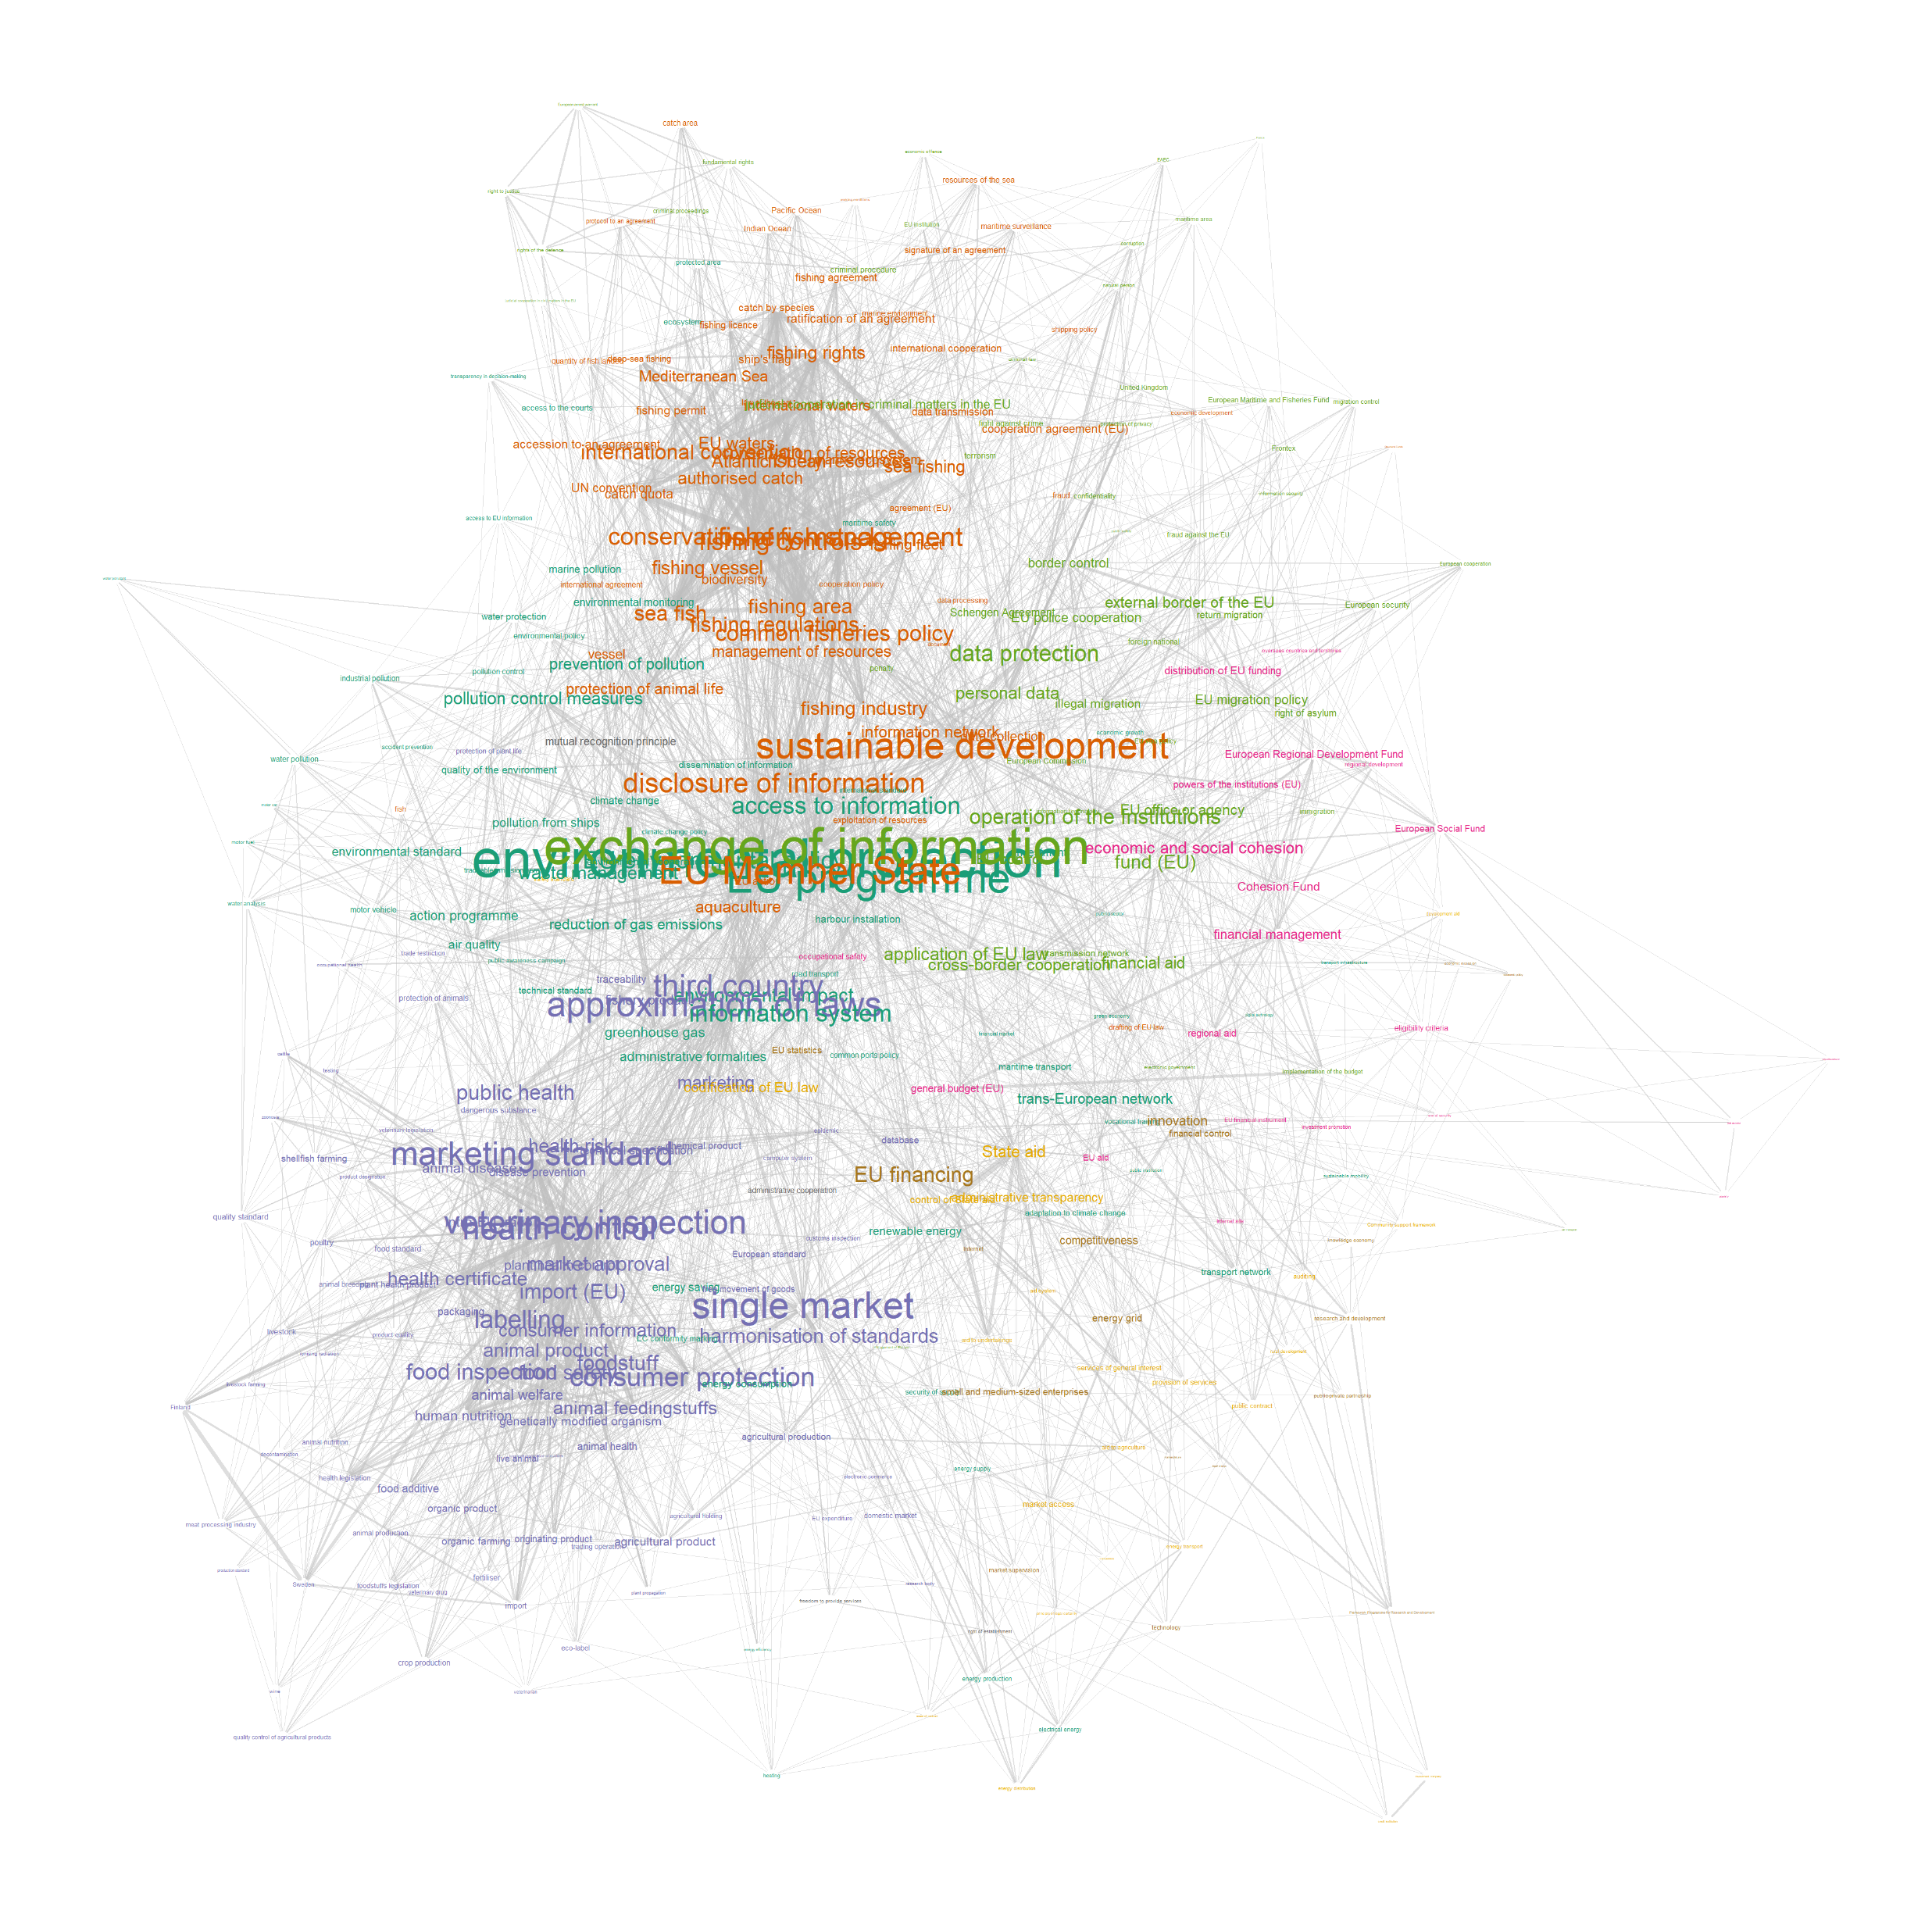
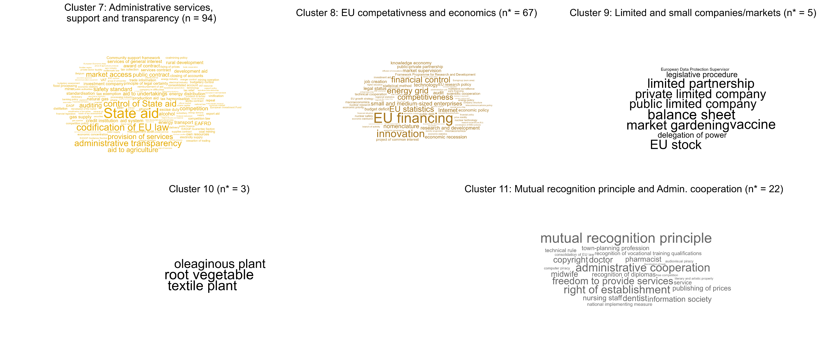
MPA Query EuroVoc themes:
Descriptor with the highest betweenness and degree: environmental protection

Slide 6
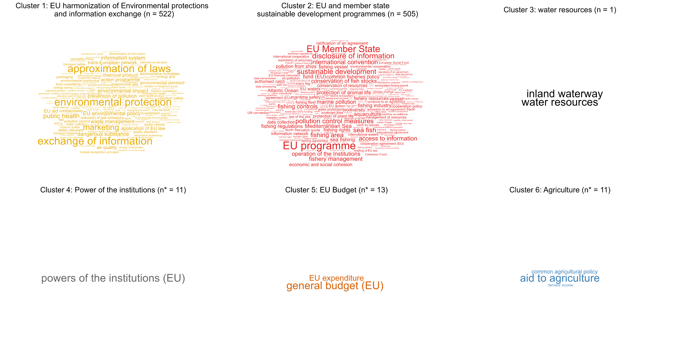
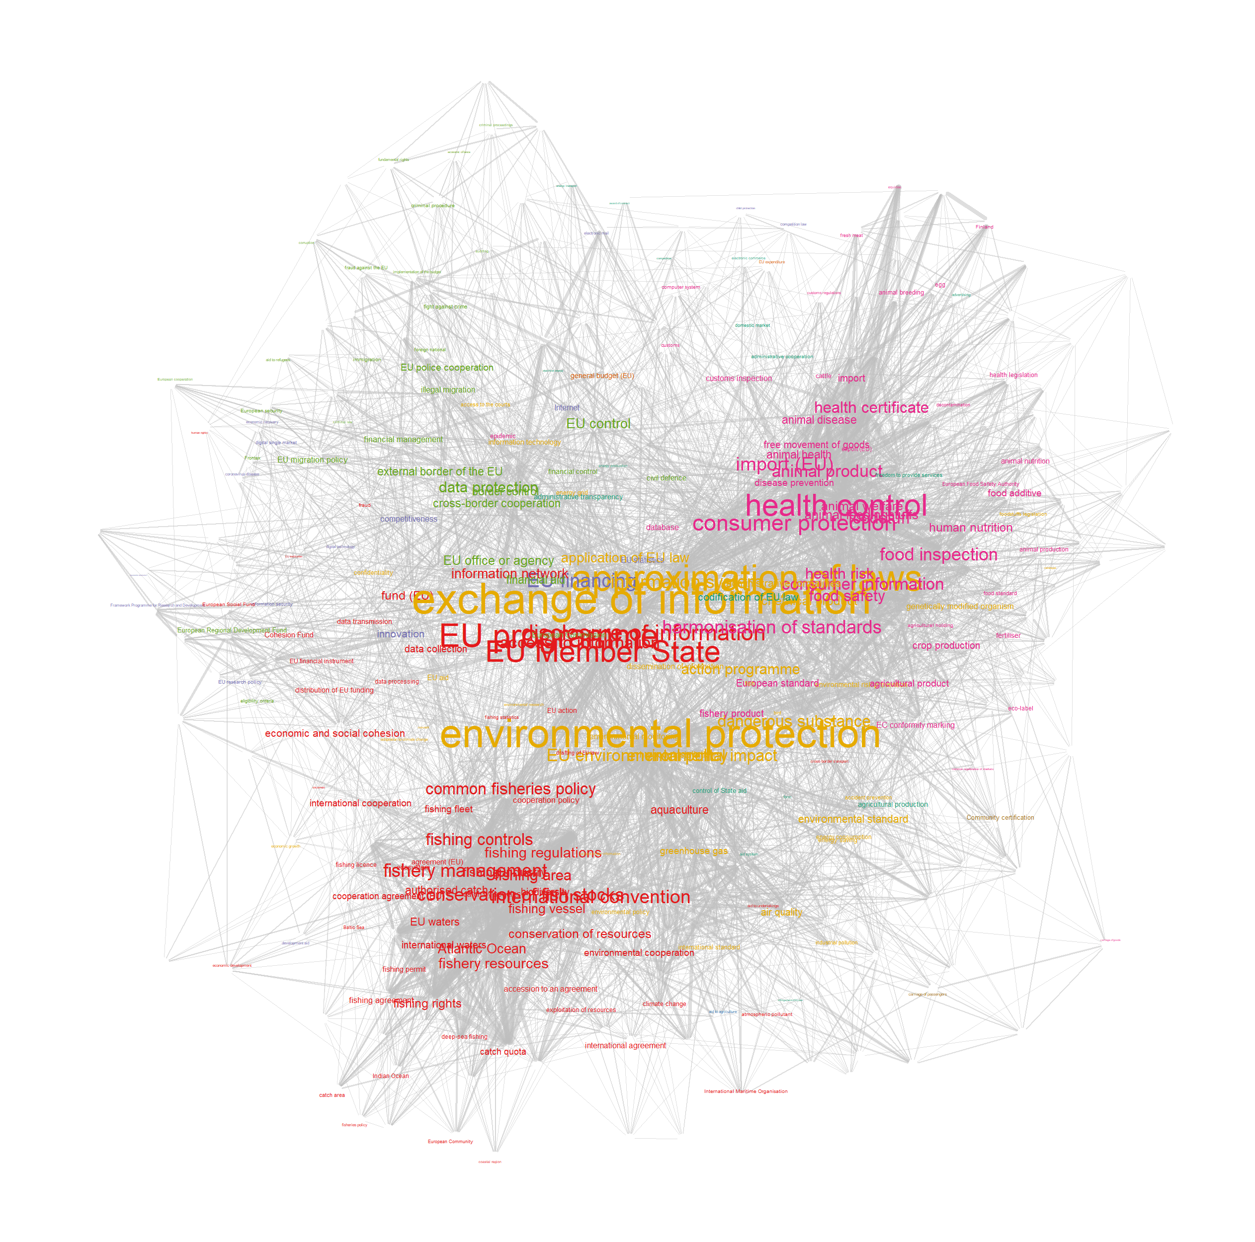
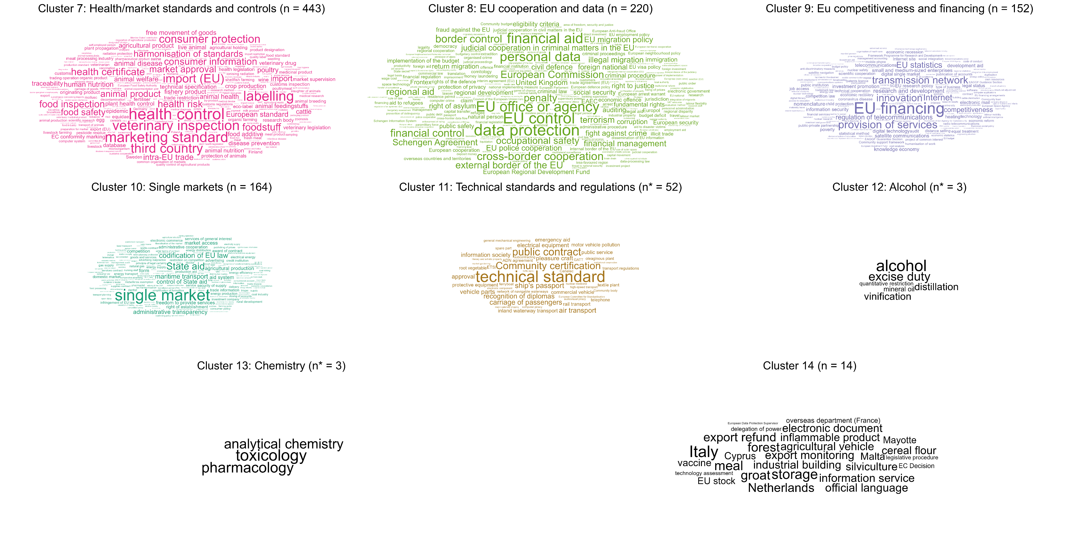
Designation Query EuroVoc themes:
Descriptor with the highest betweenness : environmental protection
Highest degree: environmental protection & exchange of information

Slide 7
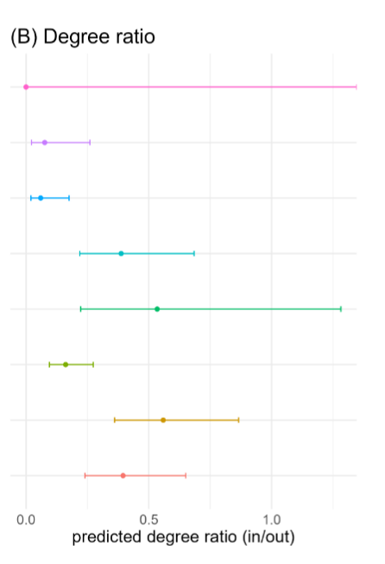
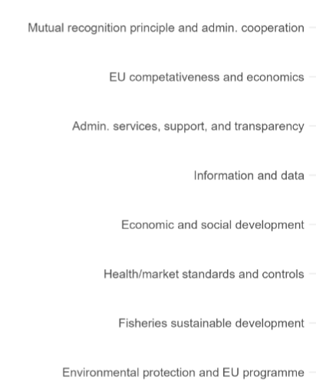
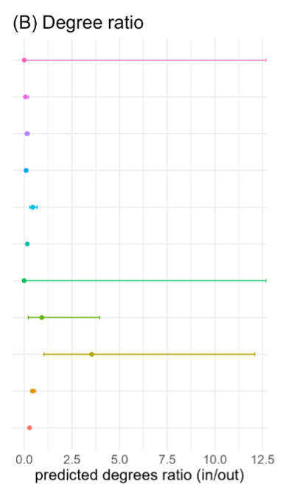
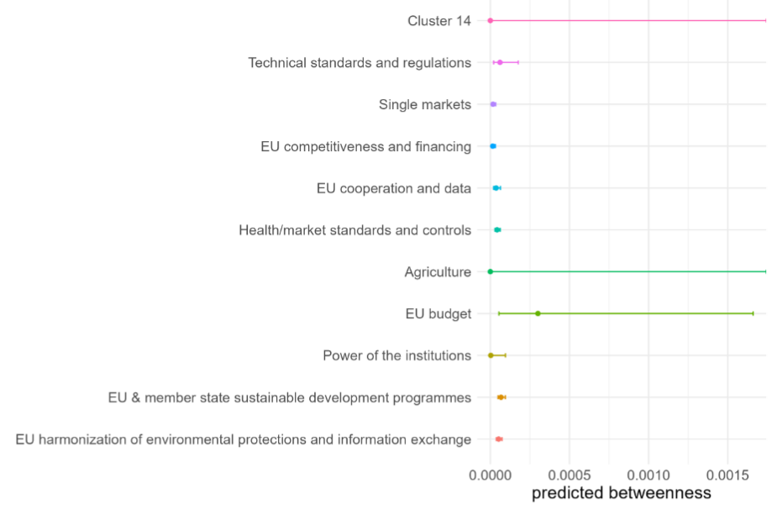
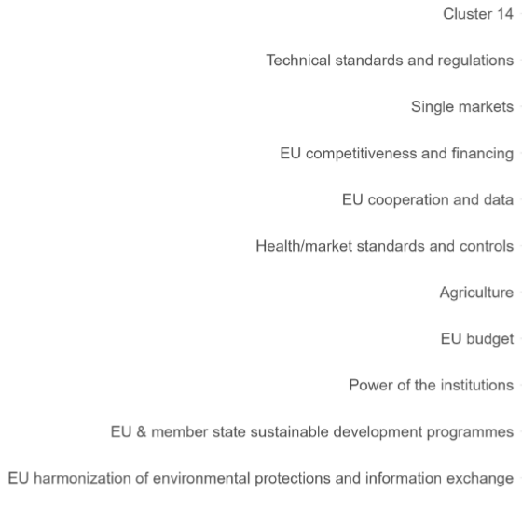
Is there an overall effect of cluster prevalence on legislations betweenness scores or degree ratio?
MPA query
For both queries we find an overall effect of cluster prevelance on the degree ratio (in/out)
MPA query: fisheries sustainability theme recieves more citations than it gives out compared to the other themes
For the designation query, this is for the theme on the power of instiutions
Designation query
For the designation query cluster prevelence also as an effect on the betweenness scores
EU budget theme has the highest betwenness score compared to the other themes

Slide 8
Discussion
Legislation that controls information flow when discussing ”marine protection” focuses on sustainable fisheries. When we expand our MPA termenology (designation titles), the legislations controling knowledge flow discuss themes around GES/water quality
In the designation query, documents that recieve more citations than give out and control the flow of knowledge are those within themes that contain no seed documents:
Legislation within the EU budgets theme have higher predicted betweenness
Legislation within the theme on Power of institutions have more than two times the number of degrees-in than degrees-out

Slide 9
Take Aways:
Citation networks allow use to explore the horizontal synergies between legislations.
highlighting the importance of complementary legislations and their objectives
By further grouping legislations into themes we get a better foundation of the types of discourse at play before reading the documents.
Legisaltions within themes that are central to MPA related discourse might be just as important for managers to reference.
i.e. those within the EU budget theme

Slide 10

Questions & comments

