Slide 1
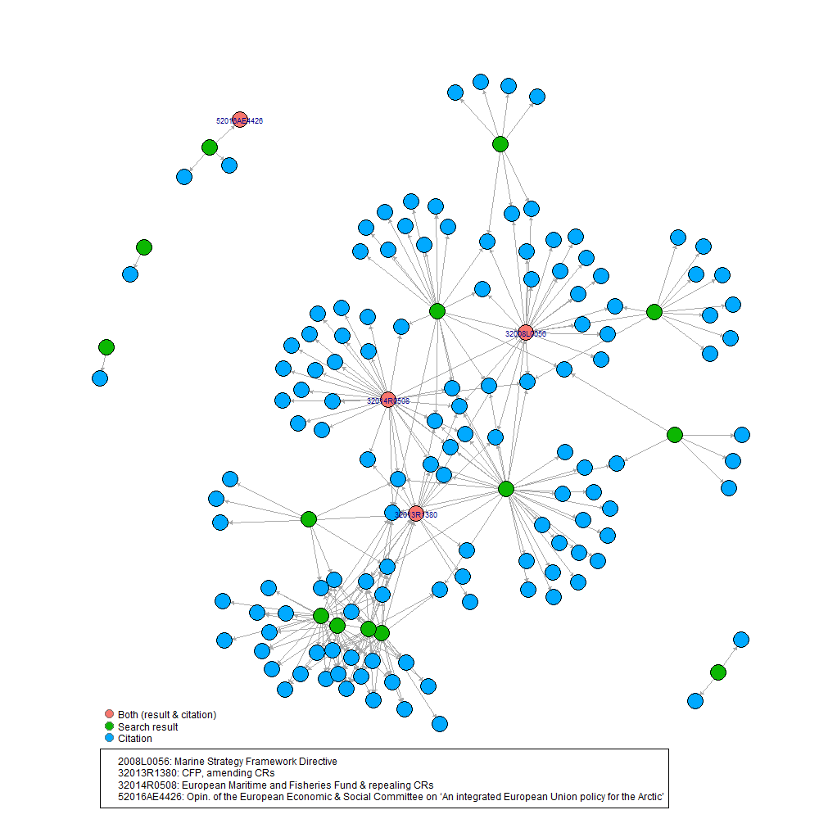
First EUR-Lex search query ”marine protected”, exactly=TRUE
Resulted in 24 documents
6 decisions
2 directives
8 opinions
1 recomendation
7 regulations
19 documents cite another document
There are 208 distinct document citations
Within the network plot:
When we filter for citations that are only legeslation…
17 documents cite legislation
134 out of the 208 citations are legislative documents
3 documents in the search results are also cited in other documents. These are:
Marine stratey framework directive (32008L0056)
CFP amending Council regulations (32013R1380)
European maritime and fisheries fund and repealing council regulations. (32014R0508)
Opinion on EU policy for the Arctic (52016AE4426)
Total:
148 vertices
498 edge interactions

Slide 2
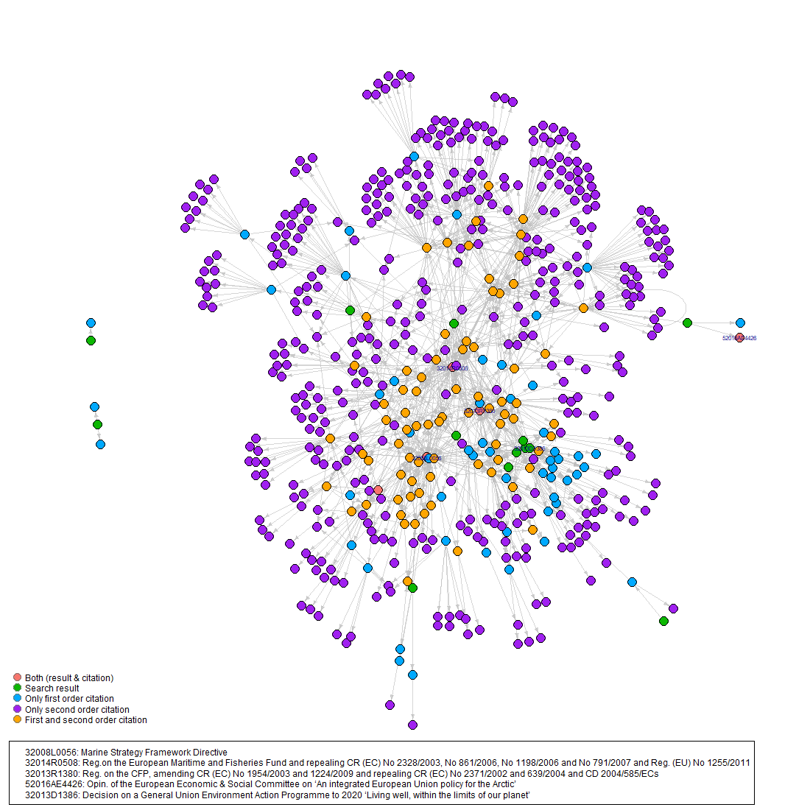
First EUR-Lex search query ”marine protected”, exactly=TRUE
54 are only first order citations
435 are second order citations.
76 are both first and second order citations.
5 documents are both a result and at one point a citation
118 citations cite another legislative document
A new document is now added to the both category.
32013D1386 was pulled from the search result and is a second order citation
Total:
583 vertices
2466 edge interactions

Slide 3
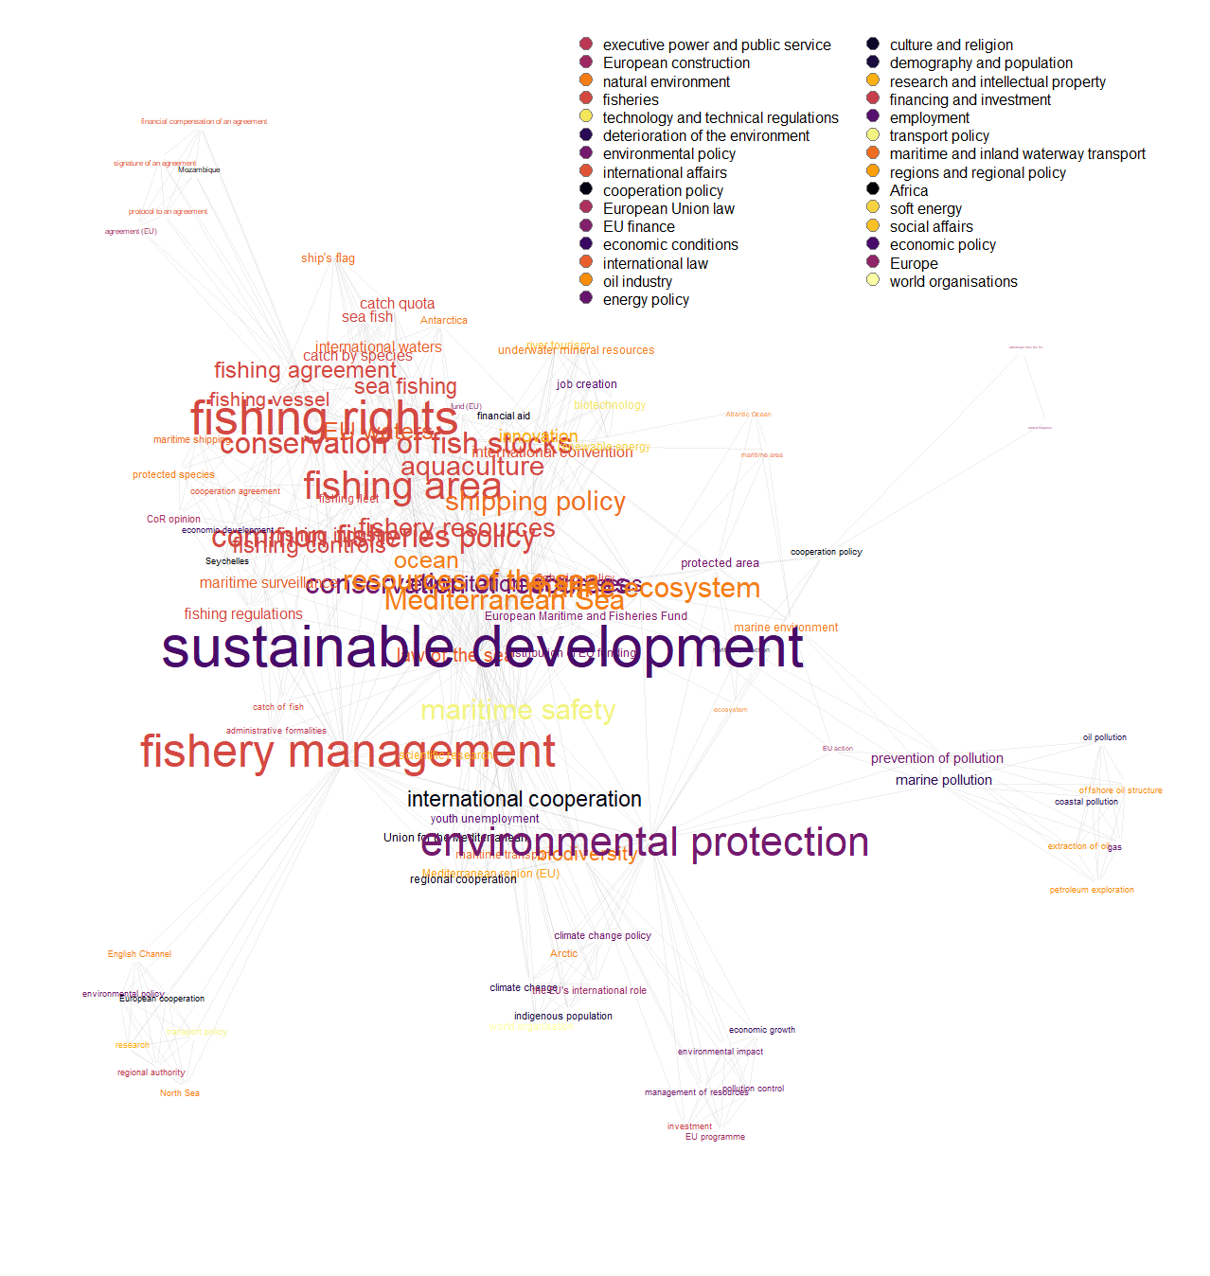
First EUR-Lex search query ”marine protected”, exactly=TRUE
EUROVOC term labels and themes for the 24 document results
103 eurovoc labels associated to 29 themes
In total there are 607 term co-occurance pairs. (Nmbr of times terms appear within a EU document)
Min number of counts is 1 and the maximum is 6
Total:
1214 edge interactions
103 vertices
The only documents that had more than one theme associated were those that have a country label. For the sake of simplicity here i only kept the continent theme and filtered out the other associated themes.
*label size is equiv. to percent of edges associated to the word out of total edges

Slide 4
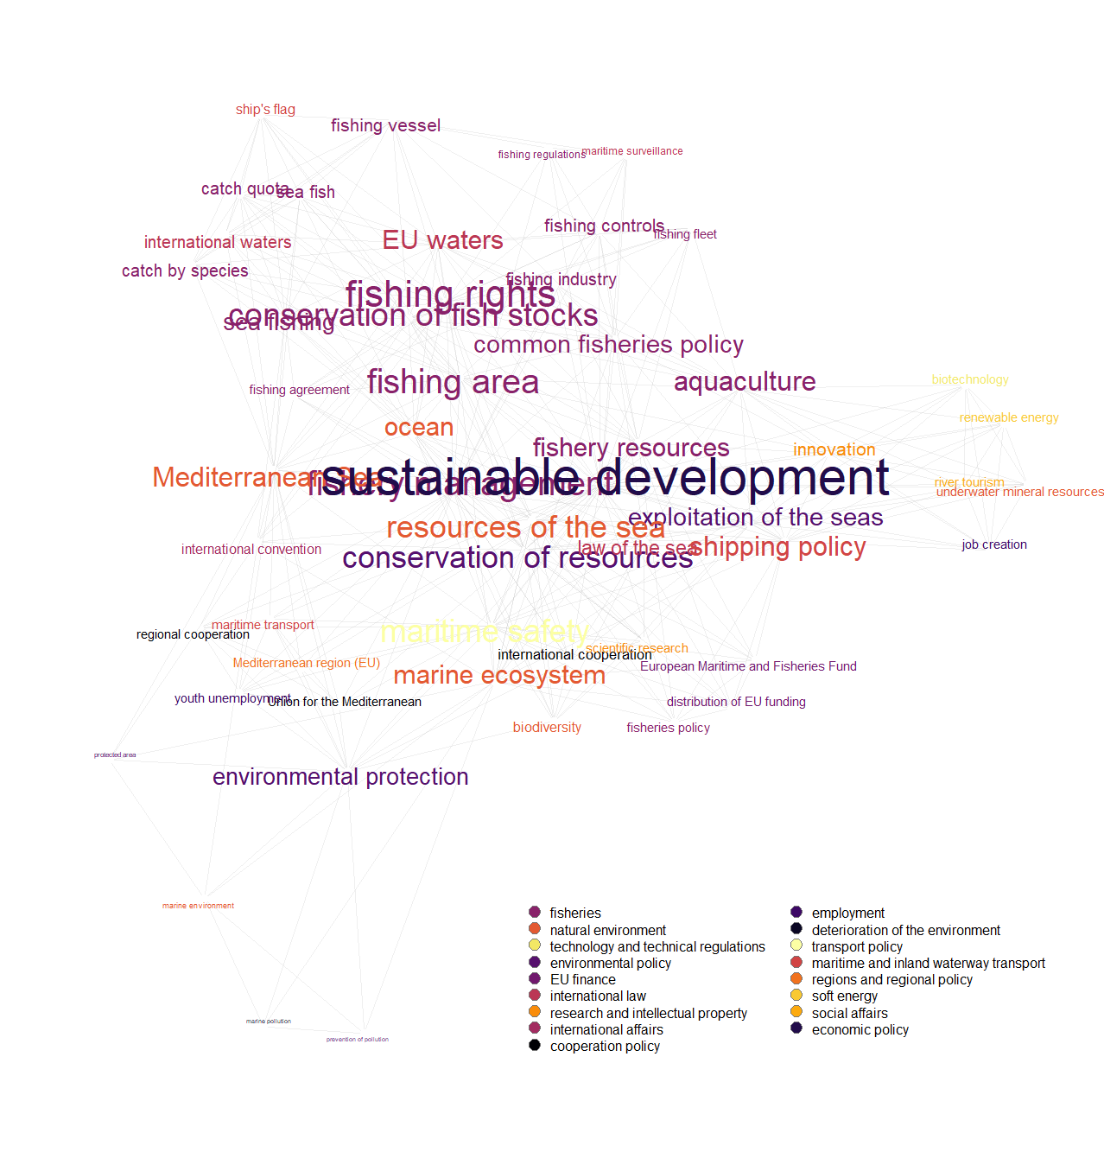
First EUR-Lex search query ”marine protected”, exactly=TRUE
To make a slightly more legable label network plots
I have filtered out the network data to be only those labels that have > median edge number (9 edges).
Total:
738 edge interactions
54 vertices

Slide 5
Second EUR-Lex search query
*The search terms are the designation names for MPAs within the EU (including UK) which have a designation type that is defined as International or Regional
18 unique search terms with exactly = TRUE
Results:
search.term nmbr. of documents pulled. Nmbr. Of mpas Nmbr. Of EU countries linked via mpa desig.
barcelona convention*? 36 24 4
birds directive*? 36 843 23
habitats directive*? 58 1388 + 481 22
helcom*? 14 163 8
marine protected area*? 24 441 10
ospar*? 27 441 10
ramsar site*? 1 237 18
site of community importance*? 4 481 18
sites of community importance*? 10 481 18
special areas of conservation*? 23 1388 19
special protection area*? 29 843 23
specially protected area*? 10 7 2
world heritage site*? 2 9 4
unesco-mab biosphere reserve 0 11 6
baltic sea protected area 0 163 8
specially protected areas of 0 24 4
mediterranean importance
wetland of international importance 0 237 18
cartagena convention 0 7 2

Slide 6
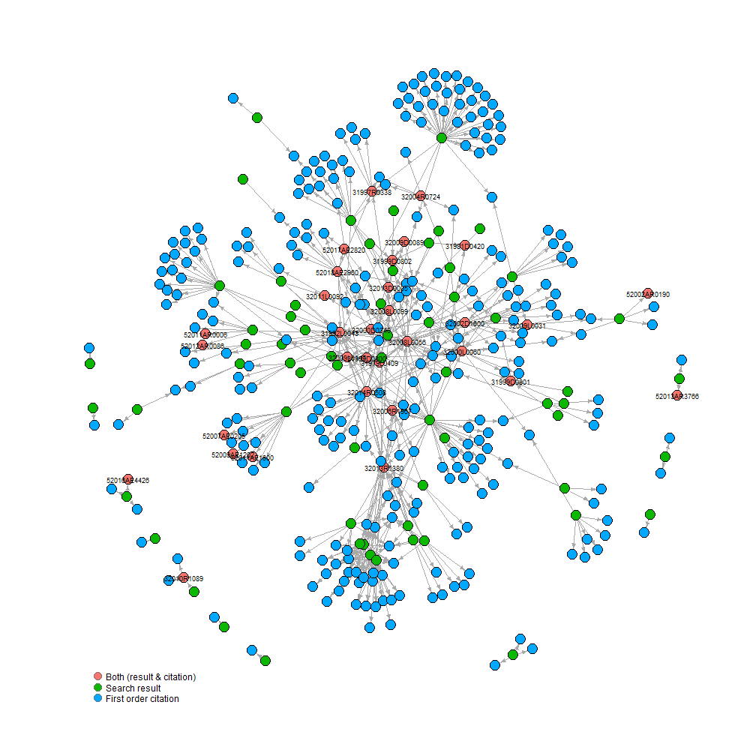
Second EUR-Lex search query
Resulted in 179 documents
41 decisions
16 directives
83 opinions
3 recomendation
36 regulations
95 documents cite another document
There are 515 distinct document citations
Within the network plot:
When we filter for citations that are only legeslation…
85 documents cite legislation
317 out of the 515 citations are legislative documents
32 documents in the search results are also cited in other documents.)
Total:
381 vertices
1,162 edge interactions

Slide 7
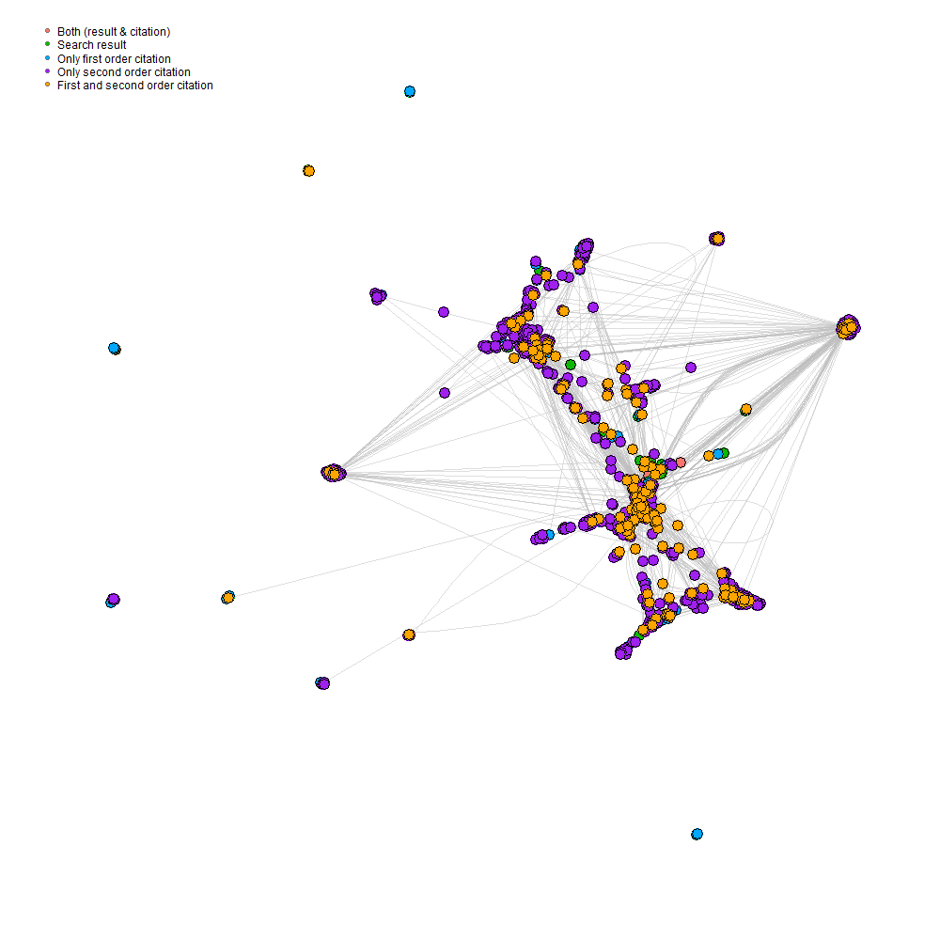
First EUR-Lex search query ”marine protected”, exactly=TRUE
1065 distinct legislative documents are second order citations´.
312 citations cite another legislative document
3 new documents now added to the both category.
pulled from the search result and is a second order citation
Total:
1126 vertices
5340 edge interactions

Slide 8
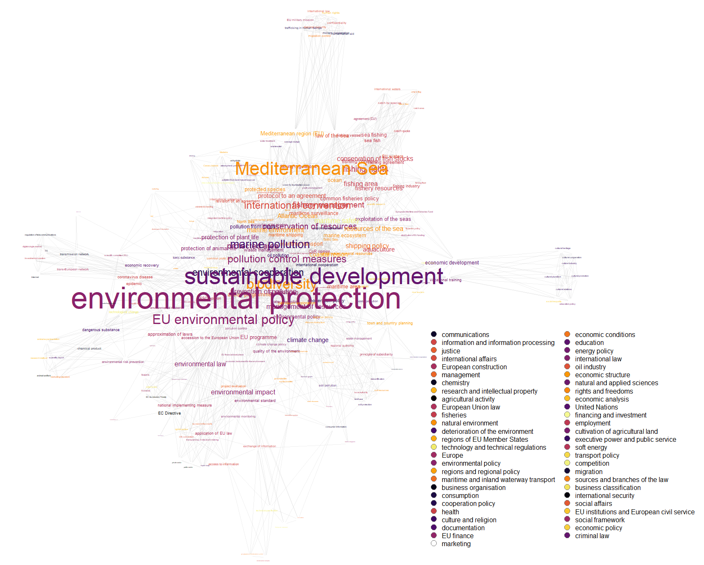
second EUR-Lex search query
EUROVOC term labels and themes for the 179 document results
403 eurovoc labels associated to 79 themes
In total there are 2,627 term co-occurance pairs. (Nmbr of times terms appear within a EU document)
Min number of counts is 1 and the maximum is 20
To make a slightly more legable label network plots
I have filtered out the network data to be only those labels that have > median edge number (9 edges).
Total:
3,614 edge interactions
226 vertices
The only documents that had more than one theme associated were those that have a country label. For the sake of simplicity here i only kept the continent theme and filtered out the other associated themes.

Slide 9
What I have for the text data for both queries
Extracted title and body and combined them and cleaned up the text data
Will start trying to pulling the sentence/paragraph the citation is located within
EUR-Lex Corpus:
EUR-Lex result Documents
Meta data includes
year/date
enforced(True/False/NA)
Type of leg. (dir., rec., opin, etc…)
for the second query we also have the MPA design. Search term (i.e. bird directive, helcom, etc…)

Slide 10
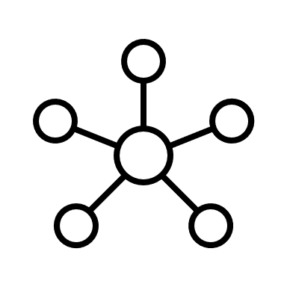
EUR-Lex Database
Extract EU legislation which mentions:
(1) ”marine protected”
(2) A query for every official MPA designation title (i.e., world heritage site, Ramsar site, etc.) within the EU and the UK.
24 legislative documents
179 legislative documents
link associated document data
(1) Extract document citations
(2) Attach documents to their assigned EU labels and themes.
Network analysis
(1) Citation network (2) term label co-occurance network
indiginous communities
catch quota
international waters
fishing fleet
sustainable development
plasic
oil spills
gas
marine pollution

Slide 11
Retsinformation:
Search queries were filter only for ”regler” and not including historical documents ***
”fiskeri”
”jagt” → then within the text I detected if it mentions sæl or fulgle
”søtrafik”
Total 1,211 documents pulled
Working on pulling the EUR-lex documents they link to…
Im a little confused how to get the results for the swedish searches…

