Slide 1
개인자산관리시스템

Slide 2
Agenda
01
02
03
04
05
Project Introduction
Programming Tool
Software Architecture
Database Relationship
Main
Function

Slide 3
Project Introduction
Project Introduction
사용자의 소비 패턴, 지출 현황을 분석한
통계 데이터를 활용하여
자산의 흐름을 파악할 수 있도록 한다.

Slide 4
Agenda
01
02
03
04
05
Project Introduction
Programming Tool
Software Architecture
Database Relationship
Main
Function

Slide 5




Programming Tool
Programming Tool
1) 개발 환경 : JAVA , HTML5, CSS3.0, AJAX, JSON
2) 개발 도구 : Eclipse Java EE IDE for Web Developers
3) 데이터베이스 구성 : Oracle DB 11g Express Edition
4) 서버 : Apache tomcat 8.0.26
5) 운영체제 : Windows7 Enterprise K 64bit, Linux CentOS

Slide 6
Agenda
01
02
03
04
05
Project Introduction
Programming Tool
Software Architecture
Database Relationship
Main
Function

Slide 7



Software Architecture
Software Architecture
Browser
Web Server
JSON
Database
Tomcat
HTML5
CSS
JSP
AJAX
MVC
JSON
Oracle
Dispatcher
(Front Controller)
Handler
Controller
Model
(VO)
Biz
Dao

Slide 8



Main Function
Service Flow Chart
Linux

Slide 9
Agenda
01
02
03
04
05
Project Introduction
Programming Tool
Software Architecture
Database Relationship
Main
Function

Slide 10
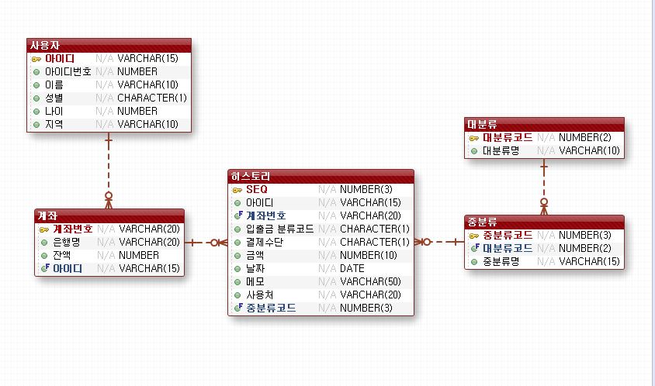
Database Relationship
Database Relationship

Slide 11
Agenda
01
02
03
04
05
Project Introduction
Programming Tool
Software Architecture
Database Relationship
Main
Function

Slide 12
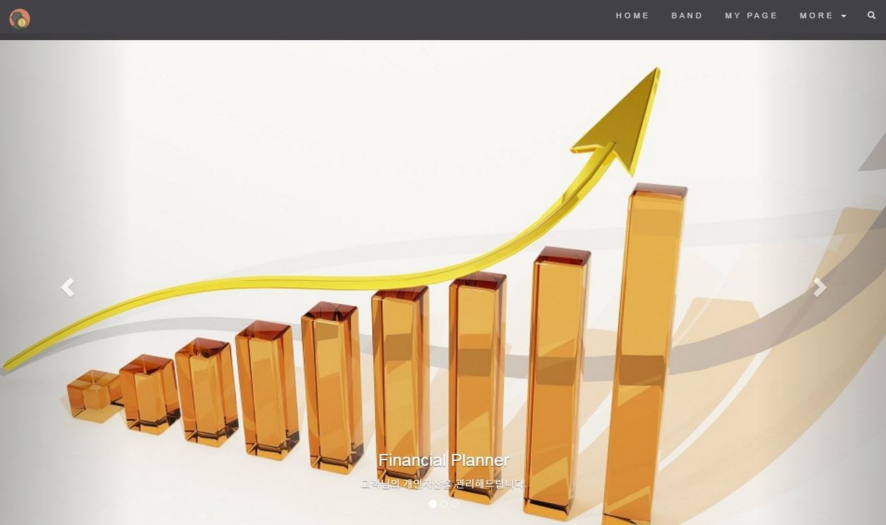
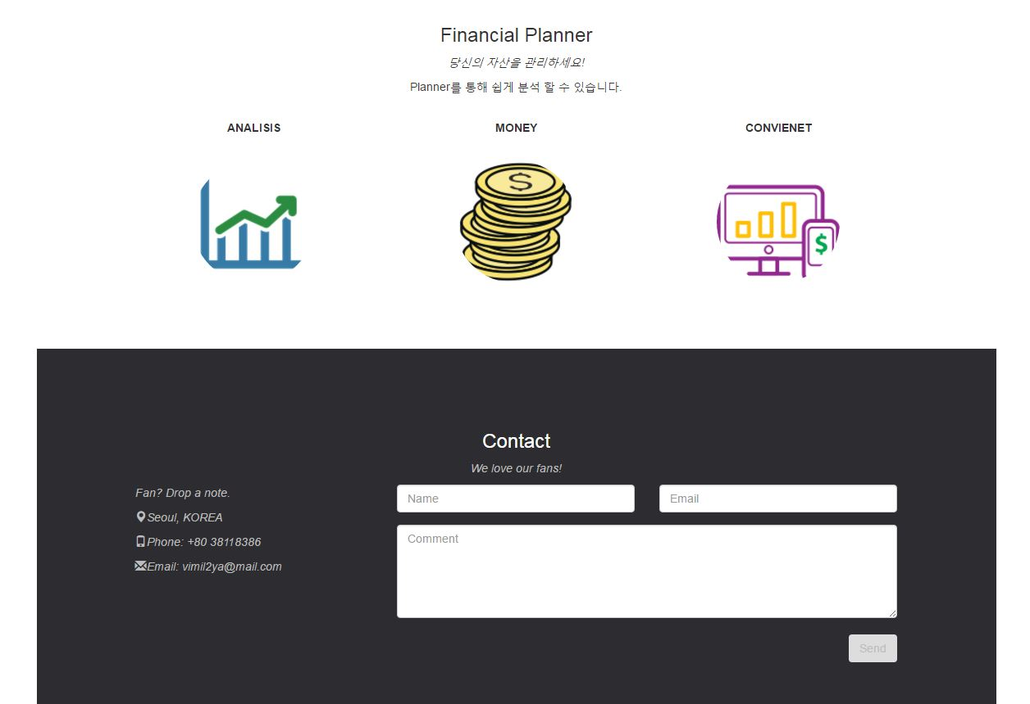
Main Function
Main Function

Slide 13
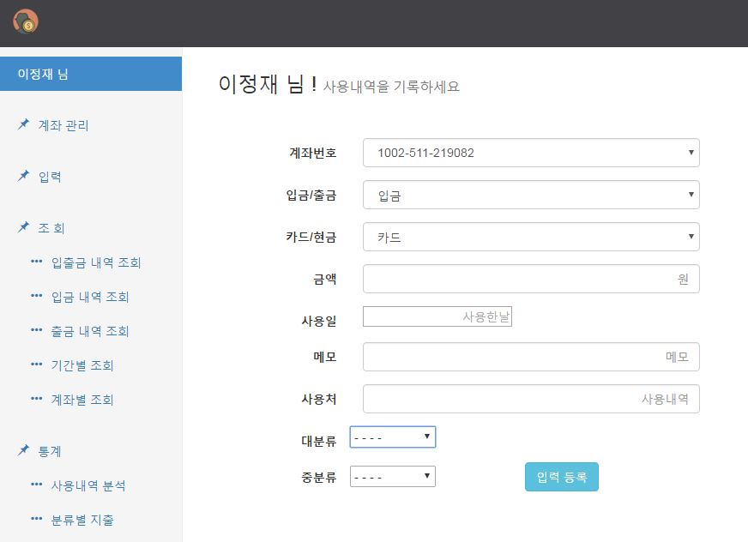
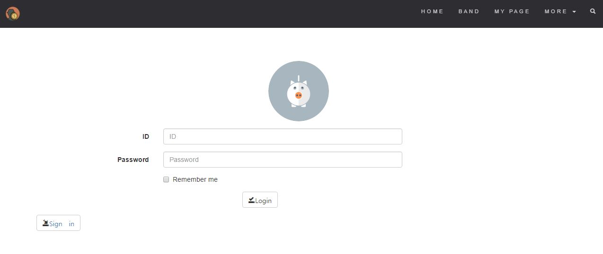
Main Function
Main Function

Slide 14
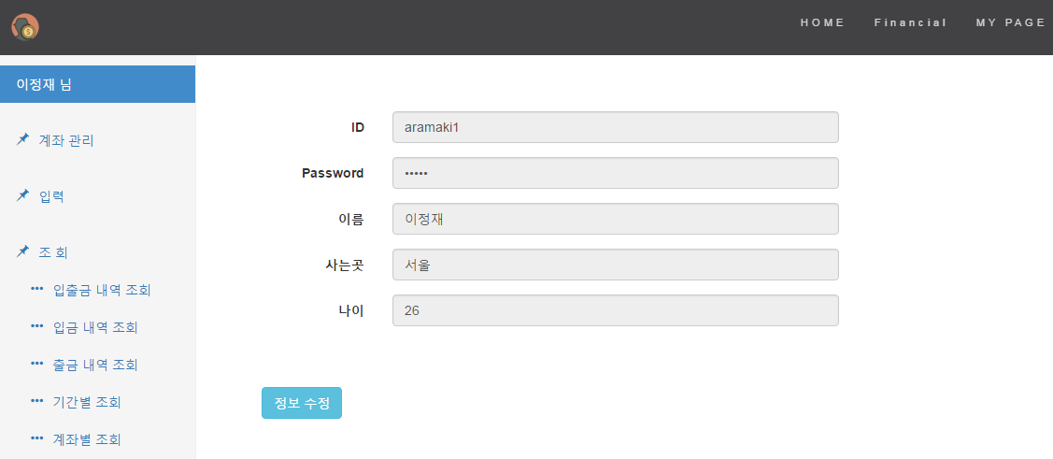
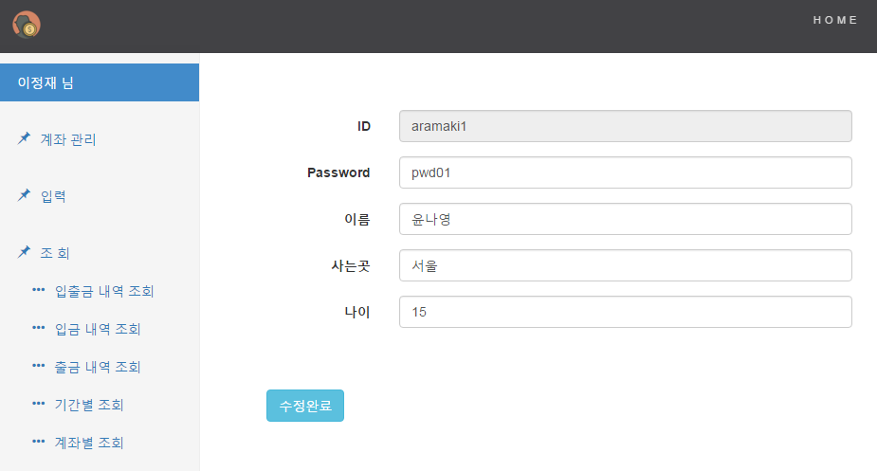
Main Function
Main Function

Slide 15
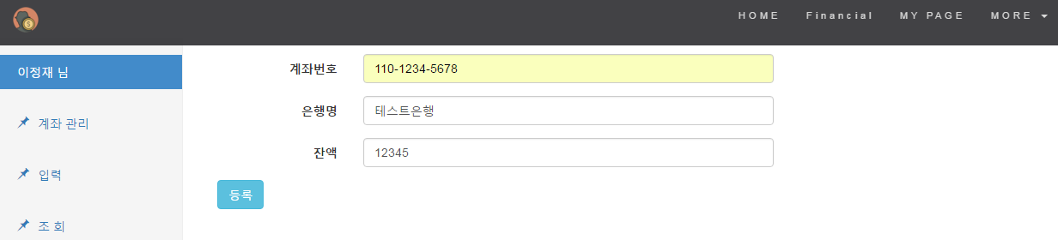
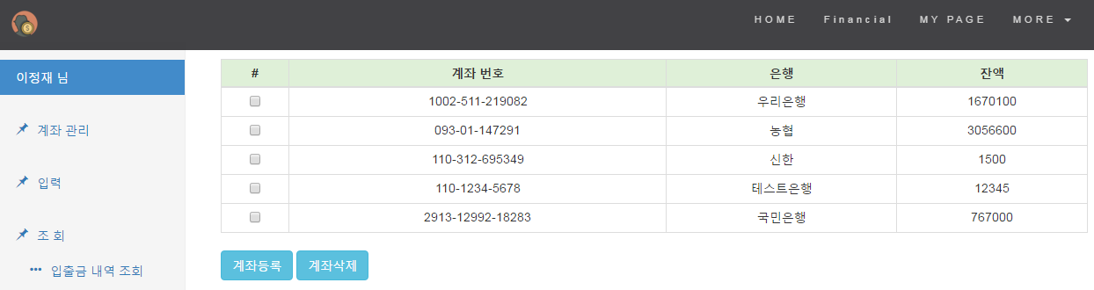
Main Function
Main Function

Slide 16
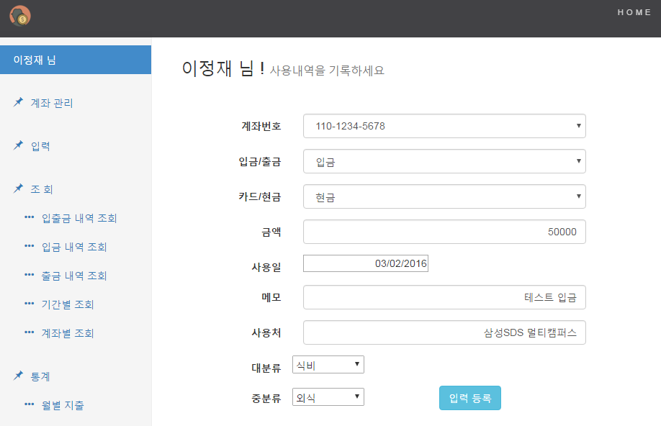
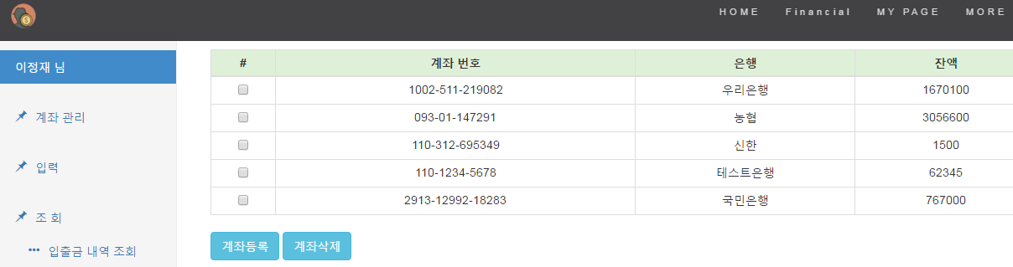
Main Function
Main Function

Slide 17
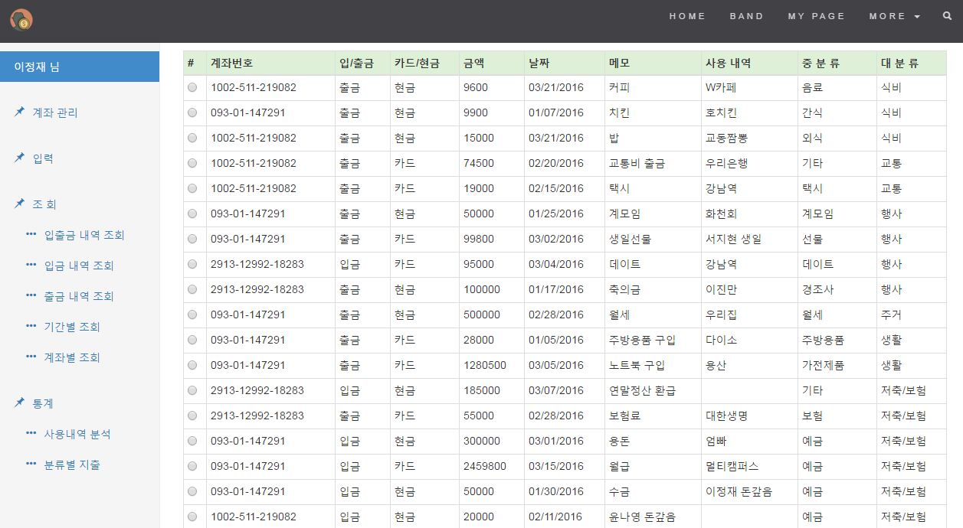
Main Function
Main Function

Slide 18
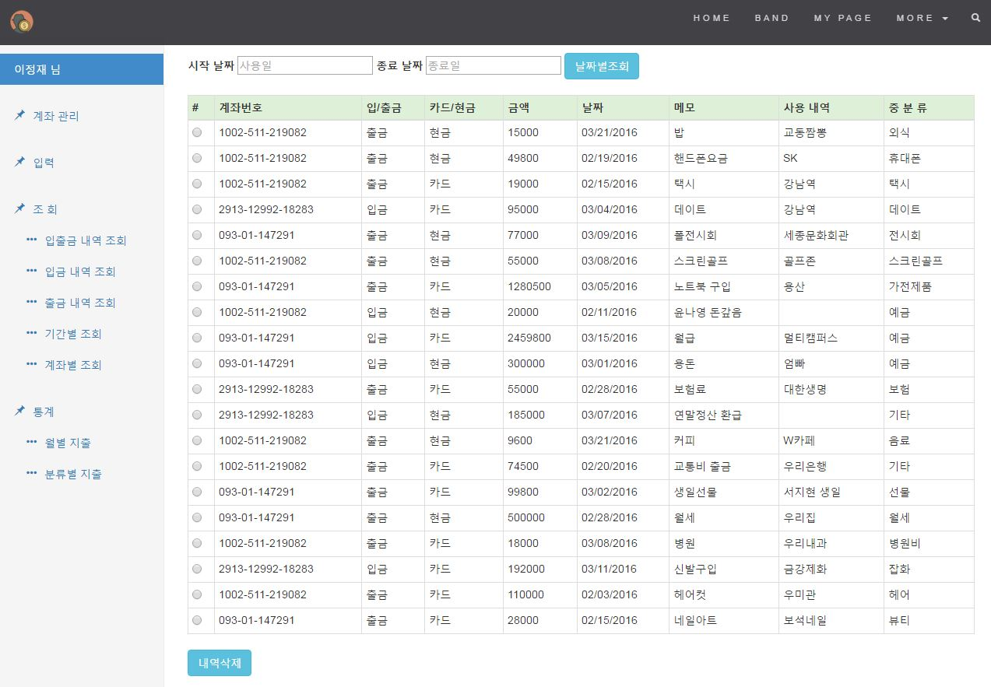
Main Function
Main Function

Slide 19

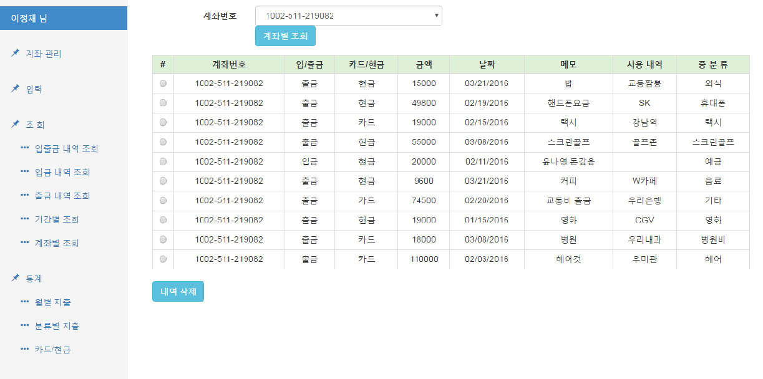
Main Function
Main Function

Slide 20
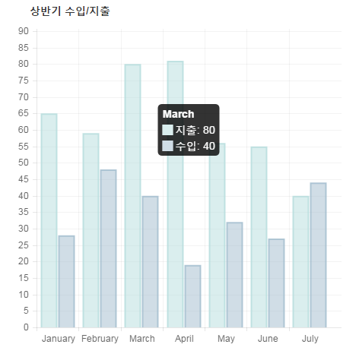
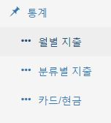
Main Function
Main Function

Slide 21
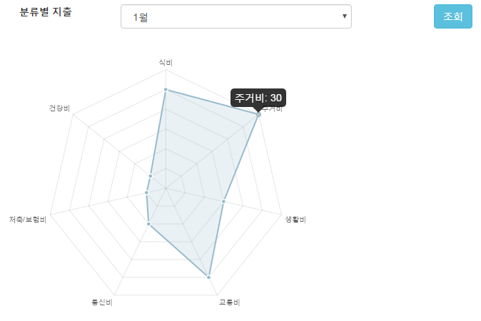
Main Function
Main Function

Slide 22
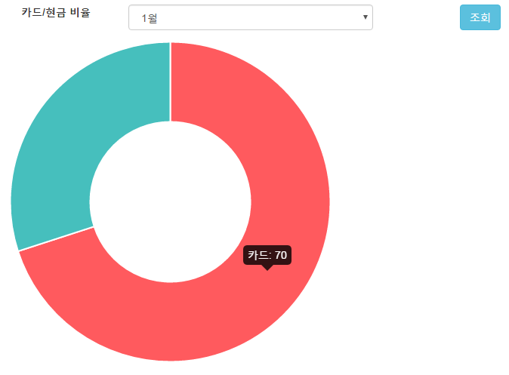

Main Function
Main Function

Slide 23
Last Page
Thank you

