Slide 1
Solving Computational Math
with LLMs, Accurately and Cheaply
Tools, Facts, and Checks
POSTECH CSED490E (Graduate NLP) · Team 5 · October 2026
Notes:
Computational math: geometry, optimization, contest problems, word problems whose answer must be computed exactly. We ask how to get them right with the fewest tokens and the smallest GPU.

Slide 2
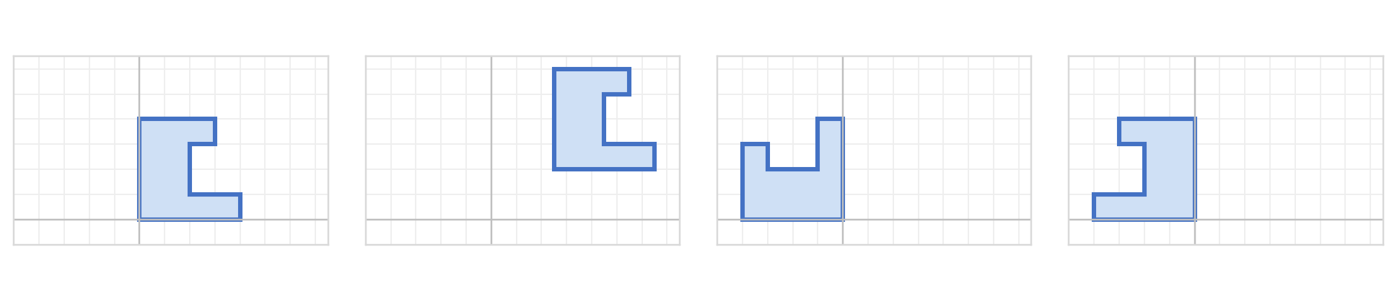
Let the computer do the math
Same shape moved, turned or flipped, so the right answer never changes: 436 (twice its area)
original
moved
turned
flipped
Answer in words
the model does the arithmetic itself
436 ✓
2944 ✗
392 ✗
728 ✗
Write a program
the computer does the arithmetic
436 ✓
436 ✓
436 ✓
436 ✓
But programs can be silently wrong, and thinking is expensive. Goal: right answers, lowest cost.
Notes:
Qwen3-8B, real outputs. Asked to answer directly, it gives a different area for each copy of the same polygon (only the original is right). Asked for a program, it writes the shoelace formula and the computer gets all copies right. Programs still fail silently, and thinking longer is expensive: on 311 contest problems gpt-oss-120b goes from 57% to 66% for 4.4 times the tokens. Goal: effective (exactly right) and efficient (fewest tokens, smallest GPU).

Slide 3
Words we use
Program
Tool
Fact
code the model writes; the computer runs it
ready-made code we put in the prompt
know-how the model may lack
e.g. the shoelace formula for an area
e.g. orient(a, b, c); the OR-Tools route library
e.g. the exact function name to call
Check
Thinking
Token
a cheap test, without knowing the answer
hidden notes before answering; costs tokens
a piece of a word: the unit of cost
e.g. run the examples printed in the problem
e.g. low / medium / high effort
e.g. a one-page answer ≈ 700 tokens
Notes:
Plain definitions for the rest of the talk. Every result is reported as accuracy and tokens (cost).

Slide 4
Findings at a glance: same or better, for fewer tokens
blue = the better way · grey = the usual way or a published method · red = makes it worse
Add the missing fact
Small models gain most
Compare two versions
delivery routing, Qwen3-32B: % optimal
word problems: % solved
geometry, Qwen3-32B: % · tokens
task only
23%
Qwen3-1.7B
0%
8 extra tools
59% · 0.6k
think longer
3%
1.7B + fact
45%
always think
98% · 5.9k
whole manual
7%
Qwen3-32B
65%
think if differ
99% · 4.3k
5 exact lines
77–90%
32B + fact
66%
Think only on failure
Reuse a checked program
All together
311 contest problems: % · tokens
48 routing days: % valid · tokens
624 problems, 3 models: % · tokens
always high
66% · 30k
new each day
7% · 86k
think on hardest
74% · 4.1k
high on failure
66% · 25k
own notes (DC)
31–40%
fix by type
83% · 4.2k
reuse one
94% · 28k
fact first
87% · 2.5k
Notes:
One panel per result. Add the fact: routing 23% to 77-90% (thinking longer 3%, whole manual 7%). Small models gain most: Qwen3-1.7B 0% to 45%, Qwen3-32B 65% to 66% (word problems). Compare two versions: 99% at 4.3k tokens vs always thinking 98% at 5.9k; with 8 extra tools 59%. Think only on a failed check (gpt-oss-120b, contest): 66.3% at 24.7k vs 66.2% at 30.1k. Reuse: 94% of 48 routing days vs 7% with a new program per day; Dynamic Cheatsheet (DC, the model's own notes) 31-40%. All together: fact first then think on failure 87% at 2.5k vs 74% at 4.1k for thinking on the hardest-looking problems (Snell-style) and 83% for choosing the fix by failure type.

Slide 5
Finding 1: give the fact, not the manual
Task: plan delivery routes for trucks with a weight limit, using Google's OR-Tools library (Qwen3-32B)
Prompt A: task + a long OR-Tools reference sheet
...the task...
RoutingModel: AddDimension(...), Solve(...),
SetArcCostEvaluator(...), ... (many functions)
✗ crash: no such function
RegisterUnaryLongLivingCallback(...)
Prompt B: task + 5 lines of exact usage
...the task...
dcb = r.RegisterUnaryTransitCallback(demand)
r.AddDimensionWithVehicleCapacity(dcb, ...)
✓ runs, best route
RegisterUnaryTransitCallback(...)
Out of 100 routing problems, how many it solves best:
Nothing extra
23
Think longer
3
Long reference sheet
7
5 exact lines
77–90
Notes:
The model writes the program (the right side shows the line that matters). With a long reference sheet it guesses a plausible function name that does not exist and crashes; with five lines showing the exact call it writes the right one. Thinking longer cannot supply a fact it does not have (3 of 100). On the 56 standard Solomon routing problems, three such facts together take gpt-oss-120b to a valid plan on every instance.

Slide 6
Finding 2: one fact helps small models most
Word problems → optimization programs (NL4OPT + IndustryOR, 345 problems, 3 runs): % solved
+44
Qwen3-1.7B
+31
Qwen3-4B
+17
Qwen3-8B
+8
Qwen3-14B
+1
Qwen3-32B
fact gain (points)
With the fact, a model on one 24 GB GPU matches Qwen3-32B (73% vs 72%) at 1/8 of the tokens
Notes:
SIZE study. Without the snippet the 1.7B model invents OR-Tools attributes and almost never runs (0.1%); with six lines of exact usage it solves 44.5%. The gain shrinks as the model grows (+44, +31, +17, +8, +1 points). With the recipe (fact first, think only when the check fails), models that fit one 24 GB GPU match or beat Qwen3-32B: gpt-oss-20b 73.0% at 0.7k tokens vs Qwen3-32B with the fact and always thinking 72.0% at 5.5k; on the optimization suite Qwen3-14B (4-bit) 87-92% vs Qwen3-32B 79-85%. Below 14B the optimization suite stays at 47% or less.

Slide 7
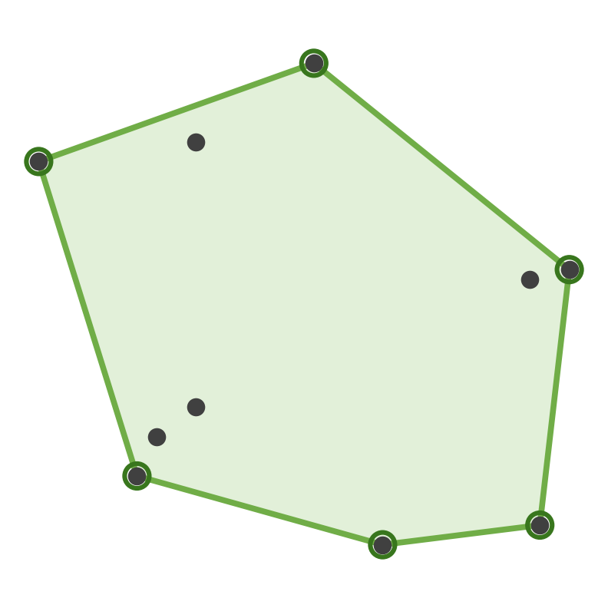
Finding 3: two versions catch each other's mistakes
Extra tools can mislead the model. Write the program with and without them, and compare:
Prompt A: only the task
Points: (20,-40) (-26,-18) ...
How many corners does the rubber
band have? Write a Python program.
6 ✓
answers differ → think it through → 6 ✓
Prompt B: the task + 8 helpers
...same task...
You may use these helpers:
orient(a, b, c) # side of a line
polar_sort(pts, o) # sort by angle
... and 6 more
0 ✗
rubber band around 10 points: 6 corners
used polar_sort: wrong method
Over 108 geometry problems (Qwen3-32B, 3 runs): how often the answer is right, and tokens per problem
Always Prompt B (+ helpers)
59% · 0.6k
Always Prompt A (task only)
77% · 0.4k
Always think long
98% · 5.9k
Both prompts, think only if they differ
99% · 4.3k
Notes:
The example (Qwen3-14B, real output): the only difference between the two prompts is the toolbox, eight correct helper functions that the task does not need. We run the two finished programs ourselves. Program A prints 6, the right answer; program B builds its method on polar_sort and prints 0. The bars (Qwen3-32B, 108 generated geometry problems, mean of 3 runs; tokens = output tokens per problem, both cheap programs counted for the last row): with the helpers 59%, task only 77%, always thinking 98% at 5.9k tokens, and writing both cheap programs and thinking only when their answers differ 99% at 4.3k (27% fewer tokens; the pair differs on 37-53% of problems). It does not help when both programs share the mistake (gpt-oss-120b on contest problems).

Slide 8
Finding 4: think harder only when a check fails
Every contest problem lists a few sample inputs with the correct outputs. Running the program on them costs nothing:
all right → submit
write a program quickly (medium effort)
run it on the examples
one wrong → think harder (high effort), then submit
"Make a triangle!" (easy)
"Arrow" (hard)
Q: how many cm to add so 3 sticks make a triangle?
samples (3,4,5) → 0 and (2,5,3) → 1: program agrees ✓
→ submit; correct, no extra tokens
Q: print the 7 corners of an arrow shape
program's corners ≠ the sample ✗ → think harder → correct ✓
4k + 13k tokens, paid only because the check failed
Over 311 problems (gpt-oss-120b): same 66% solved as always thinking hard, 18% fewer tokens
Always think hard
30k tokens
Think hard only on a failed check
25k tokens
Notes:
Real gpt-oss-120b runs on Codeforces geometry problems. The examples are a free check: if the quick (medium-effort) program gets them right we submit it; if not, we pay for high effort. Examples can miss bugs (Find Color passed all 3 examples and failed hidden test 11), so the full policy also runs a quick brute-force comparison on small inputs. Result: 66.3% at 24.7k tokens per problem vs 66.2% at 30.1k for always high effort.

Slide 9
Finding 5: repeated problems need one checked program
A delivery company plans routes every day: the same kind of problem, new customers each day (gpt-oss-120b)
A: ask for a new program every day
valid on 7% of days
≈ 86k tokens
B: the model writes 16 programs; keep the one valid on 8 past days; reuse it
valid on 94% of days
28k tokens in total
each square = one of 48 new days · green = a valid route plan
Only the data change, so one checked program keeps working (also on 4× bigger days). New rule? Ask the model to edit it.
Notes:
Analogy for the 56 Solomon routing problems: each problem is like one day's orders. A: a new program per day is valid on 6 and 1 of 48 days in two runs (7%; drawn as 3), about 1.8k tokens each. B: draw 16 programs once, keep the one that gives valid plans on 8 practice days, reuse it: valid on 45 of 48 days (94%), 28k tokens in total. Reused programs also work on 200- and 400-customer problems; for a new rule (job-shop with release dates) editing the working program beats writing a new one (10% to 68-100%).

Slide 10
Finding 6: the fact can be found without a human
solve other problems of the same kind (another benchmark)
keep the model's shortest program that passed the free check
show it as the fact for new problems
What does not work
a program from a different problem type: 14–21 points worse
a list of the library's names: Qwen3-32B 66% → 56%
Automatic = hand-written within about 1 point, with no human in the loop
Notes:
X6-AUTO / X6-VER / X7. The fact is the model's own shortest program from NL4OPT / IndustryOR that passed the label-free check (it runs and prints a value); no answers, no human. On the held-out MAMO benchmark the recipe (two programs with this fact, think only if they disagree) matches the hand-written snippet: gpt-oss-20b 78.8 vs 78.9% (within 1.2 points on 3 seeds), Qwen3-14B-AWQ 71.7 vs 71.4%, Qwen3-8B 71.0 vs 72.0%. It stays within a problem family: a program of another problem type is 14-21 points below the hand-written fact on the optimization suite, and an introspected list of the library's names hurts (Qwen3-32B 66.2 to 56.1%).

Slide 11
Finding 7: proofs need a specialized model, not a fact
Lean 4 proofs of competition statements (miniF2F, 244), 8 tries each: % proved
For general models, no step helps
Qwen3-32B
13%
a verified similar proof: 133 → 133
thinking: 133 → 129
inequality fact sheet: 24 → 21 (of 50)
fixing from Lean's errors: half as good as a fresh try
gpt-oss-20b
27%
Qwen3.6-35B
55%
DeepSeek-Prover-V2-7B
68%
Goedel-Prover-V2-8B
74%
Geometry proofs (AlphaGeometry's symbolic engine): IMO 12 of 30 alone → 13 with LLM-proposed points; easier JGEX 187 of 231 → 200
The missing piece is a skill, not a fact: use a specialized 8B prover (fits one 24 GB GPU)
Notes:
PREREG_PROOF. miniF2F test (244), 8 attempts, Lean 4 + Mathlib compiler as the exact check. Specialized provers that fit a 24 GB GPU prove the most and rarely invent lemma names (6-7% of failed attempts vs 22-40%). For general models a verified proof of the most similar statement (Qwen3.6 133 vs 133; gpt-oss-20b 65 vs 66), thinking (Qwen3.6 129), or a 10-line inequality toolkit (21 vs 24 of 50 bound statements) does not help; even for the provers, revising a failed proof from Lean's error lines proves half as many as a fresh attempt (Goedel 11 vs 22 of 107; DeepSeek 5 vs 13 of 112). Geometry: AlphaGeometry's DD+AR engine alone proves 12 of IMO-AG-30 and 187 of JGEX-AG-231; auxiliary points proposed by gpt-oss-20b add 13 JGEX problems; only IMO 2014 P4 is unlocked by any model's proposal.

Slide 12
Our method: a recipe built from the findings
pass → done
Write a program
Add the missing fact
Run a free check
1
2
3
fail → 4. think harder
right on 8 of 8 copies (slide 2)
23% → 77–90%; can be automatic (findings 1, 2, 6)
examples, or two versions agree (finding 3)
same 66%, 18% fewer tokens (finding 4)
Same problem again? Reuse the checked program
5
valid plans 7% → 94% (finding 5)
Together: 87% solved at 2.5k tokens, vs 74% at 4.1k for "think longer on hard problems"
Notes:
Each step is a measured result, shown on the next slides with an example. Step 1: the polygon. Step 2: delivery routing with OR-Tools (Qwen3-32B). Step 3: free checks (the problem's examples; two versions that should agree). Step 4: contest geometry with gpt-oss-120b. Step 5: reuse on the Solomon routing benchmark. Together (3 models, 624 geometry and optimization problems, 3 seeds): fact first and thinking only on a failed check solves 87% at 2.5k tokens per problem.

Slide 13
All together: facts first, think only on failure
Same 624 geometry and optimization problems, 3 models: % solved · tokens per problem
First program, no help
63% · 0.7k
A new task? Label 30 problems
Think on hardest-looking
74% · 4.1k
points lost vs the best policy, over 63 settings (lower is better)
Think when check fails
77% · 4.2k
always think
Fix by failure type
83% · 4.2k
8.4
fact first (default)
Retrieved fact, then think
84% · 3.3k
1.4
Fact first, then think
87% · 2.5k
pick on 30 labels
0.6
Most accurate and among the cheapest on all 3 seeds: spend thinking where a check fails
Notes:
Right panel (MODEL, 63 model x task x seed cells; 0.5 points per 1k tokens): fact first, think on failure is the best fixed default (1.4 points from each cell's best policy; always thinking 8.4); choosing among 4 policies on 30 labelled problems of the new task cuts it to 0.6 (MAMO: 0.8-1.4). U1 / U1r / U2 (pre-registered). Qwen3-8B, Qwen3-32B and Qwen3.6 on the generated geometry and optimization suites, 624 problems, cure seed 1 shown; the order is the same on seeds 2 and 3. Thinking on the hardest-looking problems (difficulty-based allocation, as in compute-optimal scaling work) is even below thinking whenever the check fails. Giving the fact first and thinking only when the check fails is the most accurate and uses fewer tokens than any thinking policy; with automatically retrieved facts (BM25) it still reaches 84%.

Slide 14
Compared with published methods
Task | Published method | Its result | Ours (same problems)
Where to spend thinking | think on the hardest-looking problems (Snell et al. 2025) | 74% · 4.1k | fact first, think on failure: 87% · 2.5k
Contest geometry | always high effort (reasoning-model default) | 66.2% · 30.1k | think only on a failed check: 66.3% · 24.7k
Pick 1 of 3 programs | CodeT: the model writes tests | 96.0% (+340 tokens) | symmetry check: 99.7% (0 tokens)
Library documentation | DRoC: decompose, retrieve per constraint (ICLR 2025) | 72% · 2.1k | exact 5-line snippet: 77% · 1.7k
Unneeded tools | System 2 Attention / a "use only if needed" sentence | 64% / 76% | only the needed tools: 92%
Daily routing | Dynamic Cheatsheet: the model's own notes | 31–40% | reuse a checked program: 94%
Measured here with the same problems and models: the recipe is more accurate, cheaper, or both
Notes:
All baselines were run by us on our benchmarks. Models: U1 policies over Qwen3-8B / Qwen3-32B / Qwen3.6 (624 problems); contest geometry gpt-oss-120b (311); selection Qwen3-8B (300 geometry instances, 3 candidates); documentation Qwen3-32B on CVRP; tools Qwen3-32B on 5 geometry tasks; daily routing gpt-oss-120b on 48 held-out Solomon instances. Tokens are output tokens per problem. More rows (MBR-exec, majority vote, DeepConf, Self-Debugging, Mixture-of-Thought cascade, BM25 retrieval) are in PROPOSAL.md section 7.

Slide 15
Where the recipe stops, and what is next
Where it stops
Next
Proofs: a skill, not a fact (use a specialized prover)
Automatic facts only within one kind of problem
Checks leak: 24–37% of wrong contest programs pass the examples
Missing world knowledge: thinking adds 2–5 points at 70–200× tokens
Repeat the held-out MAMO test for 3 more models (3 seeds)
Automatic facts for each problem type
Final report; a commercial model if available
Every claim pre-registered and checked on 3 seeds; accuracy always reported with its token cost
Notes:
Updated 2026-10-19. Done since the last version: contest geometry and competition math on 24 GB GPUs, Qwen3.6 with the model card settings (headline unchanged), automatic facts and the held-out MAMO test, the policy model, proofs. Older notes: for Lean proofs an invented lemma stands for a missing proof step (similar-name feedback fixes 2.7%, a fresh try 3.2%); for PopQA thinking adds 1.8-5 points at 70-200 times the tokens, only for well-known facts. Checks leak, which caps every policy. Facts were hand-written; BM25 retrieval recovers most of the gain. Next: SIZE-CC (gpt-oss-20b on contest geometry with check-gated escalation), X1-SIZE (competition math for Qwen3-4B/8B/14B), automatic facts, a closed API model, final report.

