Slide 1


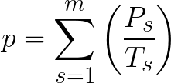
A (m²): Bay surface area
Fish Cage1
Fish Cage2
(m): Average depth
P₁ (kg):
Production of spices 1
P₂ (kg):
Production of spices 2

Slide 2
Fish Cage1
Fish Cage2
A (m²): Bay surface area
D (m): Average distance from farm to bay mouth
P₁ (kg):
Production of spices 1
P₂ (kg):
Production of spices 2
(m): Average depth

Slide 3
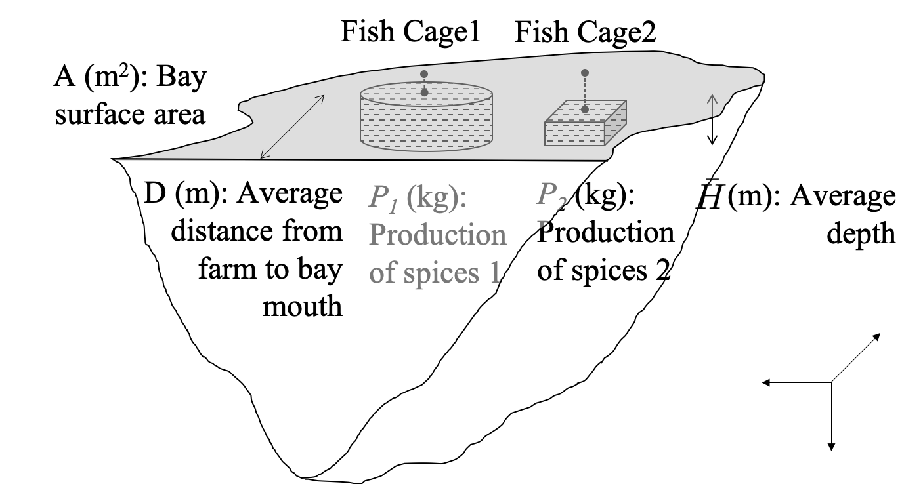
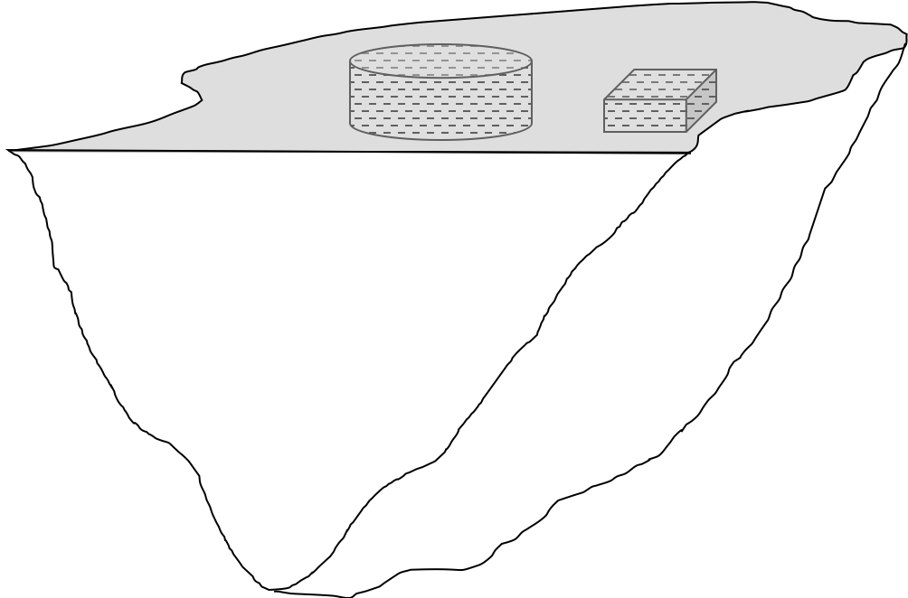
b) Combine image from high resolution tiles.
c) Fish cage detection by applying ML.
f) Diagram of the annual production of a fish farm (p) calculation.
Lon./Lat.
Shape
Size
Depth
Production
Period
Distance
FCR
Shape
Size
Number
Yellowtail
Tuna
Seabream
a) Diagram of fish farm with fish cages in a Bay.
d) Fish cage classification and counting accroding to fish species.
e) Make GIS-based database which includes fish cage information.

