Slide 1

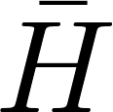
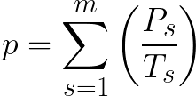
A (m²): Bay surface area
Fish Cage1
Fish Cage2
(m): Average depth
P₁ (kg):
Production of spices 1
P₂ (kg):
Production of spices 2

