Slide 1
Fraud Detection System
Big Data Analytics with PySpark and Machine Learning

Slide 2
Problem Statement
Detect fraudulent financial transactions from historical data.
Dataset is highly imbalanced: fraud rate below 1%.
Need EDA, preprocessing, Spark processing and ML evaluation.

Slide 3
Dataset
Source: Kaggle Credit Card Transactions Fraud Detection.
Train: 1,296,675 transactions.
Test: 555,719 transactions.
Target: is_fraud.

Slide 4
Big Data 5V Mapping
Volume: more than 1.85M transactions across train and test.
Velocity: financial transactions require fast fraud alerts.
Variety: amount, time, location, merchant, category and customer profile.
Veracity: missing/duplicate checks and direct identifier removal.
Value: fraud detection supports risk reduction and decision making.

Slide 5
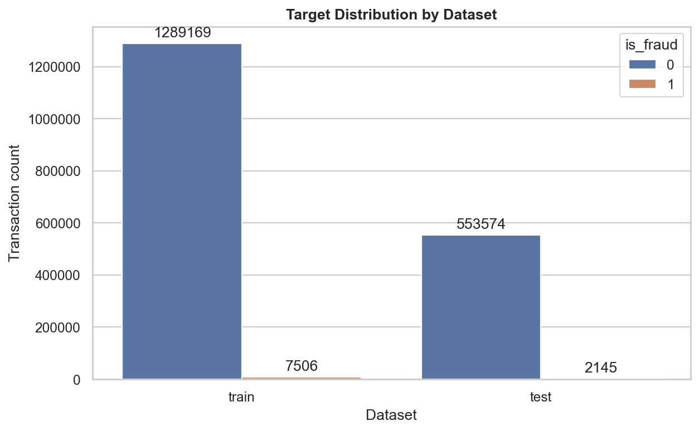
Target Distribution

Slide 6
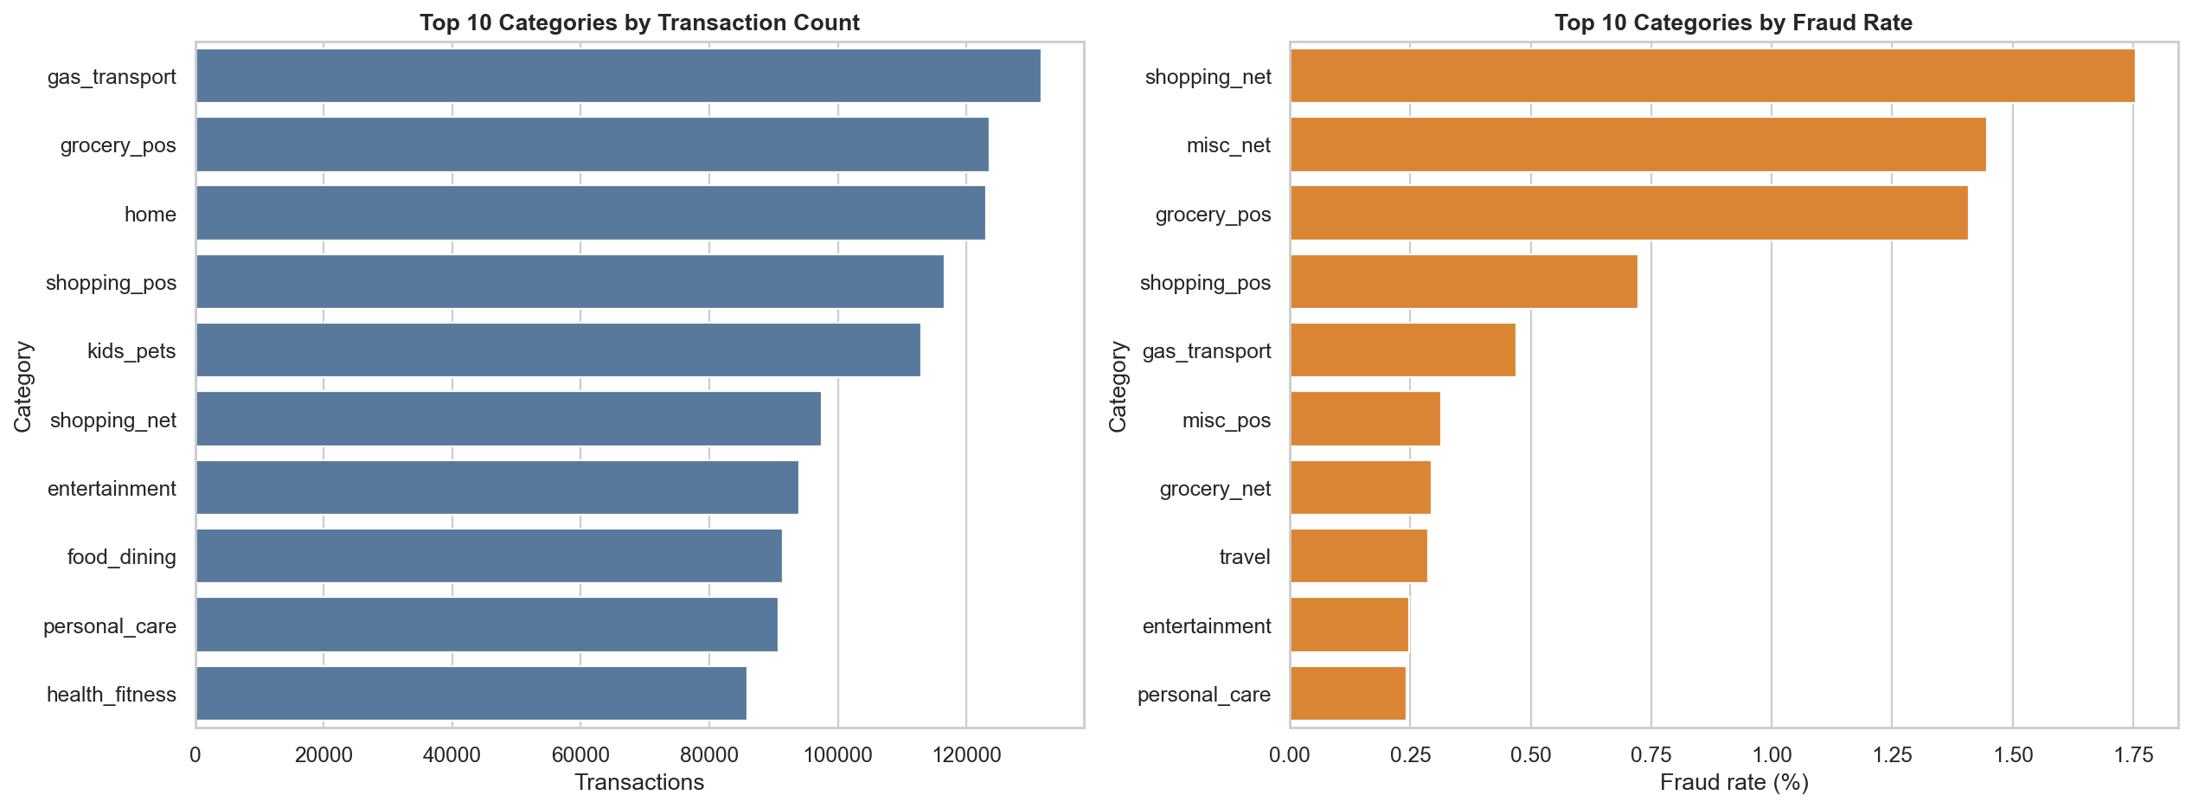
Category Fraud Analysis

Slide 7
Preprocessing
Time features: hour, day of week, month, weekend flag.
Customer age and customer-merchant distance.
One-hot encoding for category/gender/state.
Frequency encoding for merchant/job/city.
Numeric scaling and removal of direct identifiers.

Slide 8
Apache Spark
Read raw train data using Spark DataFrame.
Aggregate fraud by category, state, merchant and hour.
Spark version: 3.5.1.
Pandas vs Spark category aggregation: Spark was faster on this machine.

Slide 9
Model Evaluation
model | threshold | precision | recall | f1_score | roc_auc | pr_auc
hist_gradient_boosting_tuned_f1 | 0.8000 | 0.3557 | 0.9245 | 0.5137 | 0.9976 | 0.8701
hist_gradient_boosting_high_recall_0_90 | 0.8000 | 0.3557 | 0.9245 | 0.5137 | 0.9976 | 0.8701
hist_gradient_boosting_default_0_50 | 0.5000 | 0.1938 | 0.9669 | 0.3229 | 0.9976 | 0.8701
random_forest_default_0_50 | 0.5000 | 0.1802 | 0.9147 | 0.3011 | 0.9899 | 0.7441
random_forest_tuned_f1 | 0.5000 | 0.1802 | 0.9147 | 0.3011 | 0.9899 | 0.7441
random_forest_high_recall_0_90 | 0.5000 | 0.1802 | 0.9147 | 0.3011 | 0.9899 | 0.7441
logistic_regression_tuned_f1 | 0.7100 | 0.1577 | 0.6699 | 0.2553 | 0.9055 | 0.1189
logistic_regression_default_0_50 | 0.5000 | 0.0451 | 0.7305 | 0.0850 | 0.9055 | 0.1189
logistic_regression_high_recall_0_90 | 0.2700 | 0.0124 | 0.8149 | 0.0243 | 0.9055 | 0.1189

Slide 10
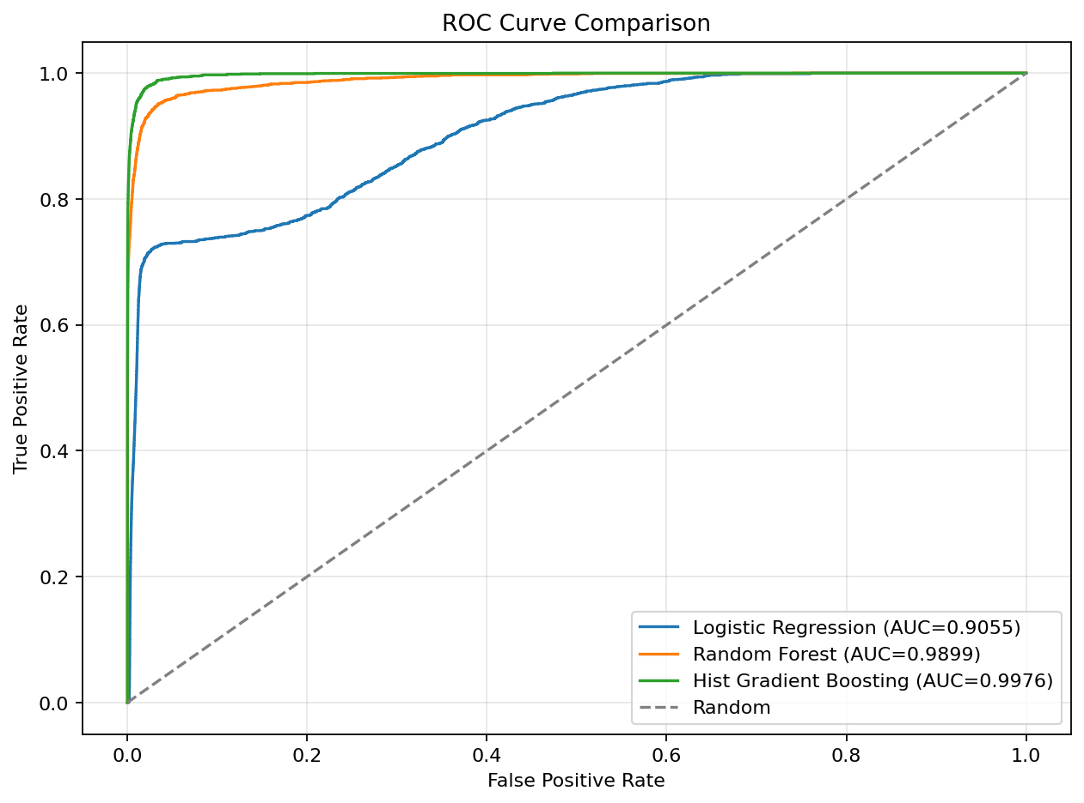
ROC Curve

Slide 11
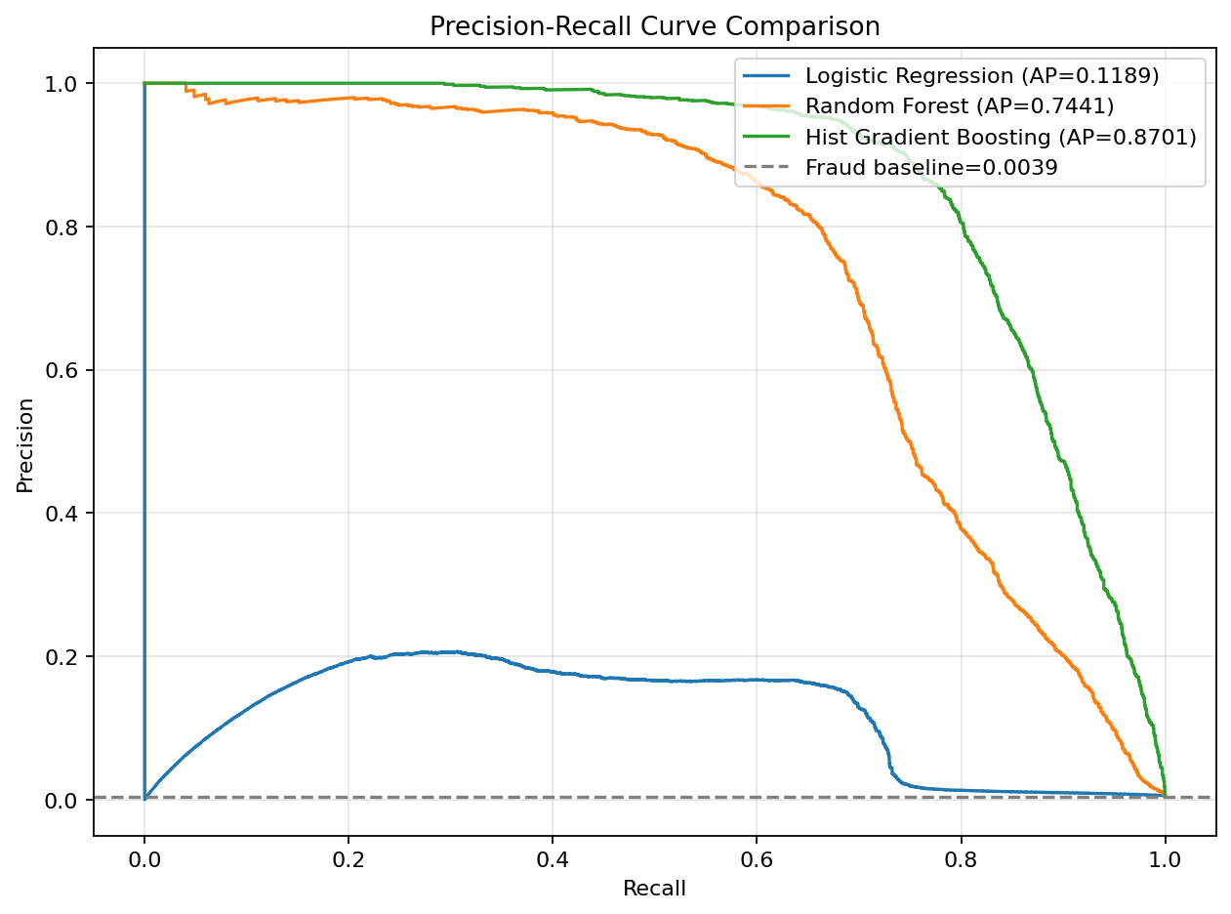
Precision-Recall Curve

Slide 12
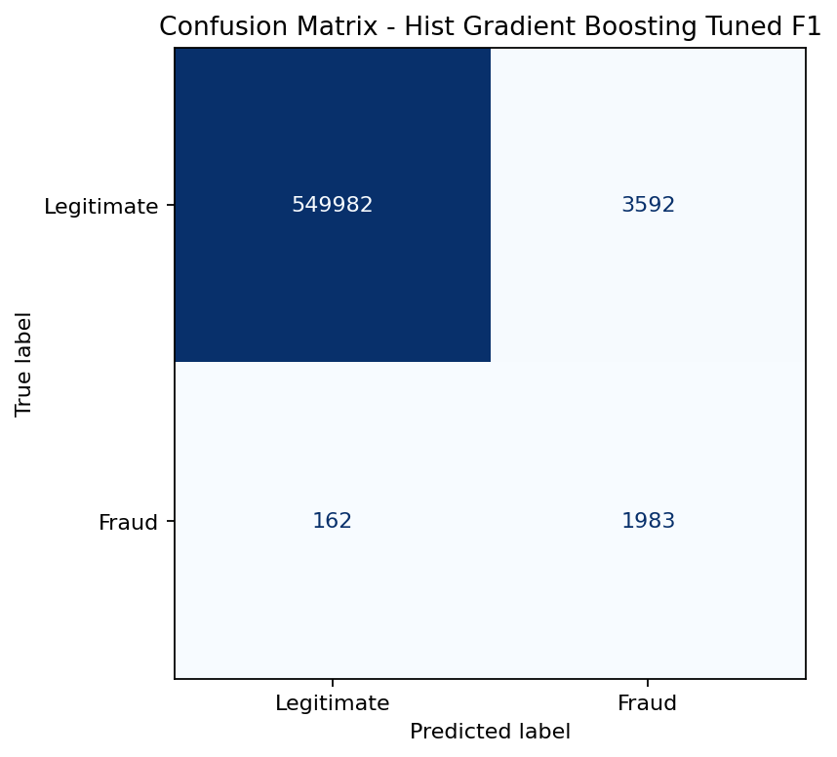
Confusion Matrix - HistGradientBoosting

Slide 13
Conclusion
HistGradientBoosting achieved the best overall performance.
Recall: 0.9245, F1-score: 0.5137.
ROC-AUC: 0.9976, PR-AUC: 0.8701.
F1-score improved from Random Forest's 0.3011 to 0.5137.
Future work: threshold tuning, PR-AUC, XGBoost/LightGBM.

