Slide 2
Cognitive Apps Using Document DB
Mike Lanzetta
Principal SDE

Slide 3
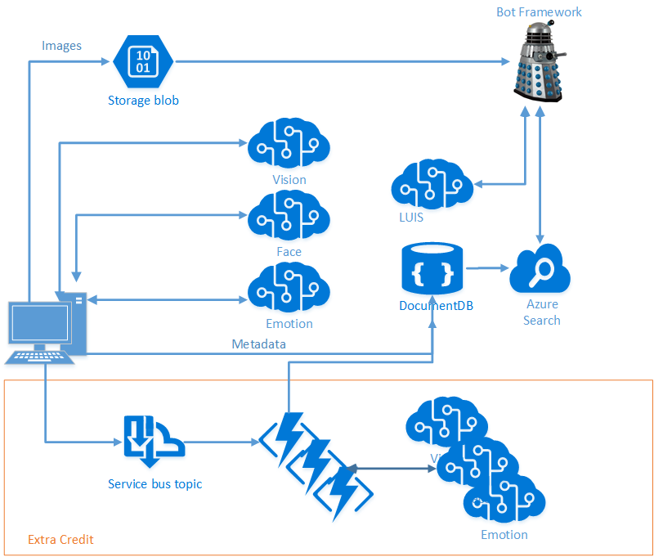
Scenario
Intelligence from Images
Vision Services
Cloud Storage
Search
Conversation and Language Understanding

Slide 4
Elastically scalable storage
Independently scale storage and throughput
No partition management
Automatically indexed SSD storage
Global distribution across Azure regions

Slide 5
Schema-agnostic databases – a beautiful thing
{
"ItemType": "Coffee Mug",
"Name": "Geek Mug",
"Color": "Graphite",
"Capacity": {
"value": 16,
"units": "oz"
},
"Microwave-Safe": "yes",
"Dishwasher-Safe": yes"
}
{
"ItemType": "Laptop",
"Name": "Surface Book",
"Processor": [
"2.4 GHz Core i5-6300U",
"3.4 GHz Core i7-6600U"
],
"Memory": [ "8GB", "16GB" ],
"Storage": {
"Type": "SSD"
"Capacity": [ 128, 256, 512, 1024 ]
}
}

Slide 6
Collections != Tables
Collections do NOT enforce schema
Co-locate multiple types in a collection
Annotate documents with a "type" property

Slide 7
Rich SQL and JavaScript queries
No impedance mismatch
Query with SQL and JavaScript
Write business logic entirely in JavaScript with stored procedures and triggers

Slide 8
Consistency Levels
Strong, Eventual, Bounded Staleness, and Session
LEFT TO RIGHT → Weaker Consistency, Better Read scalability, Lower write latency
Strong
Bounded Staleness
Session
Eventual
Client
Client
Client
Client
Client
P
S
S
P
S
S
P
S
S
P
S
S
Consistent Prefix reads.
Reads lag behind writes by K prefixes or T interval
Monotonic reads, writes and Read your writes guarantee

Slide 9

Modeling Data: The Relational Way
Person
PersonContactDetailLnk
ContactDetail
Id
PersonId
Id
ContactDetailId
Address
ContactDetailType
Id
Id

Slide 10
Modeling Data: The Document Way
{ "id": "0ec1ab0c-de08-4e42-a429-...",
"addresses": [
{ "street": "1 Redmond Way",
"city": "Redmond", "state": "WA",
"zip": 98052}
],
"contactDetails": [
{"type": "home", "detail": “555-1212"},
{"type": "email", "detail": “me@ms.com"}
],
...
}
Person
Id
Addresses
Address
…
Address
…
ContactDetails
ContactDetail
…

Slide 11
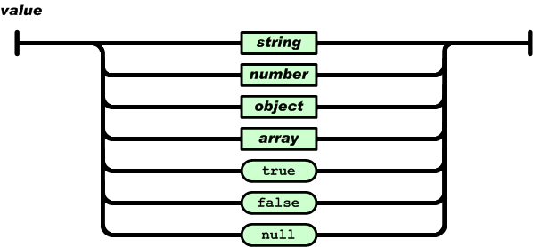
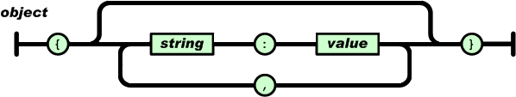
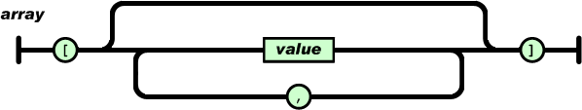
Documents as Trees
JavaScript Object Literals
JSON serializable values (aka JSON Infoset)
{
"locations":
[
{ "country": "Germany", "city": "Berlin" },
{ "country": "France", "city": "Paris" }
],
"headquarter": "Belgium",
"exports":[{ "city": "Moscow" },{ "city": "Athens"}]
};
locations
headquarter
exports
0
1
Belgium
0
1
country
city
country
city
city
city
Germany
Berlin
France
Paris
Moscow
Athens
JSON document as tree
Notes:
Databases vary in their commitment to JSON data model
Relational stores – Require schema, indices & OR mapping; great query
Key-Value stores – Schema-free; values are opaque; poor query
DocumentDB - Deep commitment to the JSON data model & JavaScript directly within the database engine
Automatic indexing of documents without requiring schema or secondary indices
SQL query dialect rooted in JSON; extensible via JavaScript
Efficient execution of application logic with (JavaScript) language integrated database transactions
Minimal impedance mismatch between the programming languages and the database type systems

Slide 12
Query
SELECT C.locations
FROM company C
WHERE C.headquarter = "Belgium"
function businessLogic() {
var country = "Belgium";
__.filter(function(x){return x.headquarter===country;});}
SQL
JavaScript
{ "locations":
[ { "country": "Germany", "city": "Berlin" },
{ "country": "France", "city": "Paris" }
],
"headquarter": "Belgium",
"exports": [{ "city": "Moscow" }, { "city": "Athens" }]
};
{ "locations": [{ "country": "Germany", "city": "Bonn", "revenue": 200 } ],
"headquarter": "Italy",
"exports": [ { "city": "Berlin","dealers": [{"name": "Hans"}] }, { "city": "Athens" }
]
};
locations
locations
headquarter
exports
headquarter
exports
0
Italy
0
1
0
1
Belgium
0
1
country
city
country
city
city
country
city
revenue
city
dealers
city
city
Germany
Bonn
200
Berlin
0
Athens
Germany
Berlin
France
Paris
Moscow
Athens
Input documents
name
{
"results":
[
{
"locations":
[
{"country":"Germany","city":"Berlin"},
{"country":"France","city":"Paris"}
]
}
]
}
Hans
results
0
locations
0
1
country
city
country
city
Query result
Berlin
Paris
Germany
France

Slide 13
Demo

Slide 14
DocumentDB Documents – Just POCOs
public class ImageMetadata
{
public ImageMetadata()
{
}
[JsonProperty(PropertyName = "id")]
public string Id { get; set; }

Slide 15
Querying Documents
λ .\bin\Debug\TestCLI.exe -settings my_settings.json -query "select * from images“
…
{"id":"Analysis_9.jpg","BlobUri":"https://milanzaiworkshop.blob.core.windows.net:443/images/Analysis_9.jpg","LocalFilePath":"F:\\dev\\data\\sample_images\\Analysis_9.jpg","FileName":"Analysis_9.jpg","Caption":"a close up of a doughnut","Tags":["food","bread","snack food"],"NumFaces":0,"Faces":[]}

Slide 17
Setup
Azure Pass
Take a look at your Azure Pass guide
Log into Portal
Visual Studio: Don’t have it? Deploy a VM!
Code
Go to our GitHub Repo: https://github.com/noodlefrenzy/CognitiveServicesTutorial
Intelligent Kiosk: https://github.com/Microsoft/Cognitive-Samples-IntelligentKiosk
Playground
Cognitive: https://azure.microsoft.com/en-us/services/cognitive-services/
DocumentDB: https://www.documentdb.com/sql/demo

