Slide 1
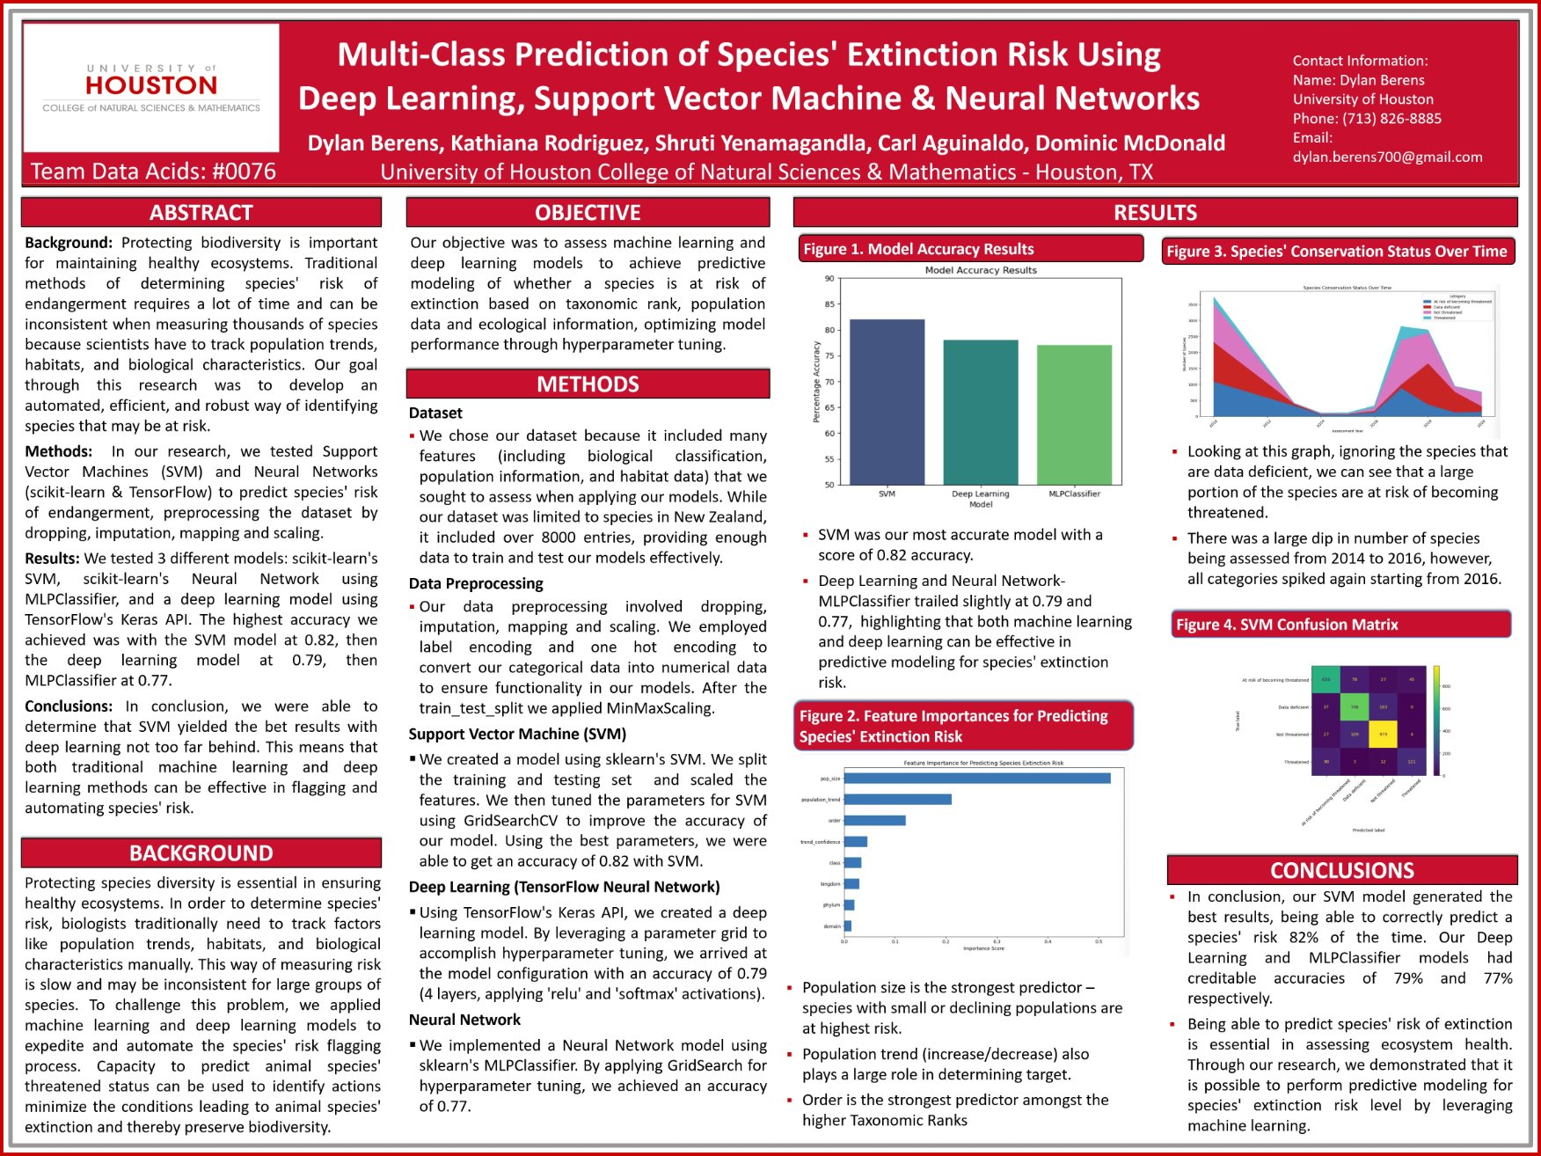

Slide 2
Prediction of Species' Extinction Risk Using
Deep Learning, Support Vector Machine & Neural Networks
DYLAN BERENS, KATHIANA RODRIGUEZ, SHRUTI YENAMAGANDLA, CARL AGUINALDO, DOMINIC MCDONALD

Slide 3
Agenda
Insight Overview
Dataset Overview
Data Visualization
Neural Networks
SVM
Final Takeaways and a Call to Action

Slide 4

Key Insight
Overview

Slide 5
Key Insights
Certain taxonomic families are at extreme risk of extinction
Threat levels have increased over time
Freshwater species are at most risk of extinction
Terrestrial species dominate numerically, making it seem that more terrestrial species are threatened than freshwater species
30% of species are data deficient
Population size and trend are key predictors of extinction risk

Slide 6
Dataset overview
11,861 entries
35 features
11,861 unique species
90,971 missing values
4 Conservation Categories: Not Threatened (4,301), Data Deficient (3,573), At Risk (3,079), and Threatened (908)
3 Domains: Land (9,571), Marine (1,569), Freshwater (721)
17 Taxonomic categories (Report Groups)
Assessment timeline spans across 2010-2020

Slide 7
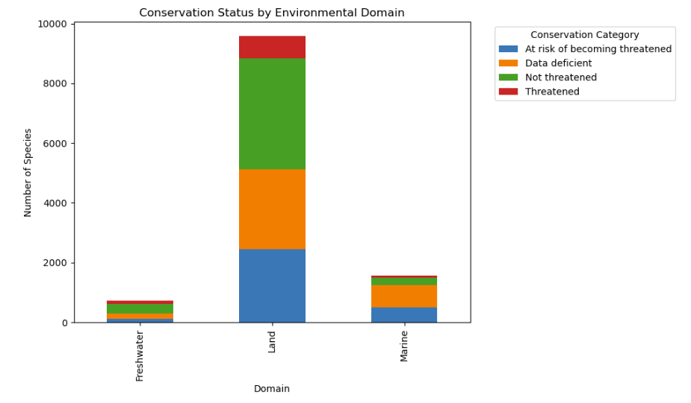
Species Risk Levels by Environmental Domain
Land species dominate the assessments
Most threatened species are found on land due to volume
Freshwater species have the highest relative risk of extinction
Marine species are the least threatened

Slide 8
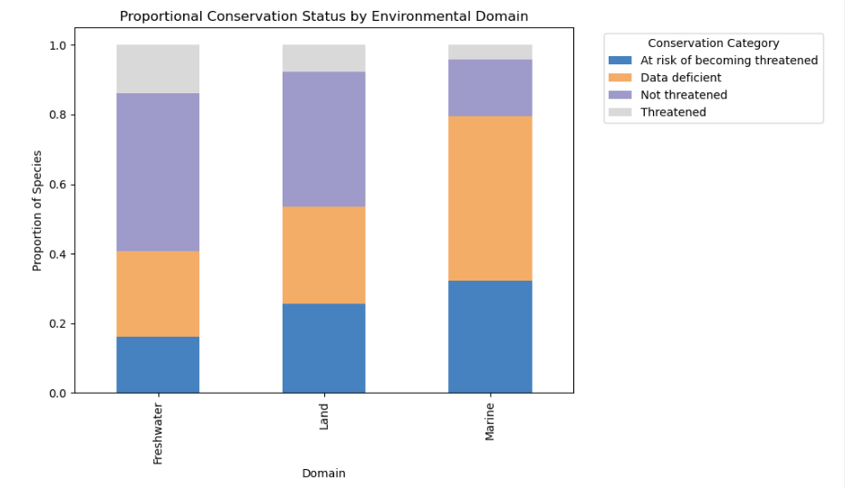
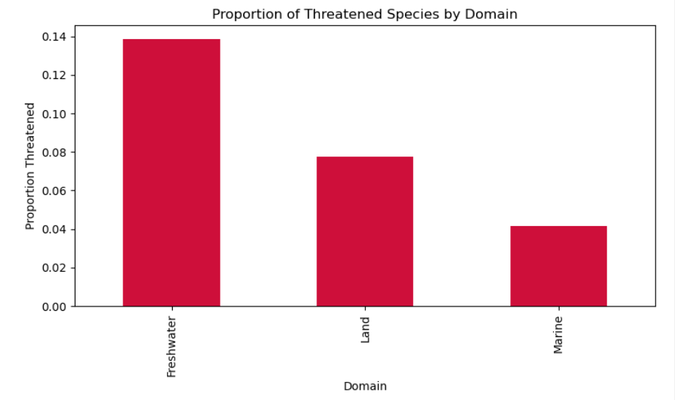
Species Risk Levels by Environmental Domain Continued

Slide 9
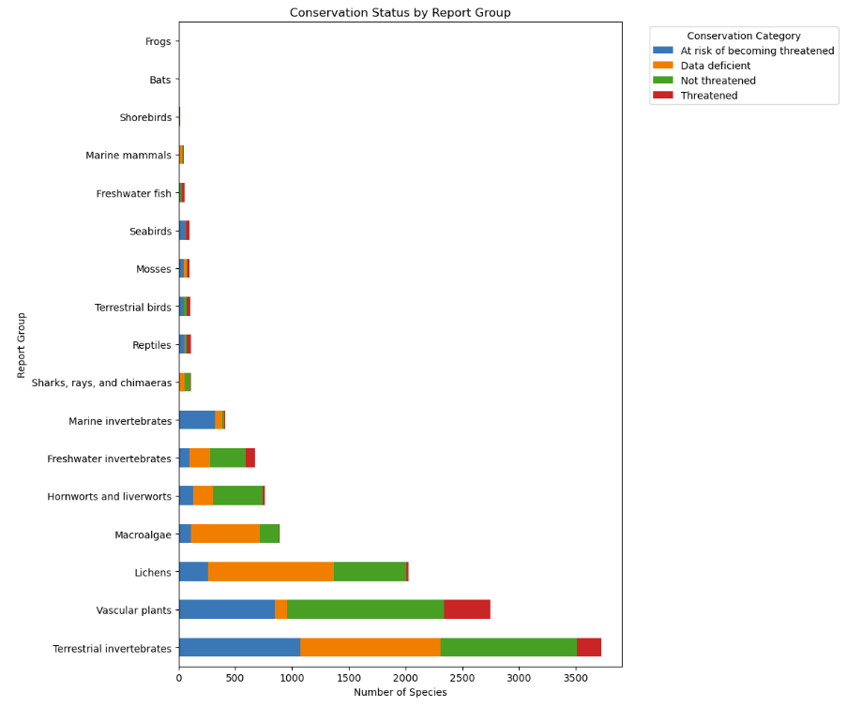
Conservation Status Across report Groups
The two groups with the most observations are vascular plants and terrestrial invertebrates
Terrestrial invertebrates makes up most of the threatened species due to sheer volume, even though they do not high proportions of threatened species
Shorebirds, freshwater fish, bats, and reptiles have the highest proportion of threatened species relative to their group size — indicating severe vulnerability despite smaller total counts

Slide 10
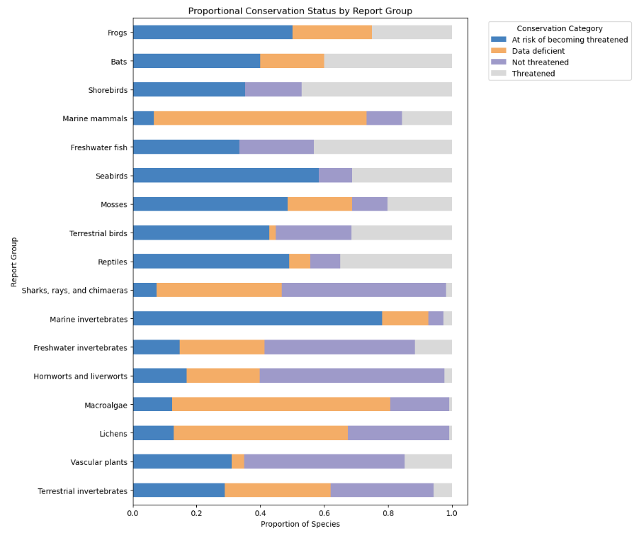
Conservation Status Across report Groups Continued
Marine mammals, microalgae and lichens are the most data deficient report groups
Marine invertebrates, seabirds, and frogs are at the highest risk of becoming threatened in the future based on their population trend

Slide 11
Top species at risk of extinction
Common Name | Species Name | Domain | Population Trend | Risk Category
Looper Moth | Hydriomena | Land | Decreasing | At risk of becoming threatened
Yellow Mistletoe | Alepis | Land | Decreasing | At risk of becoming threatened
North Island Brown Kimi | Apteryx | Land | Decreasing | At risk of becoming threatened
Looper Moth | Austrocidaria | Land | Decreasing | At risk of becoming threatened
Berggren’s Sedge | Carex | Land | Decreasing | At risk of becoming threatened
These are the top 5 species that are at highest risk of facing an extinction threat in the future.
The top 5 species are all terrestrial due to sheer volume
The species have a decreasing trend with high confidence

Slide 12
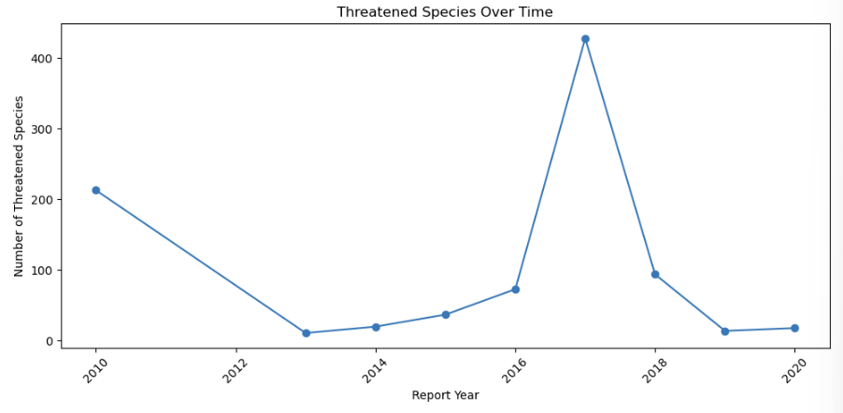
Extinction risk has grown over time
The number of threatened species has increased over time with a high spike at around 2016-2017, until a strict decrease from 2017-2020.
The number of species at risk lowers dramatically from 2014-2016, until there is a spike from 2016-2017. The number of species at risk decreased again after 2017.

Slide 13
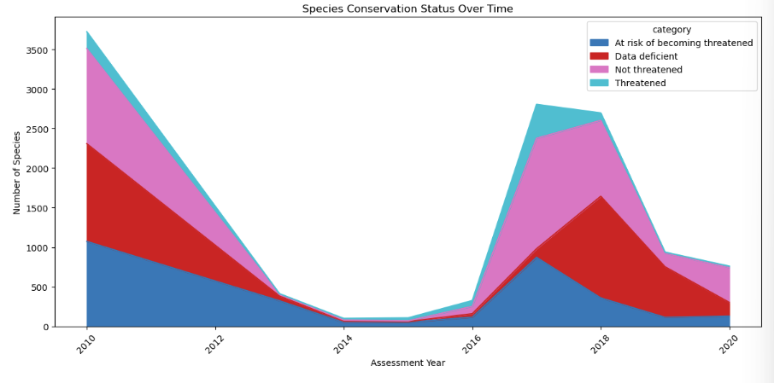
Extinction risk has grown over time Continued

Slide 14
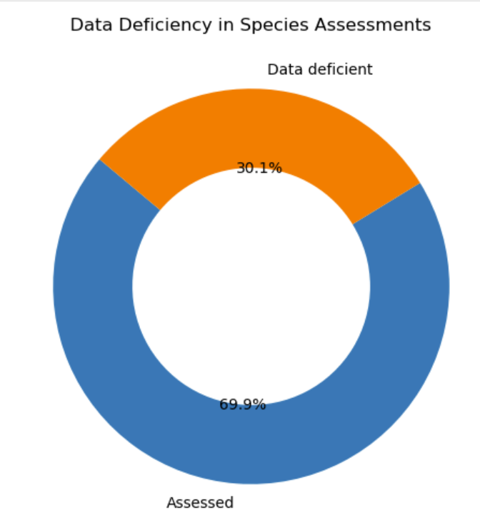
DATa quality challenges
30.1% of the species are labelled data deficient, which means we lack enough data about population of threat status for 30.1% of the species assessed

Slide 15
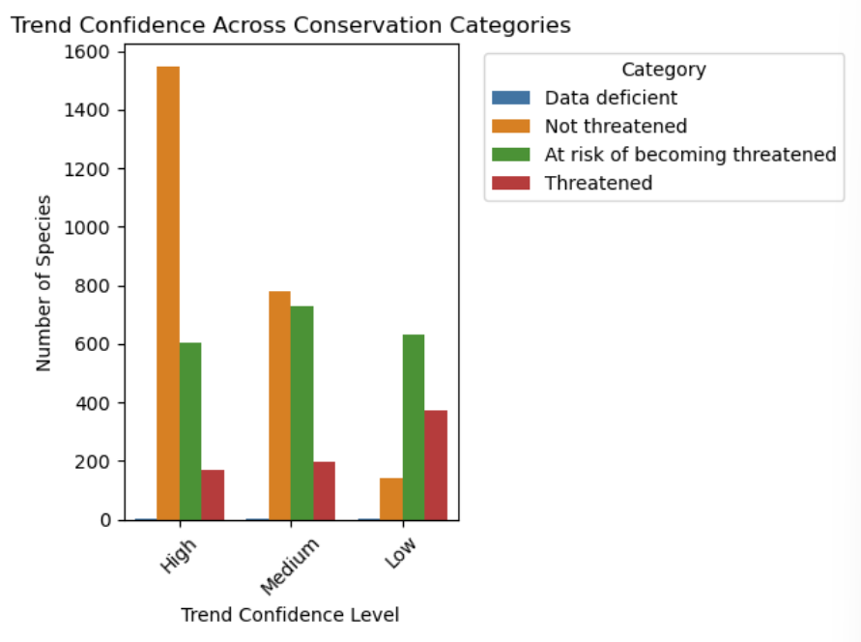
DATa quality challenges Continued
Low trend confidence is especially common in species labeled “Threatened” or “At Risk”
These gaps reduce model accuracy and make conservation planning more difficult.

Slide 16
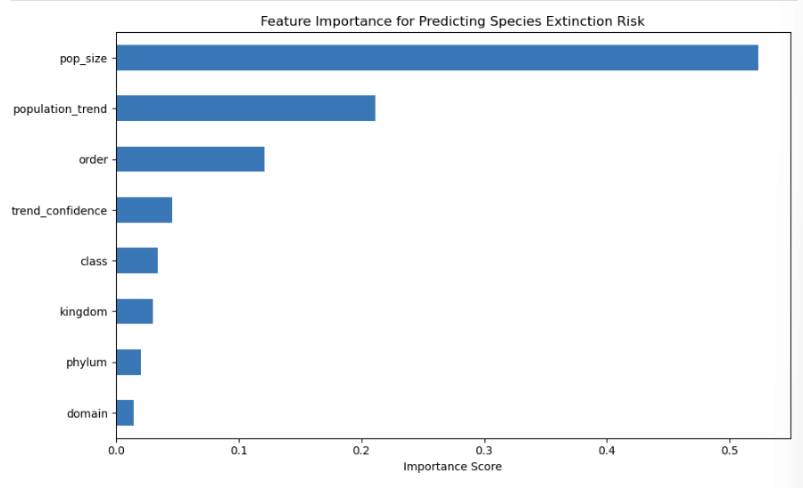
What Drives Extinction Risk?
Population size is the strongest predictor — species with small or declining populations are at highest risk.
Population trend (declining vs. stable/increasing) also plays a major role.
Taxonomic order and trend confidence help refine predictions, but with less influence.

Slide 17
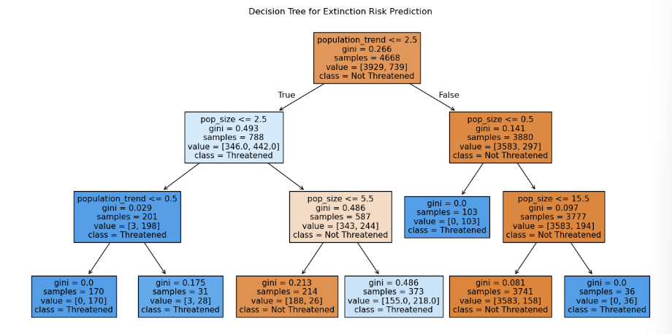
What Drives Extinction Risk? Continued
Species with declining population trends and small population sizes are most likely classified as threatened
Even a stable trend can still lead to high risk if the population size is critically low

Slide 18
Deep Learning using tensorflow neural networks
By leveraging a parameter grid to accomplish hyperparameter tuning, we arrived at the model configuration with an accuracy of 0.79 (4 layers, applying 'relu' and 'softmax' activations)
We created a build_model function to automate the parameter grid testing of dozens of other setups in addition to manually testing 14 distinct Neural Networks using different hyperparameter configurations
Given the project is multi class (3) classification, the output layer of the Neural Network used 'softmax' activation with 3 nodes
The loss function employed was sparse_categorical_crossentropy by nature of the target variable being integer-encoded rather than one-hot

Slide 19
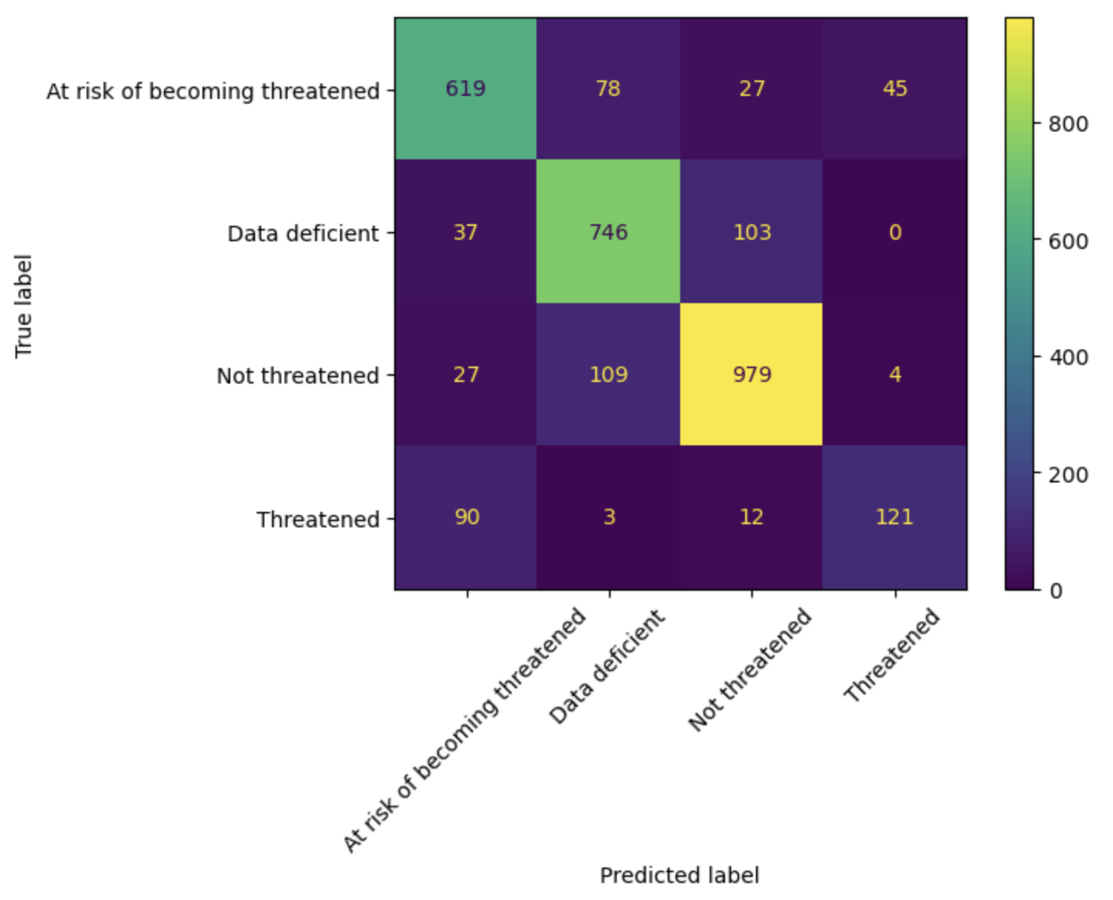
Support Vector Machine (SVM) Model: Training, Evaluation, and Insights
We developed a Support Vector Machine (SVM) classifier, tuning model hyperparameters through 5-fold cross-validation and achieving a training accuracy of 87.71% and test accuracy of 82.17%.
Feature selection prioritized only the columns that influenced the target variable. We excluded target-related attributes to prevent data leakage and dropped columns that had >50% null values.
Model training involved encoding categorical variables, scaling features for SVM sensitivity, and optimizing across multiple kernels (linear, rbf, poly) using GridSearchCV.
Performance was evaluated using accuracy, precision, recall, and F1-score, with confusion matrix analysis.
Goal: Classify species into conservation status categories
Training Accuracy: 87.71%
Testing Accuracy: 82.17%
Precision: 82%
Recall: 82%
F1 Score: 82%

Slide 20
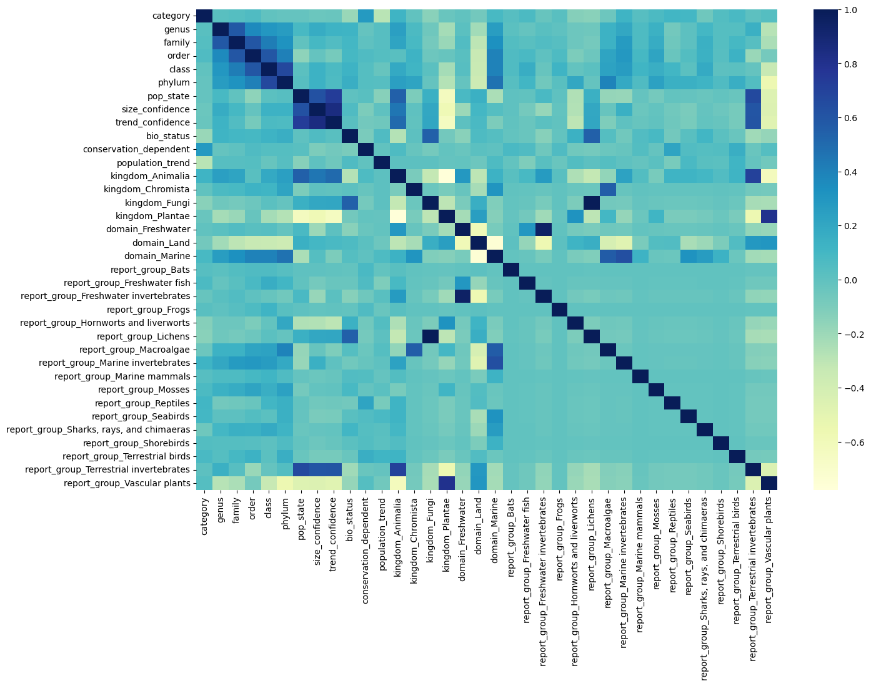
FINAL TAKEAWAYS
Extinction risk is growing: The number of threatened species has increased steadily over the last decade.
Population size and trend are critical predictors: Small, declining populations are most at risk of extinction.
Freshwater ecosystems are especially vulnerable: Freshwater species show the highest relative threat rate.
Targeted action is needed: Improving population monitoring and focusing on high-risk taxonomic groups can better allocate conservation resources.

Slide 21
THANK YOU
Kathiana Rodriguez, Dylan Berens, Shruthi Yenamagandla, Dominic McDonald, Carl Aguinaldo

