Slide 1
NYC Taxis
Denver Lybarger

Slide 2
What the What
Questions
Is Ride Sharing (RS) impacting NYC Taxis?
If so, how is RS affecting NYC yellow and green taxis?
Data
Examined Over 820 Million Rides between 2015-2017 (>100GB)
Basics
What Happened Between 2015-2017
Model Forecasts
Conclusions & Policy Implications

Slide 3
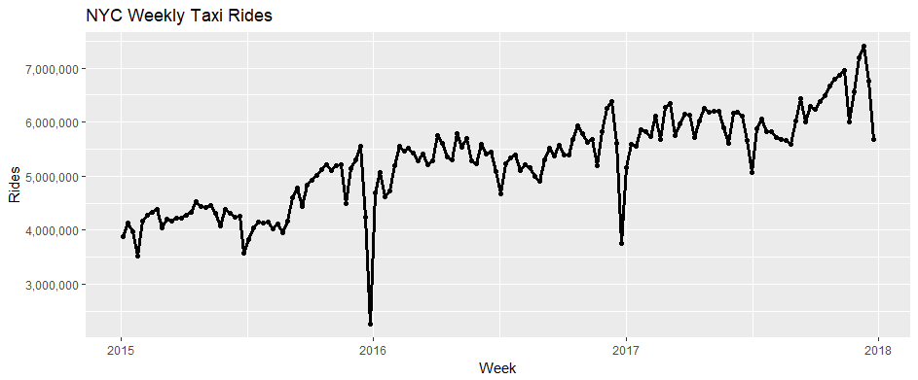
Basic Ride Metrics
2017 Average Weekly # of Rides : 6,083,043
2017 Median Weekly # of Rides : 6,040,377
2017 Min Weekly # of Rides: 5,074,513
2017 Max Weekly # of Rides: 7,407,657
2017 Weekly Standard Deviation of Rides: 466,920

Slide 4
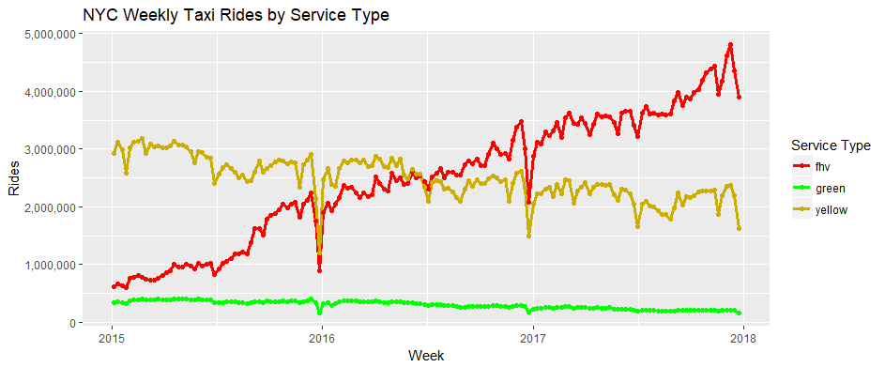
Ride Metrics By Service Type

Slide 5
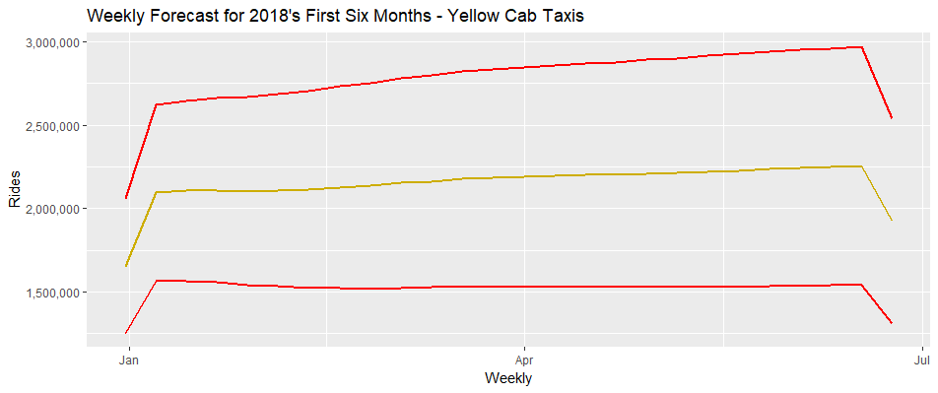
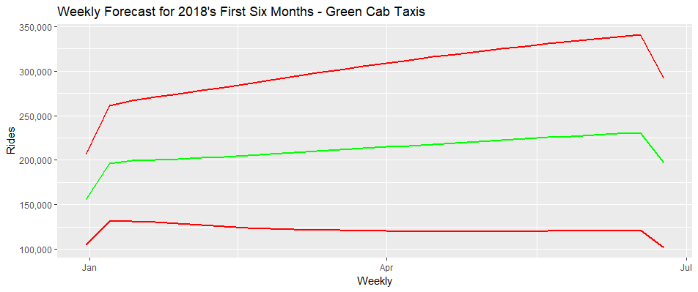
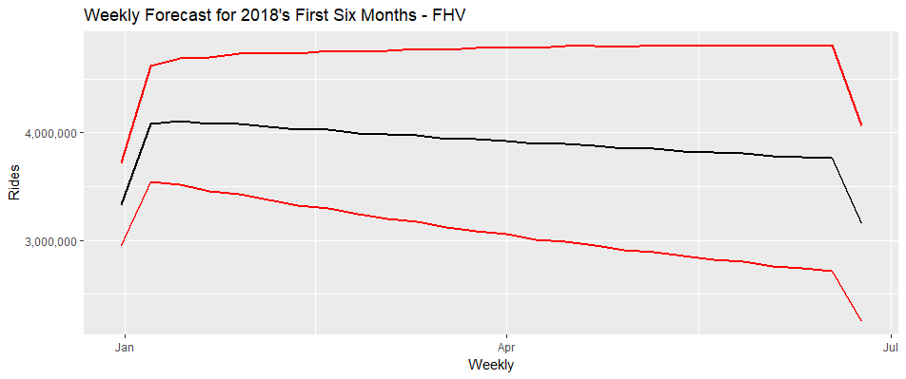
Model Forecasts

Slide 6
Conclusions & Policy Implications
The first half of 2018 should be a relatively modest increase for all three services.
Ridesharing is consuming some market share from both Yellow and Green Cabs, but ridesharing appears to be growing the market more than taking from either cabs.
Further studies will need to determine if the growth of ridesharing is leading to more congestion on NYC streets, and to understand if ridesharing is replacing public transportation utilization in the marketplace.
Better ridesharing data capture should be implemented as this data is available and data files should be compressed where appropriate.

