Slide 1
NYC Taxis
Denver Lybarger

Slide 2
What the What
Questions
Is Ride Sharing (RS) impacting NYC Taxis?
If so, how is RS affecting NYC yellow and green taxis?
Data
Examined Ride Data between 2015-2017 (>100G)
Basics
What Happened Between 2015-2017
Model
Conclusions

Slide 3
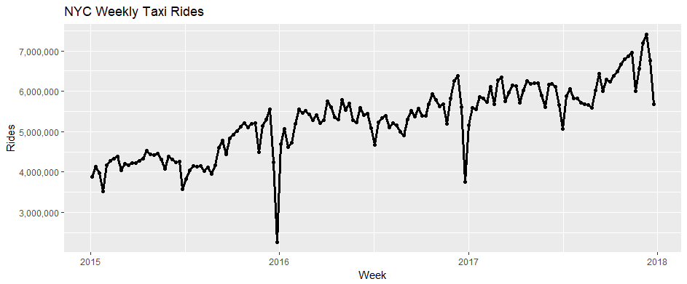
Basic Ride Metrics
2017 Average Weekly # of Rides : 6,083,043
2017 Median Weekly # of Rides : 6,040,377
2017 Min Weekly # of Rides: 5,074,513
2017 Max Weekly # of Rides: 7,407,657
2017 Weekly Standard Deviation of Rides: 466,920

Slide 4
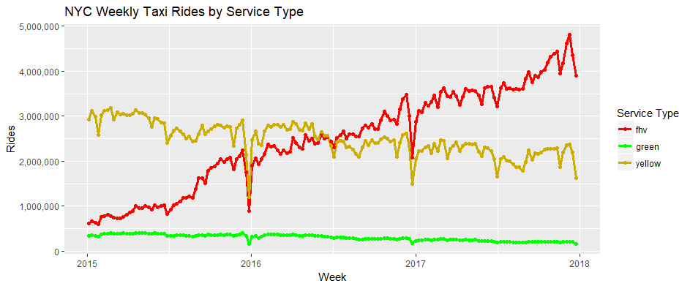
Ride Metrics By Service Type

Slide 5
Model

