Slide 1

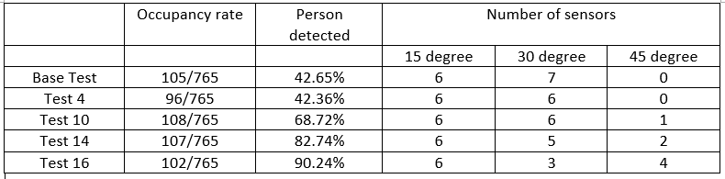
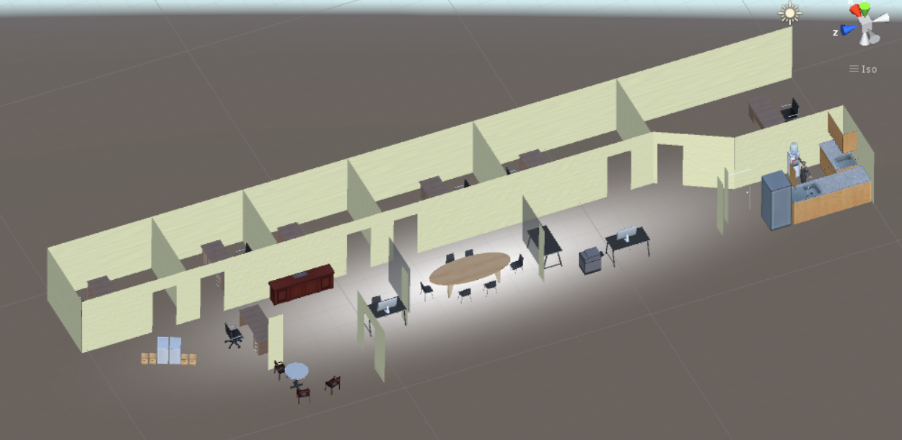
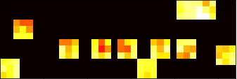
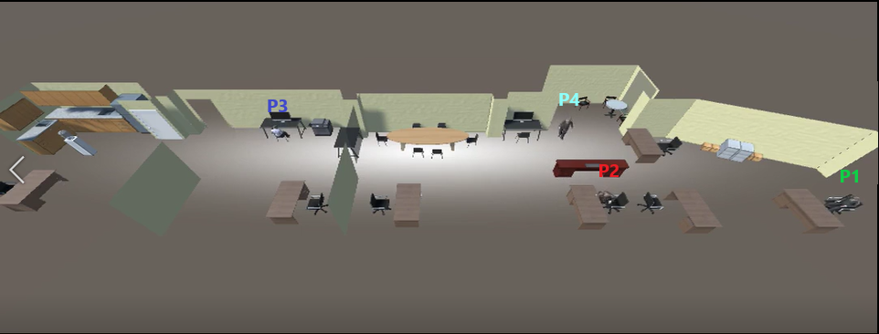
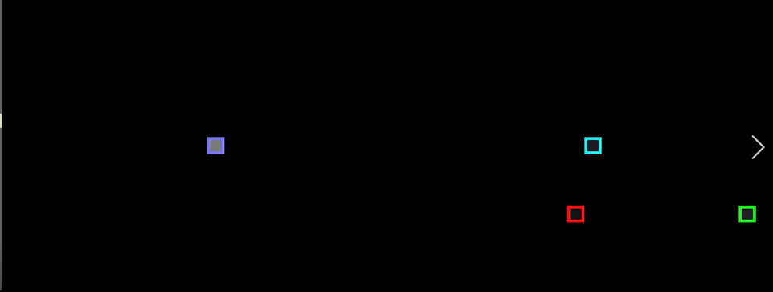
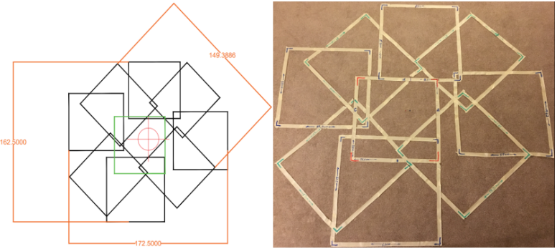
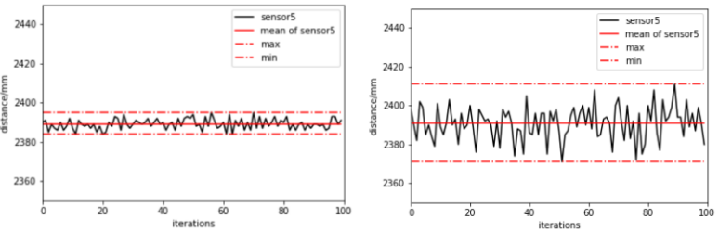

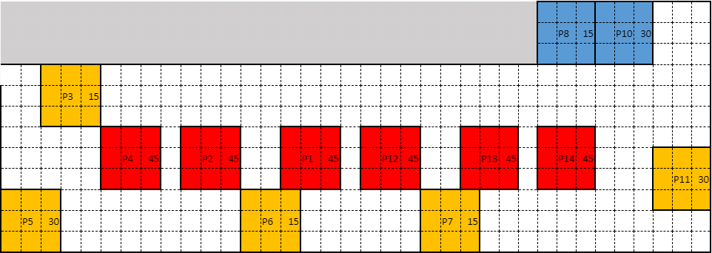



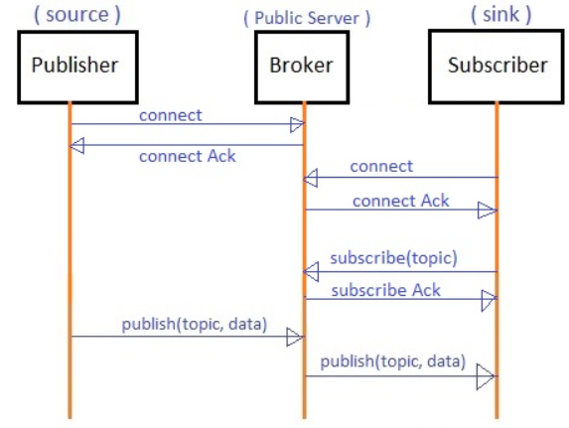












Sparse time-of-flight pods for low-cost occupancy sensing
Dewei Hu, Ziyu Liu, Arunas Tuzikas, Richard J Radke
Rensselaer Polytechnic Institute
Research Highlights
Recent Research Results
Unity simulation:
Simulate real LESA suite according real room and test the tracking algorithm based on the real sensor scenario.
Simulation from LESA suite
Simulation of occupants movement inside
the room
Tracking algorithm of occupants movement
Real test:
Person detected rate changes according to the change
of sensor placement and selection
Overview
Project Description: The project is to set up a privacy preserving in-door positioning system by distributed time-of-flight(ToF) sensor network for precision occupancy and location detection.
Problem Addressed: Smart lightening system is used widely not only improving the efficient use of energy, but also react to the human’s need with lightening control. However, traditional camera sensors system interferes with people’s privacy. Therefore, we seek technologies that strike a balance between accurately detecting human movement, and preserving the privacy of a room’s occupants. There are some specific problems we need to confront:
1. How to set up a efficient communication system between distributed sensors?
2. What algorithm to use in seeking for precise prediction?
3. How to distribute limited number of sensors to cover as much area as possible?
Project Goals: Build a smart room system to track occupants movement inside the room using single-ray time-of-flight sensor. The ultimate goal is to precisely determain the occupancy and track people's movement with optimal number of sensors applied.
Real data collected correspond to the LESA suite model
Next Steps
Near Term Milestones
Embed the tracking algorithm in the real system and feed it with real sensors reading
Collect and label data for learning
Develop the learning algorithm to track the direction of the movement of the person to predict the future position
Modelize the noise caused by sun light and make compensation.
Long Term Milestones
Optimize the number of sensors applied
Further improve the accuracy of detection and prediction
Area covered by the 15 degree pod
Sponsored Research Areas
IP relevant to this work is available for licensing. (delete this text unless applicable, if deleting please resize Acknowledgements box to eliminate blank space )
Application Areas
INCLUDE THE FOLLOWING ITEMS IN THIS SECTION:
Bulleted list of possible sponsored research areas identified by your research group – this list would serve as talking points with industry members as possible ways to collaborate with them
Noise of the ToF sensor without/with sun light
HEALTHCARE
The system can be applied to check the status of patients with their privacy protected.
COMMUNICATIONS
LESA suite model
COGNITION
Acknowledgements
PLANT SCIENCE
This work is supported by the NSF under cooperative agreement EEC-0812056 and by New York State under NYSDED Contract C160145. Any opinions, findings, and conclusions or recommendations expressed in this material are those of the author(s) and do not necessarily reflect the views of the National Science Foundation.
EFFICIENT BUILDINGS
communication using MQTT protocol
Notes:
The heading bar is color coded by Thrust with white lettering (except for the Controls & Communications Thrust) Heading font is Cambria which can be resized to fit in the bar.
Use Arial as the font and keep consistent font sizes for the body text somewhere between 24pt and 50pt. Use mostly black for the text in the body. Keep 1 inch spacing between borders of each section. Headings of sections should be 1 inch tall and should span the width of the section. Section border corners have radius of curvature of 0.5”. Heading border corners have radius of curvature of (3/8)”. Note that resizing the borders of either the sections or the headings will also resize the radius of curvature. Feel free to add, delete, or resize sections; copy and paste the existing section borders and headings to easily maintain the color scheme. Maintain a 1” margin around the edge of the poster (to accommodate printer). The middle column is slightly wider (12”) than the side columns (10”). Do not add or change the logos at the bottom or the top.

