Slide 1
Investor Protection
&
Company Law
Central University of Finance and Economics (CUFE)
DONG LIYE
2018-04

Slide 2
HKEX unveils new Listing Rules
The Stock Exchange of Hong Kong Limited (the Exchange), a wholly-owned subsidiary of Hong Kong Exchanges and Clearing Limited (HKEX), today (Tuesday) announced that the proposed new rules to broaden Hong Kong’s listing regime will take effect on 30 April 2018, from which date companies in emerging and innovative sectors seeking to list under the new regime may submit formal applications.
…
As part of the reforms, the Exchange is adding three new chapters in the Main Board Listing Rules (Listing Rules or Rules) and made consequential changes to the current Rules to: (a) permit listings of biotech issuers that do not meet any of the Main Board financial eligibility tests; (b) permit listings of companies with weighted voting right (WVR) structures; and (c) establish a new concessionary secondary listing route for Greater China and international companies that wish to secondary list in Hong Kong.
Source: Hong Kong Exchanges

Slide 3
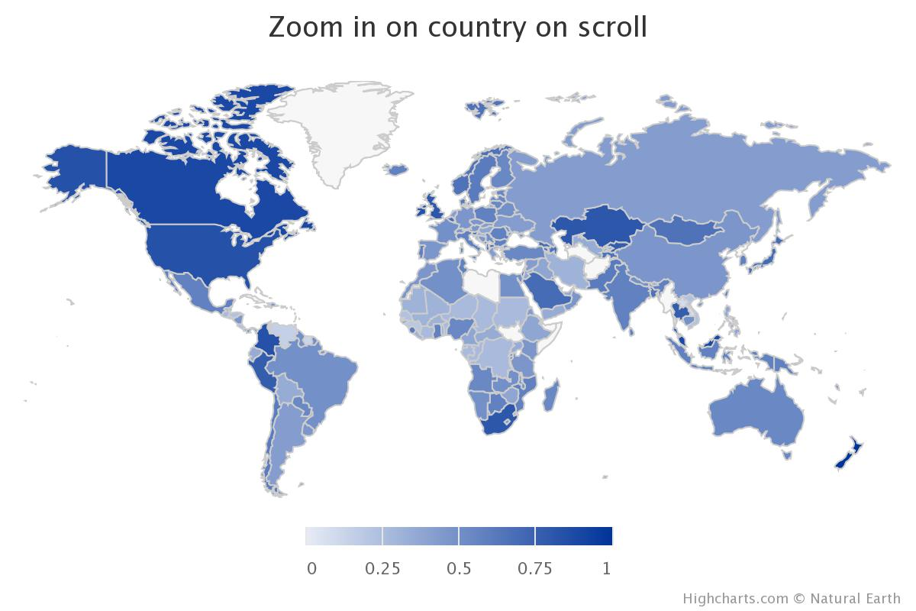
Worldwide Investor Protection Index
Rank | Country/Region | Index
3 | Hong Kong | 0.92
9 | United States | 0.83
98 | China | 0.46
Source: World Bank

Slide 4
Developments of Legal Protection for Investors
Prior to 1992
the reform and opening
the reform on State-owed enterprises (SOEs).
1993-2005
company law (1993)
After 2006
Company law (2006)
Company law (2013)

Slide 5
Company Law (1993)
Article 4 The shareholders of a company shall, in their capacity of contributors of capital, enjoy such rights of owners as benefitting from assets of the company, making major decisions and selecting managerial personnel in accordance with the amount of their respective capital investment in the company.
Article 37 The shareholders' meeting of a limited liability company shall be composed of all the shareholders. The shareholders' meeting shall be the organ of power of the company and shall exercise its functions and powers in accordance with this Law.
Article 102 A joint stock limited company shall form a shareholders' general meeting which shall be composed of all the shareholders. The shareholders' general meeting is the organ of power of the company and shall exercies its functions and powers in accordance with this Law.
Notes:
Shareholders were given some basic and general rights

Slide 6
Company Law (1993)
Article 41 Shareholders shall exercise their voting rights at the shareholders' meeting in proportion to their capital contributions.
Article 106 Shareholders attending a shareholders' general meeting shall have one voting right for each share he holds.
Article 32 A shareholder shall have the right to look up the minutes of shareholders' meetings and the financial and accounting reports of the company.
Article 110 Shareholders shall have the right to examine the articles of association of the company, the records of the shareholders' general meetings and the financial and accounting statements, and to make suggestions or inquiries about the business operation of the company.
Notes:
The right to exercise voting rights

Slide 7
Company Law (1993)
Article 33 Shareholders shall draw dividends in proportion to their capital contributions. Where a company increases capital, the existing shareholders shall have priority in subscription for new shares.
Article 111 Where a resolution of the shareholders' general
meeting or of the board of directors violates the law or
administrative rules and regulations or infringes the lawful rights
and interests of the shareholders, the shareholders concerned shall have the right to bring a lawsuit in a people's court demanding to stop that such illegal or infringing action.
Notes:
seems to be a strong protection for minority shareholders
while actually it lacks any specific means of being applied.
It does notprovide any procedures

Slide 8
Company Law (1993)
Article 111 Where a resolution of the shareholders' general
meeting or of the board of directors violates the law or
administrative rules and regulations or infringes the lawful rights
and interests of the shareholders, the shareholders concerned shall
have the right to bring a lawsuit in a people's court demanding to stop that such illegal or infringing action.
Chapter I General Provisions
Chapter II Incorporation and Organizational Structure of
Limited Liability Companies
Chapter III Incorporation and Organizational Structure of Joint
Stock Limited Companies

Slide 9
Company Law (1993)
Article 43 Shareholders' meetings shall be divided into
regular meetings and interim meetings.
Regular shareholders' meetings shall be convened on time as
stipulated by the articles of association of the company. Interim
shareholders' meetings may be convened upon proposal made by
shareholders representing one-fourth or more of the voting rights, or, by one-third or more of directors or supervisors.
Article 104 The annual meeting of the shareholders' general meeting shall be convened once a year. An interim shareholders‘ general meeting shall be convened within two months if any of the following situations occurs: …
Investors may request an interim shareholders’ meeting, while the remedy for shareholders if his request is denied by the board is not addressed.

Slide 10
Company Law (1993)
La Porta et al. (1996) developed a method to measure the index for shareholders rights granted by the company law, based on
Voting rights attached to shares,
Anti-director rights,
Remedial rights
MacNeil (2002) modified the index above and examined the legal protection for investor in Chinese Company Law (1993), while he found out that the total score for China was 2 with a world average of sample countries there of 3 and an average of common law jurisdictions of 4.
Notes:
Shareholders were given some basic and general rights

Slide 11
Company Law (1993)
 | Score
Shareholders can mail their vote to the company | 0
Shareholders are not required to deposit their share prior to the Annual Shareholders’ General Meeting | 1
Cumulative voting or proportional representation of minorities in the board of directors is allowed | 0
An oppressed minorities mechanism is in place | 0
The minimum percentage of capital that is necessary for shareholders to call an extraordinary shareholders’ meeting is less than or equal to 10% | 1
Shareholders have pre-emptive rights that can only be waived by a shareholder’s vote. | 0
Reference: MacNeil, 2002
Notes:
Shareholders were given some basic and general rights

Slide 12
Company Law (Current)
Rights to participate in the management of company,
Inspection rights,
Examine and view corporate documents such as the stubs of corporate bonds and the minutes of shareholders’ general meetings. (Art. 33, Art. 97)
Inquiry rights,
Rights to inquiry directors and senior managers during shareholders’ meeting. (Art. 150)
Cumulative voting,
Both firms limited by liability or share may adopt cumulative voting system. (Art. 42, Art. 105)
Notes:
Shareholders were given some basic and general rights
Investors would have a louder voice in the election of directors and suprevisors

Slide 13
Company Law (Current)
Responsibilities for directors, supervisors and senior managers,
Duties of loyalty and diligence are imposed (Art. 147)
Directors are liable for resolutions of the board of directors (Art. 112)
Several activities, such as misappropriating the company’s funds, are forbidden (Art. 148)
Notes:
They shall bear the duty of loyalty and diligence to the company
the directors should be responsible for resolutions made by the board of directors and be liable to the compensation.
who participate in adoption of such a resolution may be liable for compensation to the company

Slide 14
Company Law (Current)
Duties imposed on controlling shareholders and de facto controllers,
Prohibition against abuse of shareholder’s rights and liability for compensation if any loss is caused (Article 20)
Prohibition against taking advantage of their affiliated relations and liability for compensation if any loss is caused (Art. 21)
Notes:
Should not take advantage of their affiliated relations and should be liable for compensation if any loss is caused.

Slide 15
Company Law (Current)
Rights to take remedial actions,
Bring a direct or derivative action against the wrongdoers for compensatory damages
(Art. 151, Art. 152)
Request firms to buy his shares (Art. 74)
The right to file a case to dissolve the company if continued existence may cause grievous losses
(Art. 183)
Notes:
Last but not least, investors
infringed

Slide 16
Three Elements
The rights to participate in the management
Accountability
The ease of investor suits

Slide 17
Cash Dividends
In a world of significant agency problems between corporate insiders and outsiders, dividends can play a useful role. By paying dividends, insiders return corporate earnings to investors and hence are no longer capable of using these earnings to benefit themselves.
(Myers (1998), Gomes (2000), and Zwiebel (1996), etc)
So, stronger shareholder rights should be associated with higher dividend payouts.

Slide 18
Cash Dividends
Year | Firms that pay dividends | Number of firms | Ratio | Firms with positive profits | Ratio
2003 | 616 | 1267 | 0.486188 | 1103 | 0.558477
2004 | 737 | 1356 | 0.54351 | 1165 | 0.632618
2005 | 636 | 1352 | 0.470414 | 1080 | 0.588889
2006 | 715 | 1435 | 0.498258 | 1254 | 0.570175
2007 | 806 | 1549 | 0.520336 | 1429 | 0.564031
2008 | 850 | 1603 | 0.530256 | 1340 | 0.634328
2009 | 1000 | 1752 | 0.570776 | 1548 | 0.645995
2010 | 1315 | 2107 | 0.62411 | 1982 | 0.663471
2011 | 1613 | 2341 | 0.689022 | 2168 | 0.744004
2012 | 1806 | 2470 | 0.731174 | 2232 | 0.80914
2013 | 1872 | 2515 | 0.744334 | 2278 | 0.821773
2014 | 1946 | 2632 | 0.739362 | 2365 | 0.822833
2015 | 2004 | 2823 | 0.709883 | 2461 | 0.814303
2016 | 2418 | 3118 | 0.775497 | 2876 | 0.840751
Data Source: CSMAR.

Slide 19
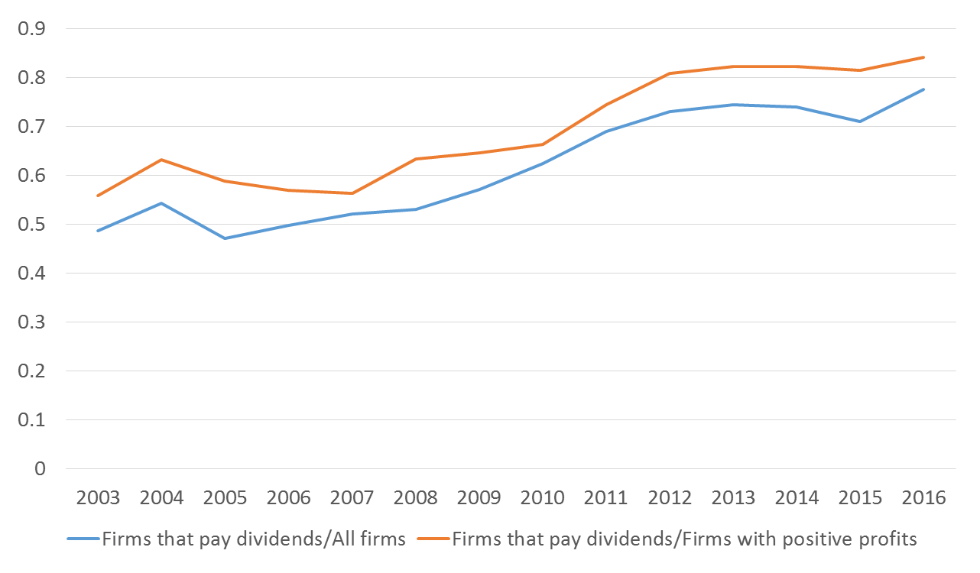
Cash Dividends
Note: This figure depicts the time trend for the ratio of firms that pay dividends.

Slide 20
Ownership Concentration
ownership concentration is a consequence of poor legal protection of minority shareholders, as agency conflict between the controlling and the minority shareholders cannot be reduced effectively. (La Porta et al., 1998)

Slide 21
Ownership Concentration
Sample: All A shares
Variable | N | Mean | Std | P25 | Median | P75
S1 | 31814 | 36.27 | 15.58 | 24.06 | 34.08 | 47.28
S3 | 31814 | 50.00 | 15.78 | 38.45 | 50.27 | 61.36
S5 | 31814 | 54.18 | 15.68 | 42.94 | 54.82 | 65.81
S10 | 31814 | 58.61 | 15.57 | 47.74 | 59.99 | 70.65
Sample: Non-SOEs
Variable | N | Mean | Std | P25 | Median | P75
S1 | 25780 | 33.75 | 14.75 | 22.47 | 31.05 | 43.47
S3 | 25780 | 47.93 | 15.67 | 36.14 | 47.68 | 59.10
S5 | 25780 | 52.42 | 15.81 | 40.71 | 52.76 | 64.36
S10 | 25780 | 57.23 | 15.91 | 45.64 | 58.27 | 70.00
Note: S1, S3, S5, S10 stand for the percent of shares owned by the largest, three largest, five largest, ten largest shareholders of each firm. Data Source: CSMAR.

Slide 22
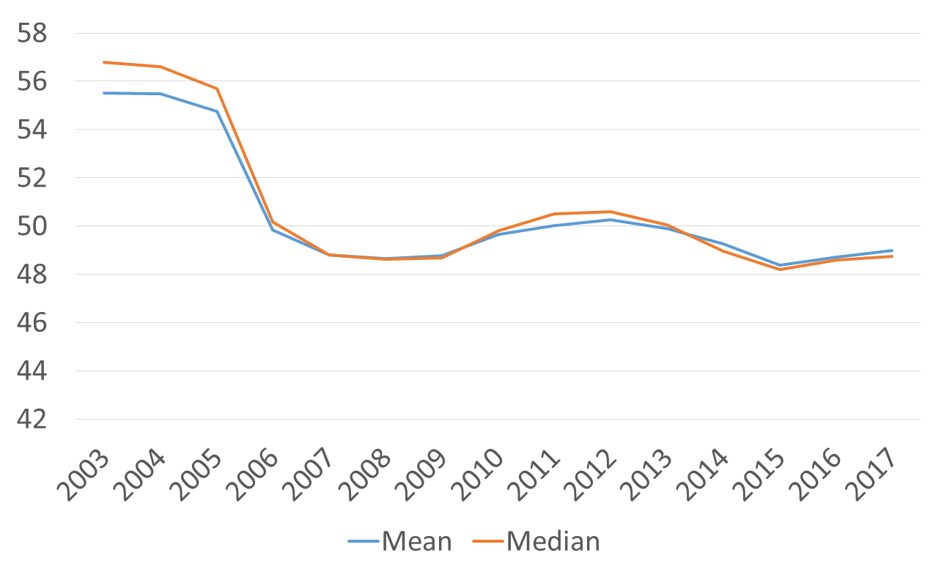
Ownership Concentration
Note: This figure depicts the time trend for the mean and median percent of shares owned by the three largest shareholders of each firm.

