Slide 1
Mail-Server
INBOX
Processed
HTML
HTML
HTML-Filter
Confluence
Text
HTML-Encode
HTML
Blog-Post
Anhang
Anhang
Dateityp-Filter
© Icons by Elegant Themes / https://www.elegantthemes.com/blog/freebie-of-the-week/beautiful-flat-icons-for-free / GPLv2

Slide 2
multipart/
mixed
multipart/
alternative
text/html
text/pain
text/plain
image/png
multipart/
related
© Icons by Elegant Themes / https://www.elegantthemes.com/blog/freebie-of-the-week/beautiful-flat-icons-for-free / GPLv2

Slide 3
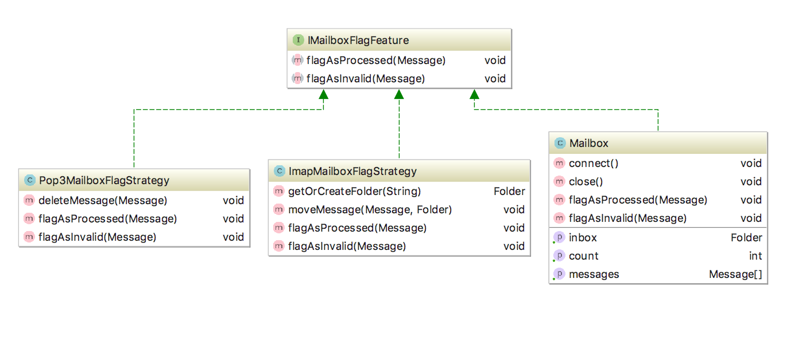
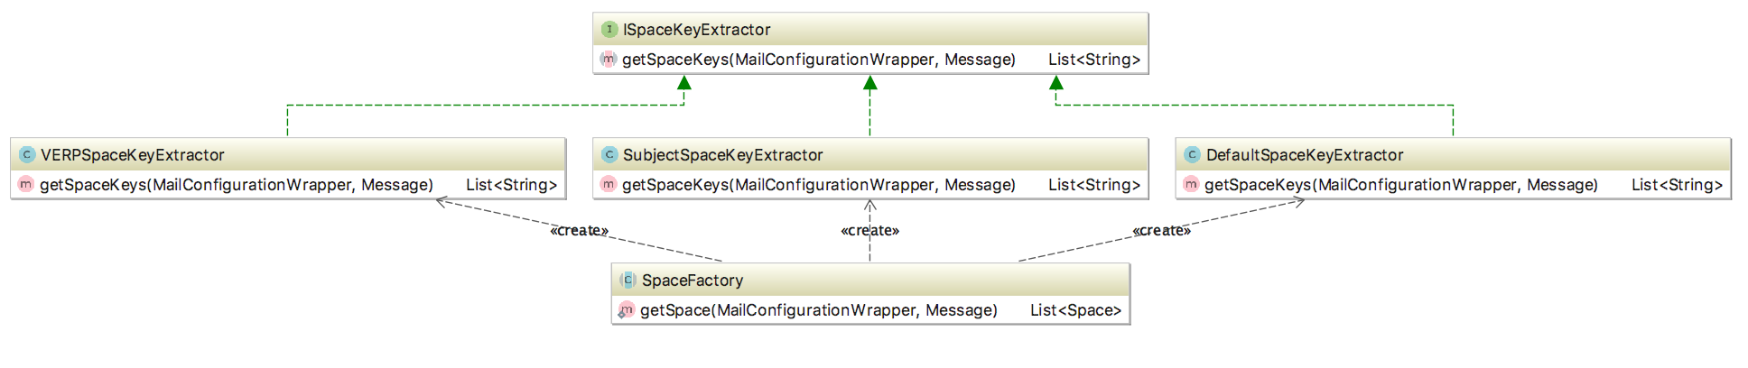
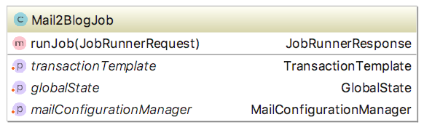
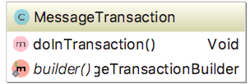

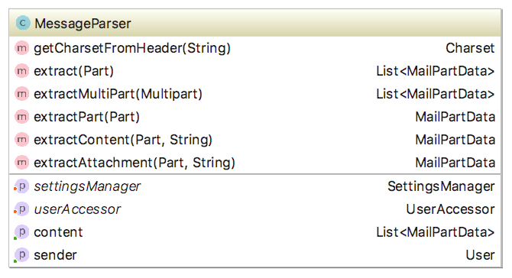
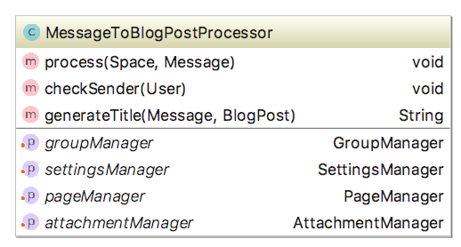
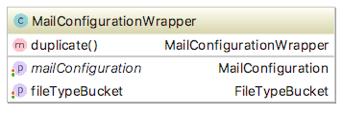
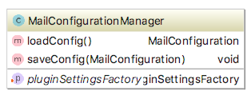
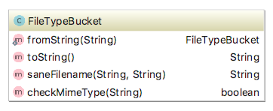
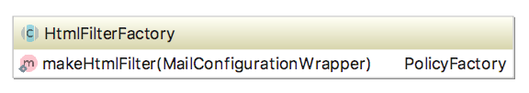
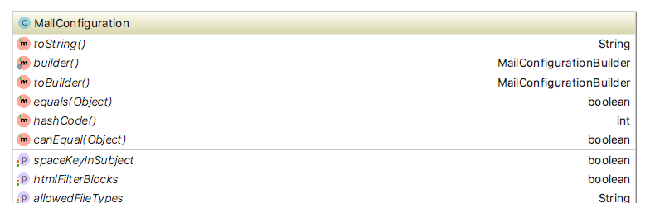

© Icons by Elegant Themes / https://www.elegantthemes.com/blog/freebie-of-the-week/beautiful-flat-icons-for-free / GPLv2
Delegates
Flag messages
Get Messages
Get space
Every 5min
For every message
Confluence
Get Configuration-Wrapper
For every message & space
Uses
For every message
Holds
Creates & Holds
Creates
Filter HTML
Holds
Loads / Saves
Uses
Checks file extensions and MIME types of files
Blog Post

Slide 4
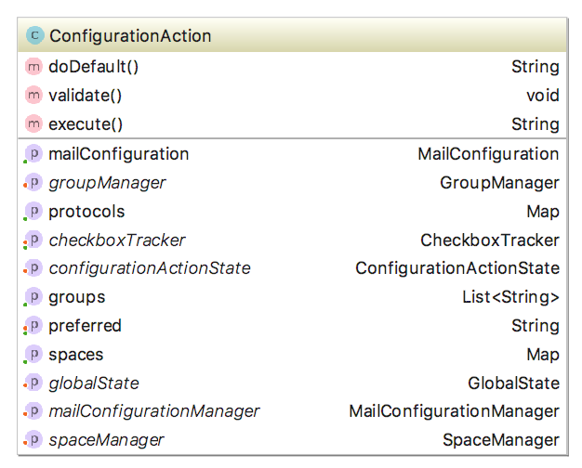
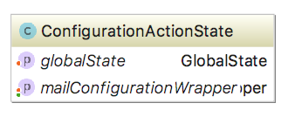
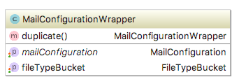
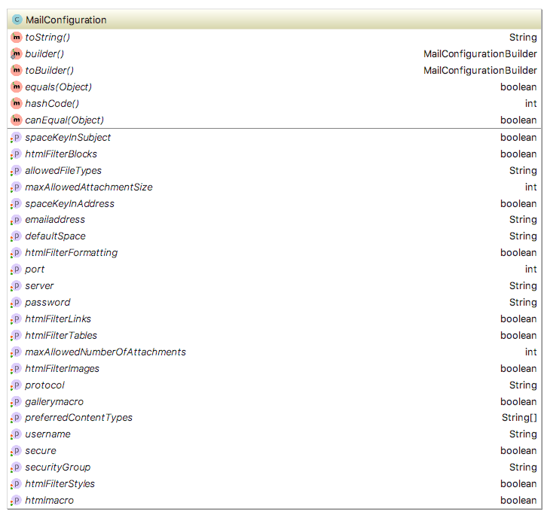
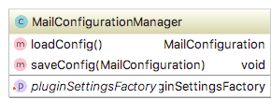
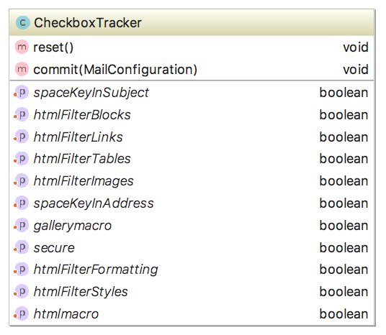
© Icons by Elegant Themes / https://www.elegantthemes.com/blog/freebie-of-the-week/beautiful-flat-icons-for-free / GPLv2
Get Configuration-Wrapper
Get global configuration
Holds
Refreshs
Talks to controller
Holds
Uses
Trigger save
Track checkboxes
User
Load / Save
Update checkbox values
Workaround for: https://answers.atlassian.com/questions/120352/check-box-in-velocity

