Slide 1

Heart Disease Prediction System using Machine Learning
Presented by:
D. M. Khalid Mahmud
ID: 1901004
Session: 2019-20
Department of IRE
Md. Al Morsaline
ID: 1901020
Session: 2019-20
Department of IRE
Bangabandhu Sheikh Mujibur Rahman Digital University, Bangladesh.

Slide 2
Introduction
Heart Disease Prediction System using Machine Learning. In this presentation, we will explore how we harnessed the power of artificial intelligence and deep learning to develop a robust and accurate stock prediction model.
The system has two parts:
The Training and Testing Part
The Prediction using Random Forest Classifier ( GUI Based)

Slide 3
Overview of Heart Disease
What is Heart Disease?
Heart disease is a condition where the heart doesn't work properly, which can lead to serious health problems.
Importance of Early Detection
Early detection is important because it helps find and treat health problems before they get worse and harder to fix.
Significance in Public Health
Detecting heart disease in public health is crucial as it allows for early intervention and prevention, reducing the overall burden of illness and saving lives.

Slide 4

Machine Learning and Heart Disease Prediction
1
Explanation of Machine Learning
Machine learning is a type of computer technology that teaches machines to learn from data and make decisions or predictions without being explicitly programmed, allowing them to improve their performance over time.
2
Application in Healthcare
Machine learning is used in healthcare to analyze patient data and make predictions to aid in diagnosis, treatment, and improving overall healthcare outcomes.
3
Introduction to Random Forest Classifier
A Random Forest Classifier is a machine learning tool that combines multiple decision trees to make more accurate predictions or classifications.

Slide 5
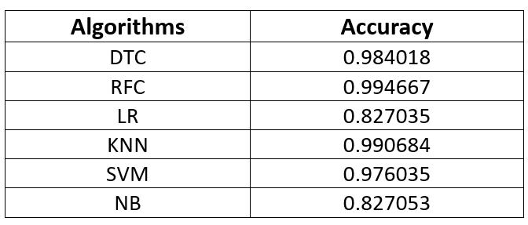
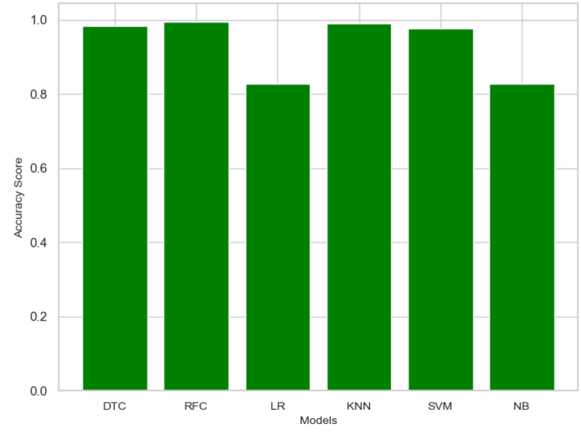
Why Random Forest Classifier?
We tested 6 machine learning models for best fit for our dataset:
Decision Tree Classifier (DTC)
Random Forest Classifier (RFC)
Logistic Regression (LR)
K-Neighbors Classifier (KNN)
Support Vector Machines (SVM)
Naive Bayes (NB)
Here, Random Forest Classifier (RFC) showing the highest accuracy.
So, we use Random Forest Classifier (RFC) model in our project for best prediction.

Slide 6

Random Forest Classifier
1
What is Random Forest?
Random Forest is a machine learning technique that uses multiple decision trees make better predictions or classifications.
2
Features for Heart Disease Prediction
Random Forest Classifier (RFC) for heart disease prediction typically uses various patient data features, including age, cholesterol levels, blood pressure, heart rate, and other relevant health metrics as input for making predictions. These features help RFC assess the risk of heart disease in individuals.
3
Training and Testing the Model
Training the model means teaching it to make predictions based on data, while testing the model means checking how well it performs using new, unseen data to ensure accuracy.

Slide 7
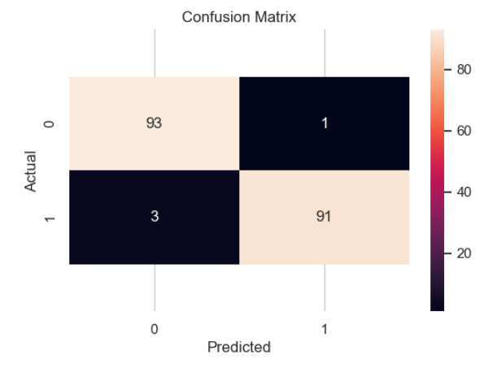
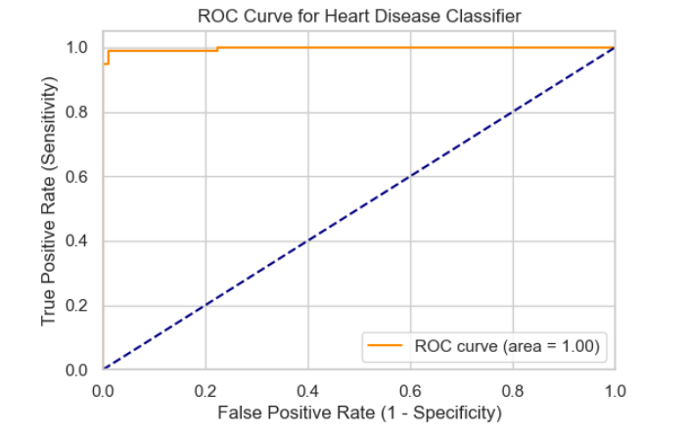
Confusion Matrix
ROC Curve with AUC Score

Slide 8
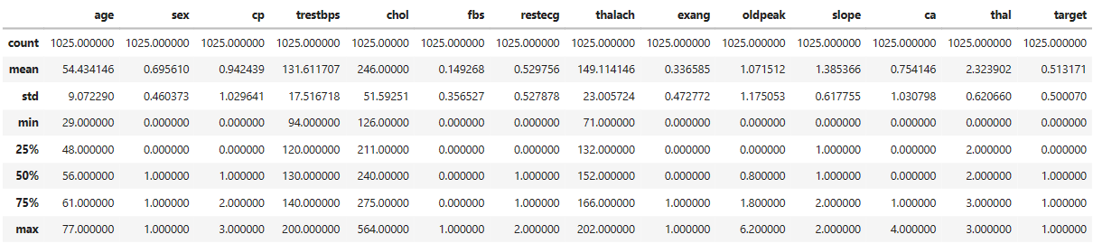
Dataset

Slide 9
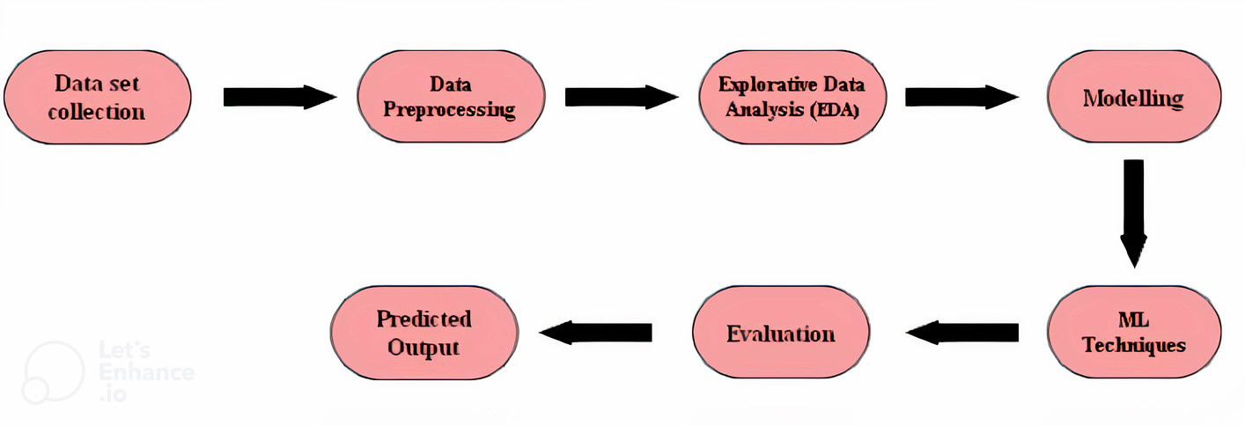
Methodology

Slide 10
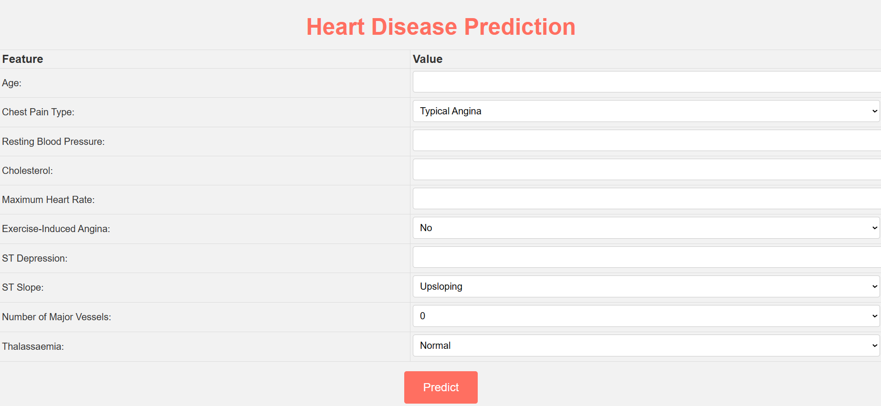
Web Interface

Slide 11
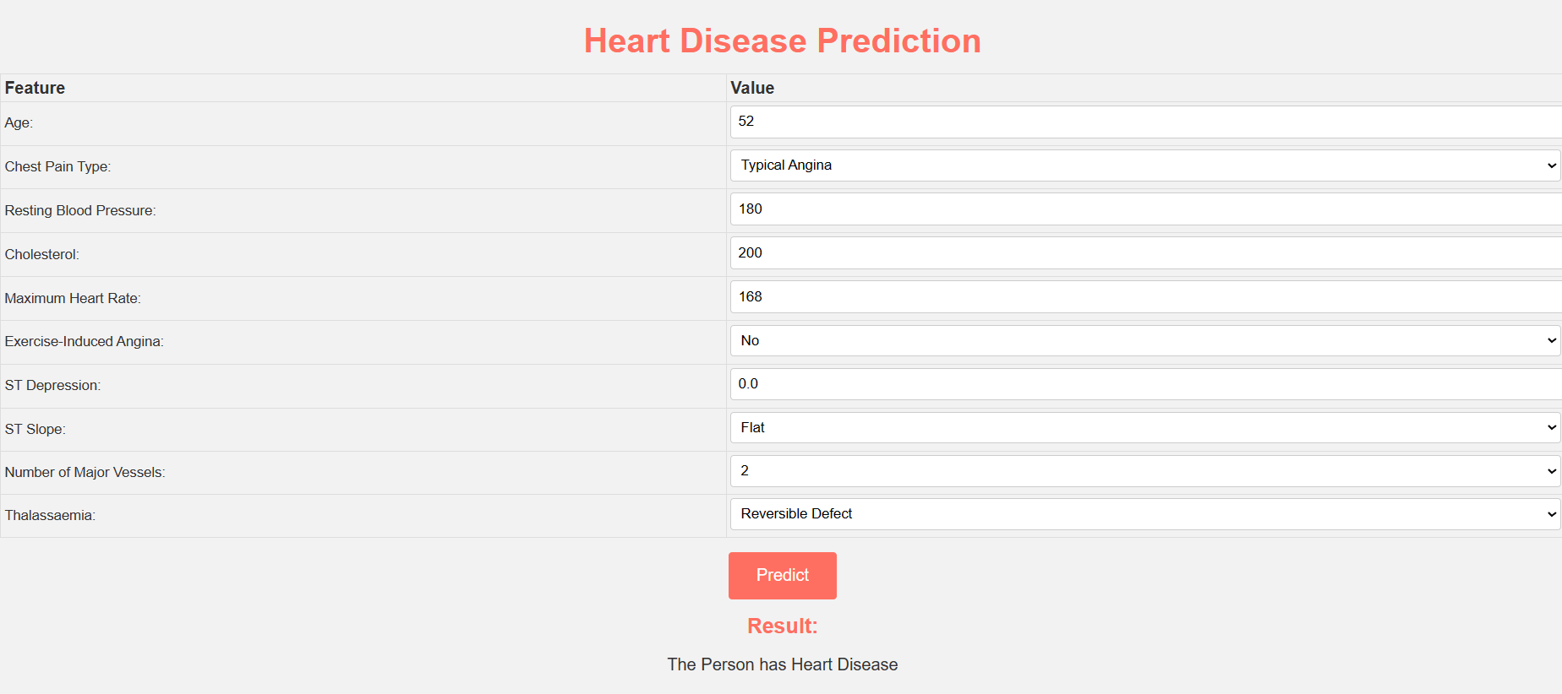
Web Interface with Prediction Result

Slide 12
Advantages and Limitations
Advantages | Limitations
1. Accurate Predictions | 1. Hard to Explain (Black-Box)
2. Resists Overfitting | 2. Needs Lots of Computing Power
3. Handles Complex Relationships | 3. Tricky to Tune Model Parameters
4. Shows Important Factors | 4. Works Best with Tabular Data
5. Deals Well with Outliers | 5. Struggles with Imbalanced Data
6. Works with Large Datasets | 6. Doesn't Continuously Adapt to New Data
7. Helpful for Healthcare Professionals | 7. Can be Overfit with Noisy Data

Slide 13
Conclusion
The Heart Disease Prediction System aims to help identify individuals at risk of heart disease. By analyzing various factors this system can make predictions about a person's heart disease in the early stage. This tool can assist healthcare professionals in early detection and intervention, ultimately improving the prevention and management of heart disease, which is a leading cause of death worldwide. It is a valuable tool in promoting heart health and saving lives.

Slide 14
Thank You

