Slide 1
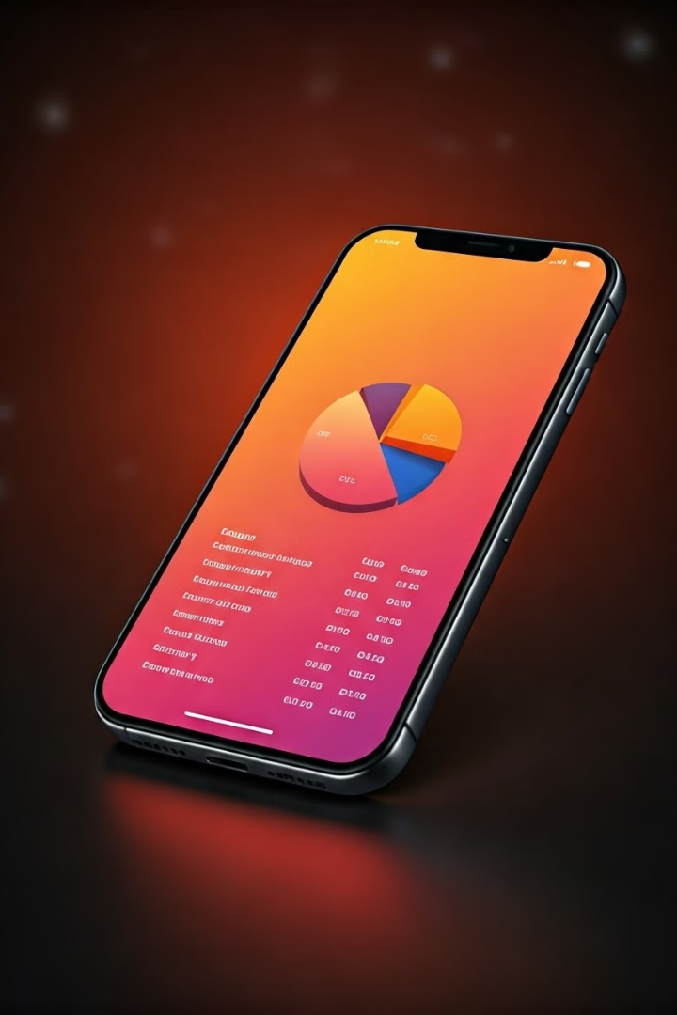

Penny Tracker: Simplify Your Finances
Intuitive finance app for easy expense tracking and visualization.
Real-time data syncing with Firebase for seamless experience.
by David Mensavi

Slide 2
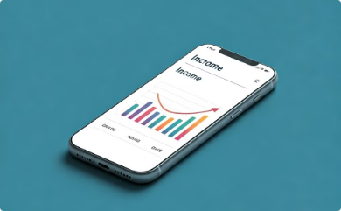
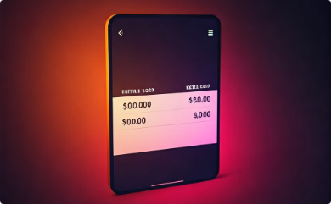
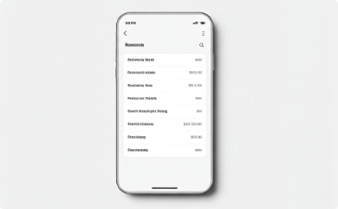
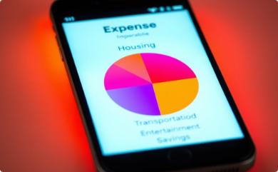
Key Features & UI
Add Income
Summary Screen
Transactions List
Visualized Breakdown
Easily input various income sources.
Quick overview of financial status.
Detailed view of recent financial activities.
Intuitive pie chart for expense category analysis.

Slide 3




Overcoming Technical Challenges
Dynamic Data Visualization
Implemented customizable unknown link.PieChart library for clear breakdowns.
Real-time Data Retrieval
Firebase listeners ensure responsive UI updates.
Data Security
Leveraged Firebase's secure backend for authentication and transactions.

Slide 4
User-Centric Results
Simplified Tracking
Visual Insights
Real-time Awareness
Effortless income and expense management.
Pie charts offer clear spending pattern analysis.
Up-to-date balance for informed financial decisions.

Slide 5

Continuous Improvement
1
Monthly Reports
2
Predictive Analysis
Implement summaries for specific timeframes.
Integrate machine learning for budget suggestions.
3
Global Reach
Add multi-language support for diverse users.

Slide 6
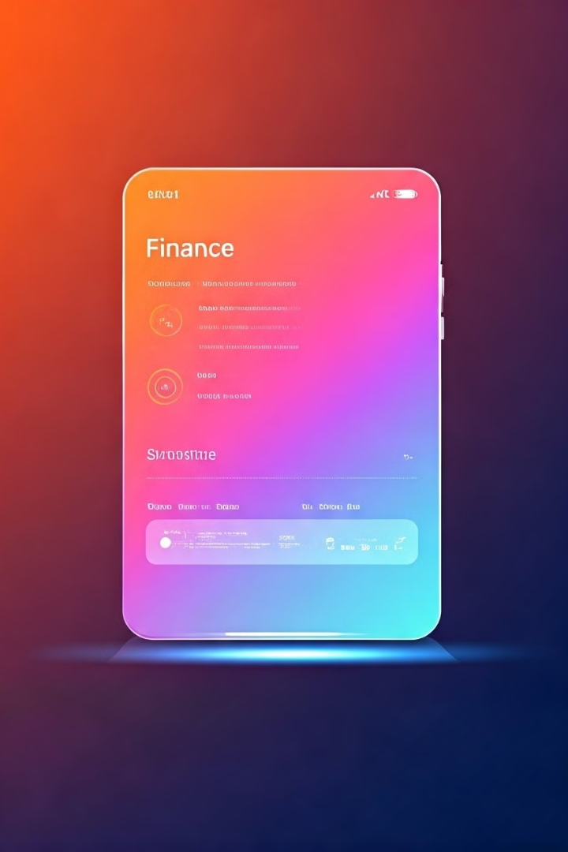
Future Roadmap
1
External Integration
Connect with bank accounts for comprehensive financial overview.
2
Advanced Analytics
Implement AI-driven spending trends and saving tips.
3
Customization
Enhance user experience with personalized settings and themes.

