Slide 1
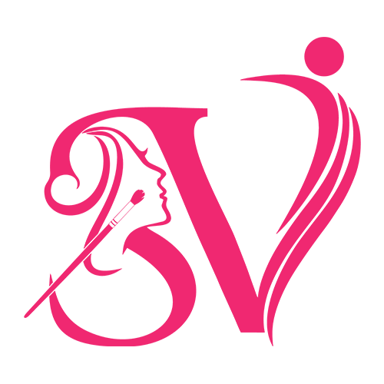
Professional Makeup Artist in Delhi

Slide 2
Overview of Makeup Industry in Delhi
Delhi is home to top-tier makeup artists offering bridal, party, and fashion makeup services with modern techniques.
Whether you’re searching for the best makeup salon in Delhi, the best MUA in Delhi, or the best makeup artist for bridal in Delhi NCR, our team ensures a stunning, long-lasting, and confident glow.

Slide 3
Services Offered
• Bridal Makeup
• Party Makeup
• HD & Airbrush Makeup
• Engagement & Pre-wedding Looks

Slide 4
Latest Makeup Trends
• Natural & Dewy Looks
• HD Makeup Finish
• Minimalist Bridal Makeup
• Bold Eye Makeup Styles

Slide 5
Choosing the Right Makeup Artist
• Check portfolio
• Read reviews
• Understand products used
• Compare pricing & experience

Slide 6
Sovi Makeover – Your Beauty Partner
Sovi Makeover is a trusted name in Delhi offering professional makeup services.
• Expert Bridal Makeup
• Customized Looks
• Premium Products
• Experienced Artists

Slide 7
Contact Us
Phone: 87399 99007
Email: beauty@sovimakeover.com
Book your appointment today!

